Slide 1
CSE 477: Introduction to Computer Security
Lecture – 1 & 2
Course Teacher: Dr. Md Sadek Ferdous
Assistant Professor, CSE, SUST
E-mail: ripul.bd@gmail.com

Slide 2
Outline
Motivations
Course Information
Basic concepts

Slide 3
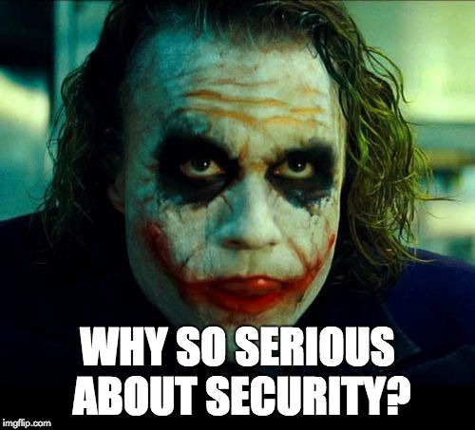
Outline
Motivations
Course Information
Basic concepts
Security properties
Security attacks
Security failure & secure solutions

Slide 4
Motivations
Currently around 4.77 billions of mobiles and increasing
Around 4 billions of Internet users
Around 320 millions of domain names
Around $2300 billions of retail e-commerce sales and growing
Almost all spheres of our lives are somehow dependent on the Internet and different web services
  Mostly in developed countries, developing nations are catching up
This trend will continue to grow

Slide 5
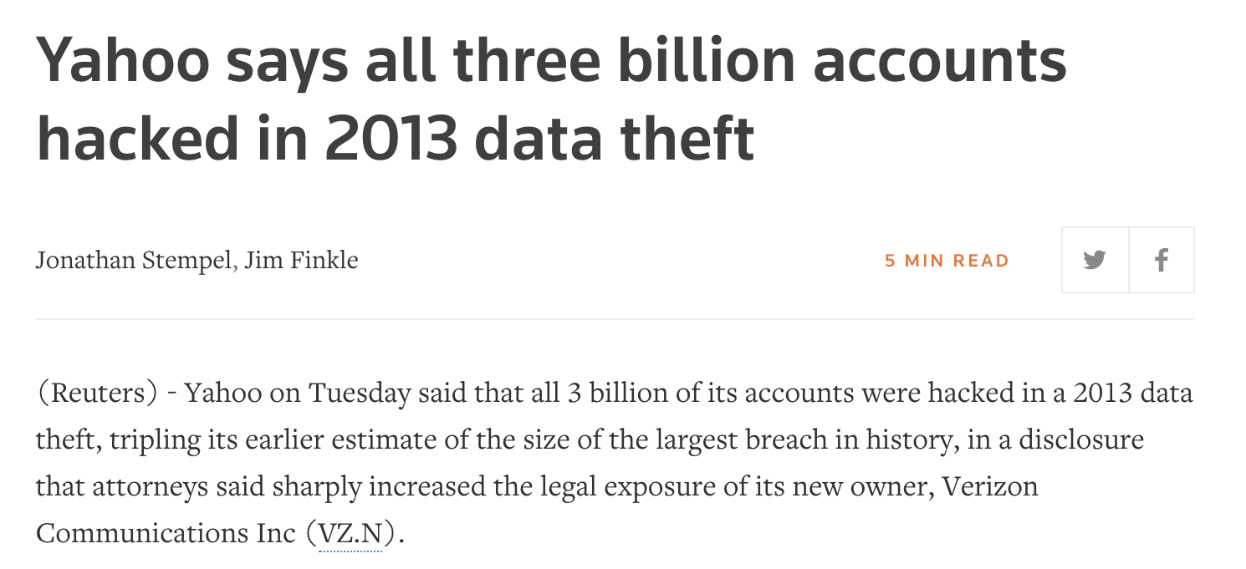
Motivations

Slide 6
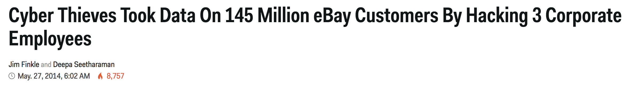
Motivations

Slide 7
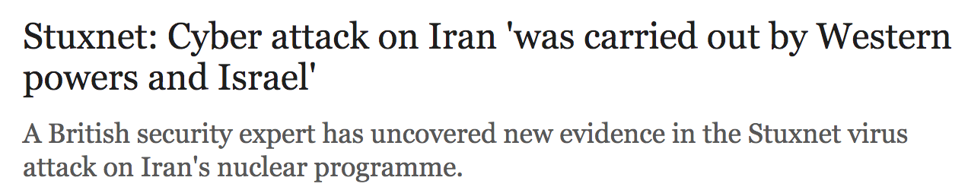
Motivations

Slide 8
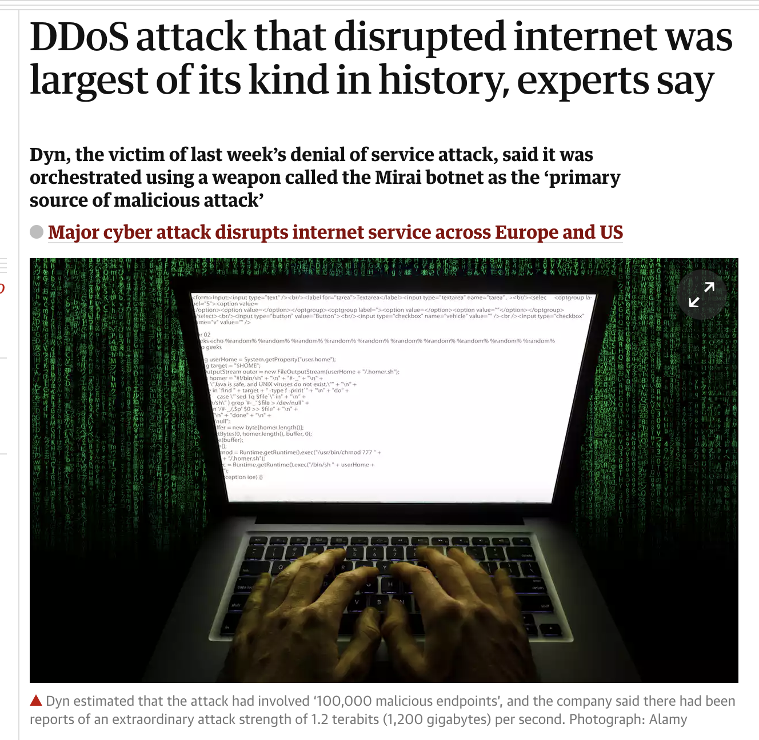
Motivations

Slide 9
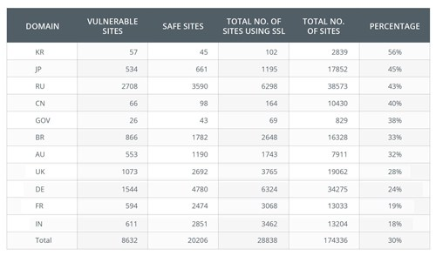
Motivations
Source: https://i1.wp.com/securityaffairs.co/wordpress/wp-content/uploads/2014/04/heartbleed-SSL-scan-results.jpg

Slide 10
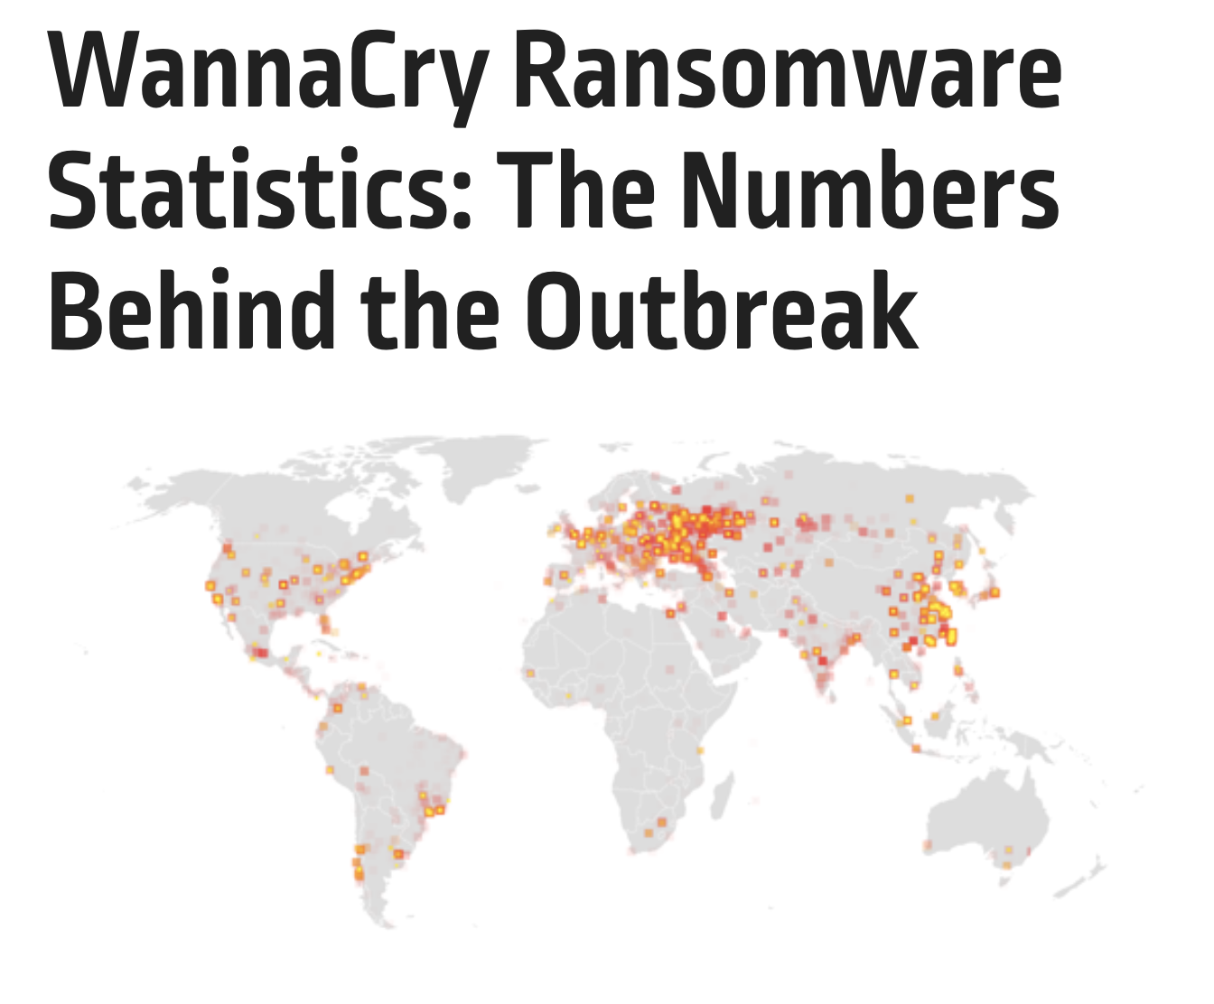
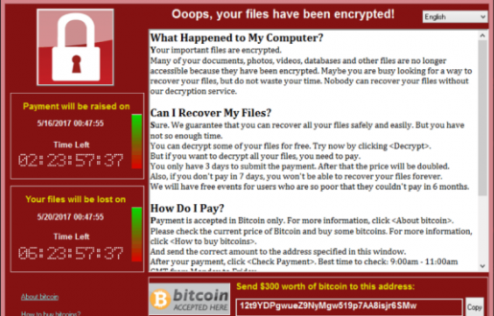

Motivations
Source: http://www.asuamaytinh.com/wp-content/uploads/2017/05/virus-wanna-cry-la-gi-cach-phong-chong-ra-sao-1888-660x330.jpg

Slide 11
Historical timeline - 1
Source: http://www.inf.ed.ac.uk/teaching/courses/cs/0910/lecs/intro.pdf

Slide 12
Historical timeline - 2
Source: http://www.inf.ed.ac.uk/teaching/courses/cs/0910/lecs/intro.pdf

Slide 13
Historical timeline - 3
Source: http://www.inf.ed.ac.uk/teaching/courses/cs/0910/lecs/intro.pdf

Slide 14

Historical timeline - 4
Source: http://www.inf.ed.ac.uk/teaching/courses/cs/0910/lecs/intro.pdf

Slide 15
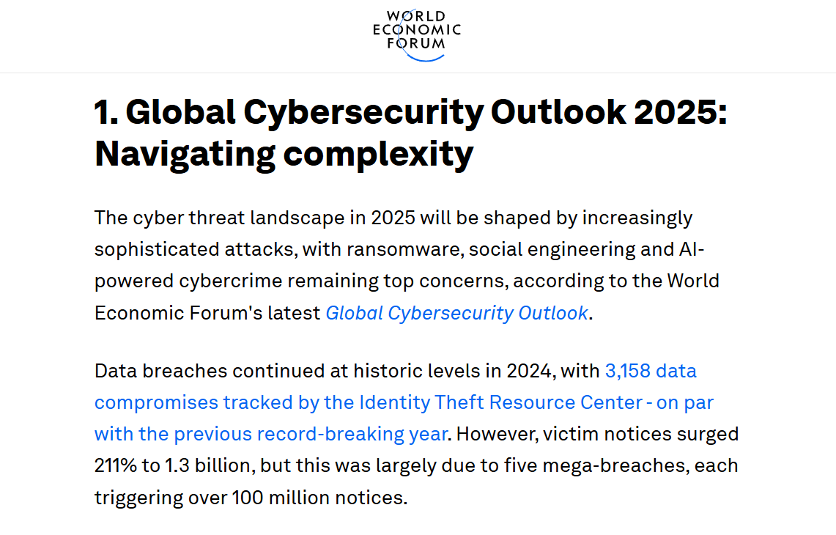
Motivations

Slide 16
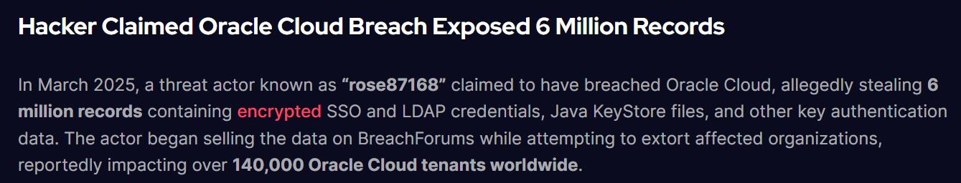
Motivations

Slide 17
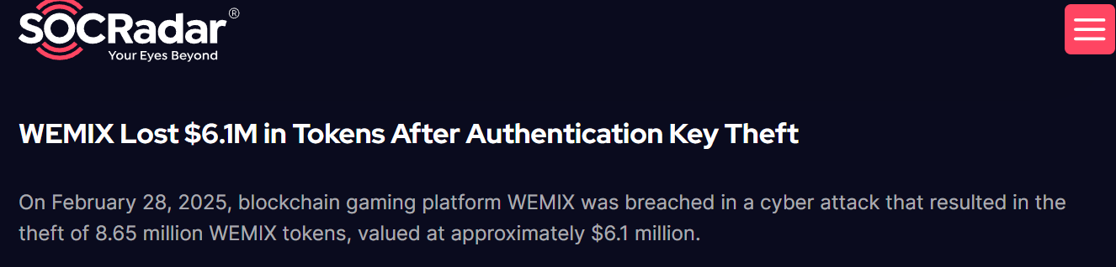
Motivations

Slide 18
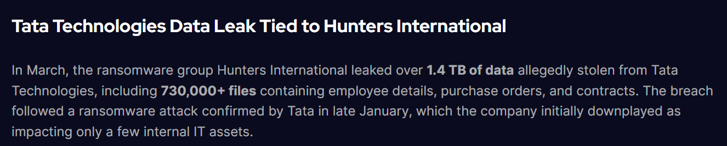
Motivations

Slide 19
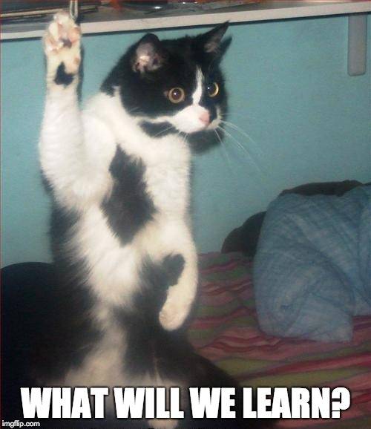
Outline
Motivations
Course Information
Basic concepts
Security properties
Security attacks
Security failure & secure solutions

Slide 20
What is computer security?
Computer security is the protection of computer systems
  operating in adversarial environments
  with possible adversaries
Protection aims to:
  allow intended use
  prevent unintended use

Slide 21
What is computer security?
Confidentiality
Integrity
Availability
Authenticity
Anonymity
….
tries to break in
having security properties
Personal motivation (Ex spouse/employee)
Financial motivation
Political motivation
In this course
  why systems are insecure?
  how to make them secure?

Slide 22
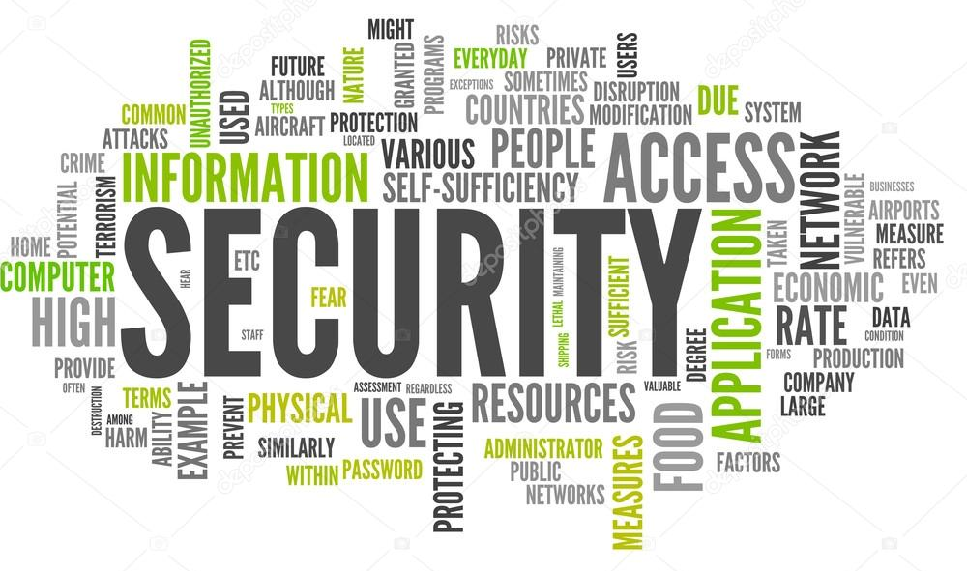
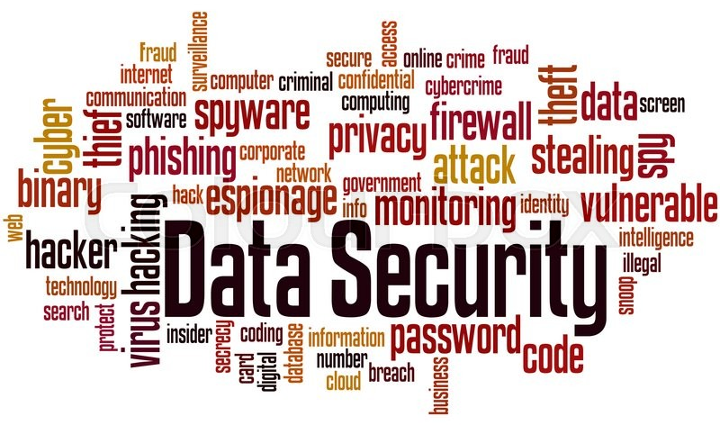
Course Information
Security
Information
Web
Network
Physical Security
Device Security
Source: https://d2gg9evh47fn9z.cloudfront.net/800px_COLOURBOX18770823.jpg
Source: http://itak.iaitam.org/wp-content/uploads/sites/2/2015/06/Can-Mega-Data-Breaches-be-Prevented-%E2%80%93-What-ITAM-Can-Learn-from-Target-and-Home-Depot.jpg

Slide 23
Resources
Textbook
  Introduction to Computer Security - Michael Goodrich & Roberto Tamassia, First Edition
Additional Resources:
  Introduction to Computer Security – Matt Bishop
  Handbook of Applied Cryptography - Alfred J. Menezes, Paul C. van Oorschot and Scott A. Vanstone. http://cacr.uwaterloo.ca/hac/
Additional research papers will be supplied throughout the course

Slide 24
Outline
Security definition
Security goals
Security attacks

Slide 25
Defining security
The security of a system, application, or protocol is always relative to
  A set of desired properties
  An adversary (attacker) with specific capabilities
Academic study of security not about
  Breaking into a system
  How to launch an attack
Our focus will be explore
  Why a system is insecure
  How to make them secure

Slide 26
Security goals

Slide 27
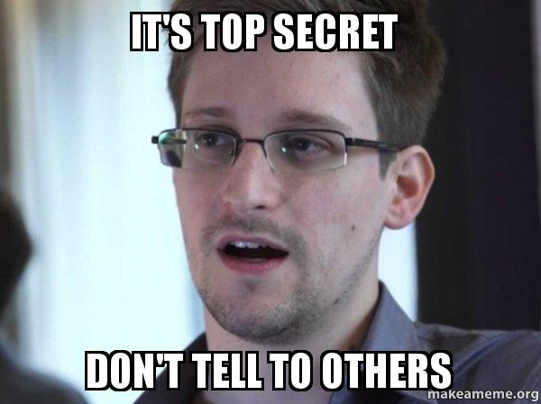
Confidentiality: Secrecy & Privacy
Confidentiality:
  protecting unauthorized information access and disclosure (secrecy)
  protecting personal privacy and proprietary information (privacy)
Two dimensions: Secrecy and & Privacy
Secrecy assures that private or confidential information is not made available or disclosed to unauthorized individuals
Privacy assures that individuals control or influence what information related to them may be collected and stored and by whom and to whom that information may be disclosed
The need of confidentiality predates computer systems:
  For example, in the first recorded use of cryptography, Julius Caesar communicated commands to his generals using a simple cipher (will be studied later)

Slide 28
Tools of Confidentiality
Encryption:
  the transformation of information using a secret, called an encryption key, so that the transformed information can only be read using another secret, called the decryption key (which may, in some cases, be the same as the encryption key)

Slide 29
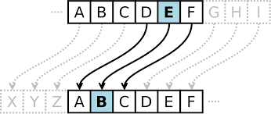
Tools of Confidentiality
Encryption:
  the transformation of information using a secret, called an encryption key, so that the transformed information can only be read using another secret, called the decryption key (which may, in some cases, be the same as the encryption key)
https://en.wikipedia.org/wiki/Caesar_cipher

Slide 30
Tools of Confidentiality
Access control:
  Rules and policies that limit access to confidential information to those people and/or systems with a “need to know”
This need to know may be determined
  By identity, such as a person’s name or a computer’s serial number
  And / Or by a role that a person has, such as being a manager or a computer security specialist

Slide 31
Tools of Confidentiality
Authentication:
  the determination of the identity or role that someone has
This determination can be done in a number of different ways, but it is usually based on a combination of
  Something the person has (like a smart card or a radio key fob storing secret keys)
  Something the person knows (like a password)
  Something the person is (like a human with a fingerprint)

Slide 32
Tools of Confidentiality
Authorization:
  the determination if a person or system is allowed access to resources, based on an access control policy
Such authorizations should prevent an attacker from tricking the system into letting him have access to protected resources
Physical security:
  the establishment of physical barriers to limit access to protected computational resources.
Such barriers include locks on cabinets and doors, the placement of computers in windowless rooms, the use of sound dampening materials, and even the construction of buildings or rooms with walls incorporating copper meshes (called Faraday cages) so that electromagnetic signals cannot enter or exit the enclosure

Slide 33
Integrity
Integrity: the property that information/system has not be altered in an unauthorized way
Two dimensions: data integrity and system integrity
Data integrity
  Assures that information and programs are changed only in a specified and authorized manner
System integrity
  Assures that a system performs its intended function in an unimpaired manner, free from deliberate or inadvertent unauthorized manipulation of the system

Slide 34

Tools of Integrity
Backups: the periodic archiving of data
Checksums: the computation of a function that maps the contents of a file to a numerical value
A checksum function depends on the entire contents of a file and is designed in a way that even a small change to the input file (such as flipping a single bit) is highly likely to result in a different output value
Data correcting codes: methods for storing data in such a way that small changes can be easily detected and automatically corrected
Metadata manipulation

Slide 35
Availability
Ensuring timely and reliable access to and use of information or a system
A loss of availability is the disruption of access to or use of information or an information system
Information or systems might be unavailable:
  due to unintentional and accidental events: fire, damage to hard disk/system
  due to intentional or malicious attacks: Distributed Denial of Service (DDoS)
Tools:
  Physical protections: infrastructure meant to keep information available even in the event of physical challenges
  Computational redundancies: computers and storage devices that serve as fallbacks in the case of failures

Slide 36
Additional security requirements

Slide 37
Assurance
Assurance refers to how trust is provided and managed in computer systems
Trust management depends on:
  Policies, which specify behavioural expectations that people or systems have for themselves and others
    For example, the designers of an online music system may specify policies that describe how users can access and copy songs
  Permissions, which describe the behaviours that are allowed by the agents that interact with a person or system
    For instance, an online music store may provide permissions for limited access and copying to people who have purchased certain songs
  Protections, which describe mechanisms put in place to enforce permissions and polices
    We could imagine that an online music store would build in protections to prevent people from unauthorized access and copying of its songs

Slide 38
Authenticity
Authenticity is the ability to determine that statements, policies, and permissions issued by persons or systems are genuine and/or have originated from the desired source
Primary tool:
  digital signatures - These are cryptographic computations that allow a person or system to commit to the authenticity of their documents in a unique way that achieves nonrepudiation, which is the property that authentic statements issued by some person or system cannot be denied

Slide 39
Anonymity
Anonymity: the property that certain records or transactions not to be attributable to any individual
Tools:
  Aggregation: the combining of data from many individuals so that disclosed sums or averages cannot be tied to any individual
  Mixing: the intertwining of transactions, information, or communications in a way that cannot be traced to any individual
  Proxies: trusted agents that are willing to engage in actions for an individual in a way that cannot be traced back to that person
  Pseudonyms: fictional identities that can fill in for real identities in communications and transactions, but are otherwise known only to a trusted entity

Slide 40
Security attacks
Largely two types: passive and active
Passive attacks
  eavesdropping on, or monitoring of, transmissions.
  The goal is to obtain and analyse transmitted information
Active attacks
  Involving some modification of the data stream or the creation of a false stream
Security attacks
Passive
Active
Release of message contents
Traffic analysis
Masquerade
Replay
Modification
DoS

Slide 41
Security attacks: passive attacks
Eavesdropping: the interception of information intended for someone else during its transmission over a communication channel

Slide 42
Security attacks: passive attacks

Slide 43
Security attacks: active attacks
Masquerading: the fabrication of information that is purported to be from someone who is not actually the author/source

Slide 44
Security attacks: active attacks
Alteration: unauthorised modification of information

Slide 45
Security attacks: active attacks
Two forms
  Modify and then replay, thus forming an active attack
  Observe and analyse and then replay, thus forming a passive attack

Slide 46
Security attacks: active attacks
Denial-of-service: the interruption or degradation of a data service or information access
  Example: email spam, to the degree that it is meant to simply fill up a mail queue and slow down an email server

Slide 47
Other security attacks
Repudiation: the denial of a commitment or data receipt
  This involves an attempt to back out of a contract or a protocol that requires the different parties to provide receipts acknowledging that data has been received
Correlation and traceback:
  The integration of multiple data sources and information flows to determine the source of a particular data stream or piece of information

