Slide 1
CSE 477: Introduction to Computer Security
Lecture – 19
Course Teacher: Dr. Md Sadek Ferdous
Assistant Professor, CSE, SUST
E-mail: ripul.bd@gmail.com

Slide 2
Outline
HTTP
DNS
Email

Slide 3
Web
Web page consists of objects
  An Object can be an HTML file, JPEG image, Java applet, audio files
A Web page consists of base HTML-file which includes several referenced objects
Each object is addressable by a URL
Example URL:

Slide 4
HTTP
HyperText Transfer protocol
Application layer protocol
client/server model
  client: browser that requests, receives, “displays” Web objects
  server: web server sends objects in response to requests

Slide 5
HTTP
HTTP uses TCP
  Client initiates TCP connection to server port 80
  Server accepts TCP connection from client
  HTTP messages (application-layer protocol messages) exchanged between browser (HTTP client) and Web server (HTTP server)
  TCP connection closed
HTTP is stateless
  Server maintains no information about past client requests
Protocols that maintain “state” are complex!
  past history (state) must be maintained
  if server/client crashes, their views of “state” may be inconsistent

Slide 6
HTTP request
Two types of HTTP messages: request, response
HTTP request message: ASCII (human-readable format)

Slide 7
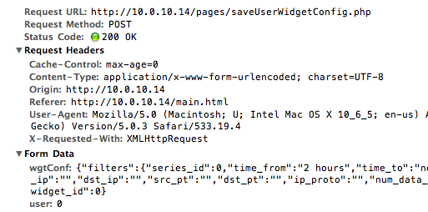
HTTP – Handling user input
GET method:
  Input is uploaded in URL field of request line
Post method:
  Web page often includes form input
  Input is uploaded to server in entity body
Example of GET method:
www.someserver.com/user?username=tom&password=password

Slide 8
HTTP response

Slide 9
HTTP response status code
In first line in server->client response message.
200 OK
  request succeeded, requested object later in this message
301 Moved Permanently
  requested object moved, new location specified later in this message (Location)
400 Bad Request
  request message not understood by server
404 Not Found
  requested document not found on this server
505 HTTP Version Not Supported

Slide 10
HTTP enabling state
Maintain state at sender/receiver over multiple transactions
Cookies: http messages carry state
What cookies can bring:
  Authorization
  Shopping carts
  Recommendations
  User session state

Slide 11
HTTP Cookie
Four components:
  cookie header line of HTTP response message
  cookie header line in HTTP request message
  cookie file kept on user’s host (user browser)
  back-end database at Web site
Example:
  Susan always uses Internet from a PC
  Visits specific e-commerce site for the first time
  When initial HTTP requests arrives at site, site creates
    unique ID
    entry in backend database for ID

Slide 12
HTTP Cookie

Slide 13
DNS – Domain Name System
Internet hosts, routers:
  IP address (32 bit) - used for addressing datagrams
  “name”, e.g., ww.yahoo.com - used by humans
Q: Mapping between IP addresses and name?
Domain Name System
  Distributed database implemented in hierarchy of many name servers
  Application-layer protocol to resolve names
  Core Internet function

Slide 14
DNS – Domain Name System
DNS services
  Hostname -> IP translation
  Host aliasing
  Mail server aliasing
Load distribution
  replicated web servers
  set of IP addresses for one canonical name. E.g., amazon.com
Why not centralise DNS?
  Single point of failure
  Traffic volume

Slide 15
DNS hierarchy

Slide 16
DNS – Domain Name System
Top-level domain (TLD) servers:
  Responsible for com, org, net, edu, etc
  Responsible all top-level country domains uk, fr, ca, jp.
  Network solutions maintains servers for com TLD
  Education for edu TLD
Authoritative DNS servers:
  Organisation’s DNS servers, providing authoritative hostname to IP mappings for organisation’s servers (e.g., Web, mail).
Can be maintained by organisation or service provider

Slide 17
DNS lookup
Client wants IP for www.amazon.com; 1st approx:
  client queries a root server to find com DNS server
  client queries com DNS server to get amazon.com DNS
  client queries amazon.com DNS server to get IP address for www.amazon.com

Slide 18
DNS local name server
Does not strictly belong to hierarchy
Each ISP (residential ISP, company, university) has one
  also called “default name server”
When host makes a DNS query, query is sent to local DNS server
  acts as proxy, forwards query into hierarchy
If a host name cannot be resolved by local name server, then forward the query to upper-level name server

Slide 19
DNS root name server
Contacted by local name server that can not resolve name
Root name server:
  contacts authoritative name server if name mapping not known
  gets mapping, returns mapping to local name server

Slide 20
DNS name resolution
Host at me.cs.vt.edu
Wants IP address for gaia.cs.umass.edu

Slide 21
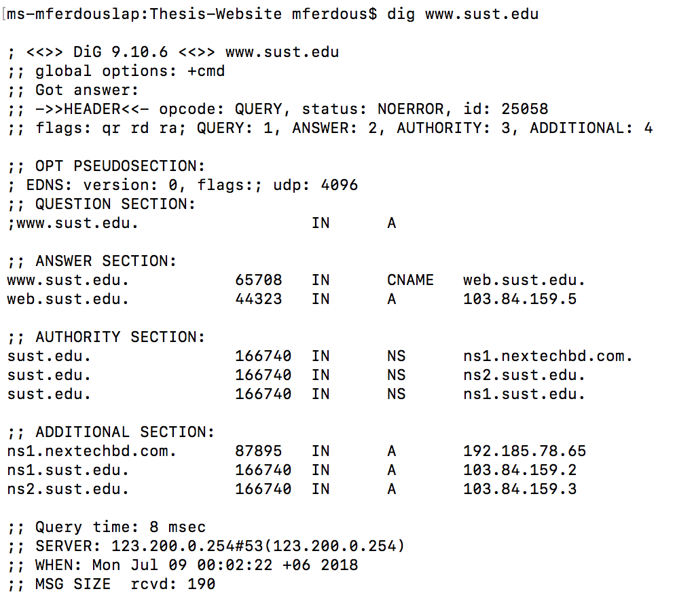
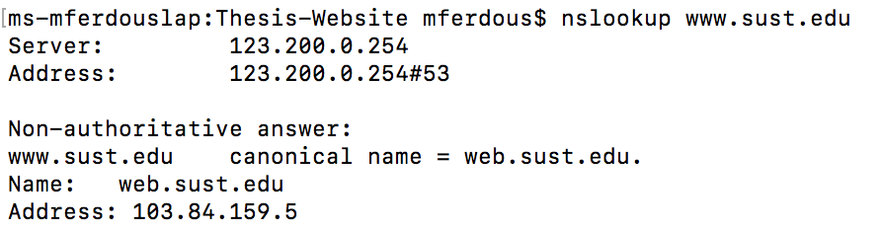
DNS caching
Once (any) name server learns mapping,
  it caches mapping
  Cache entries timeout (disappear) after some time
  TLD servers typically cached in local name servers
Thus root name servers not often visited
The “dig” and “nslookup” programs provide an interface to DNS

Slide 22
Email
Three major components:
  user agents
  mail servers
  mail transfer protocol: SMTP
User agent
  a.k.a. “mail reader”
  composing, editing, reading mail messages
  e.g. Outlook,
  outgoing, incoming messages stored on server

Slide 23
Email servers
Mail servers contains mail boxes for users
Mailbox contains
  incoming messages for users
  message queue of outgoing (to be sent) mail messages
SMTP protocol between mail servers to send email messages
  client: sending mail server
  server: receiving mail server

Slide 24
Email SMTP (Simple Mail Transfer Protocol)
Uses TCP to reliably transfer email message from client to server
  Port 25
Direct transfer: sending server to receiving server
Three phases of transfer
  handshaking (greeting)
  transfer of messages
  closure
Command/response interaction
  commands: ASCII text
  response: status code and phrase
Messages must be in 7-bit ASCII

Slide 25
Email SMTP
Alice uses UA to compose message and “to” bob@hamburger.edu
Aliceʼs UA sends message to her mail server (e.g. crepes.fr); msg placed in message queue
Client side of SMTP opens TCP connection with Bobʼs mail server
SMTP client sends Aliceʼs message over the TCP connection
Bob’s mail server places the message in Bob’s mailbox
Bob invokes his user agent to read message

Slide 26
Email sample connection

Slide 27
Email access protocol
Mail access protocol: retrieval from server
POP: Post Office Protocol [RFC 1939]
  authorization (agent <-->server) and download
IMAP: Internet Mail Access Protocol [RFC 1730]
  more features (more complex)
HTTP(s): gmail, Hotmail, Yahoo! Mail, etc.

Slide 28

The lecture slides can be found in the following location!

