Slide 1
CSE 477: Introduction to Computer Security
Lecture – 20
Course Teacher: Dr. Md Sadek Ferdous
Assistant Professor, CSE, SUST
E-mail: ripul.bd@gmail.com

Slide 2
Outline
Passive Attacks
  Sniffing
  Scanning
Active Attacks
  Spoofing
  TCP Session Hijacking
  Dos/DDoS
  DNS Cache Poisoning

Slide 3
Types of Attack
Active attack
  enables an attacker to modify, misconfigure or disrupt a target
  e.g. modifying a process, system or data; disrupting a communication channel and so on
Passive attack
  allows an attacker to observe a target without modifying it

Slide 4
Types of Threat
Interception
  Unauthorized viewing of information (Confidentiality)
Modification
  Unauthorized changing of information (Integrity)
Fabrication
  Unauthorized creation of information (Integrity)
Interruption
  Preventing authorized access (Availability)
Passive attack
Active attack

Slide 5
Passive Attacks
Eavesdropping (Sniffing)
  Listen to packets from other parties
Footprinting (Network Mapping)
  Test to determine software installed on system

Slide 6
Man In The Middle (MITM) Attack

Slide 7
Man In The Middle (MITM) Attack

Slide 8
Man In The Middle (MITM) Attack
Charlie is in the middle between Alice and Bob.
Charlie can:
  View traffic
  Change traffic
  Add traffic
  Delete traffic
Charlie could be:
  Internet service provider
  Virtual Private Network (VPN) provider
  WIFI provider such as a coffee shop
  An attacker re-routing your connection

Slide 9
Man In The Middle (MITM) Scenario

Slide 10
Man In The Middle (MITM) Scenario

Slide 11
Man In The Middle (MITM) Scenario

Slide 12
Packet Sniffing
Packet sniffing enables “reading” information traversing a network
  Packet sniffers intercept network packets, possibly using ARP cache poisoning
  Can be used as legitimate tools to analyse a network
    Monitor network usage
    Filter network traffic
    Analyse network problems
  Can also be used maliciously
    Steal information (i.e. passwords, conversations, etc.)
    Analyse network information to prepare an attack
Packet sniffers (tools used for packet sniffing) can be either software or hardware based
  Sniffers are dependent on network setup

Slide 13
Packet Sniffing

Slide 14
Detecting Sniffers
Sniffers are almost always passive
  They simply collect data
This can make them extremely hard to detect
A solution on switched hubs is ARP watch
  An ARP watch monitors the ARP cache for duplicate entries of a machine
  If such duplicates appear, raise an alarm – Problem: false alarms
Specifically, DHCP networks can have multiple entries for a single machine

Slide 15
Stopping Sniffers
The best way is to encrypt packets securely
  Sniffers can capture the packets, but they are meaningless
    Capturing a packet is useless if it just reads as garbage
  SSH is also a much more secure method of connection
    Private/Public key pairs makes sniffing virtually useless
  On switched networks, almost all attacks will be via ARP spoofing
    Add machines to a permanent store in the cache
    This store cannot be modified via a broadcast reply
    Thus, a sniffer cannot redirect an address to itself
The best security is to not let them in the first place
  Sniffers need to be on your subnet in a switched hub in the first place
  All sniffers need to somehow access root at some point to start themselves up

Slide 16
Footprinting (Scanning)
Footprinting sometime is the first phase of attacking in which the attacker gains information about a potential target
Via scanning, an attacker can discover more about the target system
  such as what operating system is used
  what services are running, and
  whether or not there are any configuration lapses in the target system
Types of Scanning
  Network scanning - IP addresses
  Port scanning - Open ports and services
  Vulnerability scanning - Presence of known weaknesses

Slide 17
Objectives of Scanning
Discovering live hosts and IP addresses of live hosts running on the network.
Discovering open ports:
  Open ports are the best means to break into a system or network
Detecting the associated network service of each port
Discovering operating systems and system architecture of the targeted system:
  This is also referred to as fingerprinting
  Here the attacker will try to launch the attack based on the operating system's vulnerabilities

Slide 18
Network Scanning – Non-targeted Host
ICMP Scanning via ping
  to determine which hosts in a network are up by pinging them all
Ping scan involves sending ICMP ECHO requests to a host
  If the host is live, it will return an ICMP ECHO reply
This scan is useful for locating active devices or determining if ICMP is passing through a firewall

Slide 19
Scanning Methods – Ping Sweep
Ping Sweep is a basic network scanning technique to determine which range of IP addresses map to live hosts (computers)
There are lots of tools available for scanning
  nmap is the most widely used tool available for this

Slide 20
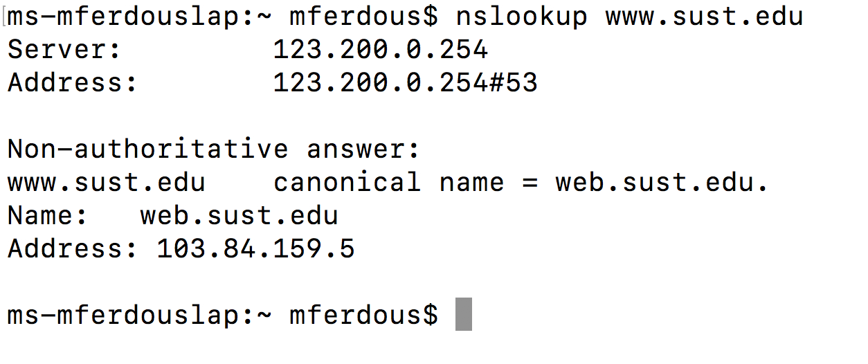
Network Scanning – Targeted Host
Use DNS to determine the IP address of a known server
  Remember the nslookup command!

Slide 21
Port Scanning
Once the IP address of the target is found, use the port scanning method to determine which ports are open in the host
Remember, ports are like doors of a house
Port scanning resembles knocking the doors to check which one is open
Some are well known open ports: web server:80, FTP: 21, SMTP: 25
However, some others ports also remain open for different applications
There are tools for checking an opening port:
  nmap!

Slide 22
Active Attacks
Spoofing
  ARP Spoofing
  IP Spoofing
TCP Session Hijacking
DoS/DDoS
DNS Cache Poisoning

Slide 23
ARP Spoofing
The ARP protocol is simple and effective, but it lacks an authentication scheme
Any computer on the network could claim to have the requested IP address
In fact, any machine that receives an ARP reply, even if it was not preceded by a request, will automatically update its ARP cache with the new association
Because of this shortcoming, it is possible for malicious parties on a LAN to perform the ARP spoofing attack

Slide 24
ARP Spoofing

Slide 25
ARP Spoofing – mitigation
ARP spoofing can occur because of its lack of identity verification in the Internet’s underlying mechanisms
Fortunately, there are several means of preventing ARP spoofing, besides restricting LAN access to trusted users
One simple technique involves checking for multiple occurrences of the same MAC address on the LAN
  Usually, one MAC address should belong to one equipment. Multiple occurrences of the same MAC address implies that the address might be spoofed
Another solution:
  Static ARP table configured by the admin in different routers/switches in the network
  However, it is inconvenient

Slide 26
IP Spoofing
IP Spoofing is an attempt by an intruder to send packets from one IP address that appear to originate at another
If the server thinks it is receiving messages from the real source after authenticating a session, it could inadvertently behave maliciously
There are two basic forms of IP Spoofing
  Blind Spoofing : Attack from any source
  Non-Blind Spoofing : Attack from the same subnet

Slide 27
IP Spoofing

Slide 28
Blind IP Spoofing
The TCP/IP protocol requires that “acknowledgement” numbers be sent across sessions
Makes sure that the client is getting the server’s packets and vice versa
Need to have the right sequence of acknowledgment numbers to spoof an IP identity
https://www.lifewire.com/thmb/uw63pSPbgC9daiNgY5aXwXxF2aE=/768x0/filters:no_upscale():max_bytes(150000):strip_icc():format(webp)/tcp-header-56a1adc85f9b58b7d0c1a24f.png

Slide 29
Non-Blind IP Spoofing
IP Spoofing without inherently knowing the acknowledgment sequence pattern
  Done on the same subnet
  Use a packet sniffer to analyse the sequence pattern
Packet sniffers intercept network packets
Eventually decodes and analyses the packets sent across the network
Determine the acknowledgment sequence pattern from the packets
Send messages to server with actual client's IP address and with validly sequenced acknowledgment number

Slide 30
Motivation of IP Spoofing
If an attacker sends an IP packet with a spoofed source address,
  He will not receive any response from the destination server
  The response will return back to the machine having the spoofed address
So, what is the motivation of an attacker for IP spoofing?
Use IP spoofing to carry out another attacks for which:
  The attacker does not care about any responses for these packets or
  He has some other way of receiving responses
For example, in denial-of-service attacks,
  The attacker doesn’t want to receive any responses back
  He just wants to overwhelm some other Internet host with data requests.
Also, it can be used for other attacks such as for circumventing firewall policy or TCP session hijacking
  In such cases, the attacker uses a different approach to receive the response back

Slide 31
Mitigating IP Spoofing
Unfortunately, IP spoofing cannot be prevented!
  But they can be handled in a different way!
Borders routers connecting two sub-nets, can be configured to block any packet with the source address outside their domain
IP spoofing can be combated by implementing IP traceback techniques
IP traceback involves methods for tracing the path of a packet back to its actual source address
Given this information, requests can then be made to the various autonomous systems along this path to block packets from this location
The ISP controlling the actual source address can also be asked to block suspicious machines entirely until it is determined that they are clean of any malware or malicious users.

Slide 32

The lecture slides can be found in the following location!

