Slide 1
CSE 477: Introduction to Computer Security
Lecture – 21
Course Teacher: Dr. Md Sadek Ferdous
Assistant Professor, CSE, SUST
E-mail: ripul.bd@gmail.com

Slide 2
Outline
Active Attacks
  Spoofing
  TCP Session Hijacking
  Dos/DDoS
  DNS Cache Poisoning

Slide 3
TCP Session Hijacking
TCP 3-way Handshake

Slide 4
TCP Session Hijacking
A security attack over a protected network
It is an attempt to take control of a network session
  Sessions are server keeping state of a client’s connection
  Servers need to keep track of messages sent between client and the server and their respective actions
Most networks follow the TCP/IP protocol
It has several flavours depending on the location and knowledge of the attacker
  TCP Sequence Prediction/Complete Session Hijacking

Slide 5
TCP Sequence Prediction
A TCP sequence prediction attack attempts to guess an initial sequence number sent by the server at the start of a TCP session, so as to create a spoofed TCP session
Early TCP stacks implemented sequence numbers by using a simple counter that was incremented by 1 with each transmission
Without using any randomness, it was trivial to predict the next sequence number, which is the key to this attack
Modern TCP stack implementations use pseudo-random number generators to determine sequence numbers, which makes a TCP sequence prediction attack more difficult, but not impossible

Slide 6
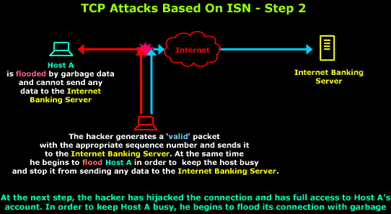
TCP Sequence Prediction
The attacker launches a denial-of-service attack against the client victim to prevent that client from interfering with the attack
The attacker sends a SYN packet to the target server, spoofing the source IP address to be that of the client victim
After waiting a short period of time for the server to send a reply to the client (which is not visible to the attacker and is not acted on by the client due to the DoS attack), the attacker concludes the TCP handshake by sending an ACK packet with the sequence number set to a prediction of the next expected number (based on information gathered by other means), again spoofing the source IP to be that of the client victim
The attacker can now send requests to the server as if he was the victim client

Slide 7
Mitigating TCP Sequence Prediction
Countermeasures to TCP session hijacking attacks involve the use of encryption and authentication
  either at the network layer, such as using IPsec, or at the application layer, such as using application-layer protocols that encrypt entire sessions
In addition, web sites should avoid creating sessions that begin with secure authentication measures but subsequently switch over to unencrypted exchanges
Such sessions trade off efficiency for security, because they create a risk with respect to a TCP session hijacking attack

Slide 8
DoS
Because bandwidth in a network is finite, the number of connections a web server can maintain to clients is limited
Each connection to a server needs a minimum amount of network capacity to function
When a server has used up its bandwidth or the ability of its processors to respond to requests, then additional attempted connections are dropped and some potential clients will be unable to access the resources provided by the server
Any attack that is designed to cause a machine or piece of software to be unavailable and unable to perform its basic functionality is known as a denial-of- service (DoS) attack
This includes any situation that causes a server to not function properly, but most often refers to deliberate attempts to exceed the maximum available bandwidth of a server
Spoofing the source IP address is commonly used to obscure the identity of the attacker as well as make mitigation of the attack more difficult

Slide 9
DoS Attacks
ICMP Attacks
  PING Flood
  SMURF
SYN Flood

Slide 10
PING Flood
In a ping flood attack, a powerful machine can perform a DoS attack on a weaker machine
To carry out the attack, a powerful machine sends a massive amounts of PING echo requests to a single victim server with the following two conditions:
  The attacker can create many more ping requests than the victim can process, and
  The victim has enough network bandwidth to receive all these requests
If these happen, the victim server will be overwhelmed with the traffic and start to drop legitimate connections

Slide 11
SMURF (Directed Broadcast) Attack
The smurfing attack also exploits the ICMP
Some implementations respond to pings to broadcast addresses
Idea: Ping a LAN to find hosts, which then all respond to the ping
Attack:
  Make a packet with a forged source address containing the victim’s IP number
  Send it to a SMURF amplifier, who swamp the target with replies
The victim then receives a multitude of PING reply by which it can be overwhelmed if the previous two conditions are met

Slide 12
SMURF (Directed Broadcast) Attack

Slide 13
Mitigating SMURF Attack
To prevent SMURF attacks, administrators should configure hosts and routers on their networks to ignore broadcast requests
In addition, routers should be configured to avoid forwarding packets directed to broadcast addresses, as this poses a security risk in that the network can be used as a ping flood amplifier
Finally, if a server is relatively weak, it would be wise for it to ignore ping requests altogether, to avoid ping floods

Slide 14
SYN Flood
In the SYN flood attack, an attacker sends a large number of SYN packets to the server, ignores the SYN/ACK replies, and never sends the expected ACK packets
In fact, an attacker initiating this attack in practice will probably use random spoofed source addresses in the SYN packets he sends, so that the SYN/ACK replies are sent to random IP addresses
If an attacker sends a large amount of SYN packets with no corresponding ACK packets, the server’s memory will fill up with sequence numbers that it is remembering in order to match up TCP sessions with expected ACK packets
These ACK packets will never arrive, so this wasted memory ultimately blocks out other, legitimate TCP session requests

Slide 15
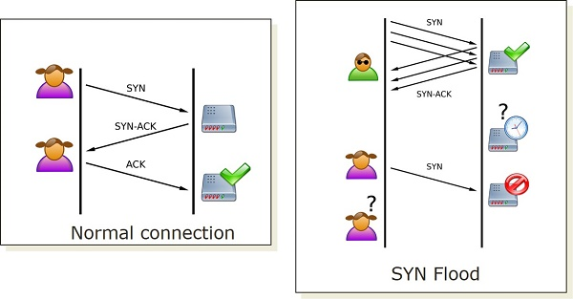
SYN Flood

Slide 16
Mitigating SYN Flood
SYN cookie: server does not really keep the client’s state until the handshake is done
Server embeds the state in the sequence number
When SYN received, server computes a sequence number to be a function of source, destination, counter, and a secret
  The function may be one-way hash function
  The secret is known only by the server
  Use as reply SYN sequence number
  When reply ACK arrives, validate it
The sequence number must be hard to guess

Slide 17
SYN Cookie Limitation
Windows has not adopted SYN cookies, but they are implemented in several Linux distributions
The lack of implementation is due to some restrictions imposed by SYN Cookie
The main limitation is that SYN cookies do not ordinarily allow the use of the TCP options field
  Since this information is usually stored alongside SYN queue entries
Recent Linux SYN cookie implementations attempt to address this second limitation by encoding TCP option information in the timestamp field of TCP packets

Slide 18
Distributed DoS (DDoS)
A denial-of-service condition can be created by using more than one attacking machine, in what is known as a distributed denial-of-service (DDOS) attack
In this attack, malicious users leverage the power of many machines (sometimes hundreds or even thousands) to direct traffic against a single web site in an attempt to create denial-of-service conditions
Major web sites, such as Yahoo!, Amazon, and Google, have been the targets of repeated DDOS attacks
Often, attackers carry out DDOS attacks by using botnets—large networks of machines that have been compromised and are controllable remotely.

Slide 19
Distributed DoS (DDoS)

Slide 20
Mitigating DDoS
In theory, there is no way to completely eliminate the possibility of a DDoS attack, since the bandwidth a server is able to provide its users will always be limited
Still, measures may be taken to mitigate the risks of DoS attacks
For example, many servers incorporate DoS protection mechanisms that analyse incoming traffic and drop packets from sources that are consuming too much bandwidth
Unfortunately, IP spoofing may make DDoS prevention more difficult, by obscuring the identity of the attacker bots and providing inconsistent information on where network traffic is coming from

Slide 21
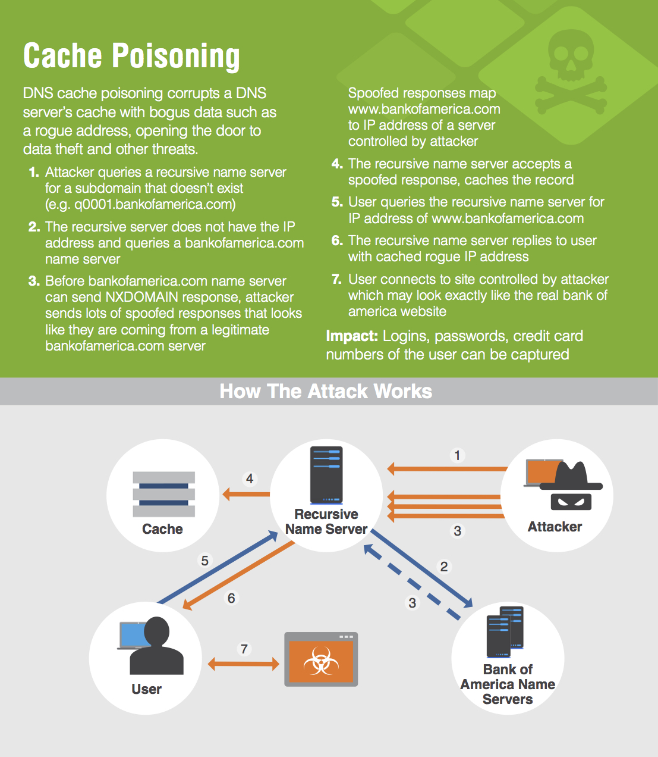
DNS Cache Poisoning

Slide 22
DNS Cache Poisoning

Slide 23
Mitigating DNS Cache Poisoning
First, most DNS cache poisoning attacks are targeted towards ISP DNS servers, known as local DNS (LDNS) servers, rather than authoritative name servers
Prior to more recent cache poisoning attacks, the practice of leaving LDNS servers openly accessible to the outside world was common, but since 2008, most LDNS servers have been reconfigured to only accept requests from within their internal network
This prevents all cache poisoning attempts originating from outside of an ISP’s network
However, the possibility of attacking from within the network remains
There are some other techniques not explored here, but the possibility of DNS Cache Poisoning still exists

Slide 24

The lecture slides can be found in the following location!

