Slide 1
VERILOG-HDL
Sajid Gul Khawaja

Slide 2
Dataflow Modeling
Shows flow of data using
Expressions
Operands
Rules:
Left hand side must be declared as type “wire”
ALWAYS use keyword assign before any expression.

Slide 3
Behavioral Modeling
Uses high level constructs such as
If/else, case, casex, casez
for, while, repeat, forever
Rules:
Left hand side must be declared as type “reg”
Code must be enclosed within a procedural block
always
initial
DO NOT use keyword assign inside a procedural block.

Slide 4
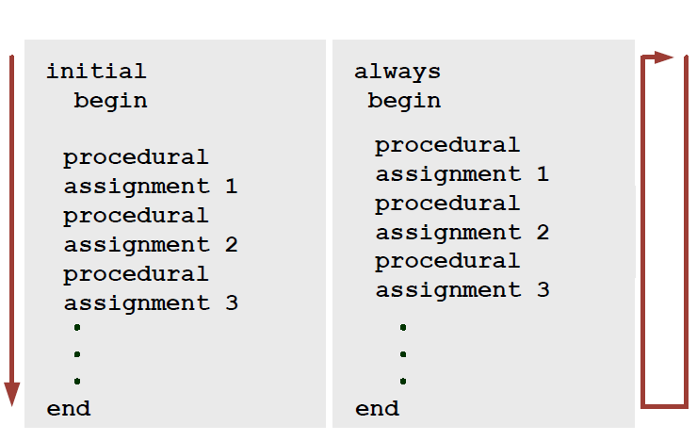
Initial and always block
Digital Design of Signal Processing Systems, John Wiley & Sons by Dr. Shoab A. Khan

Slide 5
Procedural Assignments
Blocking Assignment (=)
Regular assignment
Value is assigned immediately
Non-Blocking Assignment (<=)
Used in procedural block having clock in its sensitivity list
Assigns values in parallel once the end of block is reached

Slide 6
Examples
a = ?
b = ?
always@(*) begin
a = 5;
b = a;
end
always@(posedge clk) begin
a <= 5;
b <= a;
end
a = ?
b = ?

Slide 7
Template for inferring Physical Register (Asynchronous)
always@(posedge clk or negedge rst_n)
begin
if (!rst_n)
begin
RegA <= 0;
RegB <= 0;
end
else
begin
RegA <= data_in;
RegB <= RegA;
end
end
RegA
RegB
data_in
rst_n
rst_n

Slide 8
System Tasks or Simulation Control Statements
$finish
Finishes Simulation
$display(“Value is = %d”, out);
% specifies position of data to be displayed
d specifies display format of data
Executes only once
$monitor(“Value is = %d”, out)
% specifies position of data to be displayed
d specifies display format of data
Executes whenever value of out changes

Slide 9
Module Instantiating
Top-most Module (Calling Module)
Output port is of type “wire” by default; it can be redefined as “reg”
Input port is of type “wire”
My_Design_1
Input port is defined as either reg or wire
Output port is defined as wire only
Module Calling_module(…..);
reg in;
wire out;
My_Design_1 uut (in, out);
endmodule

Slide 10
Module Instantiating
Top-most Module (Calling Module)
a
c_t
My_Design_1
c
My_Design_2
b
d_t
My_Design_1
module Calling_Module(input a, output c);
reg b;
wire c_t, d_t;
My_Design_1 uut (a, c_t);
My_Design_1 uut2 (b, d_t);
My_Design_2 uut3 (c_t, d_t, c);
.
.
endmodule
uut, uut2 and uut3
User defined Object names for modules

Slide 11
Module Instantiating
Top-most Module (Calling Module)
a
c_t
My_Design_1
c
My_Design_2
b
My_Design_1
d_t
module Calling_Module(input a, b, output c);
wire c_t, d_t;
My_Design_1 uut (a, c_t);
My_Design_1 uut2 (b, d_t);
My_Design_2 uut3 (c_t, d_t, c);
.
.
endmodule
uut, uut2 and uut3
User defined Object names for modules

Slide 12
ANSI Style Module Instantiating
Top-most Module (Calling Module)
a
b
My_Design_1
in
out
My_Design_1 uut (.in(a), .out(b));
“a” can be defined as ?
“b” can be defined as ?

Slide 13
Parameters
By default 32 bit, used as constants
Assigned value remains same within the module (as const int in c)
Its value can be updated from calling module

Slide 14
Example
module xyz(………);
parameter N =10; //Defining N as 10
input [N – 1: 0] in; //Defining N bit input and output
output [N – 1: 0] out;
.
.
.
endmodule
Calling
Xyz #(.N(10)) obj (…….);

Slide 15
Guide Lines For Coding in HDL

Slide 16
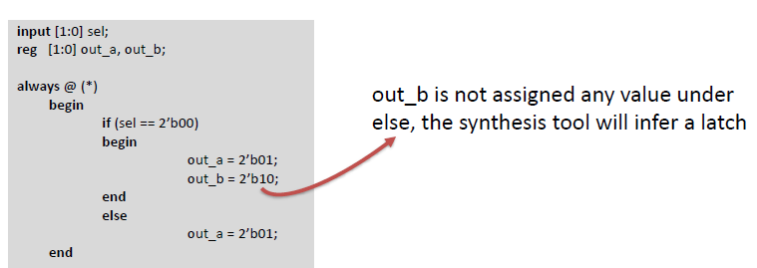
Avoid Latches
Avoid Latches at all cost
Complete all conditions when using if-else (or case statement)
Or Make use of else or default
Digital Design of Signal Processing Systems, John Wiley & Sons by Dr. Shoab A. Khan

Slide 17
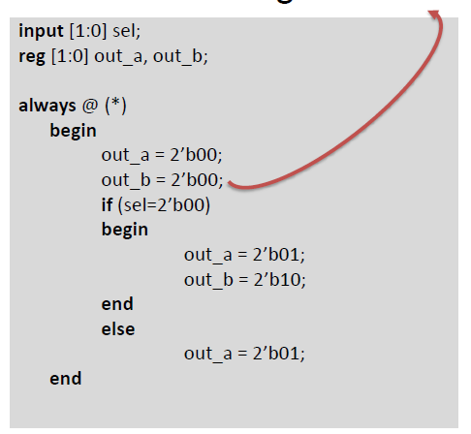
Avoid Latches
Use default values
Digital Design of Signal Processing Systems, John Wiley & Sons by Dr. Shoab A. Khan

Slide 18
Use of CORES
Use XILINX provided cores whenever possible
Block/Distributed RAM in place of local memory
Specify depth of memory in power of 2 to avoid unnecessary warnings
DSP48 module for various multi-operand operations
Math functions such as
Division
Square root
Sin, cos etc.
Use of cores helps in simplifying and optimizing the overall design

Slide 19
Non-Synthesizable Constructs (Majorly used in simulation)
Do not use non-synthesizable constructs while designing
Example constructs
initial
forever
always
(without sensitivity list)

Slide 20
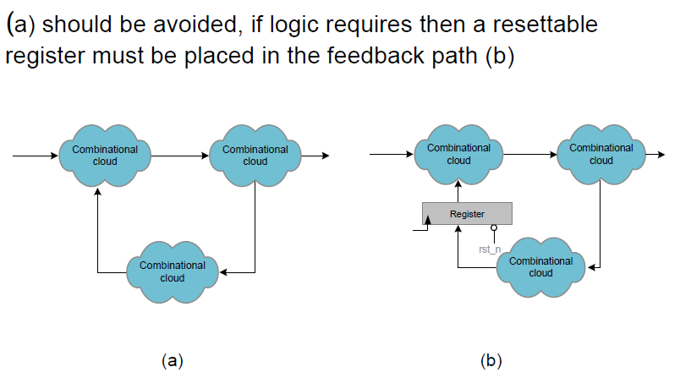
Avoid Combinational Feedback
Digital Design of Signal Processing Systems, John Wiley & Sons by Dr. Shoab A. Khan

Slide 21
Placement of registers
Place physical register at the input and output of your overall design.
Can automatically help in reducing overall delay
Ensures complete synthesis

Slide 22
Cross-Checks after Completion of Design
Synthesize your code
Check Area and Timing Analysis
Cross check your RTL schematics
Run implement design
Translate
Map
Place and Route
Run post route simulation and cross check your logic

Slide 23
Major Errors and warnings
Multi-driver Error:
When a single variable is assigned values at multiple places (assign or procedural blocks)
Incomplete Sensitivity list
FF latch inferred
Can not mix blocking and non-blocking statements
Trimming XYZ variable
Constant value in a variable

Slide 24
On board Diagnostics
Use Chipscope-Pro to debug code at run time
Provides
Integrated Controller (ICON)
Integrated Logic Analyzer (ILA)
Virtual Input Output (VIO)
Agilent Trace Core 2 (ATC2) etc.

Slide 25
Designing Examples

Slide 26

Example: Difference Equation
N – 1 specifies a delay of 1 sample.
Physical Delay in HDL-VERILOG is added using a physical Register

Slide 27
Difference Equation-Figure
x[n]
y[n]
+
x
0.5
y[n - 1]

Slide 28
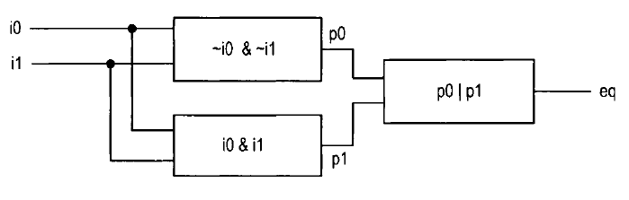
Comparator
i0 | i1 | eq
0 | 0 | 1
0 | 1 | 0
1 | 0 | 0
1 | 1 | 1

Slide 29
HDL Code
module eq1( input i0, i1, output eq);
wire p0, p1;
assign eq = p0 | p1;
assign p0 = ~i0 & ~i1;
assign p1 = i0 & i1;
endmodule
module eq1( input i0, i1, output eq);
reg p0, p1, eq;
always@(*)
eq = p0 | p1;
always @(i0, i1)
begin
p0 = ~i0 & ~i1;
p1 = i0 & i1;
end
endmodule

Slide 30
HDL Code
module eq1( input i0, i1, output eq);
wire p0, p1;
assign eq = p0 | p1;
assign p0 = ~i0 & ~i1;
assign p1 = i0 & i1;
endmodule
module eq1( input i0, i1, output eq);
reg p0, p1, eq;
always@(*)
eq = p0 | p1;
always @(i0, i1)
begin
p0 = ~i0 & ~i1;
p1 = i0 & i1;
end
endmodule

Slide 31
System Level Design and Testing

Slide 32
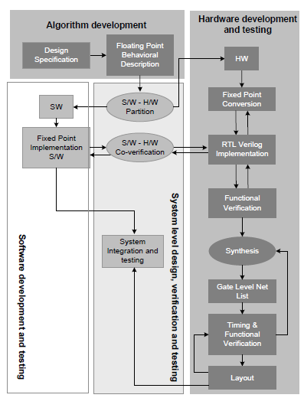
Simulation Takes up to 60-70% of the developers time
Digital Design of Signal Processing Systems, John Wiley & Sons by Dr. Shoab A. Khan

Slide 33
Stimulus-Test Bench
Used for verification of a design by providing known data called test vectors and comparing the response.
The design (top-level module) is instantiated inside the test-bench
Constructs that are not synthesizable can be used in stimulus

Slide 34
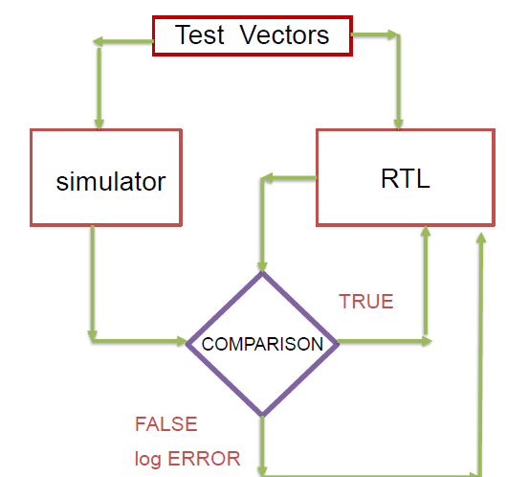
Testing RTL Design
Make a simulation model
Generate and give test vectors to both
Test against the model
Digital Design of Signal Processing Systems, John Wiley & Sons by Dr. Shoab A. Khan

Slide 35
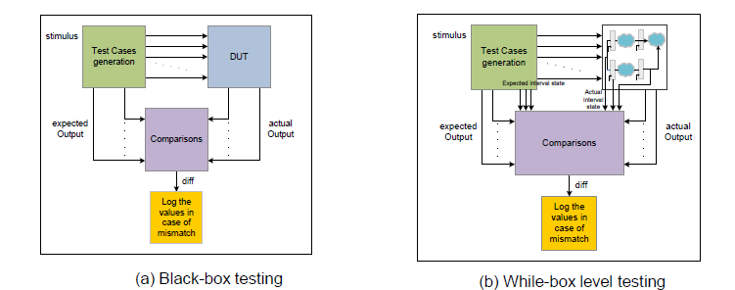
Testing Standards
A set of inputs is applied and the outputs are checked
against the specification or
expected output
No consideration to the inner details of the system
Testing against specifications while making use of the known internal structure of the system.
Enables easy location of bug for quick fixing
Performed by the developer
Digital Design of Signal Processing Systems, John Wiley & Sons by Dr. Shoab A. Khan

Slide 36
Stimulus: A Guide Line
Stimulus is the top-most module
Has no ports
Instantiates modules for testing
Provide data as test vectors using “initial” block
Generate clock via “initial” or “always” block

Slide 37
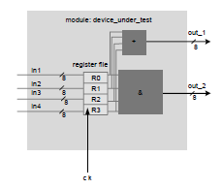
Stimulus Example Code
module stimulus();
reg [7:0] A, B, C, D;
wire [7:0] Out1, Out2;
reg clk;
Device_under_test obj (A, B, C, D, clk, Out1, Out2);
initial begin
clk = 0;
A = 0; B = 0; C = 0; D = 0;
#10
A = 9; B = 6; C = 4; D = 2;
…..
end
always
#5 clk = !clk;
Initial
$monitor(“Output 1 = %d, Output 2 = %d”, Out1, Out2;
endmodule
Stimulus:
Has no ports.
Make instance(s) of testing module.
Use Initial to provide test vectors for verification
Either use $monitor for displaying output or use waveform

Slide 38
Stimulus Example Code
module stimulus();
reg [7:0] A, B, C, D;
wire [7:0] Out1, Out2;
reg clk;
Device_under_test obj (A, B, C, D, clk, Out1, Out2);
initial begin
clk = 0;
A = 0; B = 0; C = 0; D = 0;
#10
A = 9; B = 6; C = 4; D = 2;
…..
end
always
#5 clk = !clk;
endmodule
Some Rules:
Port list order Must be same as declare or use ANSI Style
Object Name (obj here) should be unique for each instance.
Reset the system before providing input data (in codes where necessary)
Generate clock where necessary

Slide 39
NOTE:
These slides DO NOT cover the complete syntax covered in class lectures
For complete syntax study Chapter 2 from Dr. Shoabs book or study lecture slides “Lec_Chap2.ppt”

