Slide 1





كلية العلوم التطبقية
SOFTWARE
قسم علوم حاسوب وتقنية معلومات
ENGINEERING
ASSIGNMENT
: :lab1
about:git
الطالب:محمد عبدالله مسعد الفتاحي
ENG:MALEK ALMOSANIF
level:IT4
frist term
group:C

Slide 2
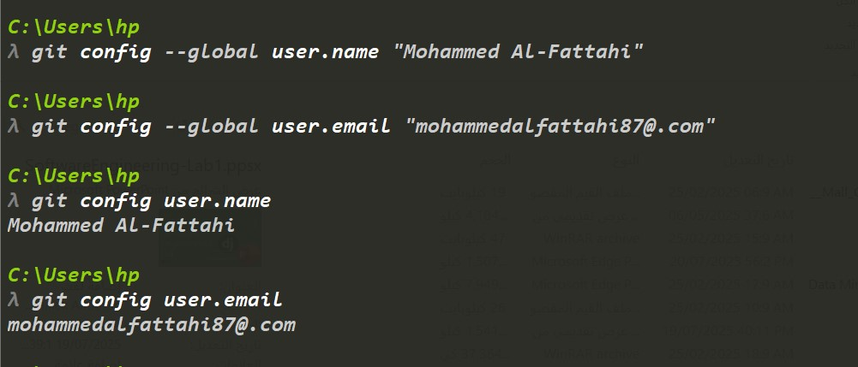
git config --global user.name “Mohammed alfattahi"
git config --global user.email “email“
git config user.name
git config user.email

Slide 3
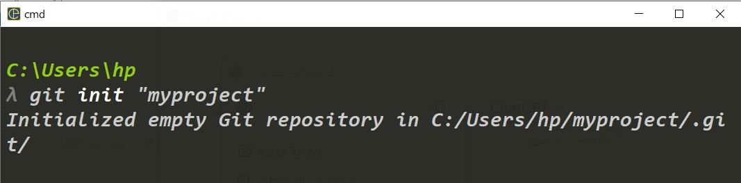
git intit
git status

Slide 4
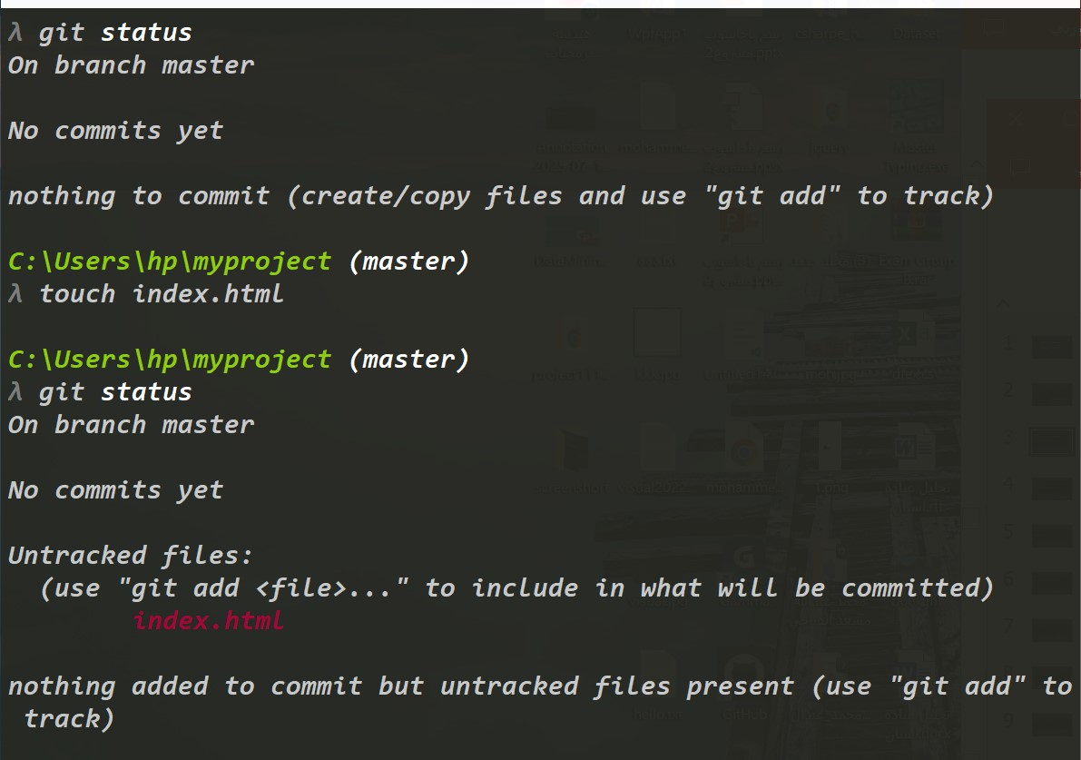
git status
git touch

Slide 5
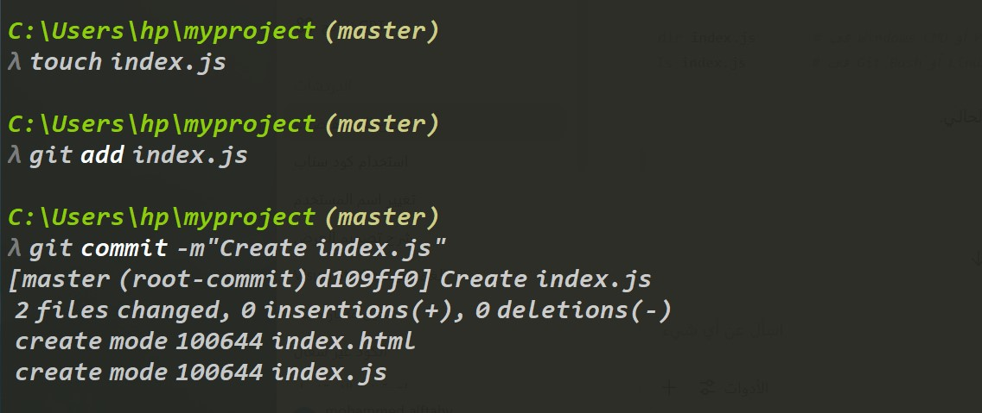
git add “name file”
git commit –m”message”

Slide 6
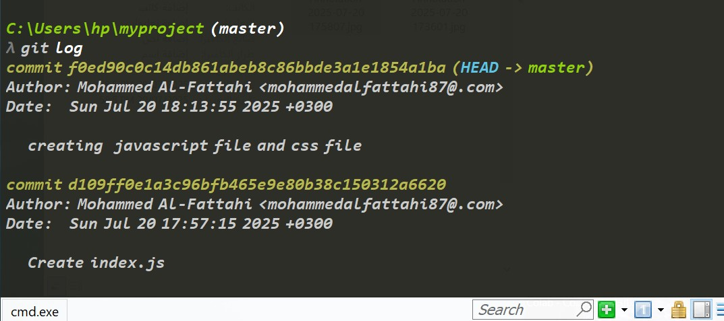
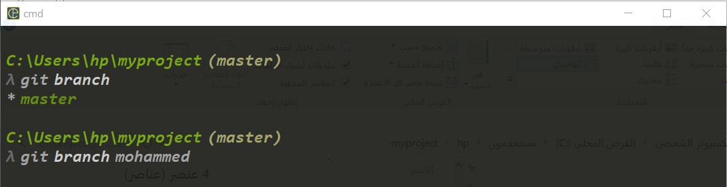
git log
git branch

Slide 7
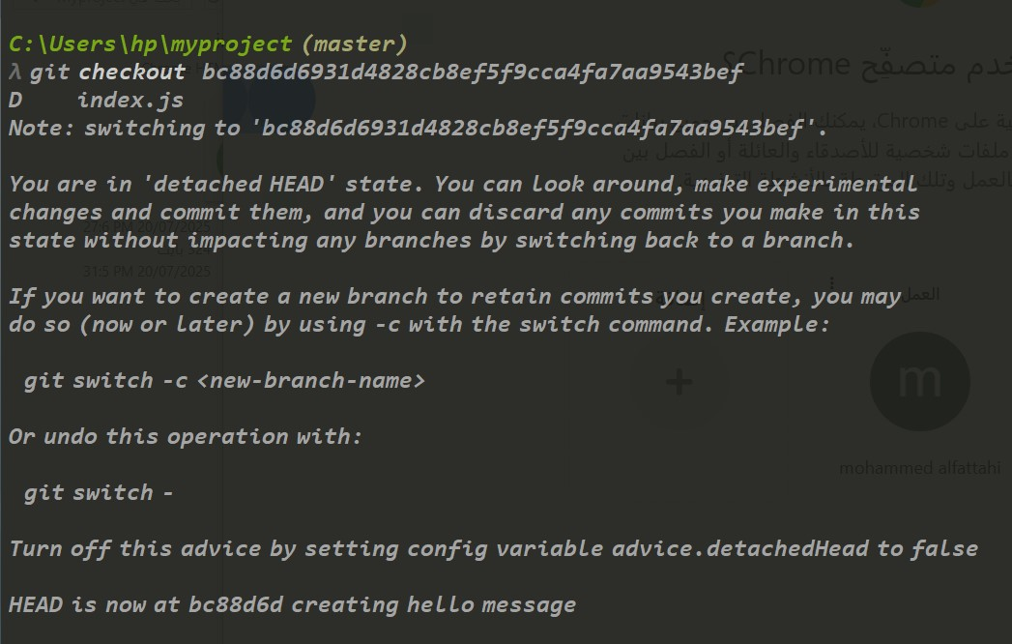
git checkout “commit id”

Slide 8
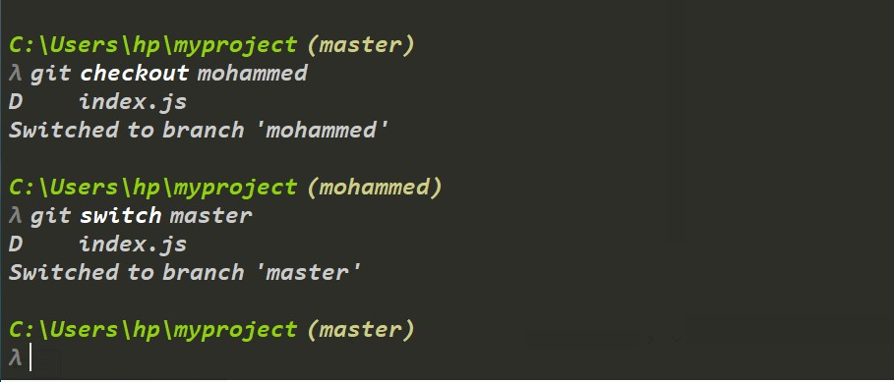
git checkout “branchname”
git switch “branchname” this the best

Slide 9
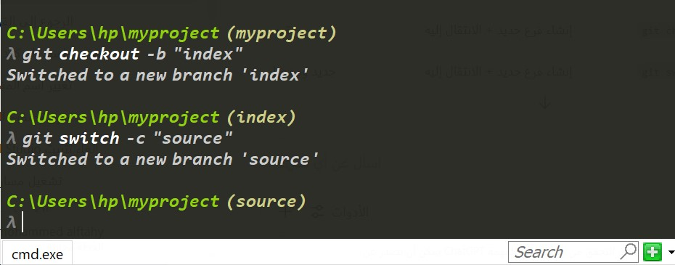
git checkout –b”BranchName”
git switch -c “branchname” this the best

Slide 10
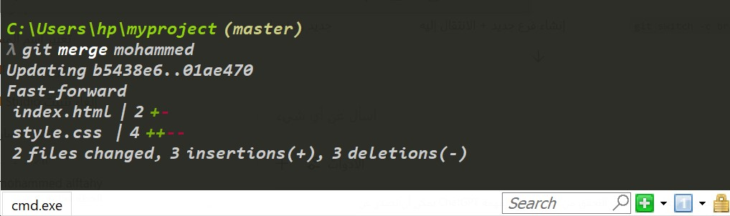
git merge targetbranch

Slide 11
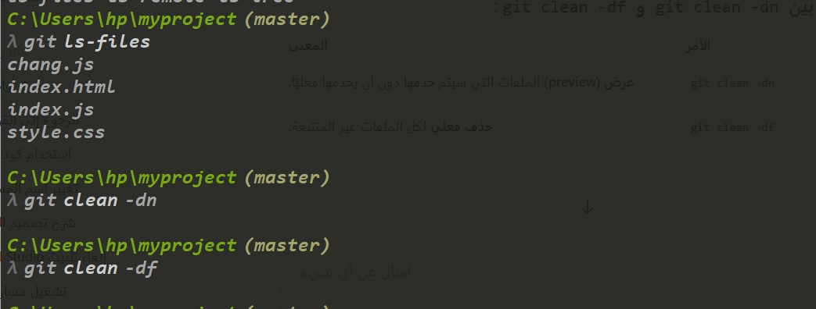
git ls-files
git clean –dn
git clean -df

Slide 12
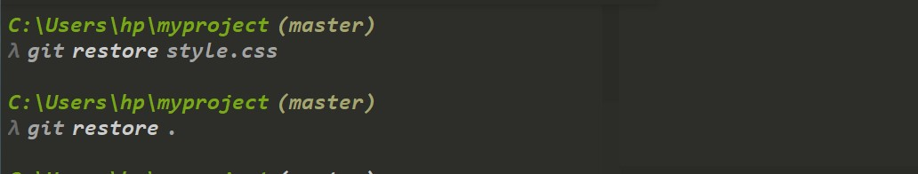
git restore “filename”
git restore .

Slide 13
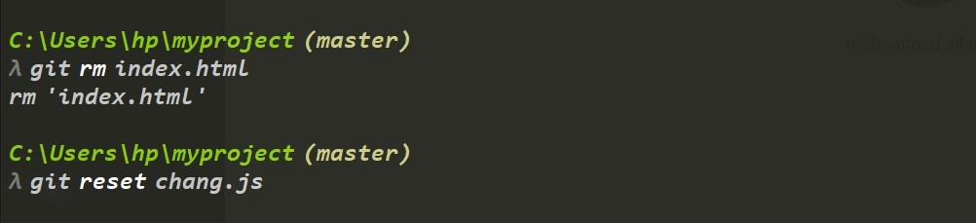
git rm “filename”
git reset “filename”

Slide 14
Thank You
By :Mohammed Al-Fattahi
mohammedalfattahi87@gmail.com
https://github.com/mohammed-alfattahi/SoftwareEngineering_mohammed_AL_Fattahi.git

