Slide 1

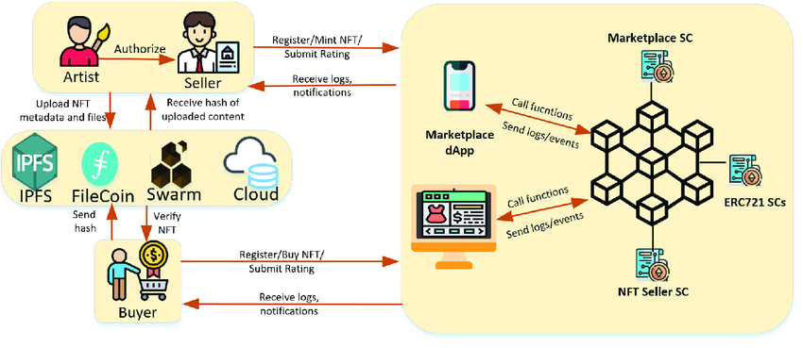
Dayananda Sagar College Of Engineering
Department Of Computer Science and Engineering
BLOCKCHAIN STOCK BROKERAGE SYSTEM
Mohammed Adnan (1DS19CS089), Mohammed Arham (1DS19CS090),
Mohammed Faisal (1DS19CS091), Mudassir Ahmed (1DS19CS093)
Guided by: Prof. Chaitra S P
INTRODUCTION
ABSTRACT
OBJECTIVES
Traditional stock markets have “so called” trusted intermediaries who execute transactions for the traders. A stock trading platform that is implemented on the blockchain can replace them and be used for decentralized stock exchanges.
Blockchain offers a decentralized solution for stock exchange problems, guaranteeing reliability and reducing costs. By utilizing smart contracts, the order execution and settlement, can be facilitated effectively.
1.To avoid illegal activities such as front-running and insider trading in the present-day trading system.
2.To avoid illegal activities such as sandwich attacks in decentralized exchange systems.
.
CONCLUSION
In conclusion, Blockchain technology can be used in a bid to enable stock exchanges to increase the efficiency in the clearing and settlement process by the major institutions around the world.

