Slide 1

BLOCKCHAIN BASED STOCK BROKERAGE SYSTEM
Phase II - Review 2
Under the guidance of
Prof. Chaitra S P
Department of Computer Science
Dayananda Sagar College of Engineering.
Mohammed Adnan [1DS19CS89]
Mohammed Arham [1DS19CS090]
Mohammed Faisal [1DS19CS091]
Mudassir Ahmed [1DS19CS093]
Department of Computer Science & Engineering, DSCE

Slide 2
CONTENTS
Problem Statement
Introduction
Contribution
System Diagram/Architecture
Algorithm
GUI Design
Co-Guide Meet Details
Project Tool Snapshot
Department of Computer Science & Engineering, DSCE

Slide 3
PROBLEM STATEMENT
The stock market and decentralized exchanges face several issues in the present day.
Insider trading is an illegal and unethical act where an employee of an organization uses insider information for personal gain.
Front running involves individuals with special privileges gaining knowledge about a transaction before it is executed, allowing them to gain an advantage over regular traders.
These issues lead to the abuse of information obtained during stock transactions, benefiting the middleman or attacker.
The consequences of these issues result in losses for the masses who trade stocks.
Therefore, it is important to find solutions to address these problems and protect the interests of stock traders.
Department of Computer Science & Engineering, DSCE

Slide 4
INTRODUCTION
Major issues in stock market trading include insider trading and front running. Insider trading occurs when employees use confidential information for personal gain, while front running involves privileged individuals gaining early knowledge of transactions for their own benefit.
To address these issues, implementing blockchain technology in the stock market can be a viable solution. By utilizing a consensus mechanism, transactions become tamper-proof, eliminating the need for intermediaries like brokers. Smart contracts can replace traditional middlemen, effectively preventing front running and insider trading.
Decentralized transactions also face a similar problem known as a sandwich attack, which combines front-running and back-running. However, this issue can be mitigated by combining blockchain with threshold encryption algorithms. A consensus signature mechanism ensures that all participants must sign transactions, preventing information leakage and effectively avoiding sandwich attacks.
Department of Computer Science & Engineering, DSCE

Slide 5
Contribution of Each project Members
 | NAME | CONTRIBUTION
1 | MOHAMMED ADNAN | Project Management & Testing.
2 | MOHAMMED ARHAM | Backend
3 | MOHAMMED FAISAL | Smart Contracts
4 | MUDASSIR AHMED | Frontend

Slide 6
Contribution of Each Team Member :
Mohammed Adnan(1DS19CS089)
.
As a project manager, Mohammed Adnan has been responsible for overseeing the entire project and ensuring that it was completed on time, within budget, and to the required quality standards. Some of his specific contributions might have included:
As a tester, Mohammed Adnan is responsible for ensuring that the software was tested thoroughly and met the required quality standards. Some of his specific contributions might have included
Creating test plans and test cases: Mohammed Adnan created test plans that outlined the testing approach and identified the types of tests that needed to be conducted. He would also have created test cases that detailed the steps to be taken during testing.
Conducting testing: This involves executing the test cases and identifying any defects or issues that arise during testing.
Reporting and documenting defects: Reported any defects or issues that were identified during testing and documented these defects for future reference.
Retesting: After defects were fixed, retested the software to ensure that the fixes were effective and that the software was functioning as expected
Department of Computer Science & Engineering, DSCE

Slide 7
Contribution of Each Team Member :
Mohammed Arham(1DS19CS090)
.
As a backend developer, Mohammed Arham would has been responsible for developing and maintaining the server-side of the "Stock Market brokerage using blockchain" project. Here are some of the specific contributions that Mohammed Arham might have made to the project:
Backend coding: Mohammed Arham would have written the code for the backend of the application using appropriate programming languages and frameworks. He would have used his expertise to create efficient and scalable code that could handle the expected workload of the project.
Use case implementation: He would have worked on all the use cases of the project, including buying and selling of stocks, and would have implemented them in the backend
.Integration with blockchain: As the project was based on blockchain technology, Mohammed Arham integrated the backend with the blockchain network.
Department of Computer Science & Engineering, DSCE

Slide 8
Contribution of Each Team Member :
Mohammed Faisal(1DS19CS090)
.
As a smart contract developer, Mohammed Faisal isresponsible for developing and deploying the smart contract server for the project.. Here are some specific contributions that Mohammed Faisal might have made to the project
Smart contract coding: Mohammed Faisal has written the code for the smart contracts used in the project. This involved writing Solidity code to create the smart contracts that would be deployed to the blockchain network.
Use case implementation: He worked on all the use cases of the project, including buying and selling of stocks, and would have implemented them in the smart contracts. This involved creating appropriate functions and events in the smart contracts to ensure that the use cases were implemented correctly
.
Deployment of the smart contract server: Mohammed Faisal is responsible for deploying the smart contract server to the blockchain network. This would have involved configuring the server, ensuring that it was secure, and monitoring the server for any issues that might arise.
Department of Computer Science & Engineering, DSCE

Slide 9
Contribution of Each Team Member :
Mudassir Ahmed(1DS19CS093)
.
As a frontend developer, Mudassir Ahmed isr esponsible for developing the user interface (UI) and designing the frontend app for the project. Here are some specific contributions that Mudassir Ahmed might have made to the project:
Frontend coding: Mudassir Ahmed would hás written the code for the frontend app using ReactJS & Tailwind CSS.
UI design: He is responsible for designing the UI of the frontend app. This would have involved creating wireframes and mockups of the app, and ensuring that the app was visually appealing and easy to use.
Integration with the backend: Worked closely with the backend and smart contract developers to ensure that the frontend was able to interact with the backend and smart contracts as expected.
.Collaboration with the backend and smart contract teams: Mudassir Ahmed would have collaborated closely with the backend and smart contract teams to ensure that the frontend was able to interact with the backend and smart contracts as expected.
Department of Computer Science & Engineering, DSCE

Slide 10
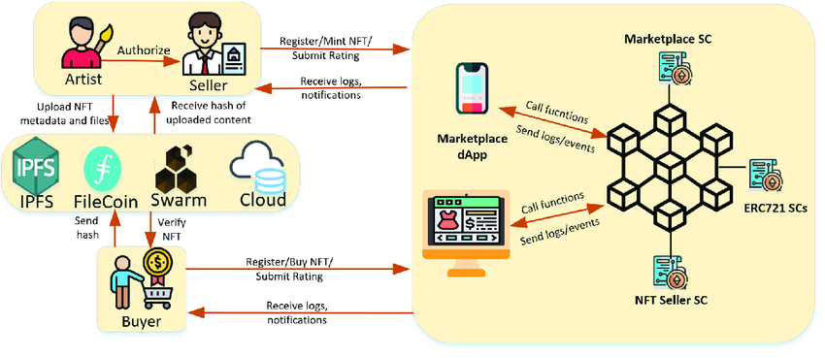
SYSTEM DIAGRAM / ARCHITECTURE:
Department of Computer Science & Engineering, DSCE

Slide 11
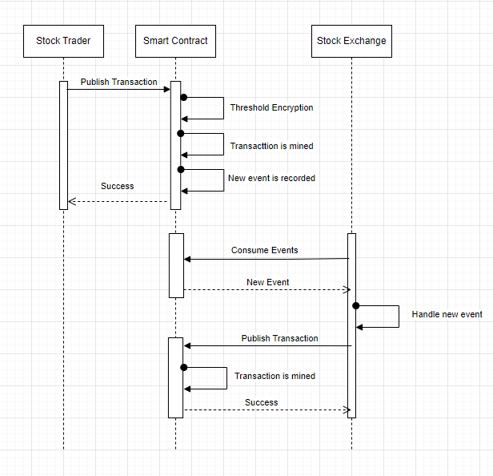
SEQUENCE FLOW DIAGRAM
Department of Computer Science & Engineering, DSCE

Slide 12
ALGORITHM:Threshold Encryption
Threshold encryption provides us a way to hide the transaction information from the participants of the network before the execution
It can be decrypted only if the transaction is signed by all the participants of the network.
This eliminates the issue of sandwich attacks as the nodes have restricted permissions to view the information before the execution of the transaction
This hence prevents front-running which eliminates a sandwich attack altogether.
Department of Computer Science & Engineering, DSCE

Slide 13
Threshold Encryption
The basic steps involved in the threshold encryption algorithm are as follows:
Key Generation: A trusted entity generates the encryption key and distributes shares of the key among multiple participants. The number of participants required to decrypt the message is known as the threshold value.
Encryption: The message is encrypted using the encryption key.
Share Submission: Each participant contributes their share of the decryption key to a shared pool.

Slide 14
Threshold Encryption
4. Decryption: Once the required number of participants have submitted their shares of the key, the message can be decrypted. Decryption is performed using the Chinese Remainder Theorem (CRT) to combine the key shares and obtain the original decryption key.

Slide 15
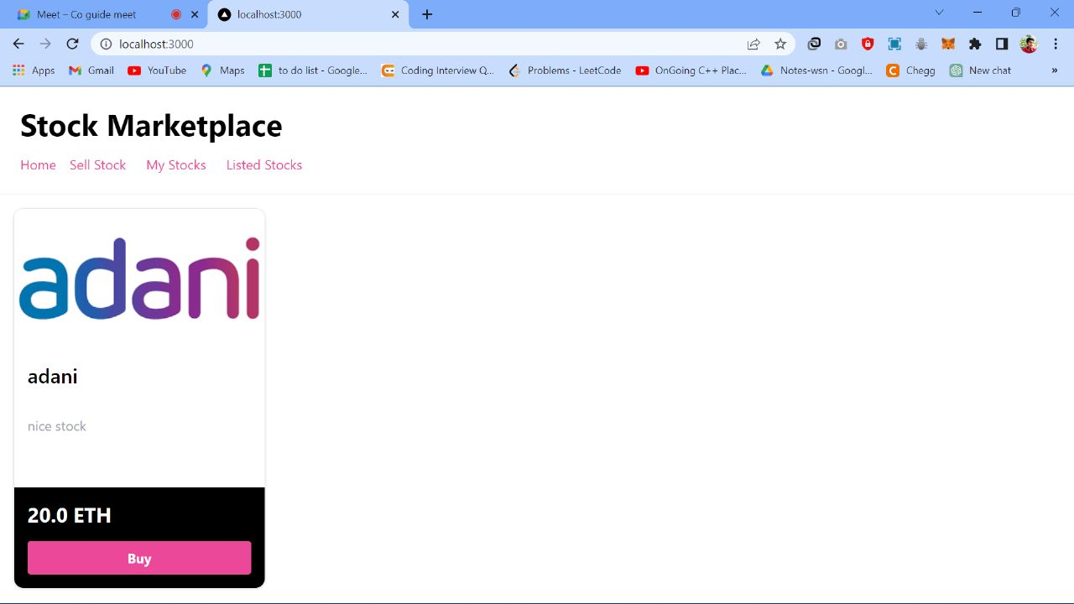
GUI DESIGN:
Department of Computer Science & Engineering, DSCE

Slide 16
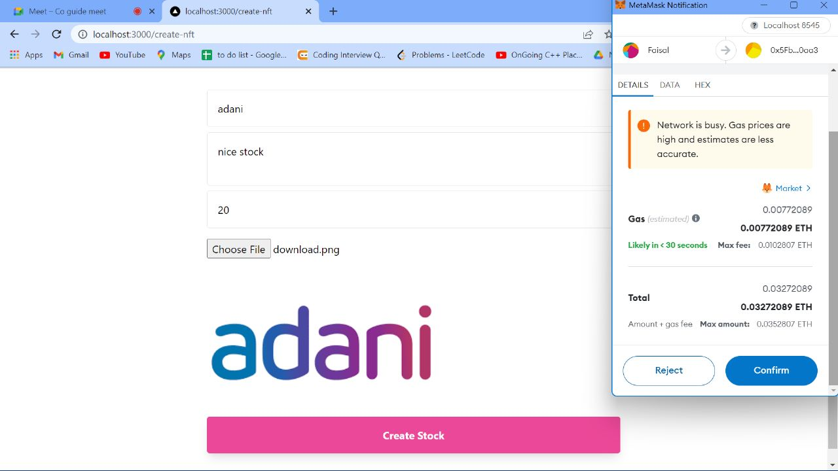
GUI DESIGN:
Department of Computer Science & Engineering, DSCE

Slide 17
Co-Guide Meet Details
Name Of Co-Guide:Yashwanth
 | DATE | MEET AGENDA
MEET 1 | 29/12/2022 | Problem statement introduction
MEET 2 | 5/03/2023 | Literature Review
MEET 3 | 08/04/2023 | Design Review

Slide 18
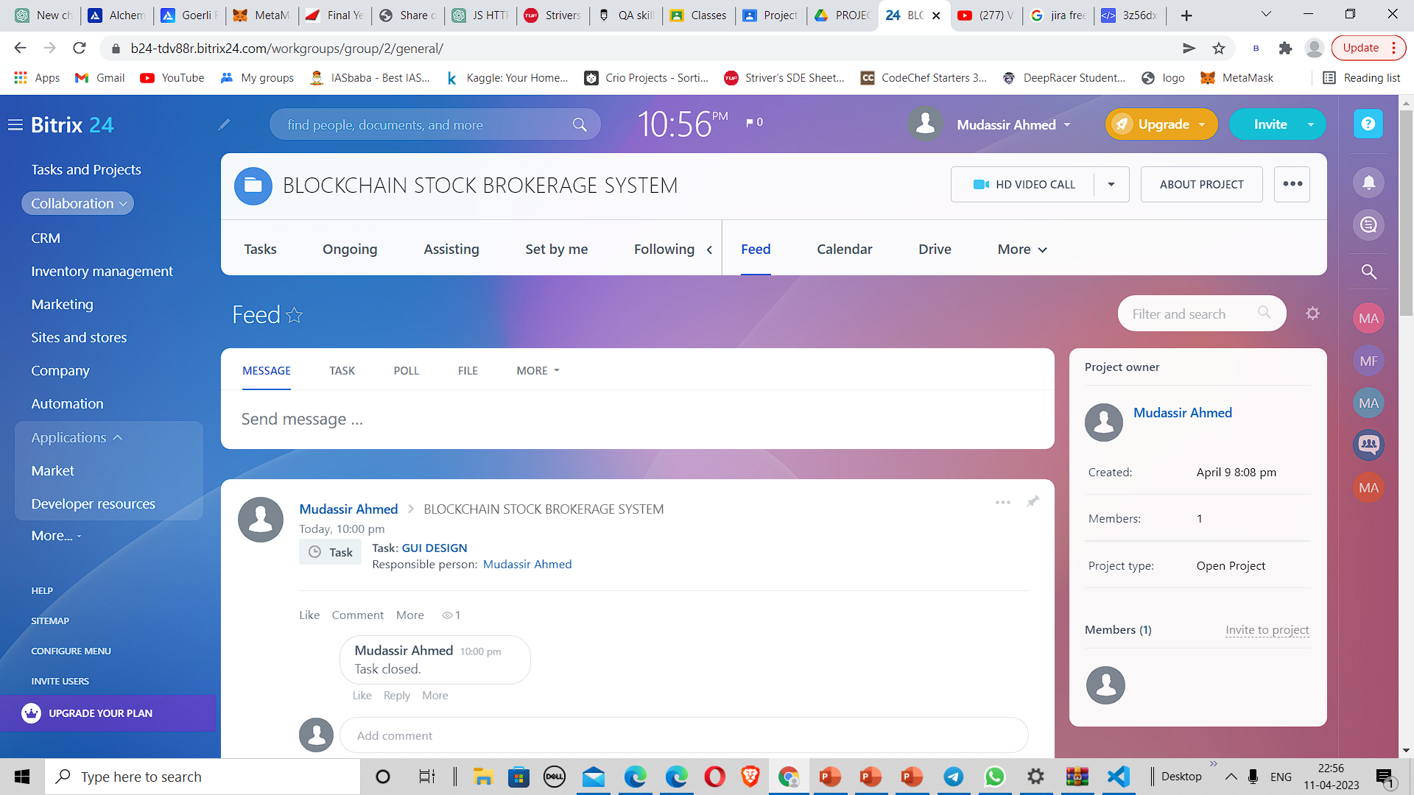
PROJECT TOOL SNAPSHOT:
Department of Computer Science & Engineering, DSCE

Slide 19
RESULT
By implementing a blockchain-based solution with smart contracts to eliminate the need for brokers and intermediaries in the stock market, we can effectively address and resolve the malpractices such as insider trading and front running.
This innovative approach ensures transparency, immutability, and tamper-proof transactions, safeguarding the interests of traders and promoting a fair and secure trading environment.
The utilization of blockchain technology in this context not only mitigates risks but also enhances efficiency, trust, and integrity within the stock market ecosystem, ultimately benefiting all stakeholders involved.

Slide 20
THANK YOU!
Department of Computer Science & Engineering, DSCE

