Slide 1

SFC/ Space for change

Slide 2
How SFC works
Many people are interested in learning throuhg stories, articles and animations, SFC website works to provide those
forms consisting of ecological notions that glorify the environment and encourage noble behaviours toward environment,
Our project aims
Our first aim is to develop forms(Articles, stories and animations) which see humans not only part of society, but also as part of the larger ecosystems that life depends on,
The second aim is to encourage people to spread environment awareness in order to achieve ecological stability and social justice,

Slide 3
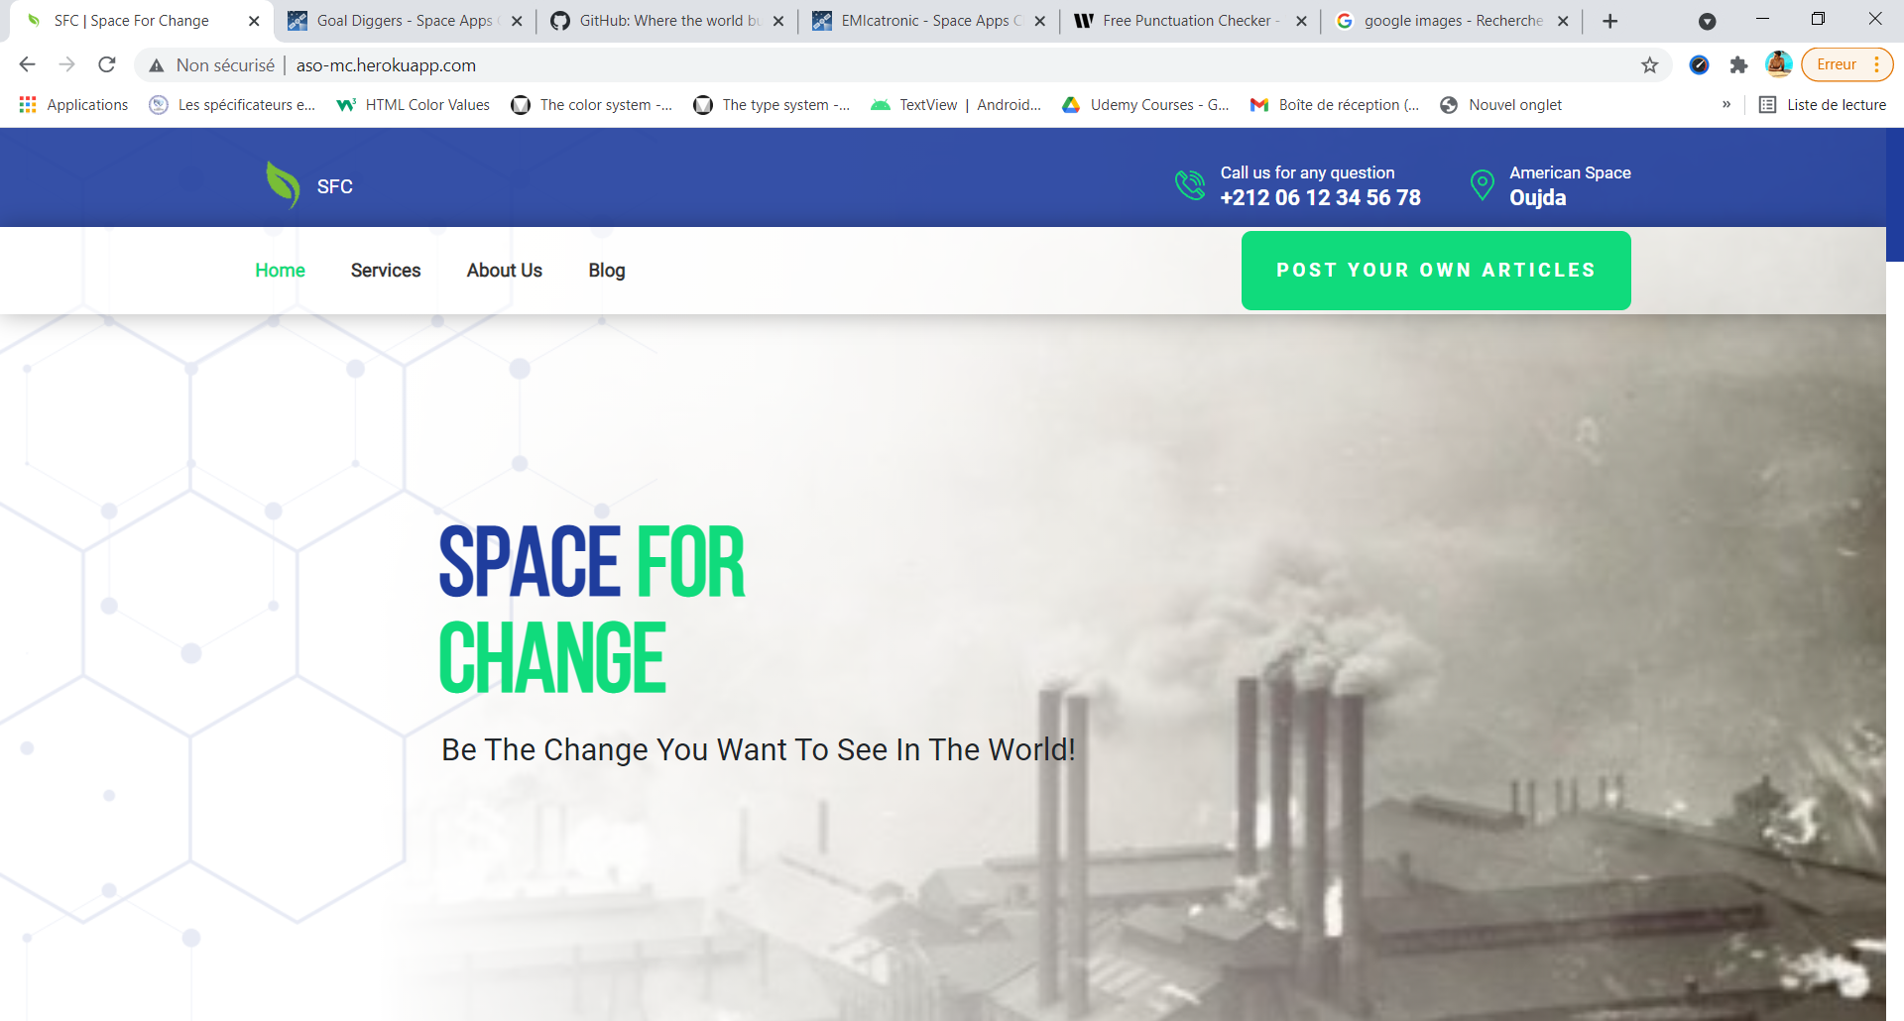
How you can join us and share your thought
http://aso-mc.herokuapp.com/
Check this link
Then, click here

Slide 4
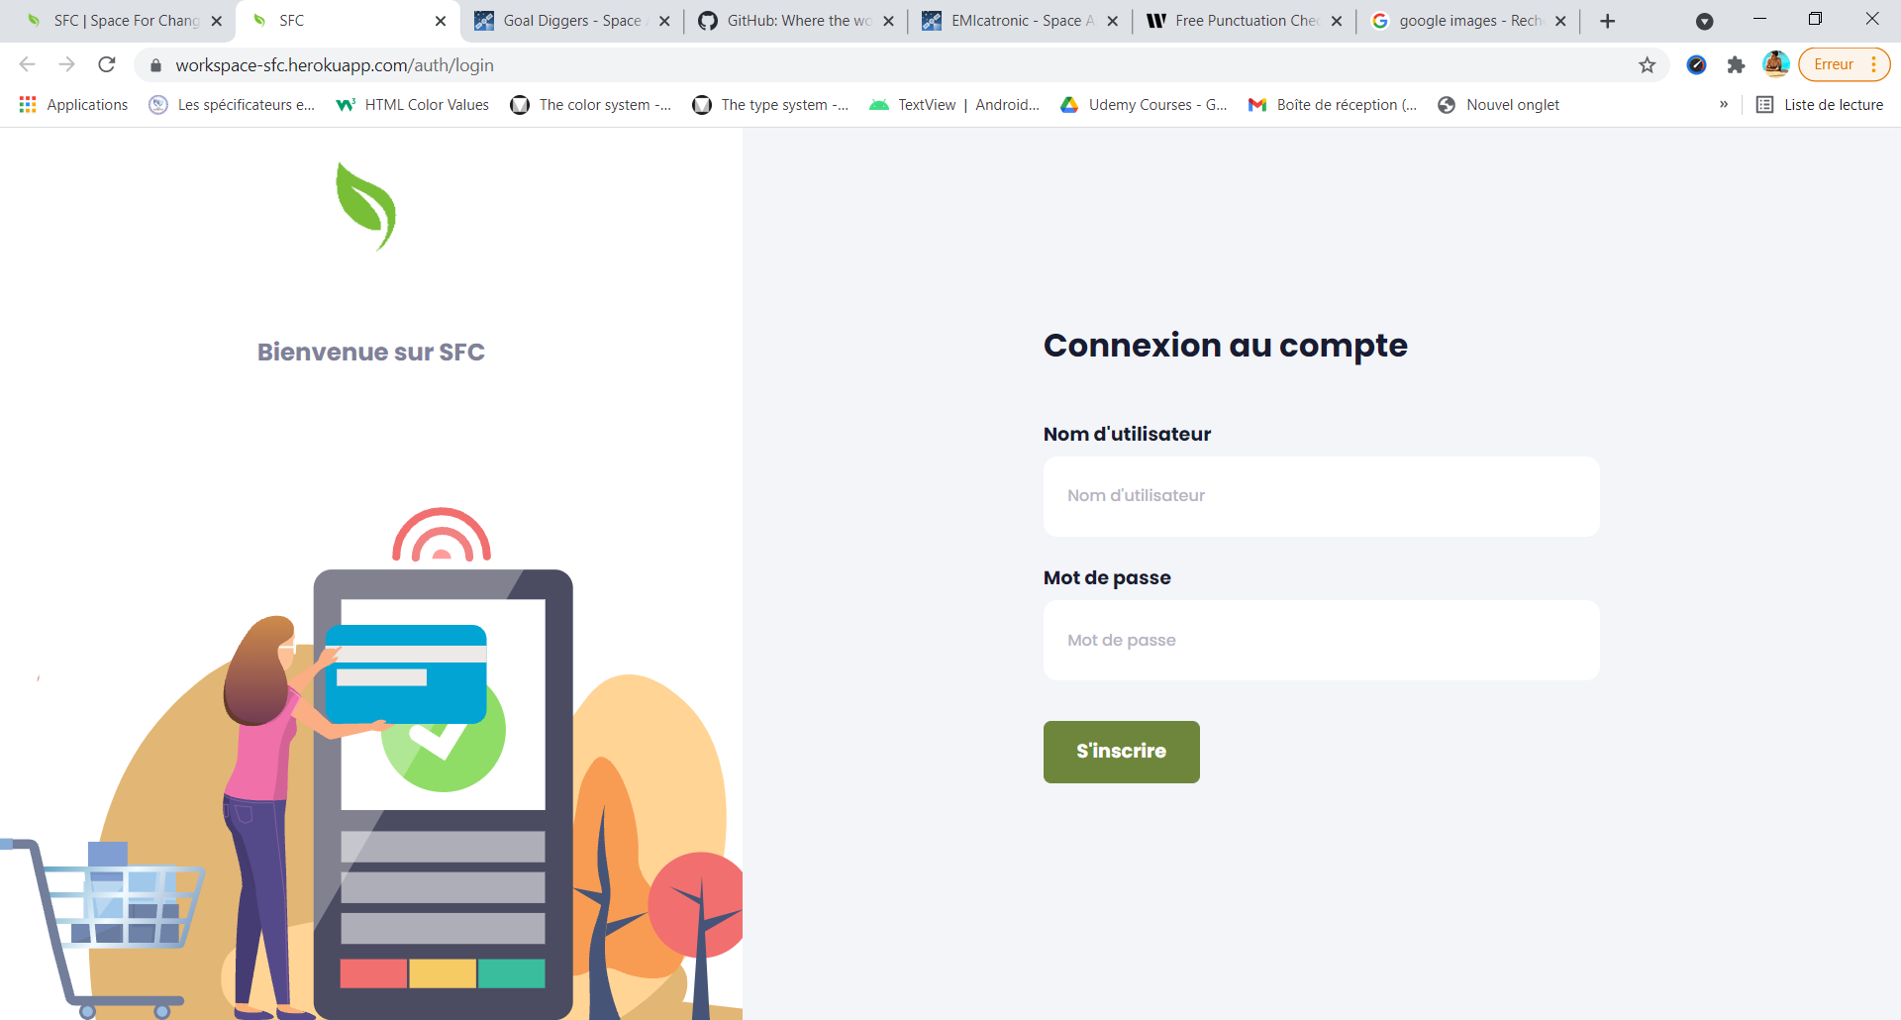
Then, register your account,

Slide 5
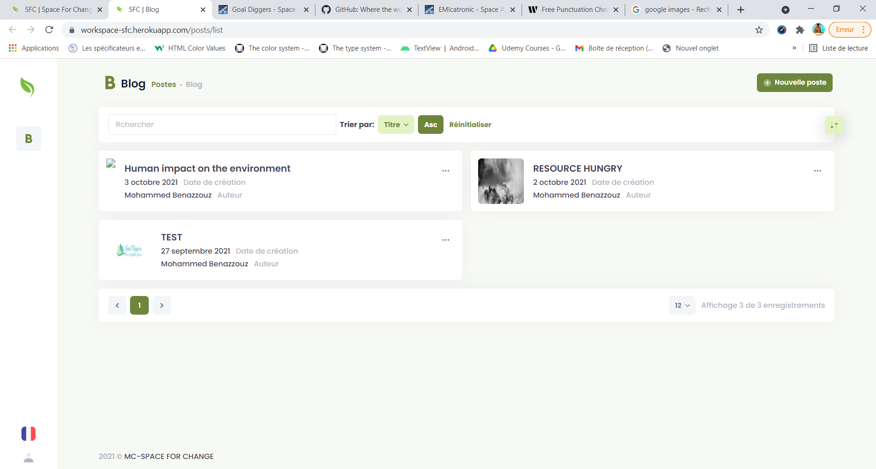
Now, you can poste your from this

