Slide 1

Deep Learning: Convolution Neural Network Trained Autonomous Car using Cheap Hardware Costing Less than $100
Mr. Fakruddin Mohammed

Slide 2
Objectives
The objective of this challenge is to:
Build a Convolution Neural Network model from scratch which identifies the lane direction (forward, left and right) and
Deploy the model onto Raspberry PI board which drives the Robotic car.

Slide 3
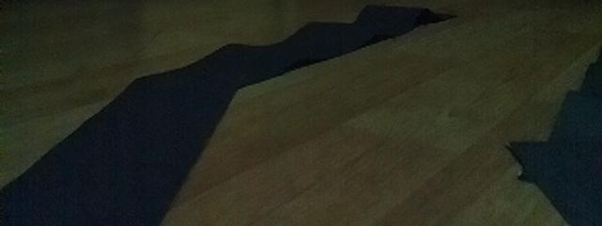
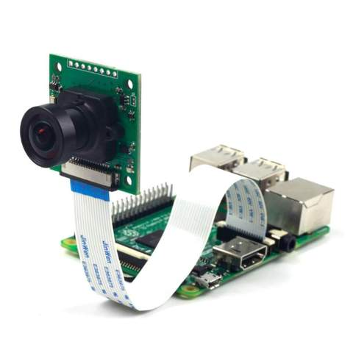
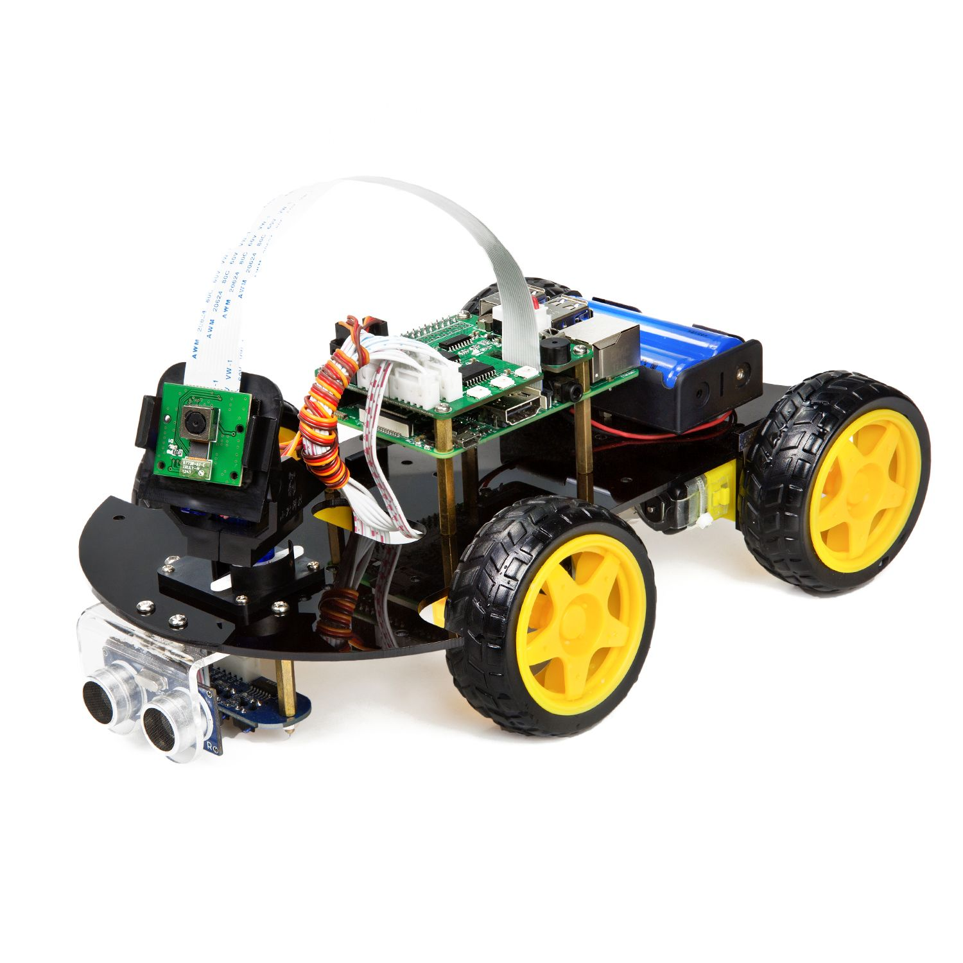
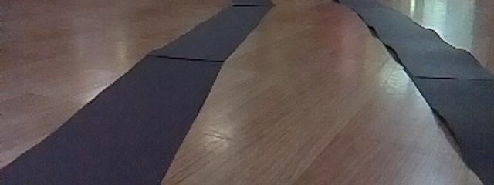
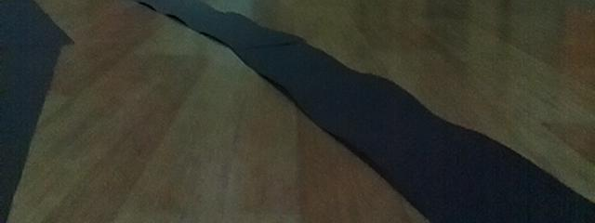
Implementation Architecture
Right
Forward
Driving Control
Left
Deep Learning Model:
Convolution Neural Networks

Slide 4
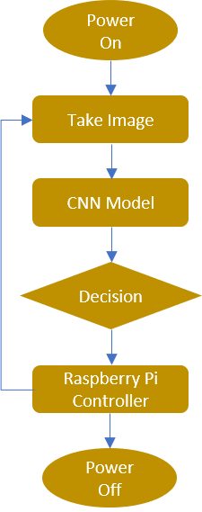
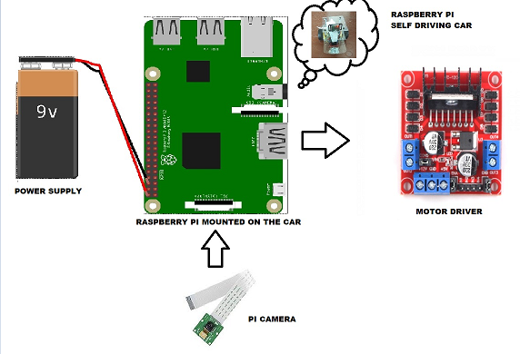
Implementation Architecture

Slide 5
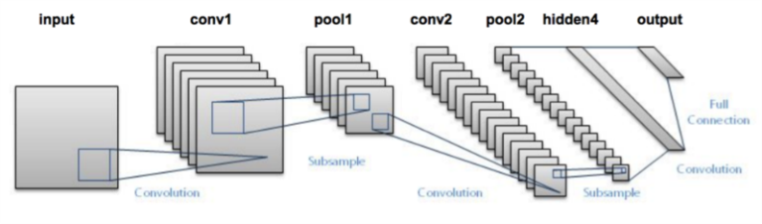
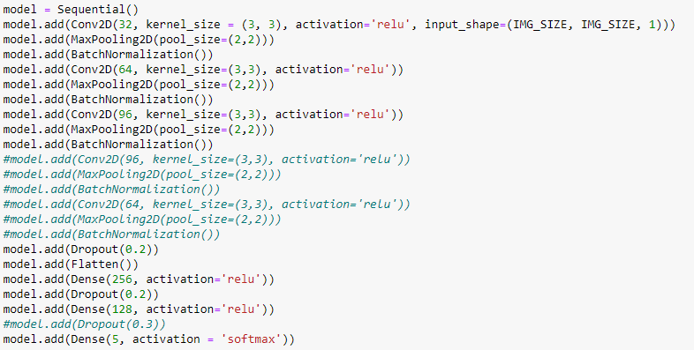
Deep Learning: Convolution Neural Network

Slide 6
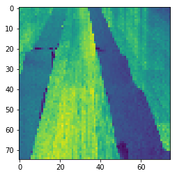
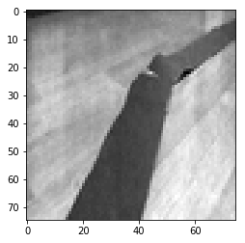
Deep Learning: Convolution Neural Network
Dataset for Training
Image Pixels Size: 75x75
Road Path Images:
Forward : 225
Left : 225
Right : 225
Forward
Right

Slide 7
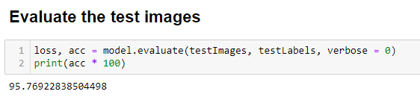
Deep Learning: Convolution Neural Network
Direction Prediction Accuracy – 95%
Right
Forward
Left

Slide 8
Deep Learning: Convolution Neural Network
Demo

Slide 9
Deep Learning: Convolution Neural Network Trained Autonomous Car using Cheap Hardware Costing Less than $100

