Slide 1

Final Project Identification of Foreign Language from Speech
Mr. Fakruddin Mohammed
CSCI E-89 Deep Learning, Spring 2019
Harvard University Extension School
Prof. Zoran B. Djordjević

Slide 2
Motivation
Demand – for Voice and Speech Recognition is coming from every industry vertical with Automotive and Healthcare leading the market, followed by Legal, Education, Government, Military, Consumer and Retail Industries
Trends – PC with keyboard, Laptop with integrated keyboard, Palm computers with qwerty keyboard, touch screen and now the latest trend is voice recognition
Regulations – such as hands free driving
Competition – Enterprises competing towards market edge and Global presence
Market Share – statistics shows the market share of global language services industry in 2018 is 45 billion and is forecasted to rise to 56.2 billion by 2021. The market share of just voice and speech recognition market size is valued at 9.12 billion in 2017

Slide 3
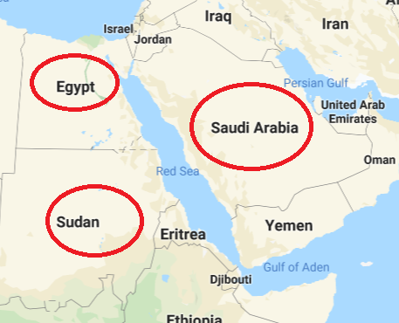
Problem Statement
In my not so extensive literature survey [1][2][3][4], I found that, using the CNN model and using the data set comprises of Chinese, German, French, Spanish and English language speech files, the spoken language is successfully predicted with success rate of 85-92%. In one of the studies [3] where the focus was on just English & French language, the reported accuracy was 98%.
The languages that are chosen in these studies [1][2][3][4] were disparate both in terms of geography/regional, dialect and accent.
Therefore, the goal of the study is to find out, if similar sounding languages in terms of geography/regional, dialect and accent are fed to the CNN model, can it predict the foreign language being spoken with similar accuracy levels that are reported in the literature.
In this study, the chosen foreign languages are:
Arabic
Arabic Egyptian Spoken
Arabic Sudanese Spoken
Using the data set available at the Top Coder website [5] and using Tensorflow/Keras API the CNN model was implemented to test the hypothesis.

Slide 4
Data Set
Data Set
The data set is downloaded from the TopCoder website link:
https://community.topcoder.com/longcontest/?module=ViewProblemStatement&rd=16555&pm=13978
The number of speech files are:
Description | Training Data | Testing Data
No of Languages | 176 | 176 (possibly)
No of Files | 66,176 | 12,320
No of Files/Language | 376 | Unknown
File Format | MP3 | MP3
Duration of Voice Recording | 10 seconds | 10 seconds
Output Labels | Yes | Unknown
Total Data Set Size | 4.5GB | 0.9GB

Slide 5
Software & Hardware Requirements
Software
Python System Libraries
os
shutil
glob
pathlib
Python Audio Processing Library
librosa
Python Data and Plotting Libraries
pandas
numpy
scipy
matplotlib
Imageio
skimage
seaborn
IPython
plotly
tqdm
Python Machine Learning Libraries
sklearn
keras
tensorflow
Hardware
Since the size of the dataset is small, all models including the data pre-processing is carried out on personal laptop of the following configuration.
Mac Air (2017)
2 CPU (quad core)
8GB RAM

Slide 6
Data Set Preview
Data Set for the Problem Statement
Since the problem statement focuses on only three languages, the details of the data set is as follows:
Description | Input Data
No of Languages | 3
No of Files | 1128
No of Files/Language | 376
File Format | MP3
Duration of Voice Recording | 10 seconds
Train/Test Split | 80/20 (902/226)
Chosen Languages | Arabic Arabic Egyptian Arabic Sudanese

Slide 7

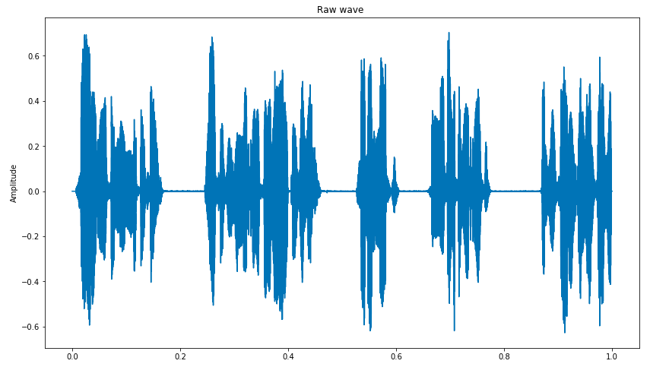
Data Set Preview
Data Set Preview
For one sample audio recording file, the Intensity plots are shown below.
Audio Play
Audio Intensity Plot

Slide 8
End to End Approach
End to End Approach
There are two approaches to the language identification from speech files: Melspectrogram and MFCC. The end to end methodology is described below.
Start
Spectrogram Approach
Step
1
MFCC Approach
Download and Extract Languages of Interest
Step
2
Step
2
Calculate Specrtogram
Calculate MFCC
Step
3
Step
3
Run Model
Run Model
Analyse & Conclude Results

Slide 9
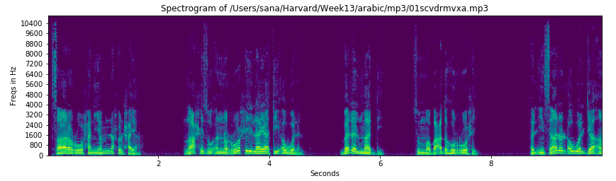
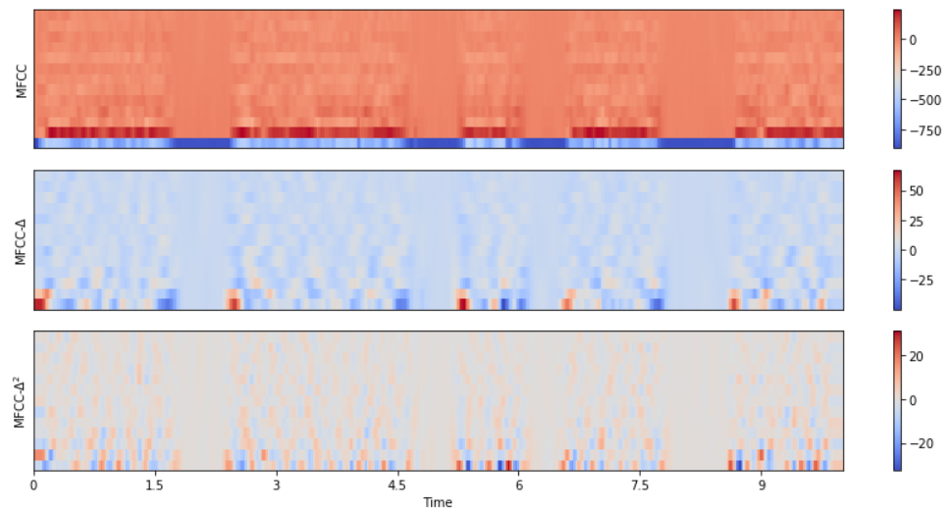
End to End Approach
End to End Approach
Spectrogram: is a visual representation of signal strength over a period of time at various frequencies. Even though it is 2D plot (Time Vs Frequency), the 3rd dimension is amplitude/loudness/strength at a particular frequency.
MFCC: is a representation of the short term spectrum of sound, based on linear cosine transformation of log power spectrum on non-linear Mel scale of frequency.

Slide 10
CNN Model Architecture
RELU
32
64
128
2x2
128
(0.25)
64
(0.4)
3
image
Convolution
Max Pool
Dense

Slide 11
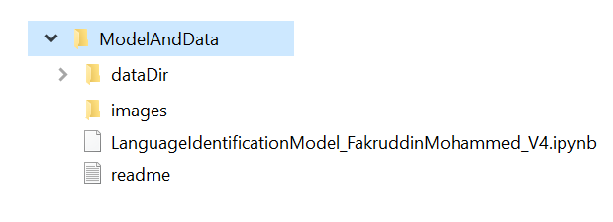
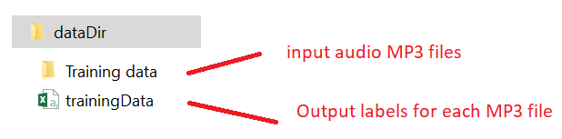
End to End Approach (Using Tiny Sample Data)
Step – 1: Using the tiny sample data that comes with this Jupyter notebook
If you decided to use the tiny sample data that comes with this jupyter notebook, then simply extract the contents of the “ModelAndZip” to a folder.
After the extract your directory structure should look like the below.
Start
Step
1
Download and Extract
Languages of Interest
The ‘dataDir’ folder has the input audio speech files along with the output labels.
From within this folder, start the jupyter notebook

Slide 12
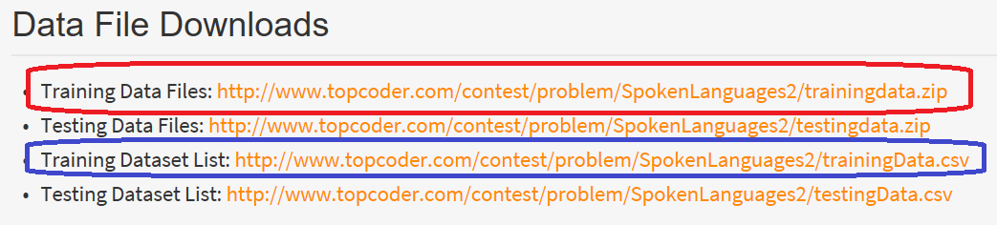
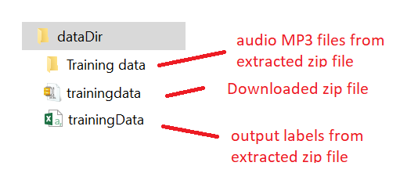
End to End Approach (Actual Data from Website)
Step – 1: Download and Extract Languages of Interest
Step 1.1: Link to website
Start
https://community.topcoder.com/longcontest/?module=ViewProblemStatement&rd=16555&compid=49304
Step
1
Download and Extract
Languages of Interest
Step 1.2: The files to be downloaded from website
Manual Step
Step 1.3: Extract the contents of the above zip file into the following directory structure:
Manual Step

Slide 13
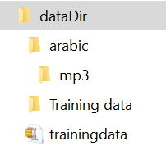
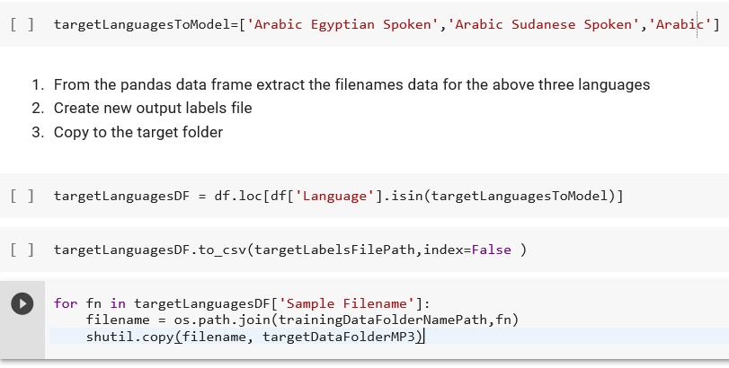
End to End Approach
Step – 1: Download and Extract Languages of Interest
Step 1.4: Copy the three languages to the target folder ‘arabic’.
Note: After the copy, the ‘dataDir’ directory should look like as shown in the adjacent figure

Slide 14
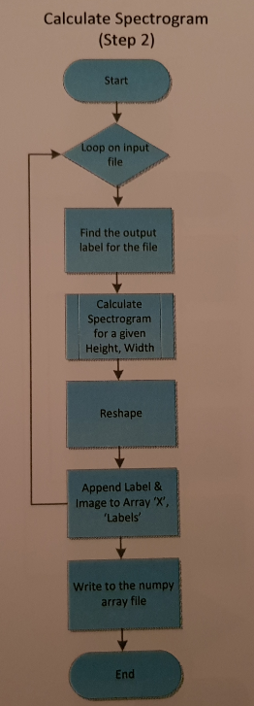
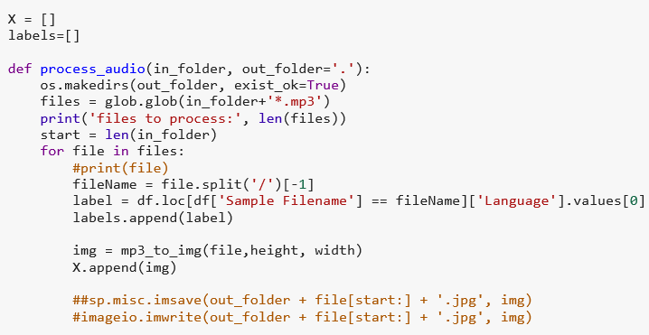
Melspectrogram Approach (Step 2)
Melspectrogram – Approach
Step-2 Calculate SpectrogramThere are two approaches to the language identification from speech files: Melspectrogram and MFCC. The end to end methodology is described below.
Start
Download and Extract Languages of Interest
Step
2
Calculate spectrogram

Slide 15
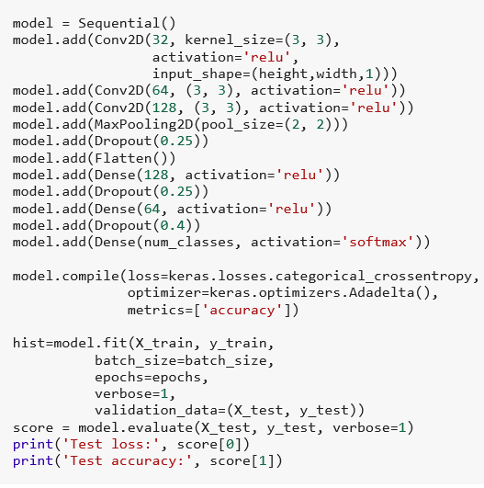
Melspectrogram Approach (Step 3)
Step-3 Run Model.
Start
Download and Extract Languages of Interest
Step
2
Calculate spectrogram
Step
3
Run Model

Slide 16
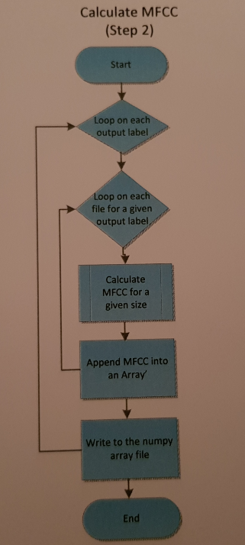
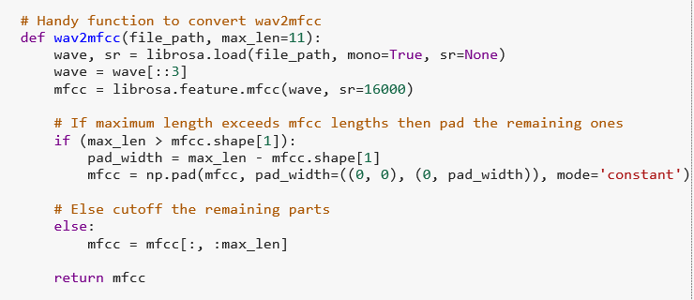
MFCC Approach
Step-2: Calculate MFCC
Start
Step
1
Download and Extract Languages of Interest
Step
2
Calculate MFCC
Run Model

Slide 17
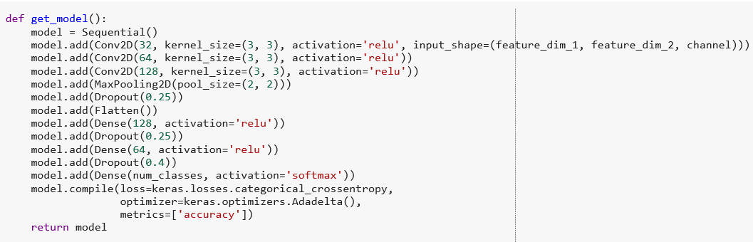
MFCC Approach (Step 3)
Start
Step-2: Calculate MFCC
Step
1
Download and Extract Languages of Interest
Step
2
Calculate MFCC
Step
3
Run Model

Slide 18
Experiments
Data Set | Train/Test Samples | Technique | Accuracy
Without Augmentation | 902/226 | Spectrogram(32x32)
Without Augmentation | 902/226 | Spectrogram(64x64)
Without Augmentation | 902/226 | MFCC (11)
Without Augmentation | 902/226 | MFCC (24)
Without Augmentation | 902/226 | MFCC (32)

Slide 19
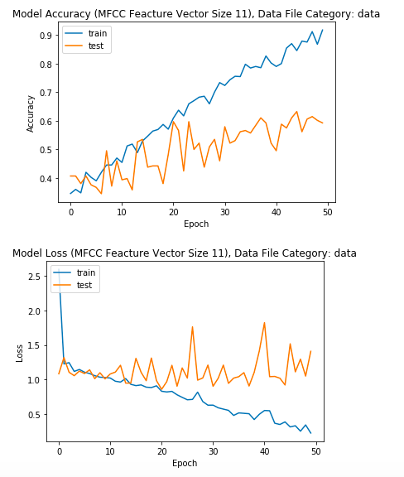
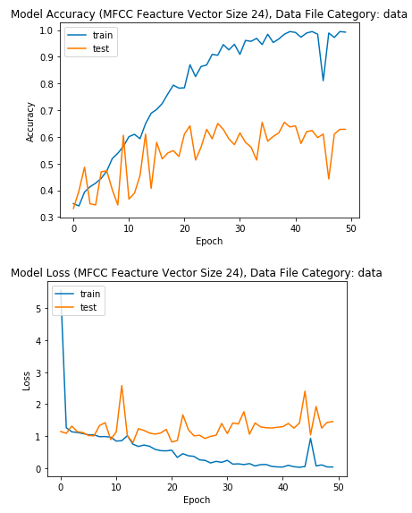
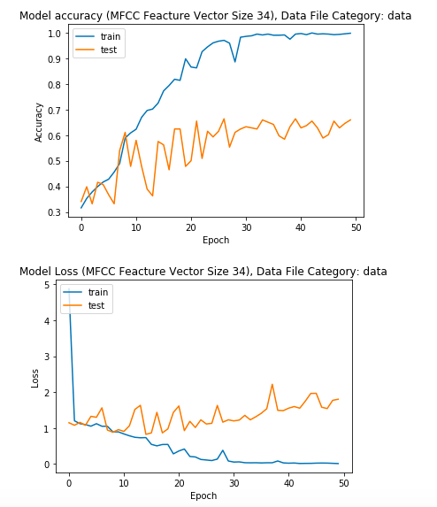
MFCC Approach without Data Augmentation
Vector sizes: 11, 24 and 32
Key Observation: Accuracy around 60%

Slide 20
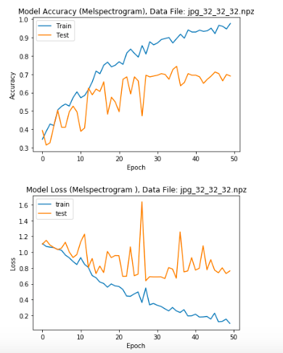
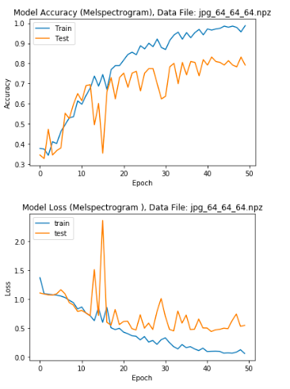
Spectrogram Approach without Data Augmentation
Spectrogram Image Size: 32x32 and 64x64
Key Observation: Accuracy around 70-80%

Slide 21
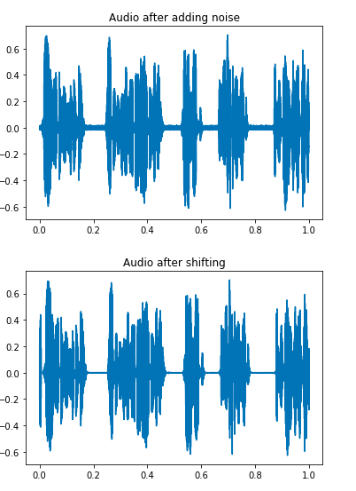
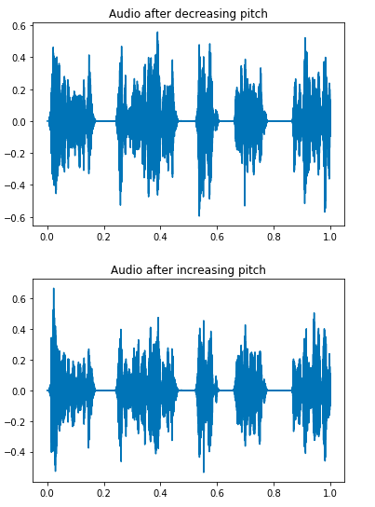
Data Augmentation Techniques
Data Set Preview (Noisy/Shifted/Pitch)

Slide 22
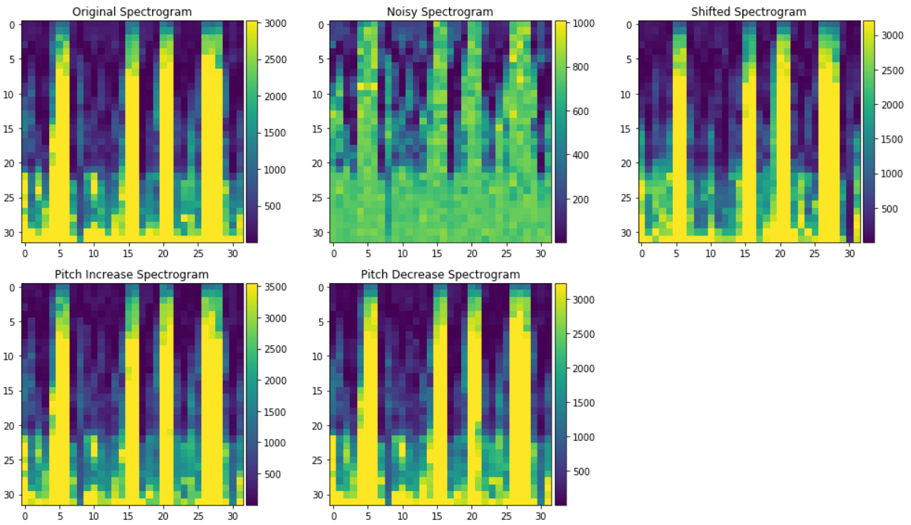
Data Augmentation Techniques
Spectrogram with Data Augmentation (Noisy/Shift/Pitch Increase/Decrease)

Slide 23
Experiments
Data Set | Train/Test Samples | Technique | Accuracy
Without Augmentation | 902/226 | Spectrogram(32x32)
Without Augmentation | 902/226 | Spectrogram(64x64)
Without Augmentation | 902/226 | MFCC (11)
Without Augmentation | 902/226 | MFCC (24)
Without Augmentation | 902/226 | MFCC (32)
With Augmentation | 4512/1128 | Spectrogram(32x32)
With Augmentation | 4512/1128 | Spectrogram(64x64)
With Augmentation | 4512/1128 | MFCC (11)
With Augmentation | 4512/1128 | MFCC (24)
With Augmentation | 4512/1128 | MFCC (32)

Slide 24
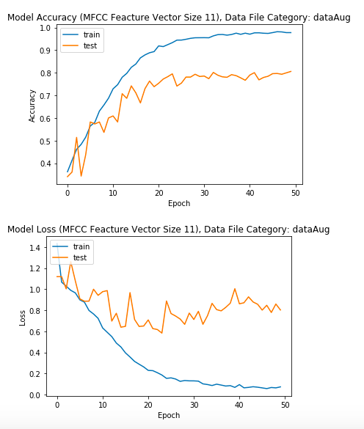
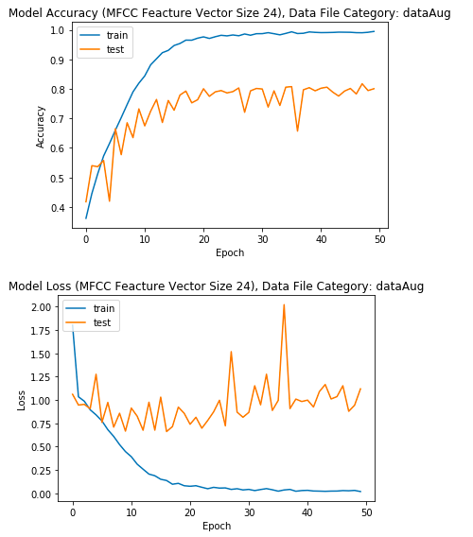
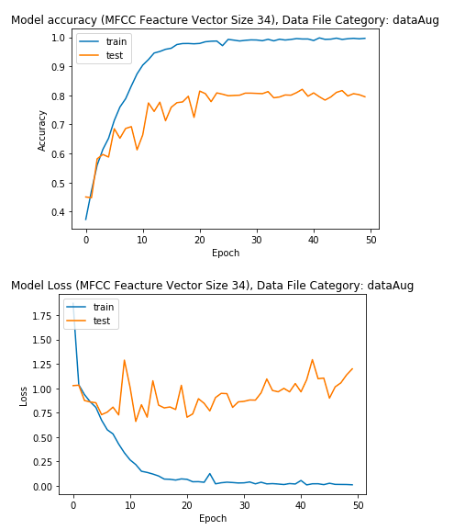
MFCC Approach with Data Augmentation
Mel Frequency Cepstral Coefficient Approach – without Data Augmentation
Vector sizes: 11, 24 and 32
Key Observation: Accuracy around 80%

Slide 25
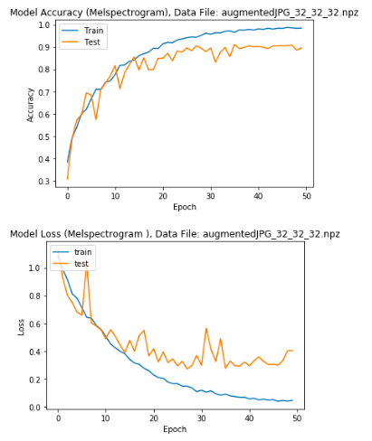
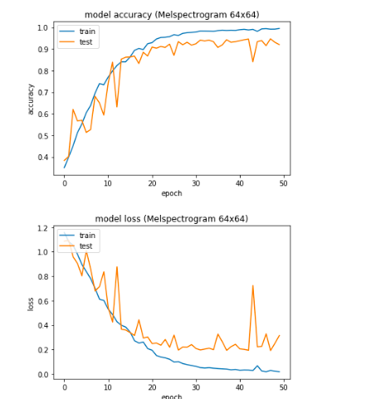
Spectrogram Approach with Data Augmentation
Spectrogram Image Size: 32x32 and 64x64
Key Observation: Accuracy around 90%

Slide 26
Results Summary
Technique | Accuracy without Data Aug (Train/Test: 902/226) | Accuracy with Data Aug. (Train/Test: 4512/1128)
Spectrogram 32x32 | 0.702 | 0.906
Spectrogram 64x64 | 0.802 | 0.905
MFCC Vector Size: 11 | 0.610 | 0.826
MFCC Vector Size: 24 | 0.605 | 0.811
MFCC Vector Size: 32 | 0.616 | 0.827

Slide 27
Conclusions
The CNN model found to be effective in predicting the foreign language from speech file with accuracies of around 90% even if the input audio data is similar in terms of dialect and accuracy.
The results show foreign language identification using the Spectrogram technique is much more effective than MFCC approach
As the sample size increases, increasing the size of the spectrogram or MFCC vector sizes had a very little impact on improving the model accuracy
When the input sample are limited, then relying on data augmentation techniques is extremely useful tool and in this study the data augmentation techniques helped to boost the model performance by 10%.

Slide 28
Lessons Learnt
The input sample size for the selected three language are 1128 files and total size of 88M. When the sample size increased with data augmentation to 5640 files and total size was 4.8GB. I had significant memory issues during the model execution, therefore, I converted each audio recording file to numpy array (spectrogram) and wrote to the disk. This approach significantly reduced the memory requirements from 4.8GB to 46MB.

Slide 29
Next Steps
Even with the data augmentation, the accuracy of the model is around 91%. Therefore, I want to explore the other architectures of CNN like increasing the number of layers and with varied sizes of nodes and kernel sizes.
Experiment with data augmentation techniques to generate more samples, to check if the accuracy limitations are due to sample size.
Test the model with k-fold cross validation, to test the model stability in predicting the language.
Explore the language prediction using RNN/LSTM model, as the meaning/interpretation of the words being spoken is dependent on the contact and RNN models are best suited to time series.
It appears the recordings are done in the controlled environment as the speaker voice is monotone not reflecting the ordinary speech or not reflecting how the languages are actually spoken. Therefore, I would like to audio recordings from variety of sources and test the models.
The literature survey reveals that, in addition to MFCC, using their 1st and 2nd derivatives as feature vectors improves the model performance. Therefore, I would like to explore this idea further.
I would like to conduct the language identification model testing on the whole data set of 373 languages with 66176 files to check if the model performance stays at 90% accuracy or deteriorates when the number of output class labels increases.

Slide 30
References
[1] Language Detection from Speech: Chinese or English?, Tianlong Song Tags Machine Learning Natural Language Processing; Sun 15 Oct 2017 ; https://stlong0521.github.io/20171015%20-%20Language%20Detection.html; https://github.com/stlong0521/language-detector
[2] Automatic spoken language identification (English, German, Spanish, French) identification using voxfrge dataset,Thomas Werkmeister; https://github.com/twerkmeister/iLID
[3] Spoken Language Classification, (German, Italian, Engligh and French) Julien De Mori, Misrab Faizullah-Khan, Cameron Holt, Shahriyar Pruisken; Autumn 1012; http://cs229.stanford.edu/proj2012/DeMoriFaizullahKhanHoltPruisken-SpokenLanguageClassification.pdf
[4] Practical Application of Multimedia Retrieval, (English, German, Spanish, French), Tom Herold, Thomas Werkmeister, https://github.com/twerkmeister/iLID/blob/master/Deep%20Audio%20Paper%20Thomas%20Werkmeister%2C%20Tom%20Herold.pdf Data set: https://community.topcoder.com/longcontest/?module=ViewProblemStatement&rd=16555&compid=49304
[5] Data augmentation of audio data: https://www.kaggle.com/CVxTz/audio-data-augmentation
[6] A Review of Audio Features and Statistical Models Exploited for Voice Pattern Design, Ngoc Q. K. Duong and Hien-Thanh Duong, https://arxiv.org/abs/1502.06811, 24th Feb 2015. Giannakopoulos T (2015) pyAudioAnalysis: An Open-Source Python Library for Audio Signal Analysis. PLoS ONE 10(12): e0144610. doi:10.1371/ journal.pone.0144610
[7] Deep Learning Lectures by Prof. Zoran B Djordjevic, Harvard University Extension School.

Slide 31
YouTube URLs, Last Page
Two minute (short): https://youtu.be/8jNt1EIKpxc
15 minutes (long):https://youtu.be/FFq7wMZ5fnY

