Slide 1

Final Project Text Similarity for Fund Objectives
Fakruddin Mohammed
ISMT E-117 Text Analytics and Natural Language Processing, Fall 2019
Harvard University Extension School
Richard E. Joltes

Slide 2

Hypothesis
High Returns
Emerging Markets
Capital Appreciation
Equity Markets
Investor Objectives
Tax Exemptions
Govt Bonds
Investor
Advisor

Slide 3
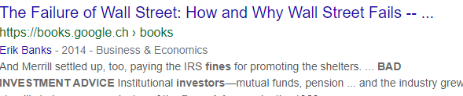


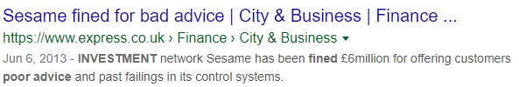
The Issues with Objectives Translation

Slide 4
The Potential for Error is Increasing
Per Statista.com in 2018: 9,599 Mutual Funds Available in the United States Alone.
Sources:
Number of Funds: https://www.statista.com/statistics/255590/number-of-mutual-fund-companies-in-the-united-states/
History of Mutual Funds: https://www.investopedia.com/articles/mutualfund/05/mfhistory.asp

Slide 5
How can an investor find a fund to meet their objectives?
In most countries, each mutual fund is required to publish a Prospectus.
Each prospectus specifies the fund’s investment objective.
A prospectus is a legally binding contract. This makes the language formal and verbose.

Slide 6
Examples
California Tax-Free Money Fund
Objective: The fund seeks to provide preservation of capital, liquidity and, consistent with these objectives, the highest level of income exempt from federal and California state income taxes.
Balanced Fund
Objective: The fund seeks to provide capital growth, current income, and preservation of capital through a portfolio of stocks and fixed-income securities.
International Bond Fund
Objective: The fund seeks to provide current income and capital appreciation.
Examples are from From T. Rowe Price’s website (https://www.troweprice.com/personal-investing/tools/fund-research/)

Slide 7
Solution
LSE
FO
www.the
.com
Fund Objectives Linguistic Search Engine

Slide 8
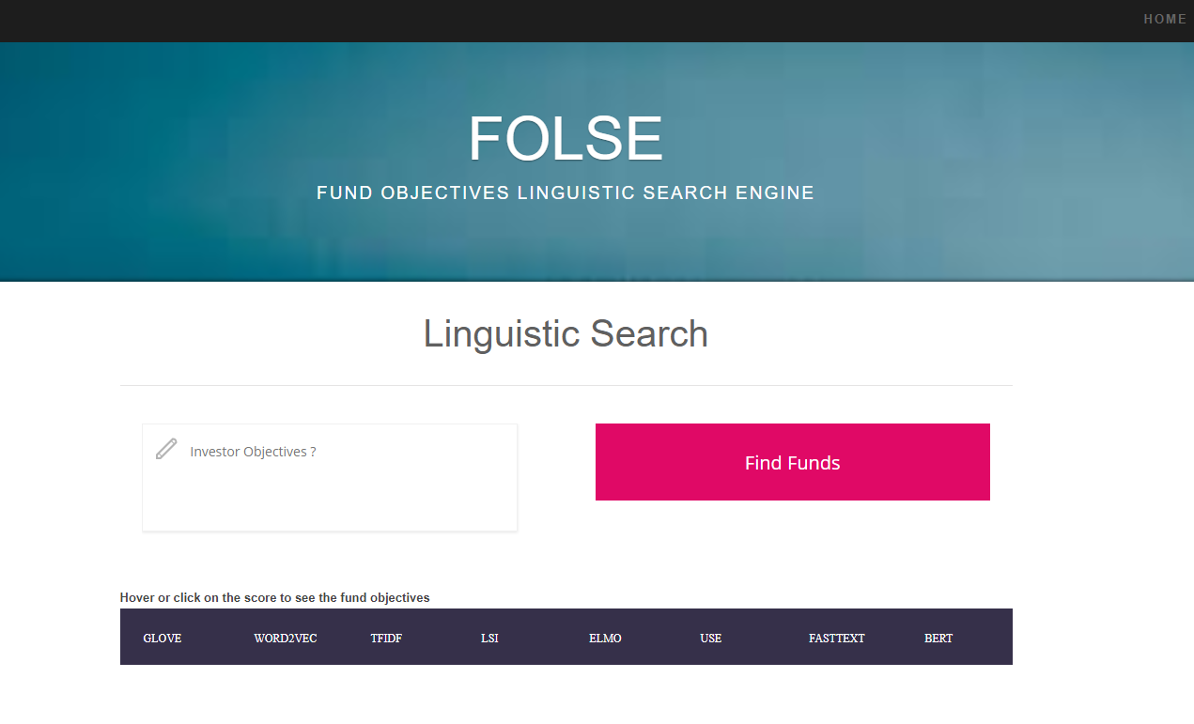
Solution

Slide 9
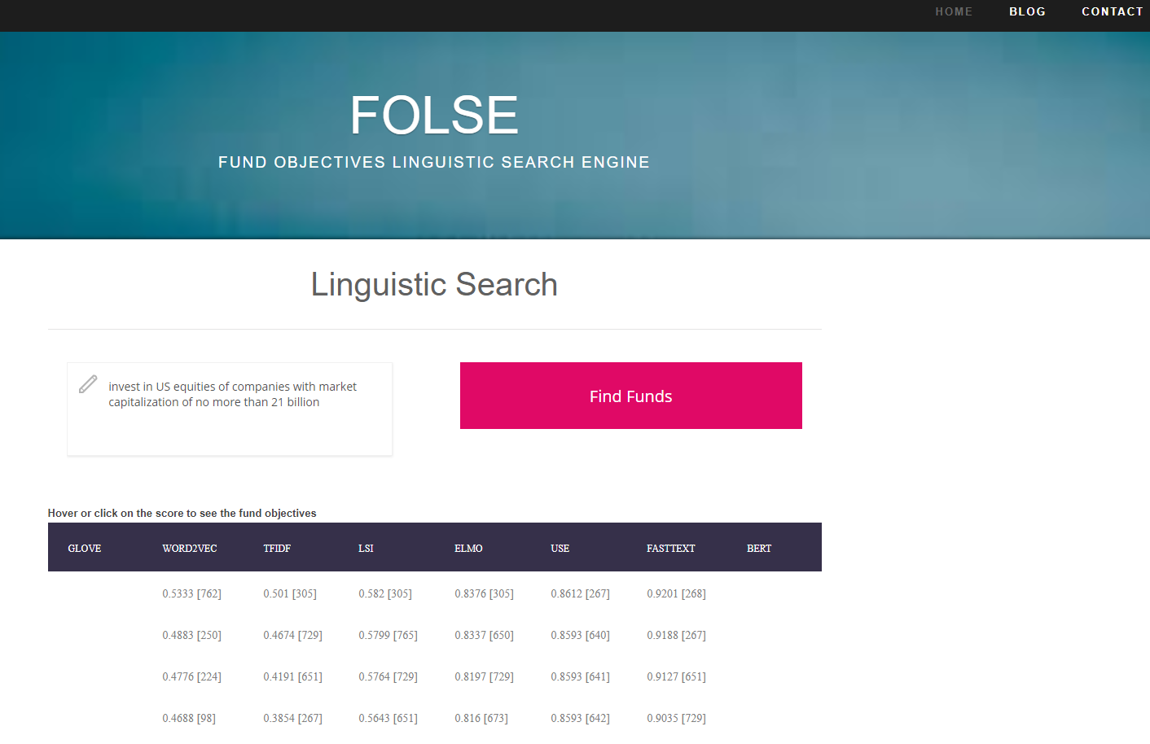
Solution

Slide 10
Software & Hardware
Software | Hardware
Python 3.6 | AWS EC2 Instance (8GB RAM/m2.large) to host website and run all NLP models (except Glove & Bert)
Flask Framework | Google Colab for Glove*
NLTK | Laptop – 8GB RAM for Bert*
Spacy
Gensim
Tenorflow 1.14, Tensorflow Hub
Scikit Learn
Matplotlib
Beautifulsoup 4
Other Misc Python Scientific Libraries
* Models not integrated on AWS due to installation & networking issues

Slide 11
Software & Hardware
Requirements.txt file for python libraries
pip3 install flask pip3 install requests pip3 install gensim pip3 install nltk pip3 install spacy pip3 install matplotlib pip3 install pandas pip3 install absl-py pip3 install tensorflow==1.14 pip3 install tensorflow-hub pip3 install bert-serving-server pip3 install bert-serving-client Pip3 install python-glove pip3 install seaborn pip3 install sklearn

Slide 12
Data Sourcing
CapitalGroup Website
Ishares Website
ISIN or CUSIO (identifier)
Fund Name
Fund Objective
TrustNetOffshore Website
Beautifulsoup
Extracted Data
MoneyUSNews Website
MarketWatch Website
YahooFinance Website
https://www.capitalgroup.com/individual/investments/prospectuses-and-reports.htm
https://www.ishares.com/us/products/etf-investments#!type=ishares&style=All&view=keyFacts
https://www.trustnetoffshore.com/Investments/Perf.aspx?univ=DC
https://money.usnews.com/funds/search?name=
https://www.marketwatch.com/tools/markets/funds/a-z
https://finance.yahoo.com/screener/predefined/top_mutual_funds?offset=0&count=1000

Slide 13
Data Sourcing
ISIN | Fund Name | Objective
LU1808993080 | AB Financial Credit Portfolio A2 USD | Seeks to maximize total returns through current income and capital appreciation by Investing primarily in the financial credit sector globally including banks, insurance and other finance companies Focusing on subordinated debt securities of the financial credit sector including contingent convertible bonds (“CoCos”) and preferred shares which may be rated Investment Grade or below Investment Grade.
LU0689625282 | AB FCP I - Short Duration Bond Portfolio | Seeks high total investment return by investing in a global portfolio of short-duration investment grade, fixed-income securities, Hedging non-US dollar-denominated positions to US dollars to minimize the risks of currency fluctuations, Drawing on a large global team to evaluate the top-down factors influencing markets as well as the bottom-up factors affecting bond prices.
LU0289939786 | AB Eurozone Equity Portfolio | Seeks long-term capital growth by Investing in stocks across the Eurozone that offer compelling long-term return potential and attractive valuations, Taking a long-term perspective in order to capitalize on short-term market inefficiencies created by investors’ overreaction to macroeconomic, industry, or company-specific concerns, Employing a disciplined, bottom-up approach that combines fundamental research with proprietary quantitative tools to identify attractive investment opportunities.
LU0539801802 | AB European Income Portfolio | Seeks high total return by maximizing current income and achieving capital appreciation by Maintaining a diversified portfolio of investment grade and non-investment grade fixed-income securities issued by European companies and governments, with flexibility to invest in some non-European issuers. Investing predominantly in Euro or European currency-denominated securities. Dynamically balancing higher-yielding Euro fixed-income assets with lower risk government bonds to generate yield from diverse sources. Employing a multi-sector approach in search of the best opportunities.

Slide 14
Data Pre-Processing
Total Number of Fund Objectives Documents | 771
Total Word Count | 31637
Total Word Count after Removal of Stops | 17996
Min Fund Objective Length (words) | 37
Max Fund Objective Length (words) | 679

Slide 15
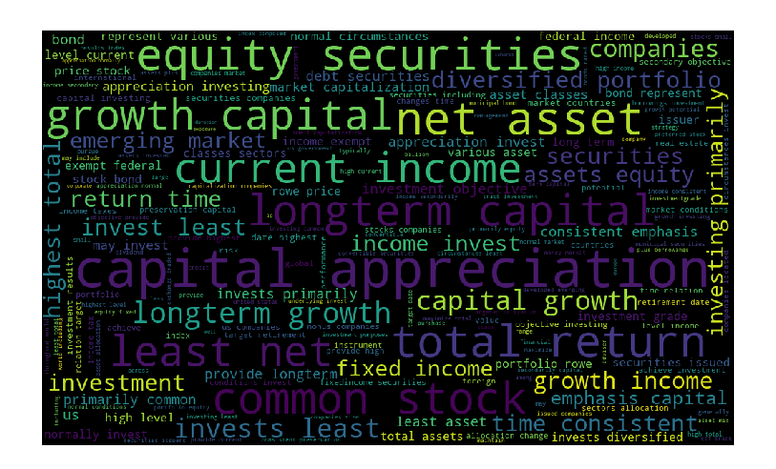
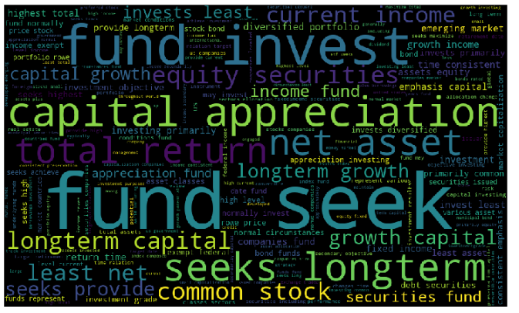
Data - Visualization
With Custom Stop Words Removal (Fund, Seek etc.)

Slide 16
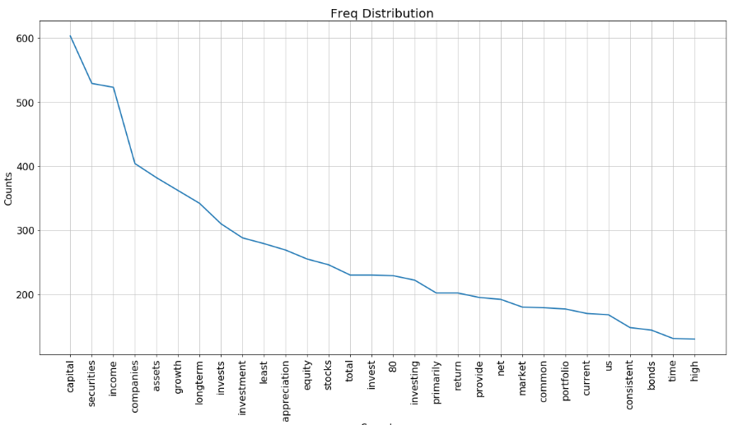
Data - Visualization

Slide 17
Data Pre-Processing
Start
Remove Punctuations
Loop on Fund Objectives
Convert to Lower
Split Fund Objective into Sentences
Remove Stops
Sentences into Tokens
Lemmatize

Slide 18



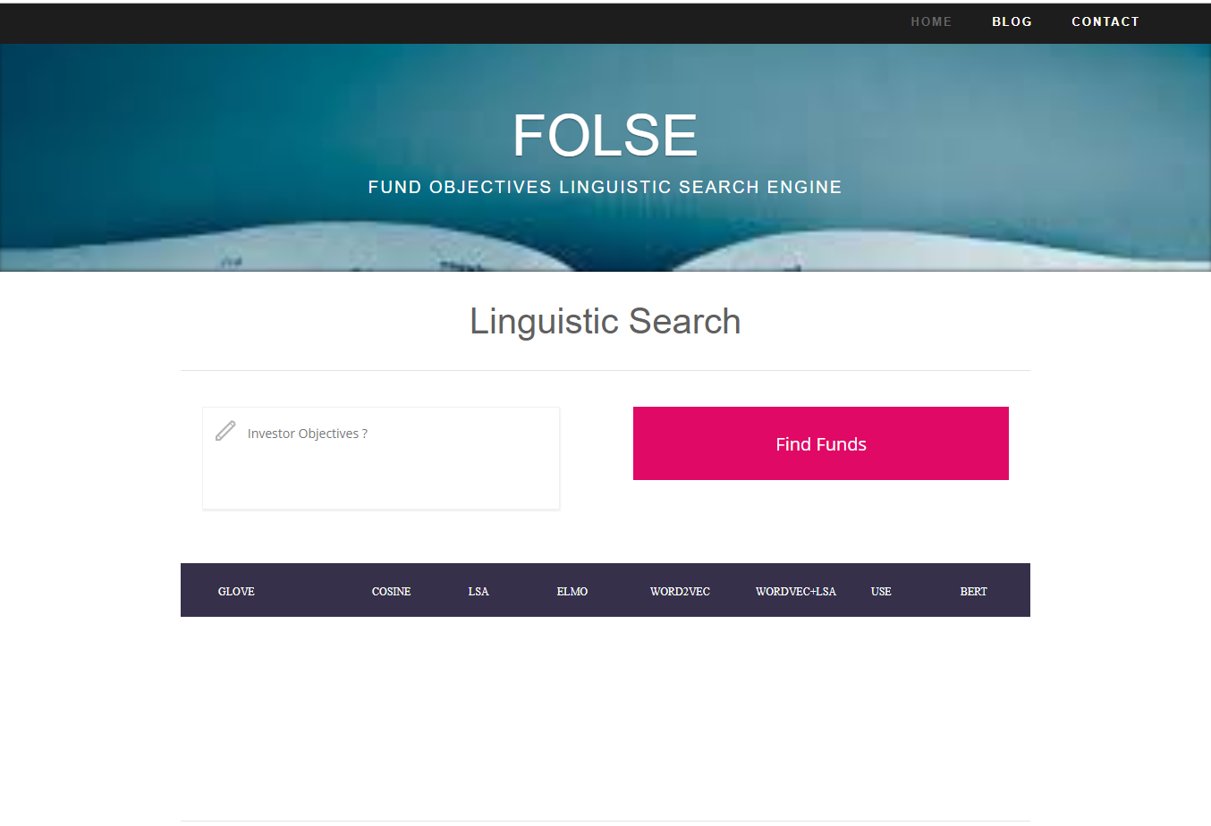
System Overview – NLP Pipeline
Fund Objectives Documents
Beautifulsoup
Glove
Websites
Word2Vec
TFIDF
Python Flask Web Framework
Investor Objective
Pre-processing
LSI
ELMO
FOLSE Website
USE
Deployed on AWS Cloud
FastText
BERT
Text Similarity Models

Slide 19
NLP Models
Model | Implementation Details
Word2Vec | Gensim Library
TFIDF | Gensim Library
TFIDF/LSI | Gensim Library
ELMO | Pre-trained model; Tensorflow
USE | Pre-trained model; Tensorflow
FastText | Gemsim Library
BERT | Yet to integrate on AWS
GLOVE | Yet to integrate on AWS
 | Word2Vec | TFIDF | TFIDF/LSI | ELMO | USE | FastText
Vector Sizes | 60 | 771x1465 | 771x25 | 1024 | 512 | 60
Window Sizes | 5 | - | - | - | - | 40

Slide 20
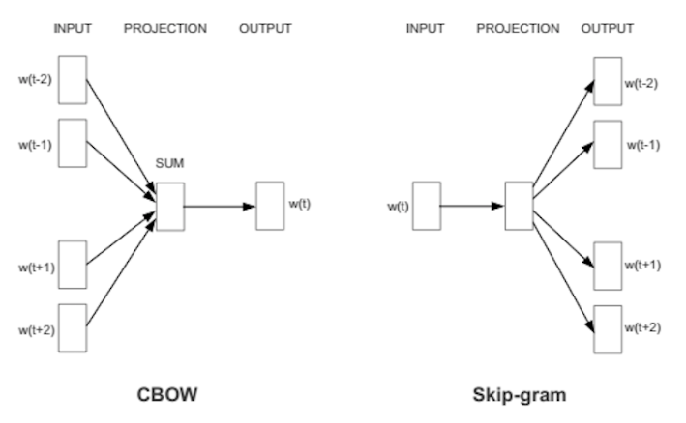
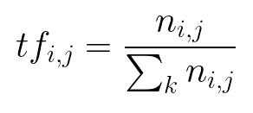
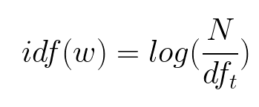
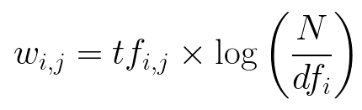
NLP Models
Word2Vec Model
TFIDF
TFIDF/LSI
It is essentially applying the SVD on TF/IDF weights
TFIDF Weight Matrix Size is: 771x1465
SVD Size is 25x25; which gives left hand and right hand size of the LSI is 771x25; 25x1465
Image source: https://israelg99.github.io/2017-03-23-Word2Vec-Explained/

Slide 21
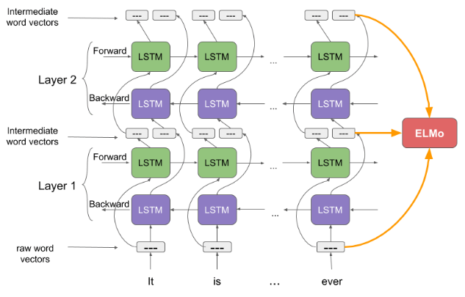
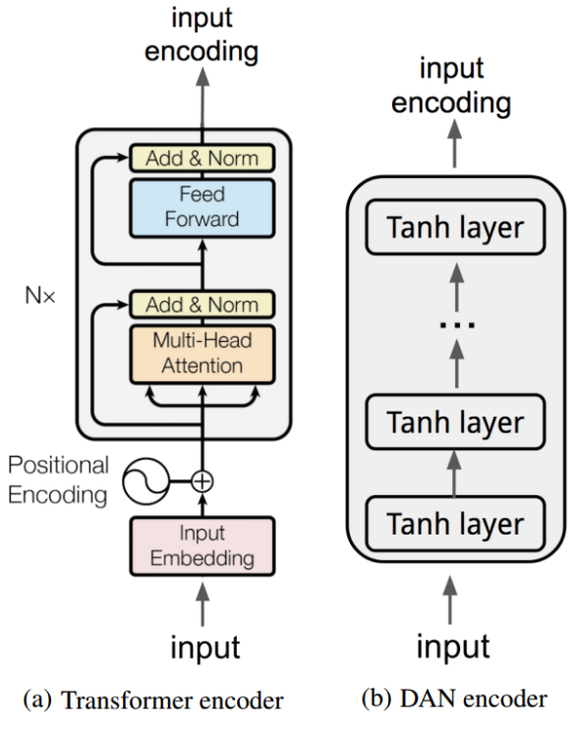
NLP Models
ELMO Model
Universal Sentence Encoder
FastText
Image source:
https://www.analyticsvidhya.com/blog/2019/03/learn-to-use-elmo-to-extract-features-from-text/
https://www.dlology.com/blog/keras-meets-universal-sentence-encoder-transfer-learning-for-text-data/

Slide 22
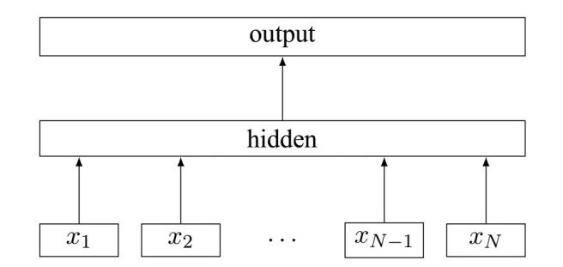
NLP Models
FastText Model
sentences: the list of split sentences.
size: the dimensionality of the embedding vector
window: the number of context words you are looking at
min_count: tells the model to ignore words with total count less than this number.
workers: the number of threads being used
sg: whether to use skip-gram or CBOW
Image Source:
https://www.google.com/search?q=universal+sentence+encoder+diagram&rlz=1C1CHZL_enCH847CH847&sxsrf=ACYBGNR0u0VtugmruV_4VYXWzTfjRO5lLw:1576273965095&tbm=isch&source=iu&ictx=1&fir=Ts_UAF0l4iwkxM%253A%252CQqrRuJDQSddLFM%252C_&vet=1&usg=AI4_-kR5gtx6hT4bcmCCzUB1Ak77F1C3Uw&sa=X&ved=2ahUKEwiKhYiOzrPmAhXRwqYKHX5vBLcQ9QEwAnoECAkQBg#imgdii=DRABE7rMSdv-FM:&imgrc=42a4sup3ZtfWdM:&vet=1

Slide 23
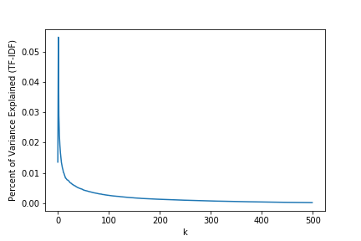
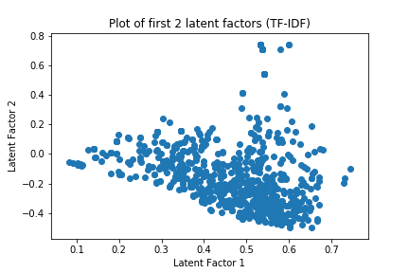
NLP Model – TFIDF/LSI
TF-IDF/LSI

Slide 24
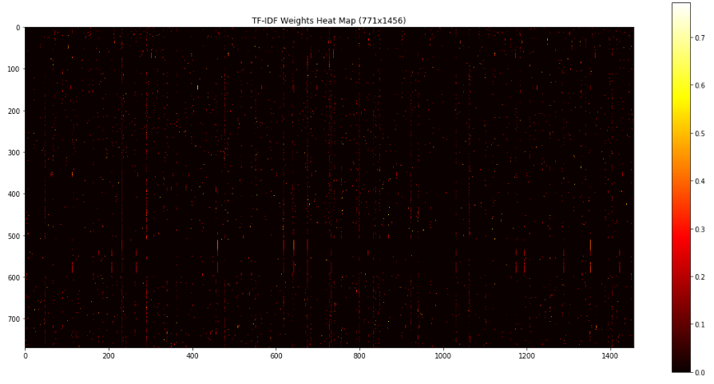
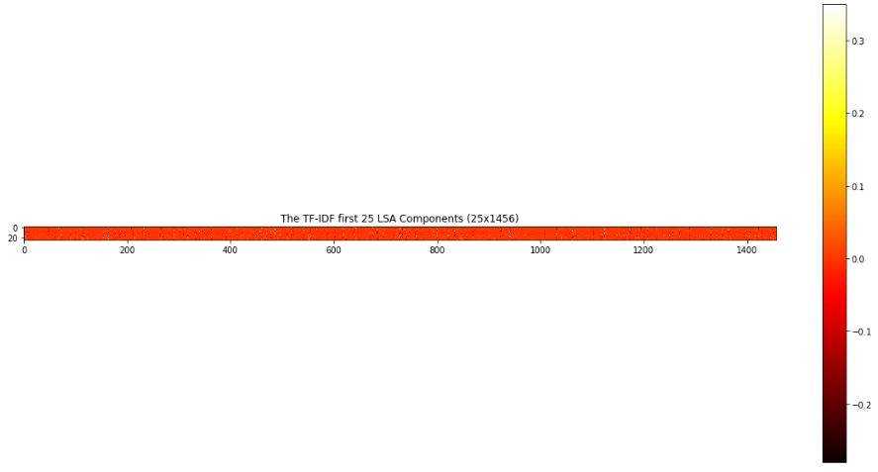
NLP Model – TFIDF/LSI
TF-IDF/LSA - Heatmap

Slide 25
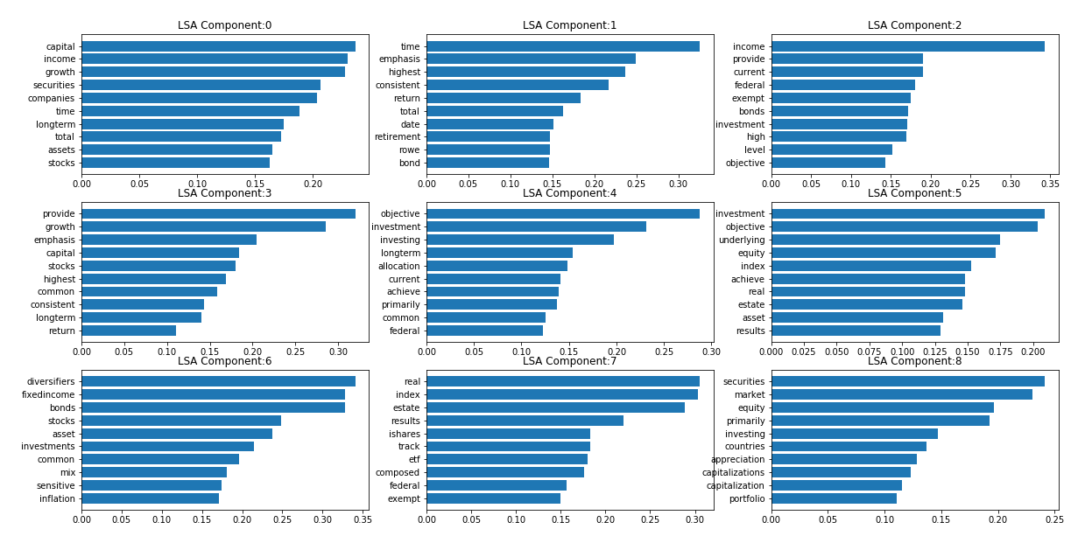
NLP Model – TFIDF/LSI
TF-IDF/LSI

Slide 26
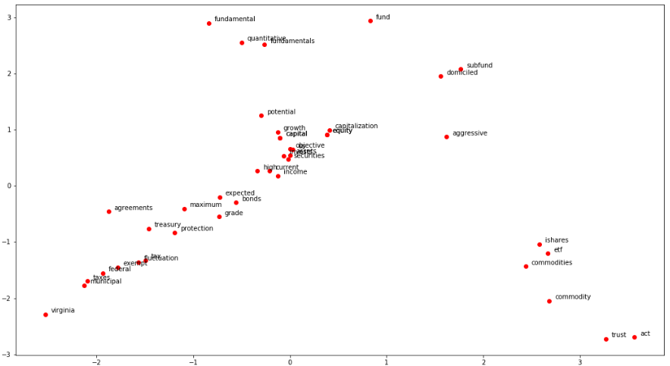
NLP Models – Fast Text
Examples of Similar Words
equity: ['us', 'securities', 'aggressive', 'capitalization', 'capital’]
commodity:['commodities', 'ishares', 'act', 'trust', 'etf’]
fund:['subfund', 'fundamental', 'fundamentals', 'domiciled', 'quantitative’]
capital: ['assets', 'growth', 'potential', 'invests', 'equity’]
income: ['current', 'grade', 'objective', 'high', 'bonds’]
tax:['exempt', 'federal', 'municipal', 'virginia', 'taxes’]
protection:['treasury', 'agreements', 'expected', 'maximum', 'fluctuation’]
long-term:['term', 'long', 'medium', 'directly', 'longterm']

Slide 27
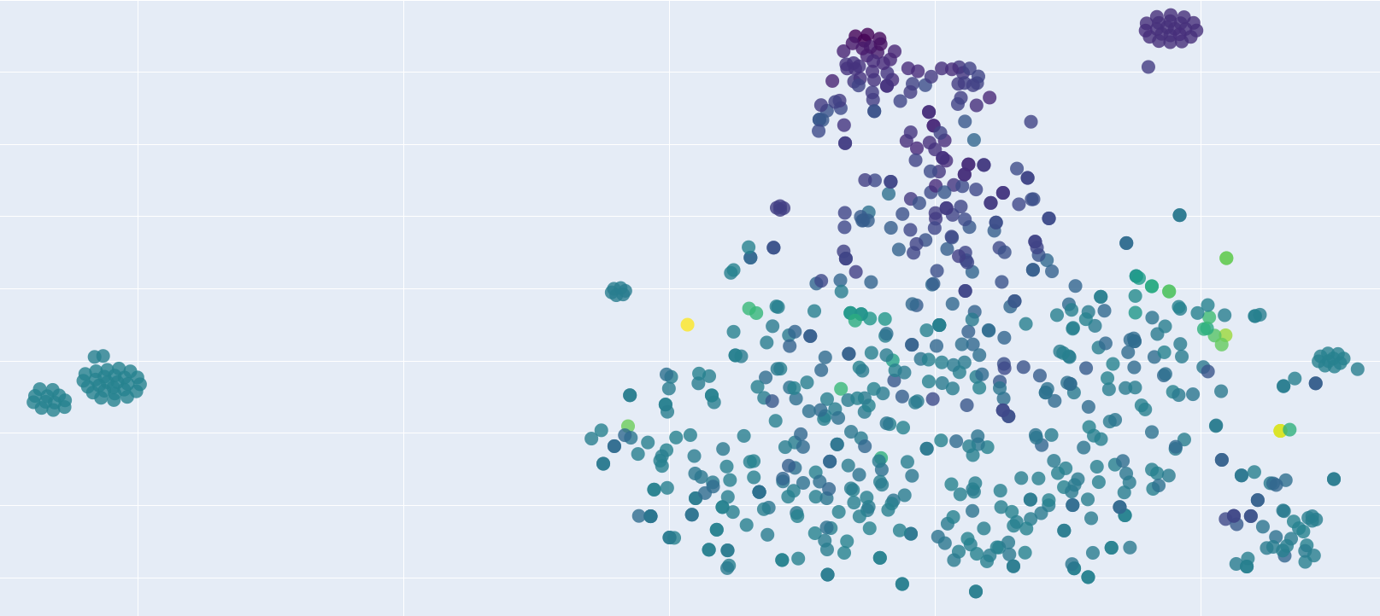
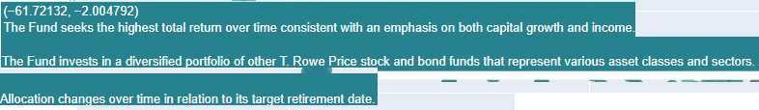
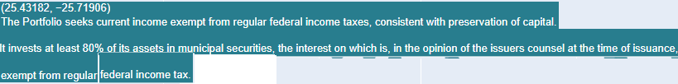
NLP Models – ELMO Model
Similar Funds Visulization
consistent performance
Max Real Return
Consistency and Retirement Age
Tax Savings

Slide 28
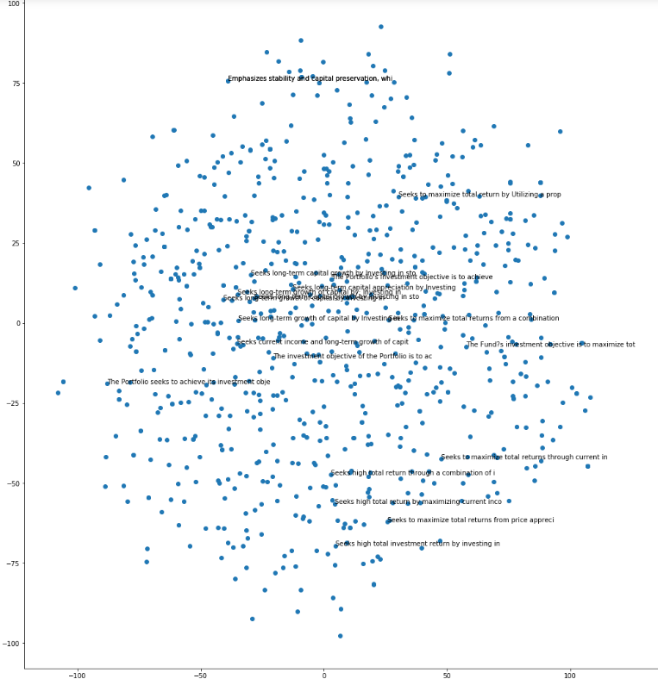
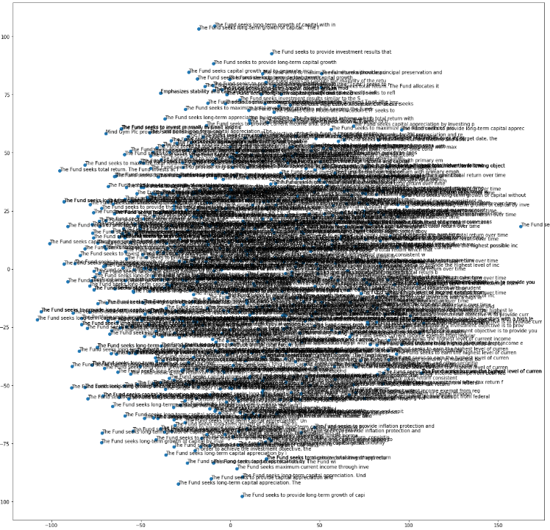
NLP Models – USE Model
USE Model Word Embeddings – random 20 funds
USE Model Word Embeddings - all 771 funds (for FUN)

Slide 29
NLP Models – Live Demo
Investor Objective is Described below:
invest in funds that match the FTSE index performance and listed in more than 15 developed countries
Results in next slide

Slide 30
Results
Investor Objective |  | A fund that offers monthly income
Model | Score | Fund Objectives
Word2Vec | 0.3381 | The Fund seeks highest total return over time consistent with its asset mix. The Fund's asset mix will be approximately 51% fixed-income, 25% equity, 22% inflation sensitive instruments and 4% fixed-income diversifiers. Its investments in fixed income and equity asset may include U.S. and non U.S. securities.
TFIDF | 0.1558 | Mind Gym Plc provides skill building and training services. It operates as a behavioural science business, which offers performance management, management development, diversity and inclusion, change, ethics, reorganization, personal effectiveness, on boarding, employee management, and customer service. The company was founded by Octavius Orlando Irvine Casati Black and Sebastian Mark Crampton Bailey in June 2000 and is headquartered in London, the United Kingdom.
TFIDF/LSI | 0.6158 | The iShares Morningstar Multi-Asset Income ETF seeks to track the investment results of an index composed of underlying equity, fixed income and other income funds that collectively seek to deliver high current income while providing an opportunity for capital appreciation.
ELMO | 0.5638 | The Fund seeks to provide total return, from current income and gains from long-term capital appreciation to provide exposure to domestic and foreign equity markets using the BuyWrite strategy. It is a strategy of selling call options on a security owned by the Fund to generate additional returns from the option premium.
USE | 0.6104 | To provide long-term capital appreciation.
FASTTEXT | 0.6747 | The Fund seeks income from municipal bonds and to distribute that income to its investors as tax-free dividends and to distribute dividends that are exempt from Virginia as well as federal tax. It seeks to invest at least 80% of assets in municipal bonds that are exempt from federal and state income tax in Virginia.

Slide 31
Results
Investor Objective |  | I would like inflation protection
Model | Score | Fund Objectives
Word2Vec | 0.3701 | The Fund seeks to provide long-term capital appreciation. Under normal circumstances, the Fund invests at least 80% of the value of its net assets, plus any borrowings for investment purposes, in equity securities (common and preferered stock, ADRs, convertible stock, convertible debt, etc.) of U.S. companies.
TFIDF | 0.4995 | The fund's investment objective is to provide inflation protection and income consistent with investment in inflation linked securities
TFIDF/LSI | 0.6614 | The fund's investment objective is to provide inflation protection and income consistent with investment in inflation linked securities
ELMO | 0.5126 | The Fund seeks to maximize real return without assuming what the Adviser considers to be undue risk. The Fund invests principally in Treasury Inflation Protected Securities (TIPS) directly or by gaining indirect exposure to TIPS through derivatives transactions such as total return swaps linked to TIPS.
USE | 0.6746 | The fund's investment objective is to provide inflation protection and income consistent with investment in inflation linked securities
FASTTEXT | 0.8411 | The Fund seeks to provide inflation protection and income by investing at least 80% of its assets in inflation-protected and inflation-indexed bonds. The emphasis will be on bonds issued by the U.S. Treasury, U.S. government agencies, foreign governments, and corporations may also be purchased.

Slide 32
Results
Investor Objective |  | invest in funds that match the FTSE index performance and listed in more than 15 developed countries
Model | Score | Fund Objectives
Word2Vec | 0.5796 | The Fund seeks current income and capital appreciation. The Fund invests primarily in income-producing equity securities.
TFIDF | 0.5776 | The Fund seeks to provide long-term capital growth by trying to match the performance of the FTSE Developed Ex North America Index, an equity market index based on the market capitalization of over 1,000 predominantly large companies listed in over 20 countries, including Japan, the U.K. and other developed countries.
TFIDF/LSI | 0.6627 | The Fund seeks to provide long-term capital growth by trying to match the performance of the FTSE Developed Ex North America Index, an equity market index based on the market capitalization of over 1,000 predominantly large companies listed in over 20 countries, including Japan, the U.K. and other developed countries.
ELMO | 0.7865 | The Fund seeks to provide long-term capital growth by trying to match the performance of the FTSE Developed Ex North America Index, an equity market index based on the market capitalization of over 1,000 predominantly large companies listed in over 20 countries, including Japan, the U.K. and other developed countries.
USE | 0.8184 | The Fund seeks to provide investment results that correspond to the total return performance of an index based upon the emerging markets of the world. It tracks the investment results of the Lattice Risk-Optimized Advancing Markets Strategy Index, which is comprised of companies domiciled within emerging market countries.
FASTTEXT | 0.861 | The Fund seeks to provide long-term capital growth by trying to match the performance of the FTSE Developed Ex North America Index, an equity market index based on the market capitalization of over 1,000 predominantly large companies listed in over 20 countries, including Japan, the U.K. and other developed countries.

Slide 33
Results
Investor Objective |  | Invest in developed countries economy
Model | Score | Fund Objectives
Word2Vec | 0.674 | The Fund seeks long-term capital appreciation and income. The Fund invests in a broadly diversified global portfolio of investments, including US and international stocks, bonds and short-term securities, and alternative investments.
TFIDF | 0.3259 | The Fund seeks capital appreciation through investment in foreign companies. The Fund invests primarily in companies located in less developed "emerging market" countries.
TFIDF/LSI | 0.4899 | The Fund seeks long-term capital appreciation. Under normal circumstances, the Fund will invest at least 80% of its net assets in equity securities of small capitalization, foreign (non-U.S.) companies primarily located in developed countries but may also invest in emerging markets.
ELMO | 0.7451 | The Fund seeks long-term growth of capital by investing mainly in common stocks of both foreign and U.S. companies. The Fund can invest without limit in foreign securities and can invest in any country, including countries with developed or emerging markets.
USE | 0.7704 | Seeks current income and long-term growth of capital.
FASTTEXT | 0.7952 | The Fund seeks long-term growth of capital by investing mainly in common stocks of both foreign and U.S. companies. The Fund can invest without limit in foreign securities and can invest in any country, including countries with developed or emerging markets.

Slide 34
Results
Investor Objective |  | invest in small capitalization companies with domicile in asia including japan
Model | Score | Fund Objectives
Word2Vec | 0.6886 | The Fund seeks long term growth. The Fund normally invests at least 80% of its net assets in equity securities of large capitalization companies. The fund invests primarily in equity securities that, in the investment adviser's opinion, are undervalued or out of favor.
TFIDF | 0.6279 | The Fund seeks long-term growth of capital by investing in both large and small capitalization companies domiciled, or with primary operations, in Asia, excluding Japan.
TFIDF/LSI | 0.6693 | The Fund seeks long-term growth of capital by investing in both large and small capitalization companies domiciled, or with primary operations, in Asia, excluding Japan.
ELMO | 0.8618 | The Fund seeks long-term growth of capital by investing in both large and small capitalization companies domiciled, or with primary operations, in Asia, excluding Japan.
USE | 0.6547 | The Fund seeks long-term growth of capital by investing in both large and small capitalization companies domiciled, or with primary operations, in Asia, excluding Japan.
FASTTEXT | 0.9322 | The Fund seeks long-term growth of capital by investing in both large and small capitalization companies domiciled, or with primary operations, in Asia, excluding Japan.
USE (3rd top) | 0.74 | The Fund seeks long-term capital appreciation. The Fund invests at least 80% of its net assets in securities of China companies. China companies are those that are organized under the laws of, or with a principal office in, the People's Republic of China, Hong Kong or Taiwan

Slide 35
Results
Investor Objective |  | invest in US equities of companies with market capitalization of no more than 1 billion
Model | Score | Fund Objectives
Word2Vec | 0.5076 | The Fund seeks long-term capital appreciation. The Fund invests at least 80% of the value of its net assets in equity securities issued by U.S. mid-cap companies. The Fund considers mid-cap companies to be companies that have market capitalizations similar to those of companies included in the Russell Midcap Index.
TFIDF | 0.3982 | The Fund seeks long-term capital appreciation by investing primarily in a diversified portfolio consisting of equity securities of U.S. companies. The Fund will invest at least 80% of its net assets in equity securities of U.S. companies with market capitalization of $5 billion and above.
TFIDF/LSI | 0.5639 | The Fund seeks to provide long-term capital appreciation. Under normal circumstances, the Fund invests at least 80% of its net assets in equity securities of U.S. large capitalization companies. The Fund defines large capitalization companies as those with a market capitalization of at least $3 billion.
ELMO | 0.8388 | The Fund seeks long-term capital appreciation by investing primarily in a diversified portfolio consisting of equity securities of U.S. companies. The Fund will invest at least 80% of its net assets in equity securities of U.S. companies with market capitalization of $5 billion and above.
USE | 0.8301 | The Fund seeks capital growth by investing primarily in common stock of U.S. companies with market capitalizations of at least $5 billion.
FASTTEXT | 0.9178 | The Fund seeks capital growth by investing primarily in common stock of U.S. companies with market capitalizations of at least $5 billion.

Slide 36
Lessons Learned
1. Pre-processing Hurts
Lesson: Spend quality time look to understand the intricacies of the input text data and use every tool available to look at input data: WordCloud, Histograms, HeatMaps, Hapaxes, Concordance and Collocations etc.
Examples:
Applied standard NLP pre-processing which removed the numerical facts; realised during the testing we came back to pre-processing
Applied standard NLP pre-processing which removed punctuation “.”, “,”, “%” which are essential for numerical facts; realised during testing we came back to pre-processing
US/UK, EU and Swiss follow different conventions for decimal point (“.” Vs “,” Vs “ ‘ “) ; this gave lot of headache.
2. Data Scraping and Cleansing is Hard Job:
Lesson: Don’t underestimate the data scraping from websites and cleansing as easier job. There are no standards and every website is different.
Examples:
Some websites have pop-up which require confirmation whether one is professional or individual investor. The pop-ups gave lot of trouble.
HTML/XML/JSON cleansing techniques that work for one website may not work for other sites so be prepared to write very specific parsing routines which are not reusable.

Slide 37
Lessons Learned
3. Testing
Lesson: If you don’t have labelled data and benchmark results to compare with be prepared to spend significant amount of time for validation & testing.
Examples:
Since we scraped the data from various websites, our testing suffered due to lack of time as we didn’t have any benchmark results to compare/assess the model performance.

Slide 38
Conclusions
If the fund objective is pure string (with negate, numericals) based then most models are giving good performance except the Word2Vec model.
All models have difficulty in interpreting the negate words (except, including, nor, no more than etc.)
All models have difficulty in interpreting the numeral and associated words (no more than, less than, over, under etc.)

Slide 39
Next Steps
All models are suffering from interpreting the negate words (except, including, excluding, apart, NOT etc.) so explore the options to improve the model performance
Thoroughly test whether the models are truly capturing the numerical facts contextual meaning. The troubled words are: “at least 5 billions”, “at most 1 billion”, “over 40%”, “60 to 80%” etc.
Revisit the decimal point punctuation pre-processing for numerical facts to deal with US/UK Vs EU Vs Swiss conventions properly.
Resolve the installation issues and integrate the BERT and Glove models on AWS.
Come up with more robust test dataset to benchmark the model performance results.
Explore the size of the word embeddings and other model parameters has any impact on model performance
Explore and compare the model performance with stemmer and lemmatization.
Explore the model performance without any pre-processing step.
Explore if the user search string is enriched with synonym/homonym/hypernyms has any impact on model performance

Slide 40
References
[1] Daniel Cera , Yinfei Yanga , Sheng-yi Konga , Nan Huaa , Nicole Limtiacob , Rhomni St. Johna , Noah Constanta , Mario Guajardo-Cespedes ´ a , Steve Yuanc , Chris Tara , Yun-Hsuan Sunga , Brian Stropea , Ray Kurzweila, Universal Sentence Encoder, EMNLP demonstration, Association for Computational Linguistics, Brussels, Belgium (2018). https://static.googleusercontent.com/media/research.google.com/en//pubs/archive/46808.pdf
[2] Adrien Sieg, Text Similarities : Estimate the degree of similarity between two texts; Last updated on July 04, 2018, https://radimrehurek.com/gensim/models/fasttext.html
[3] Radim Řehůřek, Last updated on Nov 01, 2019, https://radimrehurek.com/gensim/models/fasttext.html
[4] Prateek Joshi, March 11, 2019, A Step-by-Step NLP Guide to Learn ELMo for Extracting Features from Text
https://www.analyticsvidhya.com/blog/2019/03/learn-to-use-elmo-to-extract-features-from-text/
[5] Universal Sentence Encoder, Tensorflow Hub Example Usage, published by Google
https://tfhub.dev/google/universal-sentence-encoder/2
[6] ELMO, Tensorflow Hub Example Usage, published by Google, https://tfhub.dev/google/elmo/3
[7] TFIDF Model, Similarity Queries, https://radimrehurek.com/gensim/auto_examples/core/run_similarity_queries.html#sphx-glr-auto-examples-core-run-similarity-queries-py
[8] TFIDF/LSI, Corpora and Vector Spaces https://radimrehurek.com/gensim/auto_examples/core/run_corpora_and_vector_spaces.html#sphx-glr-auto-examples-core-run-corpora-and-vector-spaces-py
[9] Srinivasa-Desikan, Bhargav, Natural Language Processing and Computational Linguistics, Pakt 2018
[10] Anandarajan, Murugan, Hill, Chelsey, Nolan, Thomas, Practical Text Analytics Maximizing the Value of Text Data, Springer 2019.
[11] Hakcer’s Blog, Posted on March 23, 2017; Word2Vec Explained, https://israelg99.github.io/2017-03-23-Word2Vec-Explained/
[12] TFIDF Explained, http://www.tfidf.com/
[13] Giuliano Giacaglia, How Transformers Work, https://towardsdatascience.com/transformers-141e32e69591
[14] Chengwei, June 2018; Keras + Universal Sentence Encode = Transfer Learning for Text Data; https://www.dlology.com/blog/keras-meets-universal-sentence-encoder-transfer-learning-for-text-data/

Slide 41
Links
Website Link
www.theFolse.com
OR
http://54.162.42.228/
Note: The website works only with Chrome browser. If you have enabled security features on your chrome browser you may get errors saying – “not protected website”. If you do face this problem please use the URL containing the IP address: http://54.162.42.228/
GitHub Link
https://github.com/mohammed-fakruddin/TextAnalyticsandNaturalLanguageProcessing
Video Link

Slide 42
Q&A

Slide 43
Appendix

Slide 44
System Overview
The 771 fund objectives are scraped from 6 websites and processed through the standard NLP pre-processing steps such as: remove punctuations (as appropriate), convert to lower case and tokenizes sentences into word tokens.
The investor objective query string received from the FOLSE website is also pre-processed through before feeding to the model.
The pre-processed 771 fund objective tokens are fed to the various NLP models to generate the word embeddings or word vectors.
The pre-processed investor objective word token is also fed to the model to generated the word embeddings or word vector.
In a loop the cosine similarity scores are calculated between the investor objective and the fund objectives. The calculated scores are calculated and the top-4 most similar fund objectives are returned to the FOLSE website as recommended funds.

