Slide 1
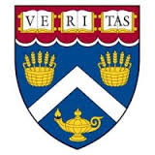
AI and Robotics Driven Moving Telescope for Celestial Objects Observation NLP Trained Digital Assistant
Mr. Fakruddin Mohammed

Slide 2
NLP Trained Robot
Robot Assistant can help with any of the following
Get Details of Stars/Clusters/Galaxies
Get Sky/Horizon/Telescoping Map for any Location
Drive Robot Car

Slide 3
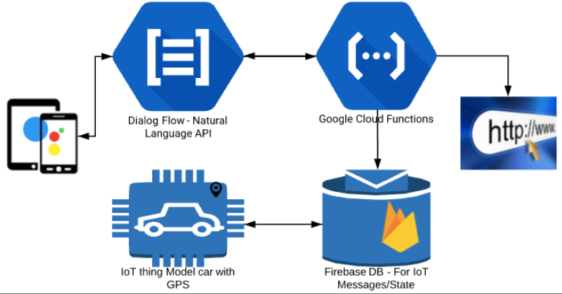
Implementation Architecture

Slide 4
AI and Robotics Driven Moving Telescope for Celestial Objects Observation NLP Trained Robotic Assistant

