Slide 1
Digital Assistant for Fund Specialists NLP Trained Digital Assistant
Mr. Fakruddin Mohammed

Slide 2
Digital Assistant for Fund Specialists
Assistant Can help with any of the following:
Fund Documentation
Fund Analytics
Fund Manager Profile Details
Fund News
Fund Data Feeds
Password Reset

Slide 3
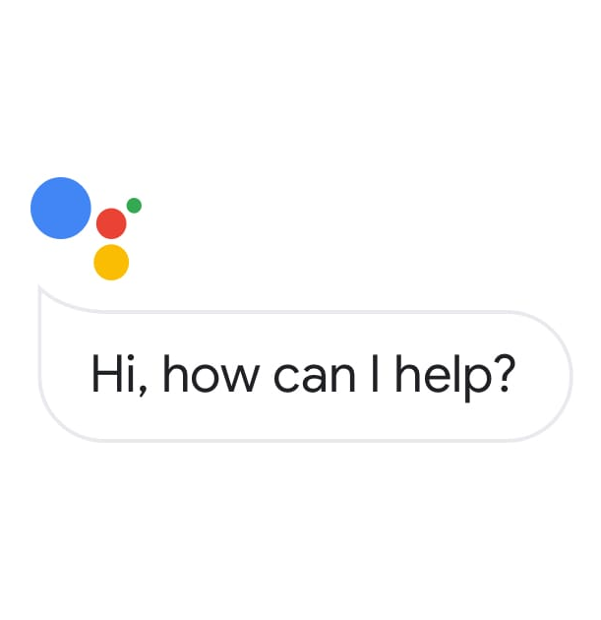


Digital Assistant Implementation Architecture
Dialogflow Gateway
NLP Intentions
Training
Python

