Slide 1



SAU JEOPARDY

Slide 2
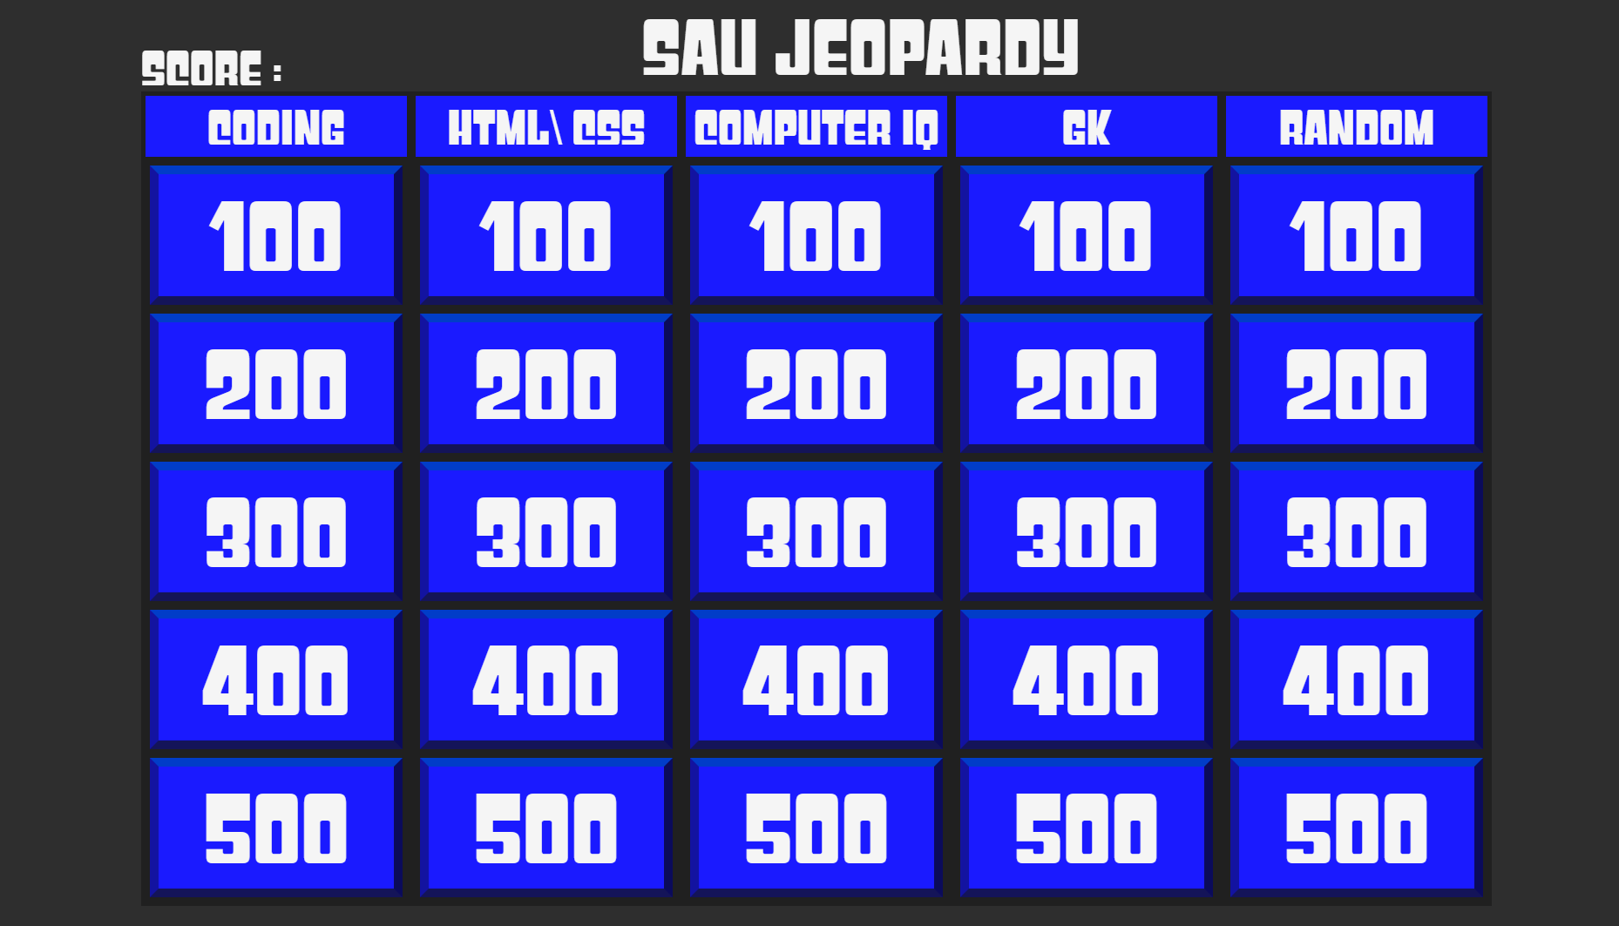

Slide 3

RULES
1
2
3
Choose topic name and score value
You will get 5 minutes to answer all questions
read the question carefully
4
5
6
Call out your answer on the mic, first answer will be considered
marks will be awarded for the same
choose your next topic and score value, repeat until timer gets over

Slide 4
Scoring
1
2
3
Correct answer will be awarded with the score card value
Wrong answers will be given minus 1/4 the score card value
Skipping a question will be regarded as wrong answer

Slide 5
Lifeline
1
2
3
Phone a friend
we will choose to call one contact of your given 3 choices on speaker
time extension 15 seconds
Ask the audience
Note:
each lifeline will deduct 100 points from your total

Slide 6


ALL THE BEST

