Slide 1
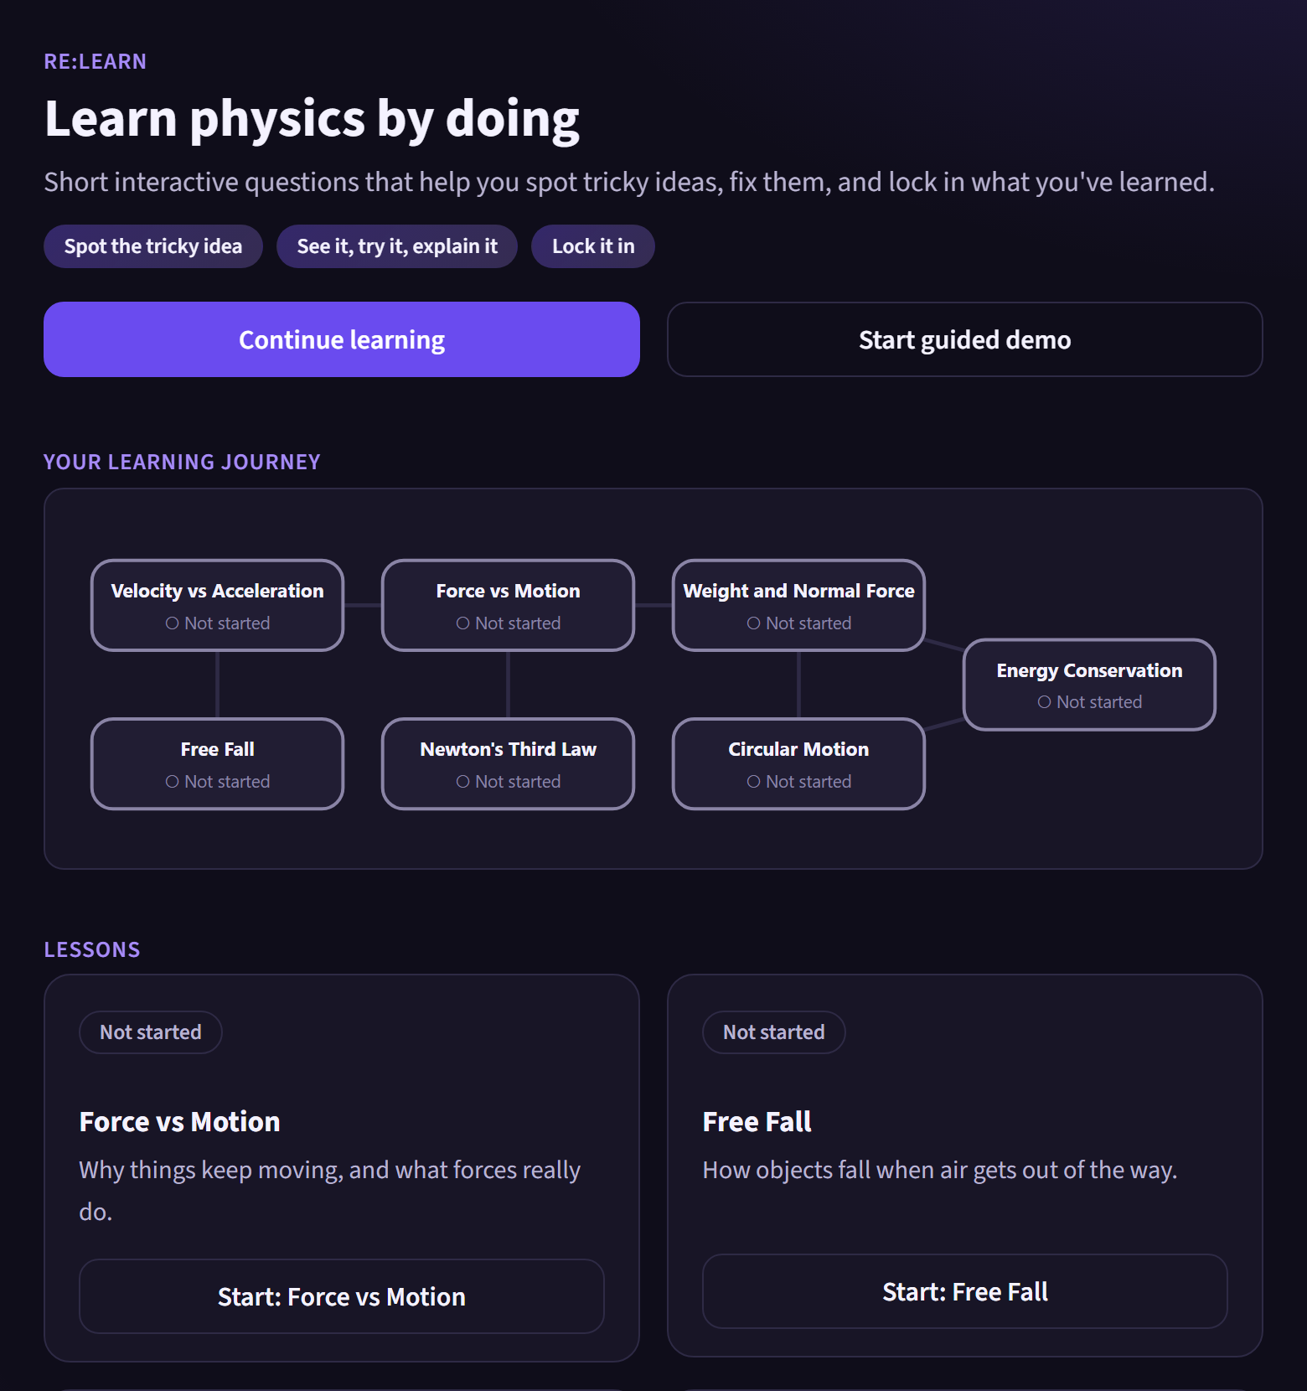
Re:Learn
TEAM GREENLARPERS · PHYSICS: MECHANICS
Find the wrong idea, not just the wrong answer.
An adaptive, multimodal learning system that diagnoses the misconception behind a student's answer, teaches against that idea, and only calls it fixed when the evidence says so.
Diagnose
Teach (see · try · explain)
Verify
Notes:
Most learning tools mark an answer right or wrong. Re:Learn asks why it was wrong: which specific misconception produced it. Then it teaches against that idea, in several modes, and only counts it as fixed after transfer questions, a trap question and a delayed retest.

Slide 2
One wrong answer can hide three different wrong ideas
THE QUESTION
"Something has to keep pushing it, or it would stop."
1
A 0.5 kg puck slides across frictionless ice at a constant 8 m/s. What is the net force on it?
M01 · A force is needed to keep moving
"The hit put a force into the puck that it still carries."
2
Three students all answer
M09 · Impetus: the force is stored inside
4.0 N forward
"It moves forward, so the net force points forward."
3
Correct answer: 0 N
M12 · Net force always follows the motion
Marking it wrong fixes none of them. Showing the right answer doesn't either: each student needs a different explanation.
Notes:
This is the core problem from the brief. These three misconceptions produce the identical wrong answer. A plain right or wrong check cannot tell them apart, and a generic explanation will miss two of the three students. They are one of our four look-alike groups.

Slide 3
Re:Learn closes the loop from mistake to verified understanding
1
2
3
4
5
Diagnose
Quick check
Teach
Reassess
Lock in
A classifier reads the question, answer and reasoning, and names one of 12 misconceptions with a calibrated confidence.
If two look-alike ideas are close, ask the one question that best separates them (highest expected information gain).
Targeted hint in the mode most likely to work for this idea: explanation, force diagram or interactive simulation.
New transfer questions plus a trap question built to catch the old idea. One right answer is never enough.
Delayed retest a few questions later, and the student explains the idea back in their own words.
Learner model underneath every step: per-concept mastery (Bayesian), per-misconception state (active → intervened → resolved → relapsed), and a decision trace for every interaction.
Notes:
This is the whole system on one slide. Each step maps to a requirement in the brief: diagnosis, differentiation, adaptive intervention, resolution assessment, learner model. The quick check and the teaching mode are chosen by algorithms, not fixed rules.

Slide 4
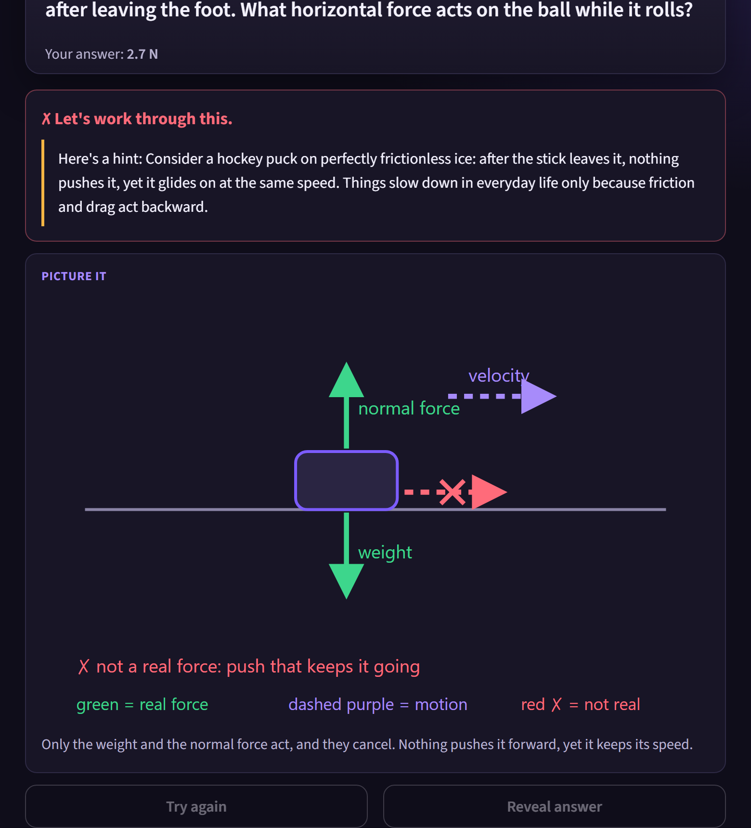
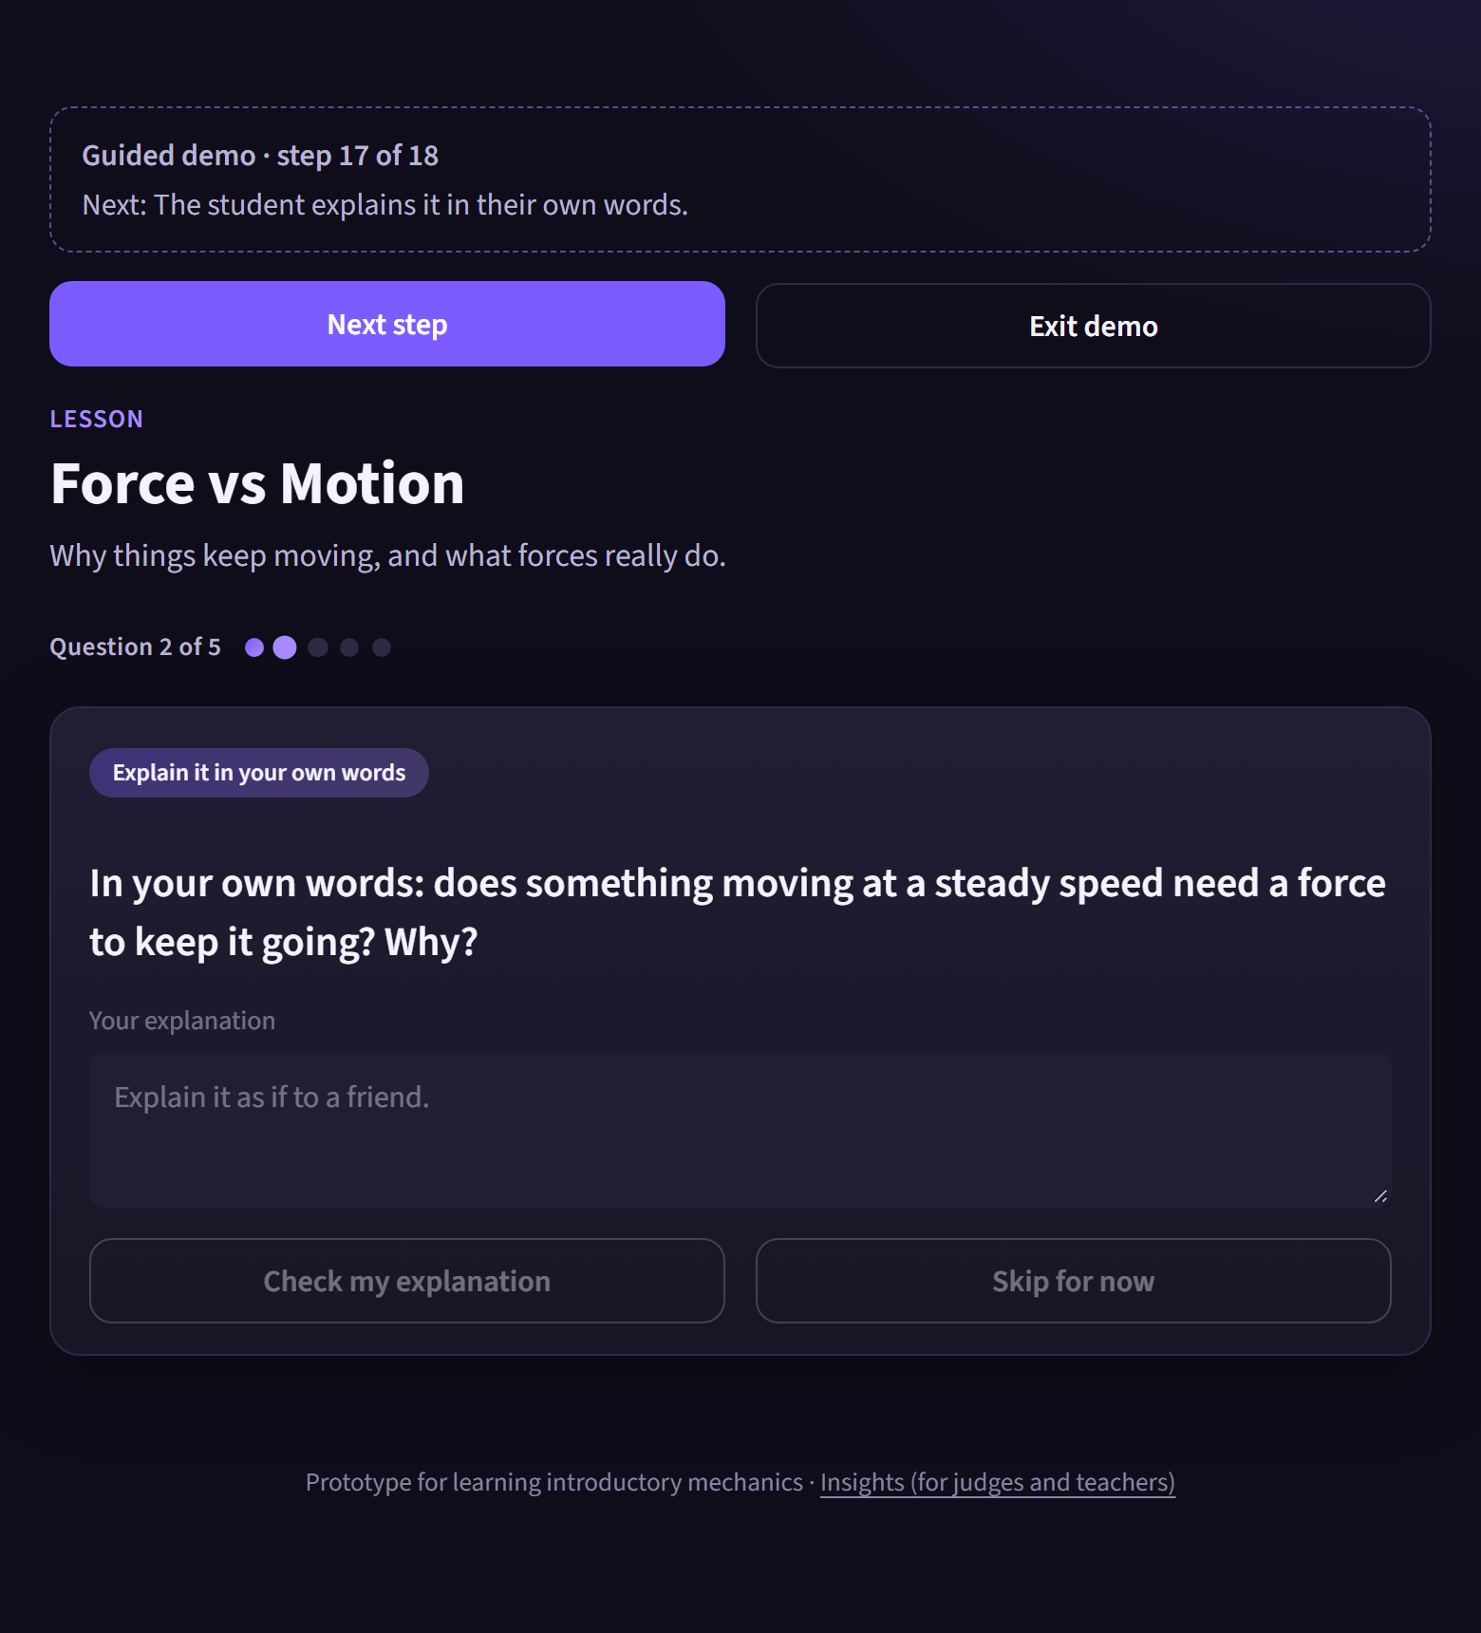
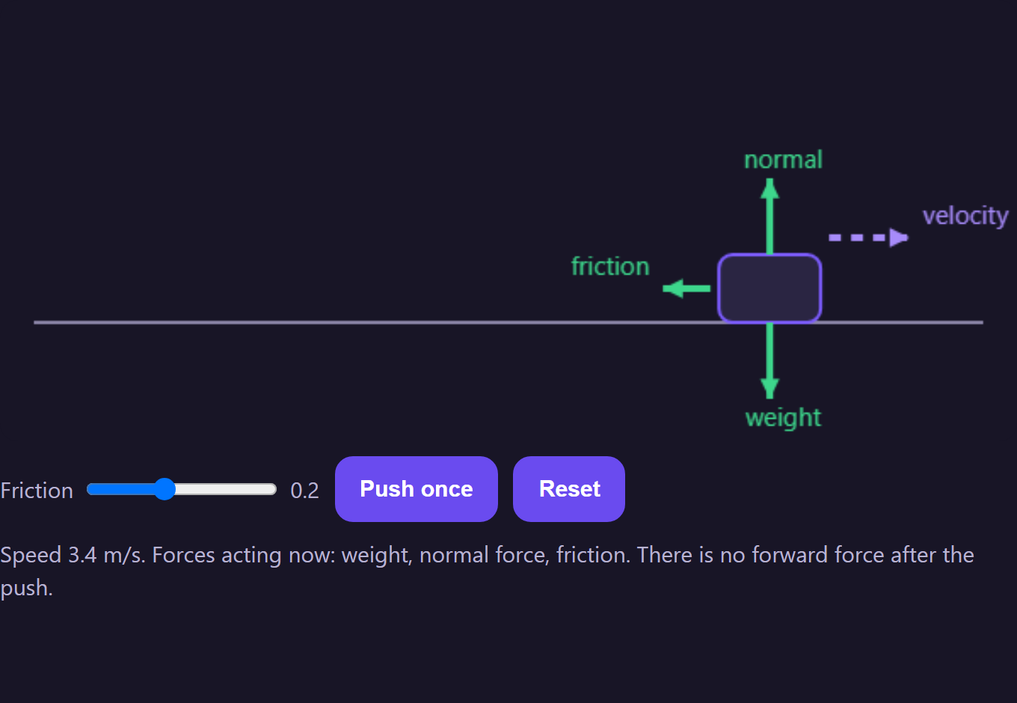
What a student sees: see it, try it, explain it
A wrong answer gets a short targeted hint, here with a force diagram that crosses out the force that isn't real
Or an interactive simulation: set friction to zero and watch the puck keep going with no forward force
Once the idea is locked in, the student explains it in their own words and the model checks it
Notes:
These are real screenshots from the running app. No probabilities or misconception codes are shown to students; that information lives in a separate Insights view for teachers and judges.

Slide 5
Architecture: an ML pipeline behind a learning-first interface
Content
Teaching
12 misconceptions · 7 concepts · 48 templates · 66 items · 12 visual specs
Strategies × modality (text, diagram, simulation) via Thompson sampling · retrieval grounding
Data
Assessment
Template generator → clean → dedupe → split by template
Transfer + trap · delayed retest · explain-it-back
Models
Learner model
TF-IDF baseline · MiniLM + TF-IDF hybrid · temperature calibration
Beta mastery per concept · misconception state machine · SQLite store
Diagnosis
Two views
Routing by confidence · information-gain probes · novelty flag
Student view with no AI jargon · Insights view for teachers and judges
Notes:
Everything runs on a free CPU with no API key. A Claude rewrite of the hint is optional when a key is present; the classifier, never the LLM, decides the misconception. 167 automated tests cover the pipeline.

Slide 6
Evaluation built to test generalisation, not memory
2,296
631
65
12
synthetic answers with reasoning, 13 classes (12 misconceptions + correct)
test answers from question templates never seen in training
hand-written answers in different phrasing, scored separately
leave-one-misconception-out retrains, to test truly unseen mistakes
Honest about provenance. All training data is synthetic, generated from 48 hand-written templates whose wrong answers and reasoning encode each misconception. Splits are by template, so test questions have new scenarios and numbers. The hand-written answers and explanations were written by the team, not collected from students.
Notes:
The brief asks for evaluation on responses and misconceptions not seen during training. We test both: unseen question templates and phrasing, and unseen misconceptions via leave-one-out.

Slide 7
Diagnosis: the embedding model handles new phrasing better
0.83
macro-F1 on hand-written answers (v1), vs 0.78 for the baseline
Using the question's answer key as well: 0.85 (v1) and 0.87 (baseline, unseen templates).
v1 was chosen on validation. It is weaker on the synthetic test split, and we report that rather than hide it.
Notes:
Hand-written answers are the closer proxy for real students because they use different wording from the templates. The hybrid model combines MiniLM sentence embeddings of the answer and the reasoning with TF-IDF features. Pure embeddings scored 0.53 macro-F1 on validation; the hybrid scored 0.65.

Slide 8
Telling look-alikes apart: one well-chosen quick check
+16 pts
accuracy on look-alike misconceptions (test) after quick checks
Each candidate question is scored by its expected drop in uncertainty (entropy) over the full diagnosis; the best one is asked, at most two per answer.
Measured with simulated learners who answer as their misconception predicts, so these are upper bounds.
Notes:
Information gain beats a random relevant probe in all four settings we tested. The student just sees a short 'Quick check' question; the uncertainty maths stays in Insights.

Slide 9
Unseen misconceptions: distinct ones get flagged
0.71
overall test AUROC; flags 63.5% of unseen-misconception answers at a 28.2% false-flag rate
An unseen idea that resembles a known one is mistaken for it: M03 is read as M04, and M06 as M07.
So unfamiliar mistakes go to a teacher review queue, never to the student.
Notes:
We retrained the model twelve times, each time without one misconception, and asked whether it could say 'this is unfamiliar'. Clearly distinct misconceptions score 0.90 to 1.00. Look-alike pairs are the honest failure case, which is exactly why our quick checks exist.

Slide 10
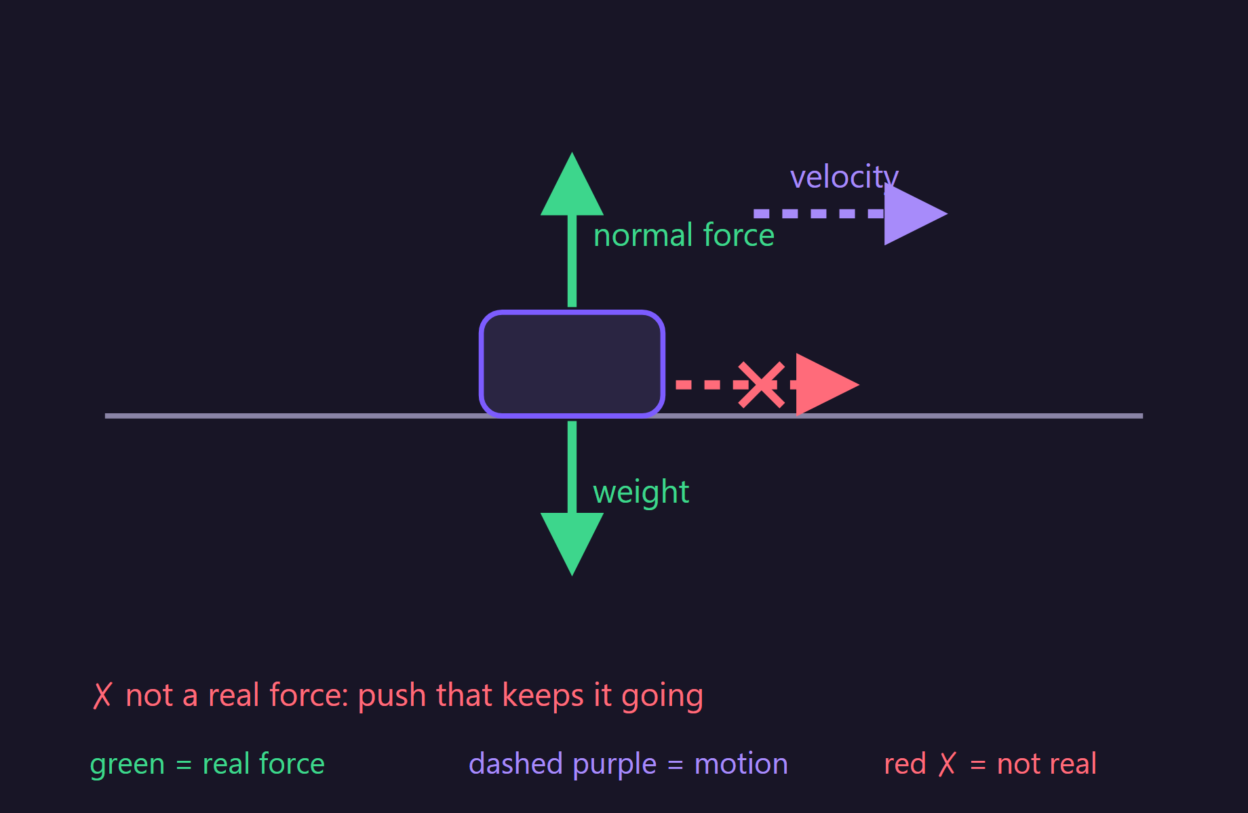
Multimodal teaching that learns which mode works
12 code-drawn diagrams and 7 interactive simulations. The adaptive policy needs 1.74 interventions on average vs 2.03 for text only. 3,000 simulated learners × 5 seeds; assumptions are in the report.
Notes:
The backstory says adaptive systems usually change difficulty, not how a concept is taught. Re:Learn changes the teaching mode. A Thompson-sampling policy learns, per misconception, which mode leads to a passed reassessment. The resolution data used in the simulation is synthetic and labelled as such.

Slide 11
Resolution is earned with evidence, and tracked over time
1
Never one right answer
2
Explain it back
3
Learner model
Resolved only after ≥2 of 3 transfer questions
plus a trap question aimed at the old idea
plus a delayed retest a few questions later
"Pass the first follow-up, fail the trap → not resolved" is a permanent test
11 of 12 misconception-holding explanations are not cleared
9 of 12 sound explanations are accepted
A second, independent signal of understanding (24 hand-written explanations)
Per-concept Bayesian mastery, every update logged before and after
Misconception states: active → intervened → resolved → relapsed
Progress predictor AUC 0.97 (reach mastery) and 0.88 (persists), on simulated learners
Mastery scores set difficulty and feed dashboards, but they can never mark a misconception resolved on their own.
Notes:
This is the brief's key requirement: don't assume a correct follow-up means learning happened. Mastery scores inform difficulty and dashboards, but they can never mark a misconception resolved on their own.

Slide 12
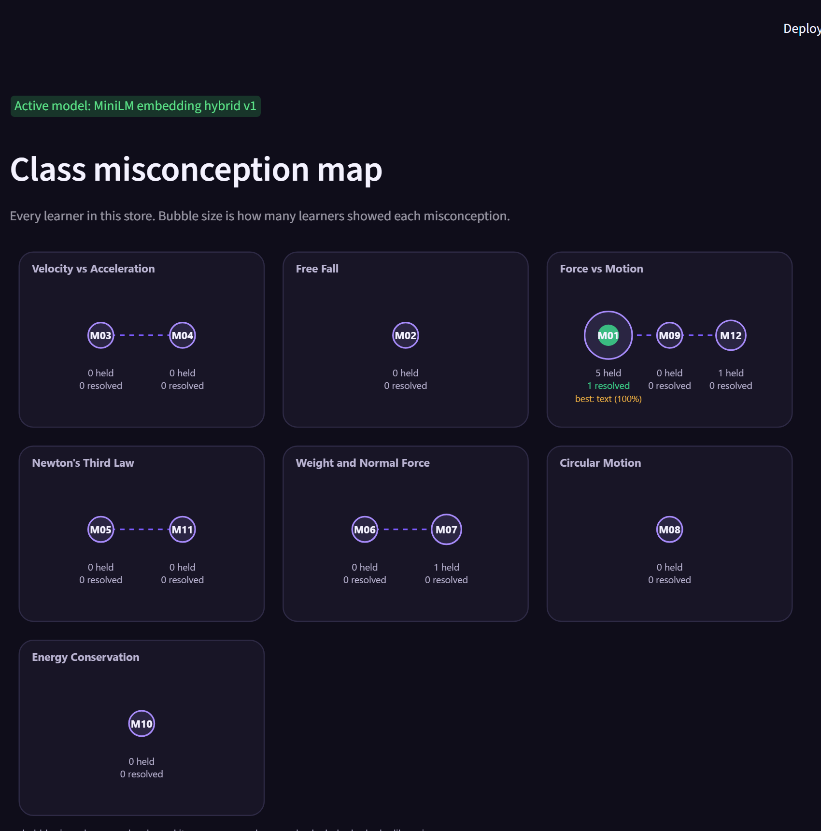
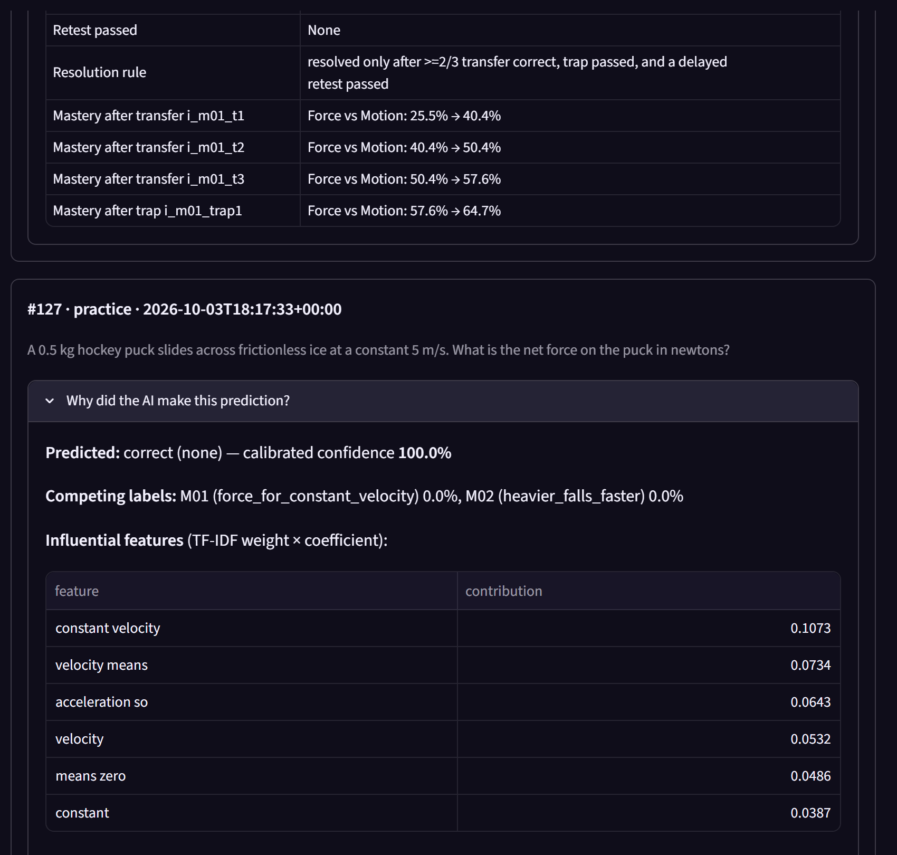
Insights: every AI decision is inspectable
Class misconception map · teacher review queue for unfamiliar mistakes · per-answer decision trace with confidence, quick-check entropy, mastery change and model explanations (TF-IDF features, nearest examples, word occlusion) · model evaluation · teaching-mode outcomes.
Notes:
The student view stays clean. Judges and teachers open Insights from the footer link. Every number there is read from storage or from the metrics report.

Slide 13
Limitations and what comes next
Limitations
Next steps
Synthetic training data and one domain (mechanics)
Quick-check, teaching-mode and progress results come from simulated learners
Unseen-misconception detector still flags 28.2% of known mistakes, so it only feeds a review queue
Explain-back evaluated on 24 hand-written explanations
Classroom pilot to collect real answers and reasoning
Fine-tune a larger model on real data; recalibrate thresholds
More subjects: algebra and introductory programming
Voice and handwriting input; longer-term learner modelling
167 automated tests · runs on a free CPU with no API key · every number here comes from reports/metrics.json
Notes:
Close by restating the loop: diagnose the idea, teach it in the mode that works, verify with evidence. Then invite a judge to try a live question in the app.

