Slide 1

Predictive Modeling for Cardiovascular Disease: A Systematic Review
Makadia Rishit 1BM23CS177
Manojkumar 1BM23CS185
Mohammed Kalandar 1BM23CS195
Navneet Kumar 1BM23CS207
Guide: Dr. P Jayarekha
Designation: Professor, BMSCE
Department of Computer Science & Engineering
B.M.S. College of Engineering
Notes:
Arpana

Slide 2

Introduction
Heart disease remains one of the leading causes of mortality worldwide, demanding early and accurate detection. A machine learning–based heart problem prediction model leverages patient data to identify hidden patterns, enhance diagnosis, and support timely intervention. This approach empowers healthcare providers with data-driven insights for improved outcomes and prevention.
Notes:
Niha

Slide 3

Problem Statement
The core problem is the lack of reliable, early cardiovascular risk stratification from routinely collected clinical data that is actionable across diverse populations and care settings, leading to preventable delays in intervention.
Clinical data are fragmented, sparse, and noisy (missingness, label bias), and existing tools rarely quantify uncertainty or fairness, undermining clinician trust and operational adoption.
The objective is to develop a data-efficient, generalizable risk prediction model that is calibrated, uncertainty-aware, and deployable using low-cost variables, enabling timely triage without reliance on invasive or expensive diagnostics

Slide 4
Literature Survey A Systematic Review and Meta-Analysis of Heart disease prediction system REVIEW METHODOLOGY
A. DATA SOURCES
Publication Source | No.of Papers
IEEE Explore | 10
Springer | 9
Journals | 6
WHO | 4
Table 1: Distribution of Surveyed papers by Publication Source
Year | No.of Papers
2025 | 14
2024 | 6
2023 | 2
2022 | 2
2021 | 1
2020 | 2
< 2019 | 3
Table 2: Year-wise Distribution of papers
Notes:
Pooja

Slide 5
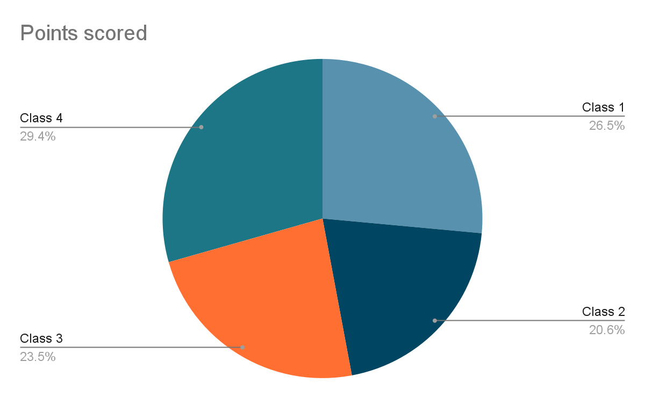
Literature Survey B. CLASSIFICATION OF SELECTED REFERENCES
4 Clusters of Studies
Class 1. Heart related problems → 9 articles
Class 2. Beyond the Basics: How ML is Revolutionizing Heart Disease Detection → 7 articles
Class 3. Why ML → 8 articles
Class 4. Implementing ML to predict heart disease based on survey, dataset → 10 articles
Notes:
Pooja

Slide 6
Literature Survey Class 1 – Heart Related Problems
Heart diseases require continuous monitoring of heart rate and blood pressure.
Heart disease patients often face complex treatment planning due to co-morbidities and lifestyle differences.
Patients with cardiac arrhythmia need pacemakers for regulating heart rhythm.
Adults with Tetralogy of Fallot (ToF) reported poorer physical health than healthy controls, showing more limitations in daily activity, work roles, fatigue, and self-perceived health.
Anxiety/Depression and Pain/Discomfort were common issues among ToF patients, consistent with previous studies on congenital heart disease (CHD).
Older patients reported greater physical problems and lower health ratings, especially in Physical Functioning and PCS scores (p < 0.05).
All ToF patients had undergone complete repair with a transannular patch.
74% required reoperation in adulthood (13/17 females and 28/35 males) due to valve insufficiency, mostly via transcatheter pulmonary valve replacement.
Selected References: [1]
Notes:
Pooja

Slide 7
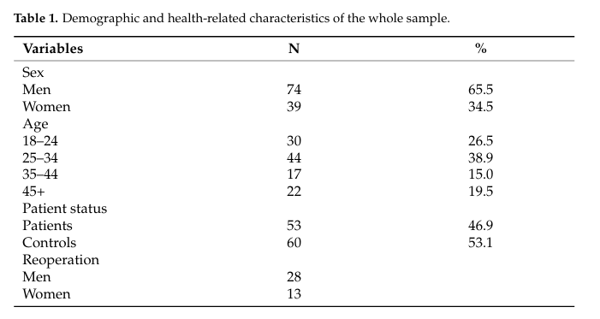
Table 3. Demographic and health-related characteristics of the whole sample.
This table presents demographic and health-related data from a sample population, detailing sex, age groups, patient status, and reoperation counts. It shows that men make up 65.5% of the sample, with the largest age group being 25–34 years. The sample is nearly evenly split between patients and controls, offering a balanced foundation for health-related analysis.
Selected References: [2]

Slide 8
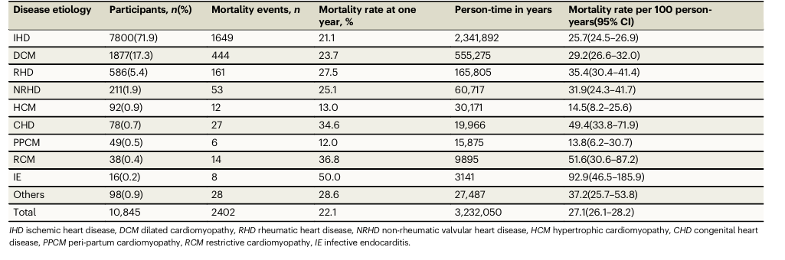
Table 4. Mortality rate by disease by etiology [3]
Ischemic heart disease shows the highest mortality rate among cardiovascular conditions, exceeding 25 deaths per 100 person-years. This underscores the urgent need for predictive models that can identify high-risk individuals early. Machine learning offers a powerful approach to reduce mortality through timely, data-driven interventions and personalized healthcare strategies.
Selected References: [3]

Slide 9
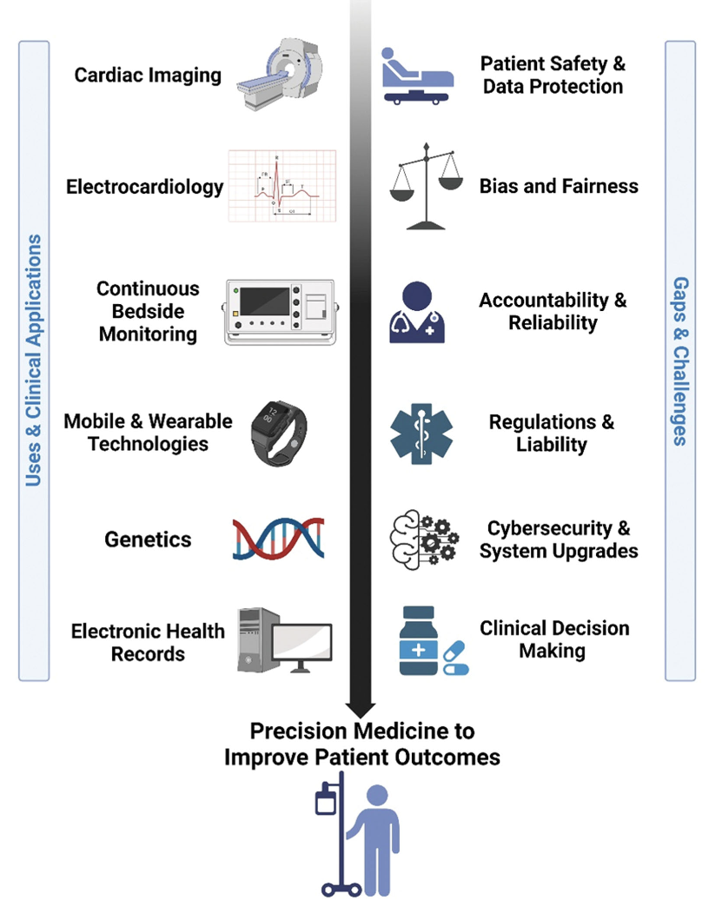
Literature Survey
CLASS 2: Beyond the Basics: How ML is Revolutionizing Heart Disease Detection
Traditional care depends on clinical risk scores like the Framingham model, which use limited factors such as age, cholesterol, and blood pressure. Diagnosis relies on manual interpretation of ECGs and imaging, requiring specialist expertise and significant time. Treatment and research are physician-driven, often slow, costly, and less personalized.
Expensive diagnostic methods (angiography, advanced imaging, genetic tests).
Require specialized expertise, not scalable in rural/low-resource settings.
Time-consuming, prone to delayed diagnosis.
Not always personalized → same approach applied to diverse patient groups.
Fig. 2.1 Applications and challenges of AI in cardiovascular disease [4]
Notes:
Pooja

Slide 10
Literature Survey CLASS 2: Beyond the Basics: How ML is Revolutionizing Heart Disease Detection
Why Machine Learning for Heart Disease?
Conventional Methods: The Limitations
Reactive: Often focused on diagnosis after symptoms appear.
Generalized: Relies on traditional risk scores (e.g., Framingham) that average risk across large populations, missing individual nuances.
Limited Data: Uses a small number of variables (age, cholesterol, blood pressure) and struggles to incorporate complex data.
The Machine Learning Promise: A Paradigm Shift
Proactive & Predictive: Aims to forecast disease risk before an event occurs, enabling early intervention.
Personalized: Creates highly individualized risk profiles by analyzing hundreds of variables from patient data (EHR, genomics, imaging).
Data-Driven: Uncovers hidden patterns and complex interactions in large datasets that are invisible to humans.
Bottom Line: ML shifts the focus from treating sickness to proactively managing health.
Notes:
Pooja

Slide 11
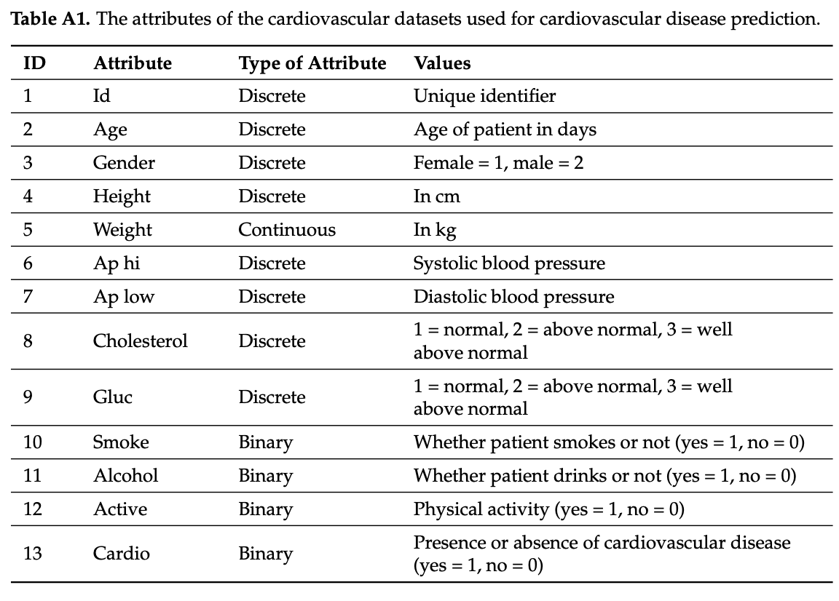
Literature Survey CLASS 2: Beyond the Basics: How ML is Revolutionizing Heart Disease Detection
According to paper [7], conventional cardiovascular diagnosis often relies on costly imaging, invasive tests, and time-consuming clinical evaluations. In contrast, AI and ML models can achieve reliable predictions using only basic patient data such as age, weight, blood pressure, cholesterol, and lifestyle factors. This makes prediction cheaper, faster, and more accessible, especially in resource-limited settings, while still providing clinically relevant insights into heart disease risk.
Uses simple, routinely collected data (age, BP, cholesterol).
No expensive equipment needed.
Provides quick and scalable heart disease predictions.
Builds the foundation for accessible preventive care.
Fig 2.2. Attributes of the cardiovascular dataset used for ML-based heart disease prediction [5]
Notes:
Pooja

Slide 12
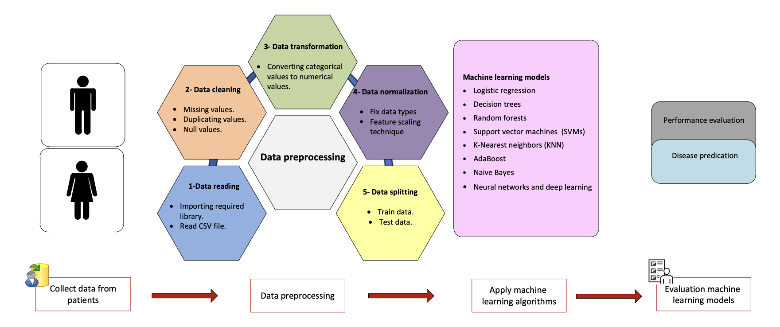
Literature Survey CLASS 2: Beyond the Basics: How ML is Revolutionizing Heart Disease Detection
Fig. 2.3. General workflow of ML-based cardiovascular disease prediction [5]
Notes:
Pooja

Slide 13
Literature Survey CLASS 2: Beyond the Basics: How ML is Revolutionizing Heart Disease Detection
Collect basic patient data (age, blood pressure, cholesterol, lifestyle).
Preprocess the data → clean, transform, normalize.
Split into training & testing sets.
Apply ML algorithms (Logistic Regression, Decision Trees, Neural Networks).
Evaluate results → fast, low-cost, and reliable predictions.
But, first let's answer the question “What is Machine Learning?”

Slide 14
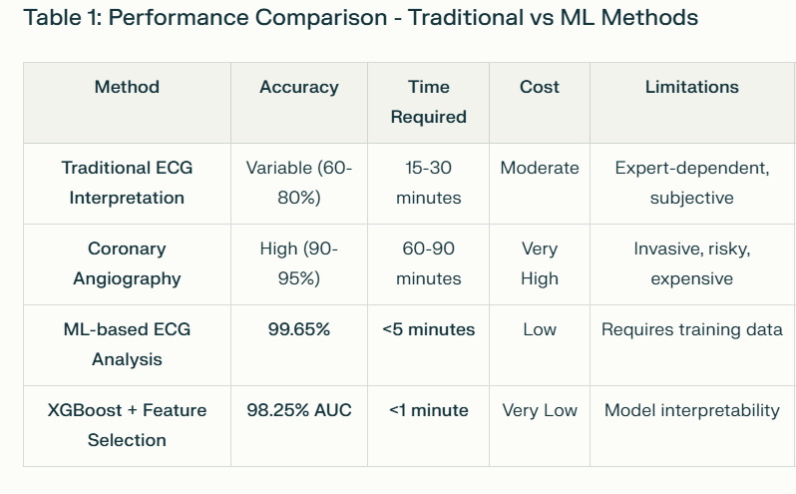
Literature Survey CLASS 3: MACHINE LEARNING
ML Advantages Over Conventional
Critical Need for ML in Heart Disease :
Global Health Crisis: CVD causes 17.9 million deaths annually (32% of global deaths)
Limitations of Traditional Methods:
ECG, angiography require expert interpretation and considerable time
Diagnostic variability between clinicians
High costs and limited accessibility in underdeveloped areas
Data Explosion: Healthcare generates 2 zettabytes of data annually, exceeding human analytical capacity
Urgent Need: Early detection critical for prevention, but current methods fail to leverage all available medical data
Table 3.1 Based on Comparison for Conventional and Modern Methods [6]
Notes:
Pooja

Slide 15
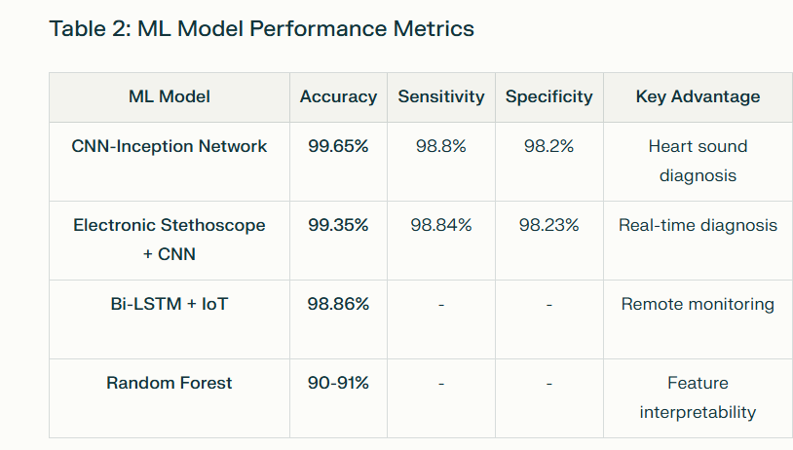
Literature Survey CLASS 3: ML Advantages Over Conventional
Methods :
Pattern Recognition: Detects complex patterns in multimodal data (ECG, imaging, EHR) beyond human capability
Reduces dependency on specialized expertise
Enables real-time monitoring through IoT/wearables
Cost-effective for mass screening
Data Integration: Combines clinical data, imaging, biometric signals, and wearable device data simultaneously
Consistency: Eliminates human diagnostic variability and provides standardized assessments
Table 3.2 : Prediction of Machine Learning Accuracy [7]

Slide 16
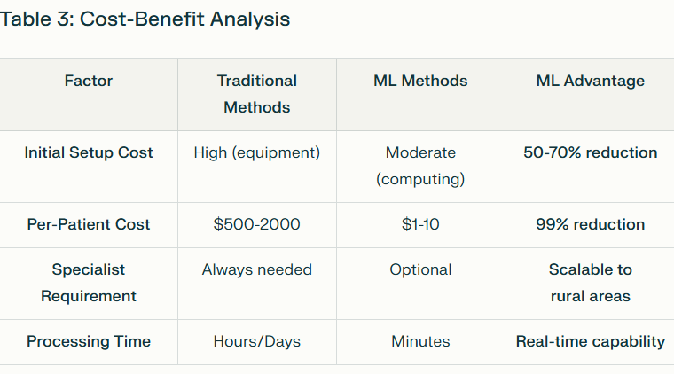
Literature Survey CLASS 3: ML Advantages Over Conventional
Proven Superior Performance :
Random Forest: 90-91% accuracy consistently
XGBoost: 97.57% accuracy with 98% AUC
Learning Vector Quantization: 98.7% accuracy
Deep Learning: Up to 99.65% accuracy
Comparative Performance: ML models consistently exceed 95% accuracy, outperforming traditional diagnostic methods
Clinical Impact:
Early detection before symptom manifestation
Reduced diagnostic time and costs
Real-time monitoring achieves 98.86% accuracy.
Table 3.2 : Expenditure Saving on using Machine Learning rather than Old Methods [8]

Slide 17
Literature Survey CLASS 4: MACHINE LEARNING TECHNIQUES
Machine Learning (ML) uses algorithms that learn patterns from historical patient data to predict heart disease risk.
Clinical and demographic data such as age, blood pressure, cholesterol, BMI, smoking habits, and genetic factors are used as input features.
Preprocessing steps include handling missing values, encoding categorical variables, and feature selection to improve model accuracy.
Common ML algorithms applied include Decision Trees, Random Forest, K-Nearest Neighbors (KNN), Naive Bayes, and gradient boosting methods like XGBoost. [10]
These algorithms analyze complex nonlinear relationships in the data that traditional statistical methods may miss.
Model training involves splitting data into training and testing sets, tuning hyperparameters, and evaluating performance using metrics like accuracy, precision, recall, and F1-score.
The ultimate goal is to develop predictive models that can classify patients based on their likelihood of developing heart disease, enabling early intervention and better management.

Slide 18
Literature Survey
Table 4.1 Continued
Dataset
Variable Name | Role | Type | Description | Missing Values
age | Feature | Integer | Age | No
sex | Feature | Categorical | Sex | No
cp | Feature | Categorical | Chest Pain Type | No
trestbps | Feature | Integer | Resting blood Pressure (on admission to hospital) | No
chol | Feature | Integer | Serum Cholesterol | No
fbs | Feature | Categorical | Fasting Blook Sugar > 120 mg/dl | No
thal | Feature | Categorical | Thalassemia | Yes

Slide 19
Literature Survey
Table 4.1 Data Set For ML [9]
Dataset
Variable Name | Role | Type | Description | Missing Values
restecg | Feature | Categorical | Resting Electrocardiographic results | No
thalach | Feature | Integer | Maximum Heart Rate Achieved | No
exang | Feature | Categorical | Exercise Induced angina | No
oldpeak | Feature | Integer | ST depression induced by exercise relative rest | No
slope | Feature | Categorical | Slope of the peak exercise ST segment | No
ca | Feature | Integer | Number of major vessels colored by fluoroscopy | Yes
num | TARGET | Integer | Diagnosis of heart disease | No

Slide 20
Literature Survey
EDA, Feature Scaling & Extraction
EDA helps understand the dataset’s structure, distributions, and relationships between variables through visualization and statistical summaries.
Common visualizations include histograms, box plots, scatter plots, and correlation heatmaps to detect patterns and anomalies.
Feature selection identifies the most relevant attributes affecting heart disease prediction, improving model accuracy and reducing complexity.
Techniques such as correlation analysis (Pearson coefficient) and mutual information are used to select key features like age, cholesterol levels, blood pressure, BMI, smoking, and genetic factors.
Removing redundant and irrelevant features minimizes overfitting and enhances computational efficiency.
Proper feature selection ensures models focus on impactful predictors, boosting interpretability and performance. [12]

Slide 21
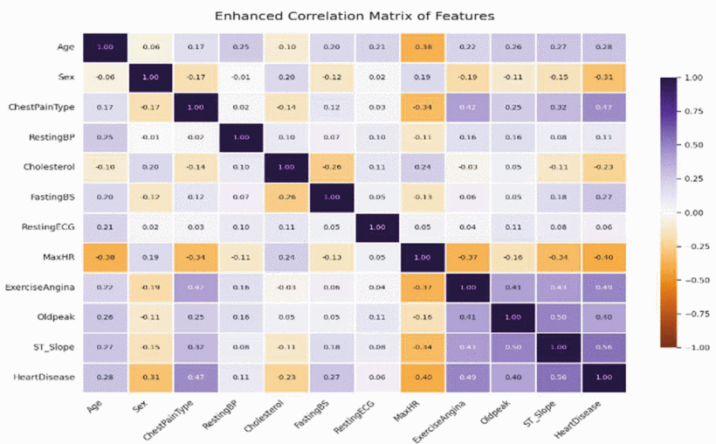
Literature Survey
Figure 4.1 Enhanced Correlation Matrix of Features[10]
EDA, Feature Scaling & Extraction

Slide 22
Literature Survey
Model Selection & Development
Multiple models were considered, focus was on hybrid ensemble methods for enhanced predictive accuracy and generalization [10].
Stacking Hybrid Model (Random Forest + XGBoost):
Uses stacking ensemble technique with Random Forest as base learner and XGBoost as meta-learner.
Meta-model captures patterns missed by base models, resulting in superior performance.
Demonstrated the best overall performance in all metrics and is recommended as the best model [10].
Voting Hybrid Model (Random Forest + SVM):
Combines predictions via voting mechanism to improve stability.
Performance inferior to stacking hybrid model [10].
Hybrid Voting Model (Gradient Boosting + Random Forest + SVM):
Versatile but less accurate than stacking model [10].
Individual classifiers trained for benchmarking:
Logistic Regression (simple & interpretable), Decision Tree, Random Forest, K-Nearest Neighbors (KNN), Naive Bayes, and Support Vector Machine (SVM) [10].

Slide 23
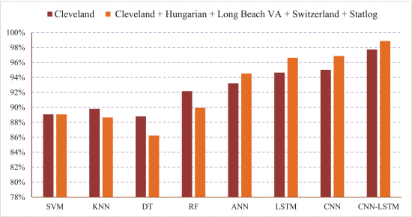
Literature Survey
Figure 4.2 Model Comparison [14]
Cross-validation with 5 folds used to ensure robust evaluation and reduce overfitting [10].
Stacking Hybrid Model (RF + XGBoost) optimally leverages strengths of both models, making it most suitable for heart disease prediction [10].
Model Selection & Development

Slide 24
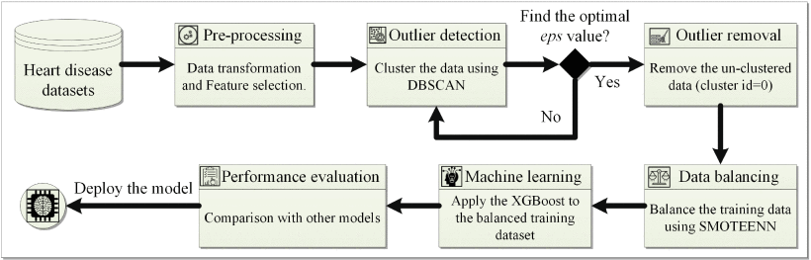
Literature Survey
Figure 4.3 The Proposed Heart Disease Prediction Model [11]
Overall Process

Slide 25
Literature Survey
Rationale Behind the Problem Statement
High Burden of Cardiovascular Diseases Heart disease is the leading cause of death worldwide, accounting for 17.9 million deaths annually. [15]
Limitations of Existing Methods Current diagnostic tools (ECG, angiography, imaging) are expensive, invasive, time-consuming, and not always accessible in rural or low-resource settings. [16]
Need for Early & Accurate Prediction Traditional risk scores (like Framingham) rely on limited variables and fail to capture the complexity of real patient data, leading to delayed interventions.
Role of Machine Learning ML can analyze diverse health factors (age, BP, cholesterol, lifestyle) and uncover hidden patterns that doctors may miss. It offers fast, low-cost, and scalable predictions that empower healthcare providers.
Our Aim To develop a reliable, data-efficient, and generalizable prediction model that supports early diagnosis, preventive care, and better decision-making.

Slide 26
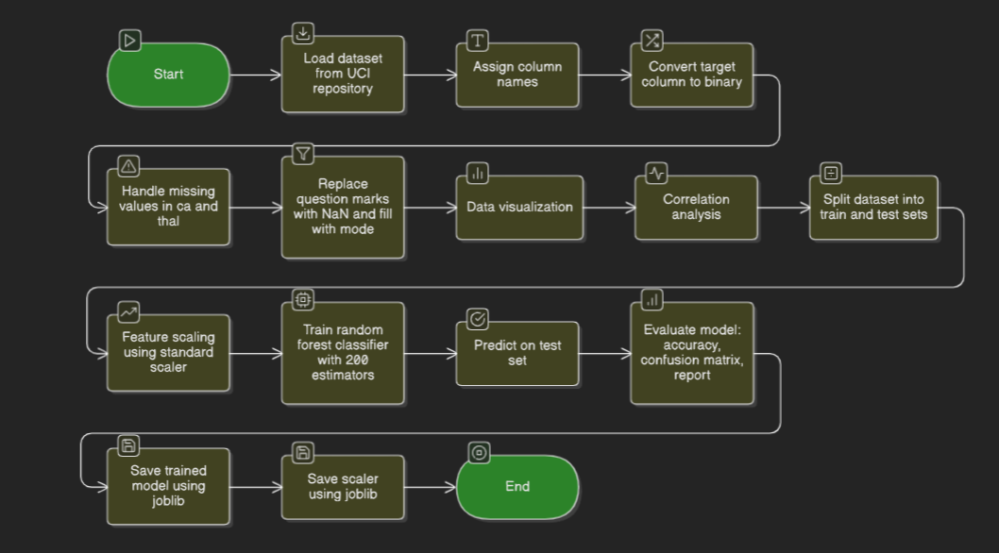
High Level Design

Slide 27
Detailed Design
Data Source and Ingestion
Input: Dataset from the UCI Machine Learning Repository (processed.cleveland.data).
Format: CSV file without headers.
Process:
Load dataset using pandas.read_csv().
Assign feature names for clarity and preprocessing.
Convert the target column so that all non-zero entries become 1 (indicating presence of heart disease).
2. Data Preprocessing
Objectives: Clean, transform, and prepare data for modeling.
Steps:
Missing Value Handling
Replace '?' symbols with np.nan.
Convert categorical columns (ca and thal) to numeric types.
Fill missing values in these columns with their respective mode values.
Data Type Conversion
Ensure all columns are numeric to avoid type errors during model training.
Feature Transformation
Binary encode target into 0 (no disease) and 1 (disease).
Notes:
Pooja

Slide 28
Detailed Design
3. Exploratory Data Analysis (EDA)
Goal: Understand class distribution and feature correlations.
Steps:
Create count plots for target to visualize class balance.
Generate a correlation matrix using df.corr().
Plot a heatmap to identify highly correlated features that impact model performance.
4. Data Splitting
Tool: train_test_split from scikit-learn.
Parameters:
Test size: 20%
Stratified Splitting: Ensures class balance in train and test sets.
Random state: 42 for reproducibility.
Output:
X_train, X_test, y_train, y_test
Notes:
Pooja

Slide 29
Detailed Design
5. Feature Scaling
Purpose: Normalize feature distributions to improve model performance.
Process:
Initialize StandardScaler.
Fit and transform X_train to standard scale (mean 0, std 1).
Apply same scaler on X_test for consistent scaling.
6. Model Training
Algorithm: Random Forest Classifier (RandomForestClassifier)
Configuration:
n_estimators = 200 (number of trees)
random_state = 42 for reproducibility.
Training:
Fit the model using X_train_scaled and y_train.
The model learns decision boundaries from ensemble-based tree voting.
Notes:
Pooja

Slide 30
Detailed Design
7. Model Evaluation
Metrics:
Accuracy Score: accuracy_score(y_test, y_pred)
Confusion Matrix: Visual validation of true and false predictions.
Classification Report: Precision, recall, f1-score for each class.
Objective: Measure predictive quality and model balance on unseen data.
8. Model Persistence
Purpose: Save trained artifacts for reuse or deployment.
Library: joblib
Artifacts:
heart_model.pkl – Serialized trained Random Forest model.
scaler.pkl – Serialized StandardScaler for consistent feature scaling.
Notes:
Pooja

Slide 31
Detailed Design
9. Output and Visualization
Figures:
Target distribution bar plot (disease vs no disease).
Correlation heatmap to analyze inter-feature relationships.
Reports:
Classification summary printed on console.
Accuracy displayed as percentage.
10. Deployment Readiness
The saved model (heart_model.pkl) and scaler (scaler.pkl) can later be integrated into:
A web app (Flask, FastAPI) for real-time predictions.
Batch inference pipelines for bulk patient records.
Dashboards for medical analytics with visualization tools.
Notes:
Pooja

Slide 32
Implementation And Mathematical Model
Algorithm used for implementation
1. Load heart‑disease dataset into Python.
2. Clean, encode, scale features and handle missing values.
3. Split data into train and test sets.
4. Train the dataset into ML model Random Forest.
5. Evaluate models using accuracy, precision, recall, F1‑score, and Confusion Matrix.
6. Select the best model and save it for heart‑disease risk prediction.
Notes:
Pooja

Slide 33
Implementation And Mathematical Model
Mathematical Model For Random Forest
Input Dataset Representation
D={(x1 ,y1),(x2 ,y2),…,(xN,yN)}
Where:
❖ xi = [xi1 ,xi2 ,…,xid]is a feature vector with d input attributes
❖ yi ∈{0,1} is the heart disease label (0 = No disease, 1 = Disease)
❖ For the Cleveland dataset:
❖ N=303
❖ d=13
Notes:
Pooja

Slide 34
Implementation And Mathematical Model
Mathematical Model For Random Forest
Bootstrap Sampling (Bagging)
Random Forest creates B different bootstrap datasets:
Db={(xi ′,yi ′)},b=1,2,…,B
Where each bootstrapped dataset is constructed by sampling from D with replacement:
xi ′∼D
Typically: B=200 trees in our model.
Notes:
Pooja

Slide 35
Implementation And Mathematical Model
Mathematical Model For Random Forest
Random Feature Selection (Feature Subspacing)
At each node of every decision tree:
❖ Instead of considering all ddd features,
❖ Random Forest selects a subset of m features:
𝑚 = Sqrt(𝑑) For classification tasks.
❖ So, at each split:
❖ Choose best split only from m randomly selected features
❖ This reduces correlation between trees → improves model generalization.
Notes:
Pooja

Slide 36
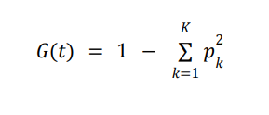
Implementation And Mathematical Model
Mathematical Model For Random Forest
Decision Tree Construction
Where:
❖ pk proportion of samples belonging to class k in a node
❖ K = 2 (heart disease vs no disease)
Notes:
Pooja

Slide 37
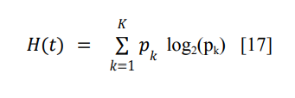
Implementation And Mathematical Model
Mathematical Model For Random Forest
Decision Tree Construction
Where:
❖ pk proportion of samples belonging to class k in a node
❖ K = 2 (heart disease vs no disease)
Notes:
Pooja

Slide 38
Implementation And Mathematical Model
Mathematical Model For Random Forest
Decision Tree Construction
Where:
❖ pk proportion of samples belonging to class k in a node
❖ K = 2 (heart disease vs no disease)
Notes:
Pooja

Slide 39
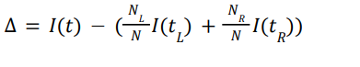
Implementation And Mathematical Model
Mathematical Model For Random Forest
Optimal Split Selection
Where:
❖ I(t) = impurity (Gini or Entropy)
❖ tL, tR = left & right child nodes
❖ NL,NR = number of samples
Notes:
Pooja

Slide 40
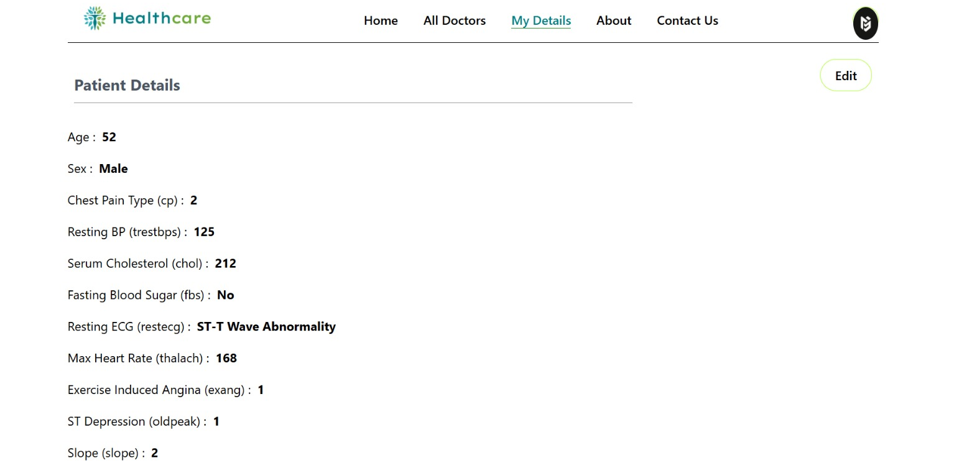
Results And Discussion
Notes:
Pooja

Slide 41
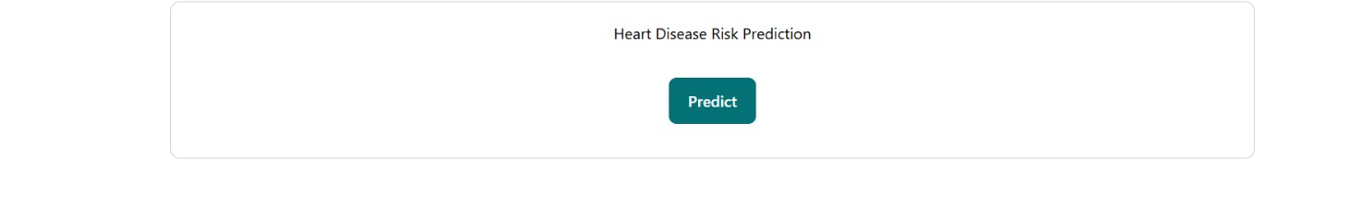
Results And Discussion
Notes:
Pooja

Slide 42
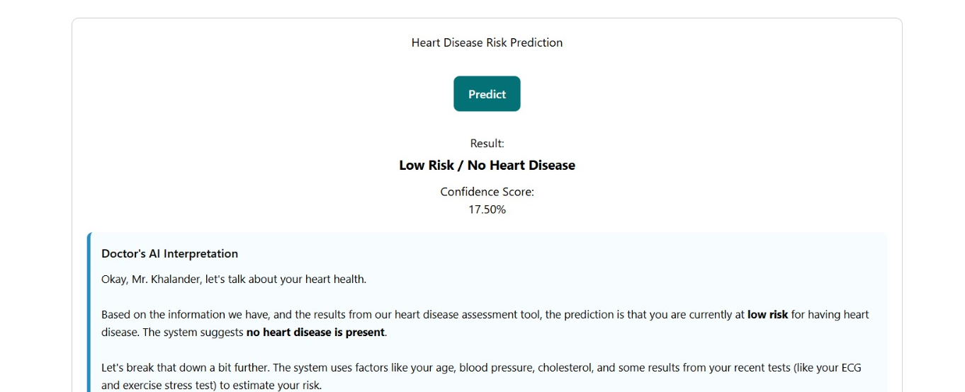
Results And Discussion
Notes:
Pooja

Slide 43
References
[1] Zhang, J., Xu, H., Li, Y., Li, J. and Wang, Y., “Psychometric evaluation of the Pediatric Quality of Life Inventory 3.0 cardiac module in adolescents with congenital heart disease in China”, Health and Quality of Life Outcomes, Volume 21, Article no. 125, Pages 1, 2023.
[2] Zhang, J., Xu, H., Li, Y., Li, J. and Wang, Y., “Psychometric evaluation of the Pediatric Quality of Life Inventory 3.0 cardiac module in adolescents with congenital heart disease in China”, Health and Quality of Life Outcomes, Volume 21, Article no. 125, Pages 4, 2023.
[3] Harikrishnan, S., Bahl, A., Roy, A., Mishra, A., Prajapati, J., Manjunath, C. N., Sethi, R., Guha, S., Satheesh, S., Dhaliwal, R. S., Sharma, M., Ganapathy, S., & Jeemon, P., “One-year mortality and re-admission rate by disease etiology in National Heart Failure Registry of India”, Nature Communications, Volume 16, Article no. 275, Pages 4, 2025.
[4] C. W. Callaway et al., "Transforming Cardiovascular Care Through Artificial Intelligence: The Future is Now: A Scientific Statement From the American Heart Association," Circulation, vol. 148, no. 9, pp. e127-e148, Aug. 2023, doi: 10.1161/CIRCULATIONAHA.120.048365.
[5] M. A. Naser, A. A. Majeed, M. Alsabah, T. R. Al-Shaikhli, and K. M. Kaky, "A Review of Machine Learning’s Role in Cardiovascular Disease Prediction: Recent Advances and Future Challenges," Algorithms, vol. 17, no. 2, art. 78, 2024, doi: 10.3390/a17020078

Slide 44
References
[6] B. Kumar, S. Sharma, A. Gupta, and R. Singh, “A comprehensive review of machine learning for heart disease prediction: Recent advances and future perspectives,” Frontiers in Artificial Intelligence, vol. 8, art. 1583459, May 2025, doi: 10.3389/frai.2025.1583459.
[7a] A. Rajesh, P. Kumar, S. Mehta, and R. Sharma, "Cardiovascular disease prediction using machine learning metrics," J. Young Pharmacists, vol. 17, no. 1, pp. 226-233, Jun. 2025, doi: 10.5530/jyp.20251231.
[7b] S. M. Alzahrani et al., "Comprehensive evaluation and performance analysis of machine learning algorithms for heart disease prediction," PMC Cardiovascular Medicine, Apr. 2024. [Online]. Available: https://pmc.ncbi.nlm.nih.gov/articles/PMC10991287/ .
[7c] M. A. Rahman, S. K. Biswas, and N. Ahmed, "Prediction of heart disease based on machine learning using Jupyter notebook," PMC Public Health, Jul. 2023. [Online]. Available: https://pmc.ncbi.nlm.nih.gov/articles/PMC10378171/ .
[8a] A. A. Lamir, S. Razzagzadeh, and Z. Rezaei, "A comprehensive machine learning framework for heart disease prediction: Performance evaluation and future perspectives," arXiv preprint, arXiv:2505.09969, May 2025, doi: 10.48550/arXiv.2505.09969.
[8b] A. Gnanavelu, P. Kumar, S. Rajesh, and M. Sharma, "Cardiovascular disease prediction using machine learning metrics," J. Young Pharmacists, vol. 17, no. 1, pp. 226-233, Jun. 2025, doi: 10.5530/jyp.20251231.

Slide 45
References
[9] Markelle Kelly, Rachel Longjohn, and Kolby Nottingham, The UCI Machine Learning Repository, available: https://archive.ics.uci.edu
[10] R. S. Bhaduaria, I. Javid, and A. Khara, "Advanced Heart Attack Risk Prediction Using Stacked Hybrid Machine Learning," Journal of Mobile Multimedia, vol. 21, no. 3-4, pp. 393-406, Jul. 2025, doi: 10.13052/jmm1550-4646.21343. [Accessed: Sep. 5, 2025].
available:- https://ieeexplore.ieee.org/document/11129235
[11] N. L. Fitriyani, M. Syafrudin, G. Alfian, and J. Rhee, "HDPM: An Effective Heart Disease Prediction Model for a Clinical Decision Support System," IEEE Access, vol. 8, article no. 9144587, pp. 133034–133050, 2020, doi: 10.1109/ACCESS.2020.3010511. [Accessed: Sep. 6, 2025].
available:- https://ieeexplore.ieee.org/document/9144587
[12] P. Goswami and D. Bhatia, "Application of Machine Learning in FPGA EDA Tool Development," IEEE Access, vol. 11, pp. 109564–109580, 2023, doi: 10.1109/ACCESS.2023.3322358. Available: https://ieeexplore.ieee.org/document/10272331

Slide 46
References
[13] A. Janosi, W. Steinbrunn, M. Pfisterer, and R. Detrano, "Heart Disease [Dataset]," UCI Machine Learning Repository, 1989, doi:10.24432/C52P4X. Available: https://archive.ics.uci.edu/dataset/45/heart+disease
[14] M. S. Al-Reshan, S. Amin, M. A. Zeb, A. Sulaiman, H. Alshahrani, and A. Shaikh, “A Robust Heart Disease Prediction System Using Hybrid Deep Neural Networks,” in IEEE Journals & Magazine (IEEE Access), 2025, doi: 10.1109/ACCESS.2025.10302290. Available: https://ieeexplore.ieee.org/document/10302290
[15] World Health Organization, “Cardiovascular diseases (CVDs),” WHO, 2025. Available: https://www.who.int/health-topics/cardiovascular-diseases#tab=tab_1
[16] S. Muniasamy, A. R. Rajeswari, and P. S. Satheesh, “Prediction of Heart Disease Using Machine Learning Algorithms,” in 2023 International Conference on Computer Communication and Informatics (ICCCI), Coimbatore, India, 2023, pp. 1–6, doi: 10.1109/ICCCI56946.2023.10122547. Available: https://ieeexplore.ieee.org/document/10122547

Slide 47
THANK YOU
Notes:
ap

