Slide 1
CGB1201 – JAVA PROGRAMMING
Department of Artificial Intelligence and Data Science
Academic Year: 2024 – 2025 (Odd Semester)
Register Number :2303811724321069
Name :Mohammed raasith H
Year :II
Semester :III
Section :B
Date :3-12-24

Slide 2
Title of the Project
QUIZ APPLICATION

Slide 3
Abstract
The Quiz Application divides key processes into components: Quiz Creation, User Responses, Scoring, and Feedback. Educators use an abstract class for quiz creation, while user input and scoring are handled separately. Feedback is provided based on performance. This modular design ensures flexibility, ease of maintenance, and a user-friendly experience.

Slide 4
Introduction
The Quiz Application simplifies quiz creation, administration, and grading for educators.It enables easy quiz creation, collects user responses, and auto-calculates scores.
Personalized feedback helps students improve, while saving time for educators.This tool enhances learning efficiency and interactivity.

Slide 5
Java Programming - Concepts Used
Classes & Objects: Question, Quiz, and QuizApp represent the core components.
Constructors: Initialize Question and Quiz objects.
Methods: checkAnswer(), startQuiz(), and provideFeedback() handle logic.
Data Structures: Arrays store options; ArrayList stores questions.
Loops & Conditionals: for loops for iteration; if-else for checking answers and feedback.
User Input: Scanner to capture user answers.
Arithmetic: Calculates score and percentage for feedback.

Slide 6
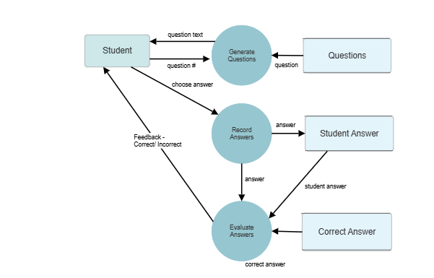
Proposed Architecture

Slide 7
Proposed Architecture - Description
1.User Interface (UI):
Displays questions, options, and collects user answers.
2.Quiz Controller:
Manages quiz flow, handles user input, and updates the score.
3.Question & Answer Logic:
Stores questions and checks user answers.
4.Score & Feedback:
Calculates the score and generates feedback based on the result.
5.Database (Optional):
Stores quiz data (questions, scores, etc.) for persistence.

Slide 8
List of Modules
Question Module:
Quiz Module:
User Interaction:
Scoring & Feedback:
Data Persistence (Optional):

Slide 9
Module Description
Question Module:
Stores quiz questions, answer options, and the correct answer.
Quiz Module
Manages the quiz, including adding questions and tracking the score.

Slide 10
Module Description (Cont..)
User Interaction Module
Handles user inputs, like selecting answers.
Scoring & Feedback Module
Calculates the score and provides feedback based on performance.
Data Persistence (Optional)
Saves quiz results and user data for future use.

Slide 11
Results and Discussion

Slide 12
Conclusion
In conclusionthe educational quiz application efficiently manages quiz creation, user responses, scoring, and feedback.
With a modular structure—covering Question handling, Quiz flow, User Interaction, Scoring, and Feedback—
it ensures smooth operation and effective learning.
Immediate feedback helps users improve, while the modular design allows for future scalability and enhancements.

Slide 13
Thank You
ANY QUERIES???

