Slide 1
Enhanced Text Extraction Using Image Processing
FINAL PRESENTATION (IMAGE PROCESSING 481)
- Mohammed Saalim Kartapillai
- Noor Fathima

Slide 2
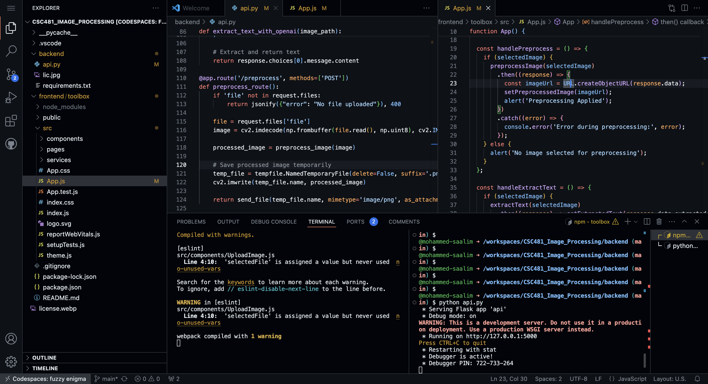
Introduction
Brief Background: Text extraction from images is a critical task in image processing, especially for street signs, banners, and license plates.
Challenges: Noise from various environmental factors (e.g., dirt, weather).
Varying lighting conditions, shadows, or glare.
Image distortions due to camera angles or poor quality.
Diverse font styles and inconsistent text clarity.
Purpose of the Project: Develop a robust method to accurately extract text from images using preprocessing techniques.

Slide 3
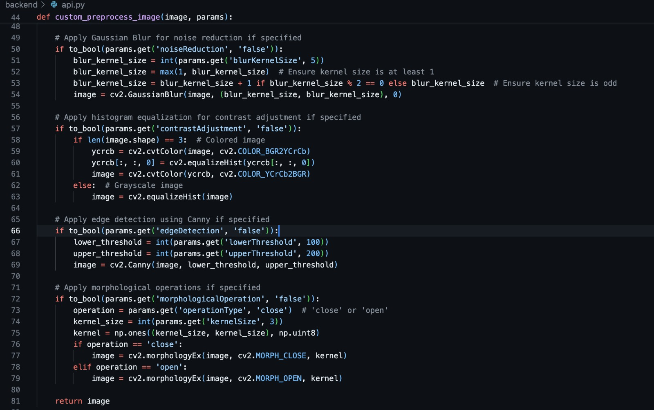
Goals
Improve text extraction accuracy through image preprocessing.
Tackle issues like noise, lighting variability, and distortions.
Develop an application allowing customizable preprocessing.

Slide 4
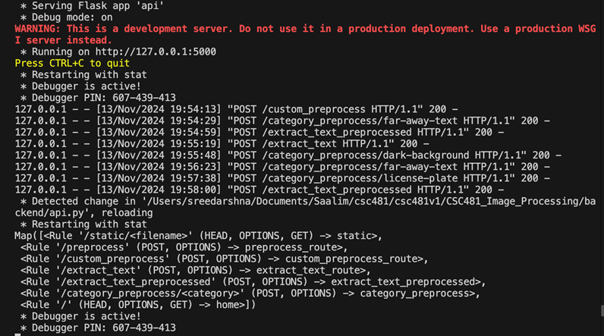
Implemented Methods
Dataset Used: Images of id cards, tables, dimlight, license plates, etc.
Technologies & Tools:
Python, OpenCV, Flask (Backend)React (Frontend) API for text extraction.
Tesseract, 3rd Party API for extraction, Customizable preprocessing options

Slide 5
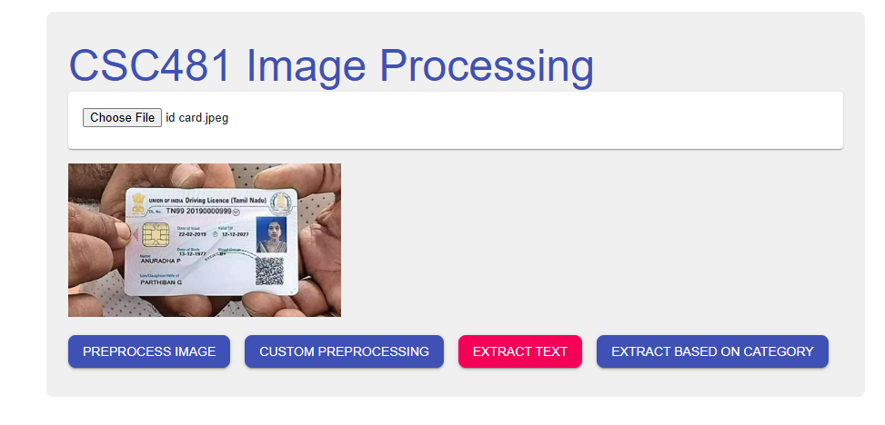
Landing Page

Slide 6
1. Preprocessing Methods Overview of Techniques
Noise Reduction: Gaussian Blur to reduce image noise and enhance text regions.
Contrast Adjustment: Histogram Equalization to improve text clarity by equalizing image brightness.
Edge Detection: Canny Edge Detection to highlight text boundaries and separate it from the background.
Morphological Operations: Dilation and Erosion to refine the shape of detected text regions.
Thresholding: Adaptive and Otsu’s Thresholding to convert images to binary format for better text isolation.
Color Space Conversion: Converting images to grayscale or other color spaces to simplify text detection and processing.

Slide 7
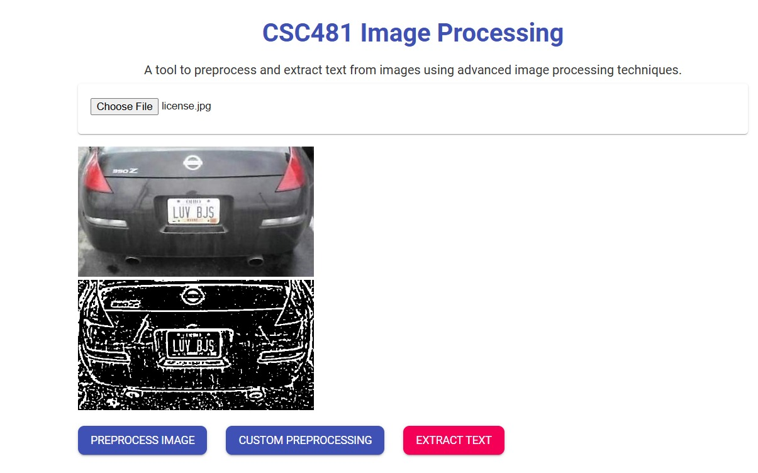
Preprocessed Image

Slide 8
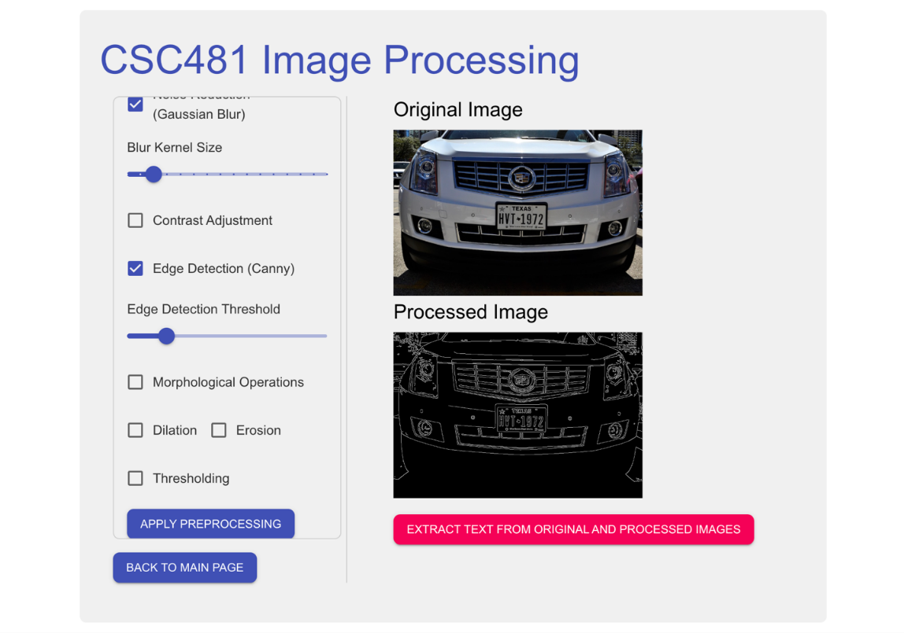
2. Custom Preprocessing Application
Customizable User Interface: Users can select and adjust preprocessing parameters. Options include kernel sizes, thresholds, etc.
Image Display: Original and processed images shown side by side.
Backend Communication: Preprocessed image sent to the backend for text extraction.

Slide 9
Prebuilt Configuration Modules for Specific Scenarios
Why Prebuilt Modules?
Different images present unique challenges for text extraction.
Tailored configurations improve OCR accuracy and save processing time.
Modules Covered:
License Plates: Improved contrast, reduced noise, adaptive thresholding.
ID Cards: Grayscale conversion, noise reduction, contrast enhancement.
Table Images: Gridline enhancement and text extraction.
Dark Backgrounds: CLAHE for contrast, denoising for noise reduction.
Far-Away Text: Resizing, sharpening, and segmentation.

Slide 10
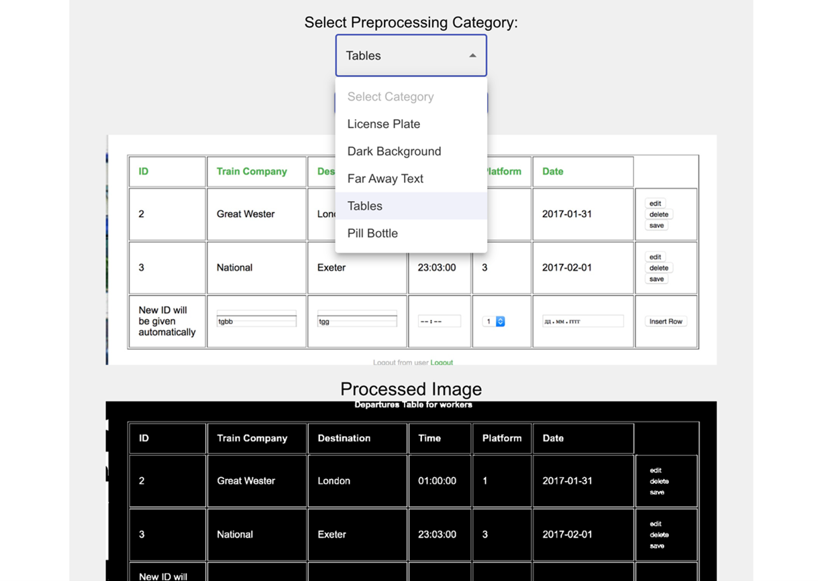
Tables

Slide 11
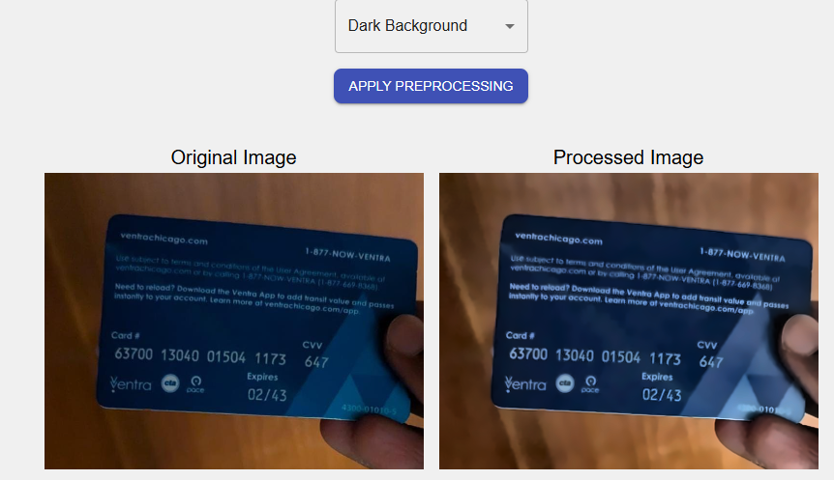
Dimlight

Slide 12
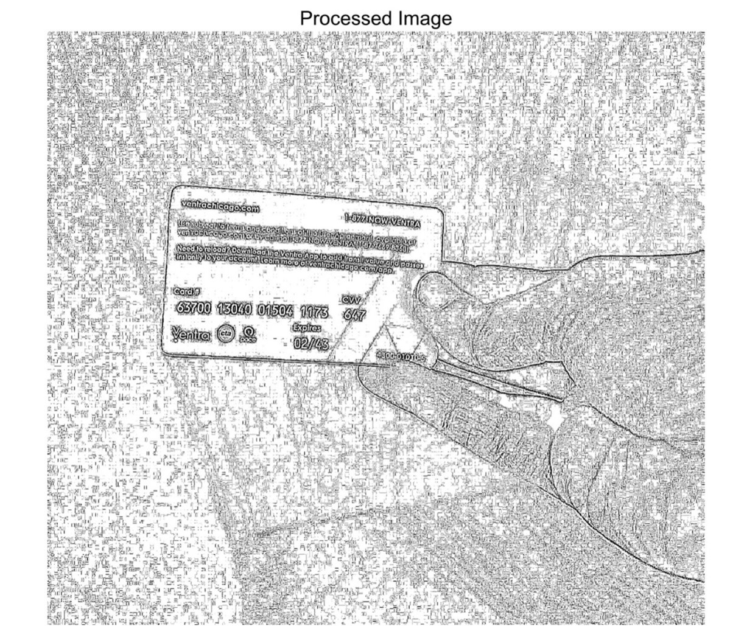
Distant images

Slide 13
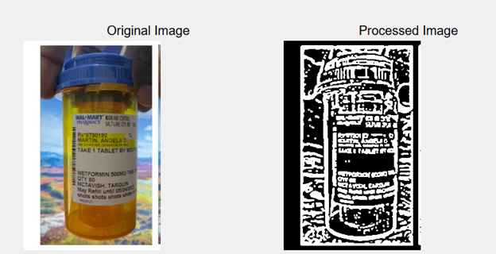
Challenges & Solutions
Challenges:
Different images require different preprocessing steps.
Handling noise, lighting, and image distortions.
Solutions:
Customizable preprocessing in the app to adjust for different image conditions.

Slide 14
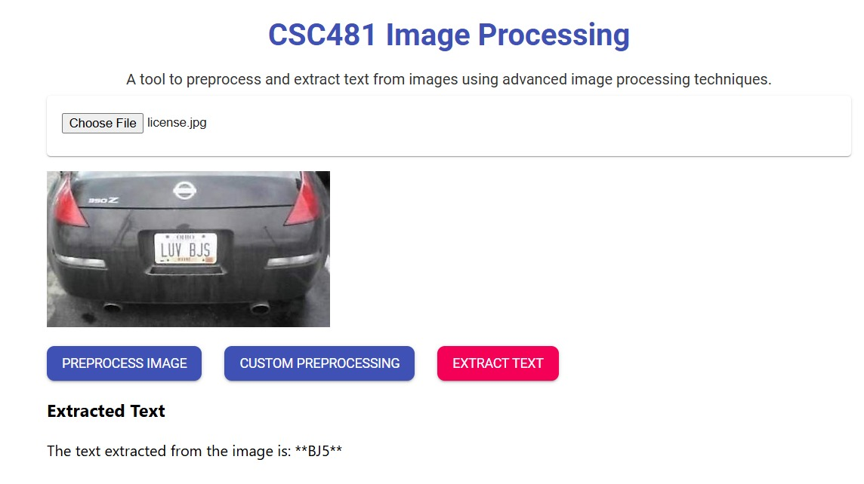
Results (Before Preprocessing)

Slide 15
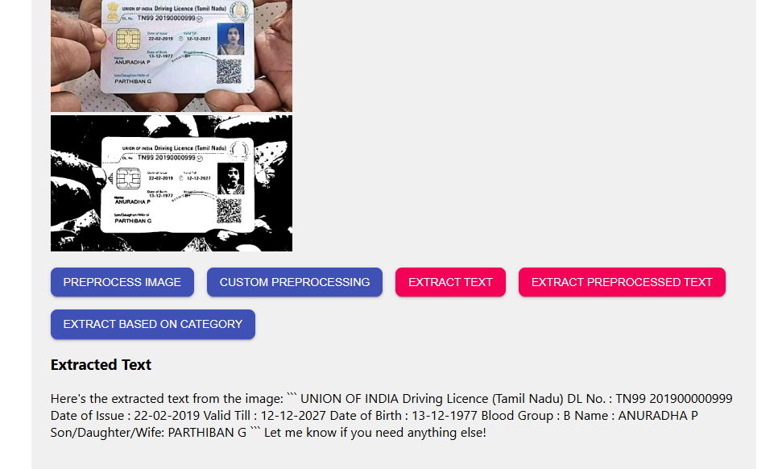
Results (After Preprocessing)

Slide 16
Impact on OCR Accuracy
Observation: Preprocessing significantly improves OCR performance.
Benefits:
Reduced noise impact.
Better text detection in poor lighting or with distortions.

Slide 17
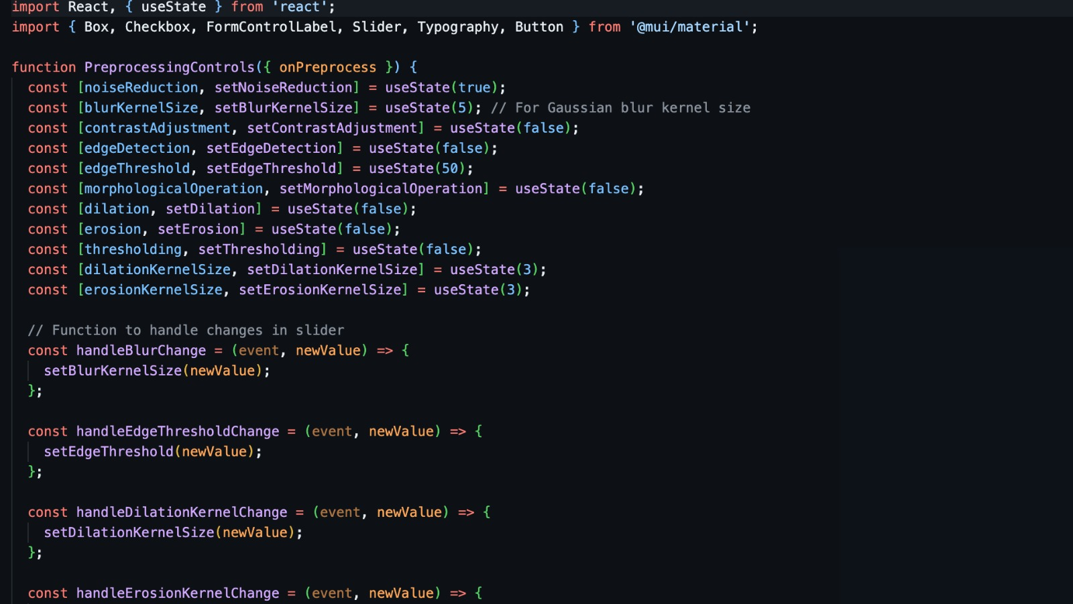
Conclusion & Future Work
Summary:
Developed a customizable preprocessing tool to enhance text extraction accuracy.
Future Enhancements:
Dynamically analyze images and apply optimal preprocessing techniques using Machine learning.
Optimize for real-time se and larger datasets.
Improve user experience.

Slide 18
Live Demo

Slide 19
THANK YOU

