Slide 1
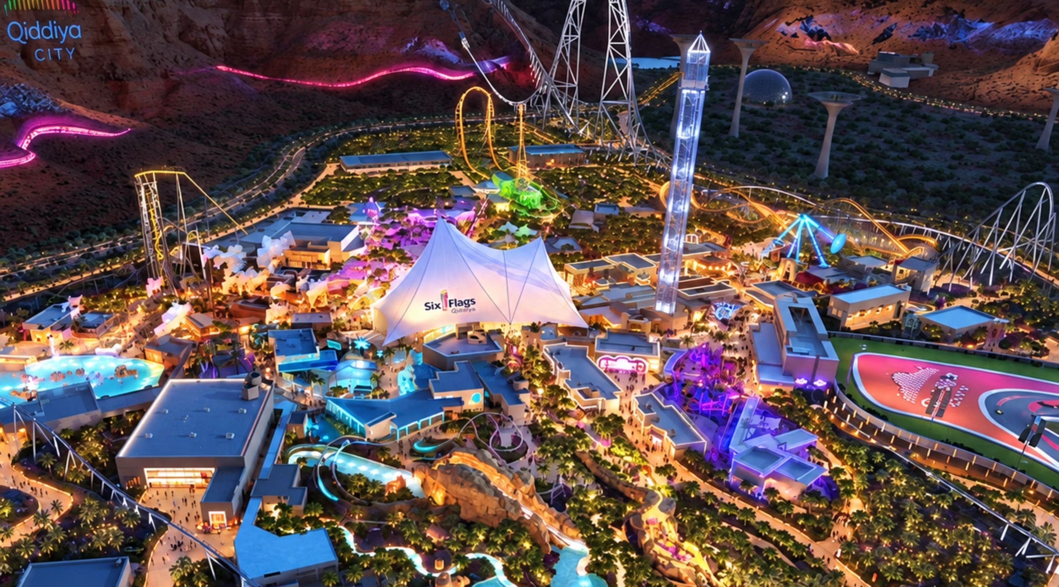


×
Nawaf Alghamdi
Abdulaziz Shafae
Mohammed Aljubaili
Java Web Development and AI Integration Bootcamp
Tuwaiq Academy
Notes:
SIKKA is a personalized visit planning assistant for Six Flags Qiddiya visits. Introduce the team and bootcamp.

Slide 2
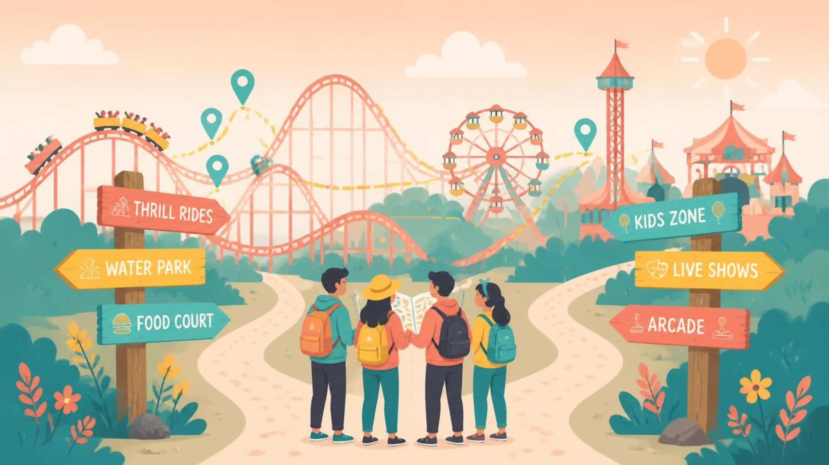



2
A Great Day Shouldn’t Be Hard to Plan
Is This Ride Suitable for Me?
How Do I Make the Most of My Time?
How Do We Plan for Everyone?
Visitors struggle to match ride requirements with their age, height, weight, health conditions, and companion needs.
Choosing rides, accounting for queues and walking distances, and fitting in breaks makes planning difficult.
Different interests and ride restrictions make it difficult for families and friends to coordinate their day.
Notes:
These are relatable visitor situations, not measured research findings. Start with the uncertainty of choosing the next activity, then connect that uncertainty to suitability, time and coordination.

Slide 3
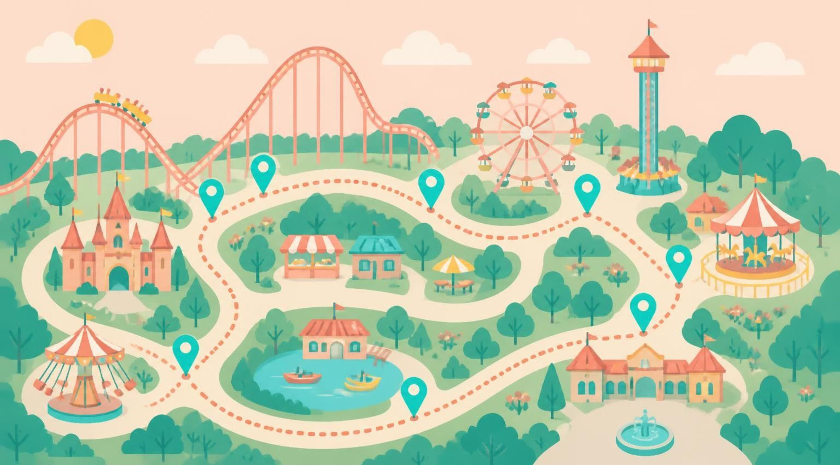
3
SIKKA Turns Uncertainty into a Plan
Understand Ride Suitability
Get a Personalized Plan
Coordinate the Day Together or Solo
Generate a plan based on preferences, available time, estimated waiting and walking times, and breaks.
Compare visitor profiles with available ride requirements and highlight restrictions or information requiring further confirmation.
Bring members’ preferences and needs into a coordinated plan that can be reviewed and adjusted.

Slide 4
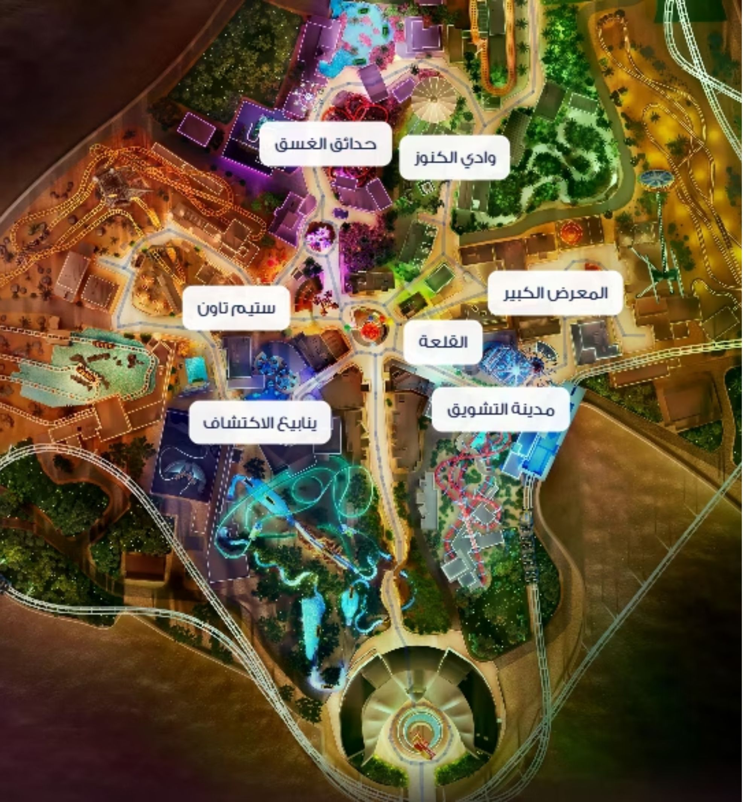
Explore Before You Plan
Rides and attractions shown on the map
Facilities and points of interest across the park
Published ride requirements for each ride
Estimated walking routes between points.

Slide 5
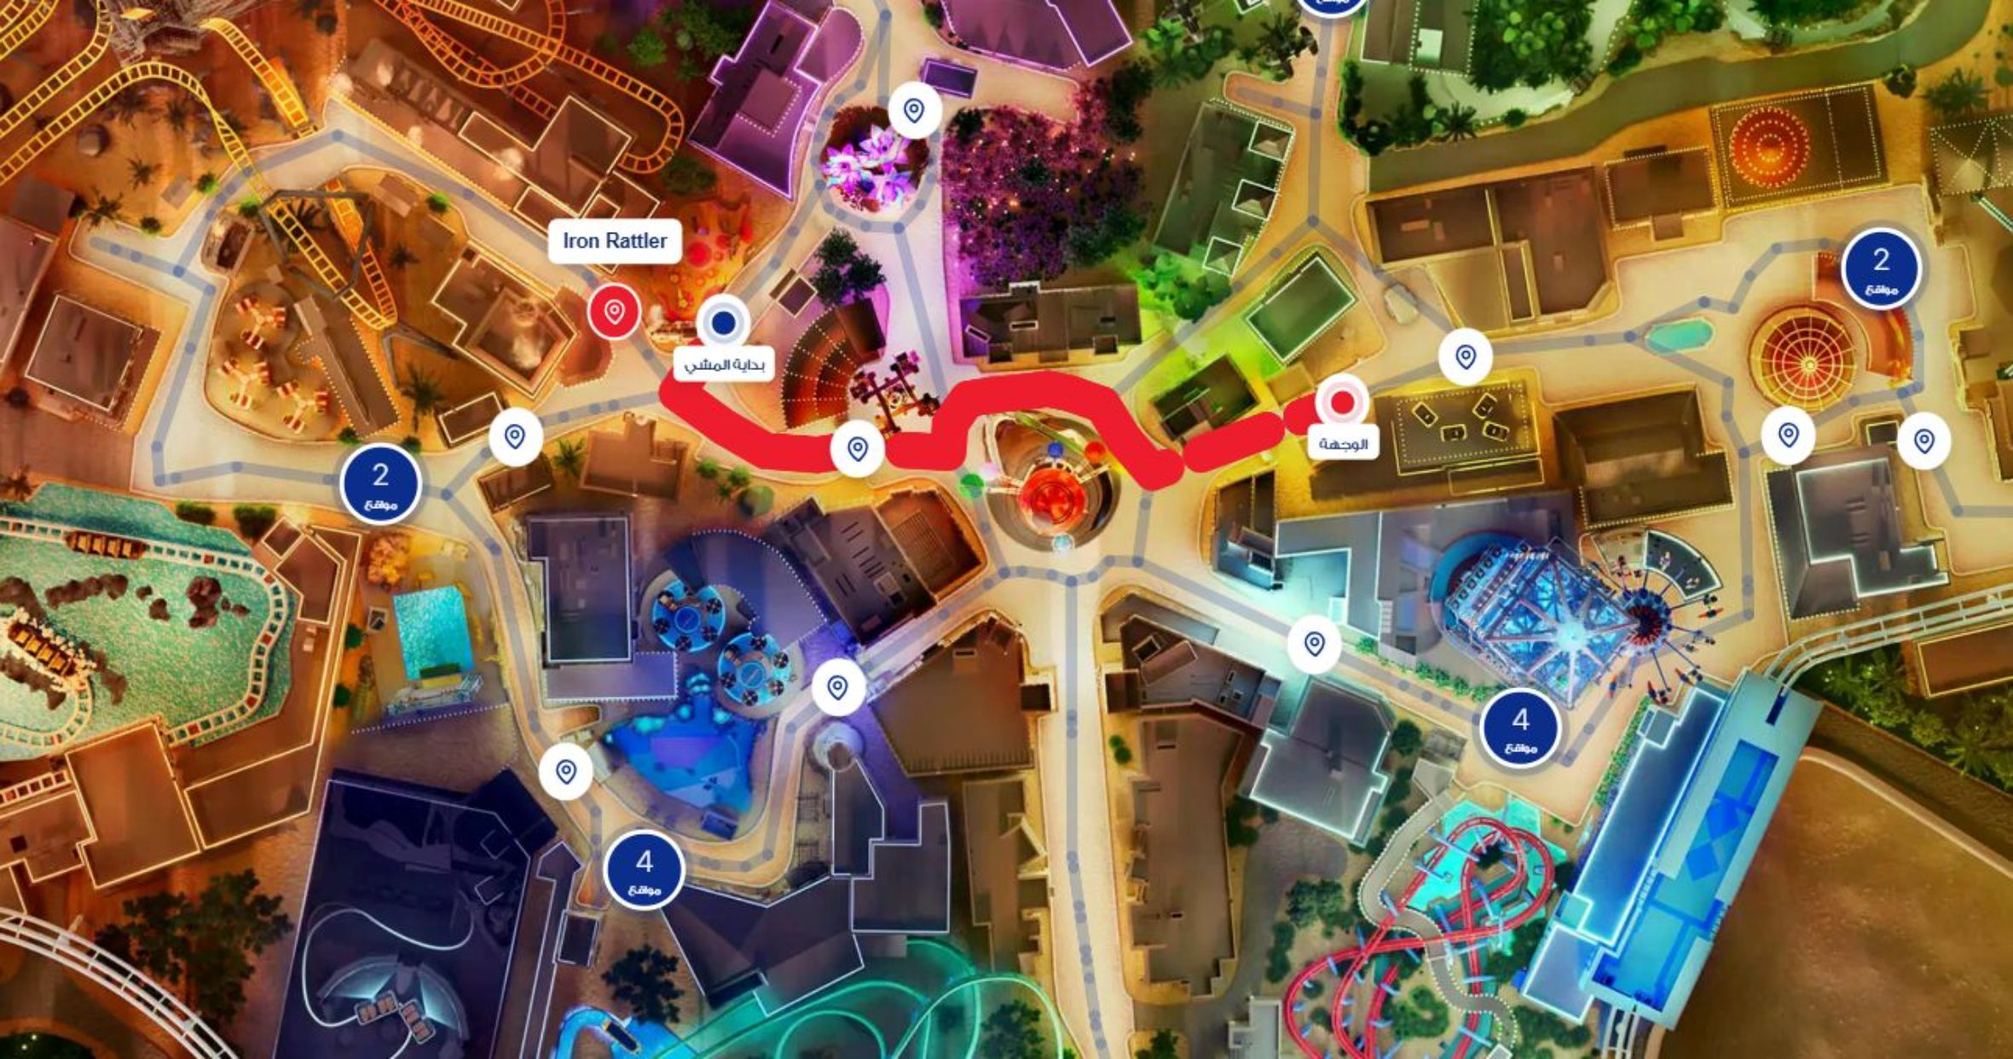

1
CHOOSE YOUR DESTINATION
From One Stop to the Next
Select a ride, restaurant, or facility.
Turn your next destination into a clear walking route.
2
SEE THE WALKING ROUTE
Follow a highlighted route along the mapped park walkways.
3
PLAN YOUR NEXT MOVE
View the estimated distance and walking time.
Notes:
Add the real route screenshot inside the dashed frame when available.

Slide 6
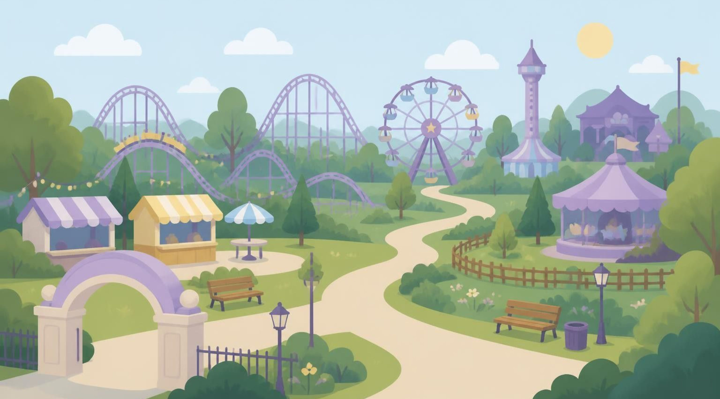
6
FLOW 01 — THE SOLO JOURNEY
Your Day, Your Priorities
Entrance
1
2
3
Set your visit
Share your preferences
Generate your itinerary
Choose the date and available duration.
➜
Complete your profile and select your preferred rides.
➜
Receive a plan considering your interests, eligibility, and time.
5
4
Start exploring
Review and approve
Ready to Enjoy
⬅
Follow your activities and walking routes.
⬅
Request adjustments or approve the proposed plan.
Individual interests, ride eligibility and available time shape one clear plan.
Notes:
One visitor's journey: the plan uses the visit date, duration, profile details and preferences to check ride eligibility and available time.

Slide 7

7
FLOW 02 — THE FAMILY JOURNEY
A Day That Considers Everyone
1
2
3
Create a family visit
Add family members
Set preferences and breaks
Entrance
Set the date and available time.
▶
Provide their ages and relevant eligibility details.
▶
Choose activities and meal preferences.
5
4
Review and approve
Generate the itinerary
Ready to Enjoy
◀
The organizer checks the plan and requests changes if needed.
◀
Consider ride suitability, companion requirements, and shared activities.
Different ages, ride eligibility, companion requirements and meal breaks fit one day.
Notes:
One family's journey: ages, ride eligibility, companion requirements and meal breaks are considered in one coordinated itinerary, approved by the organizer.

Slide 8
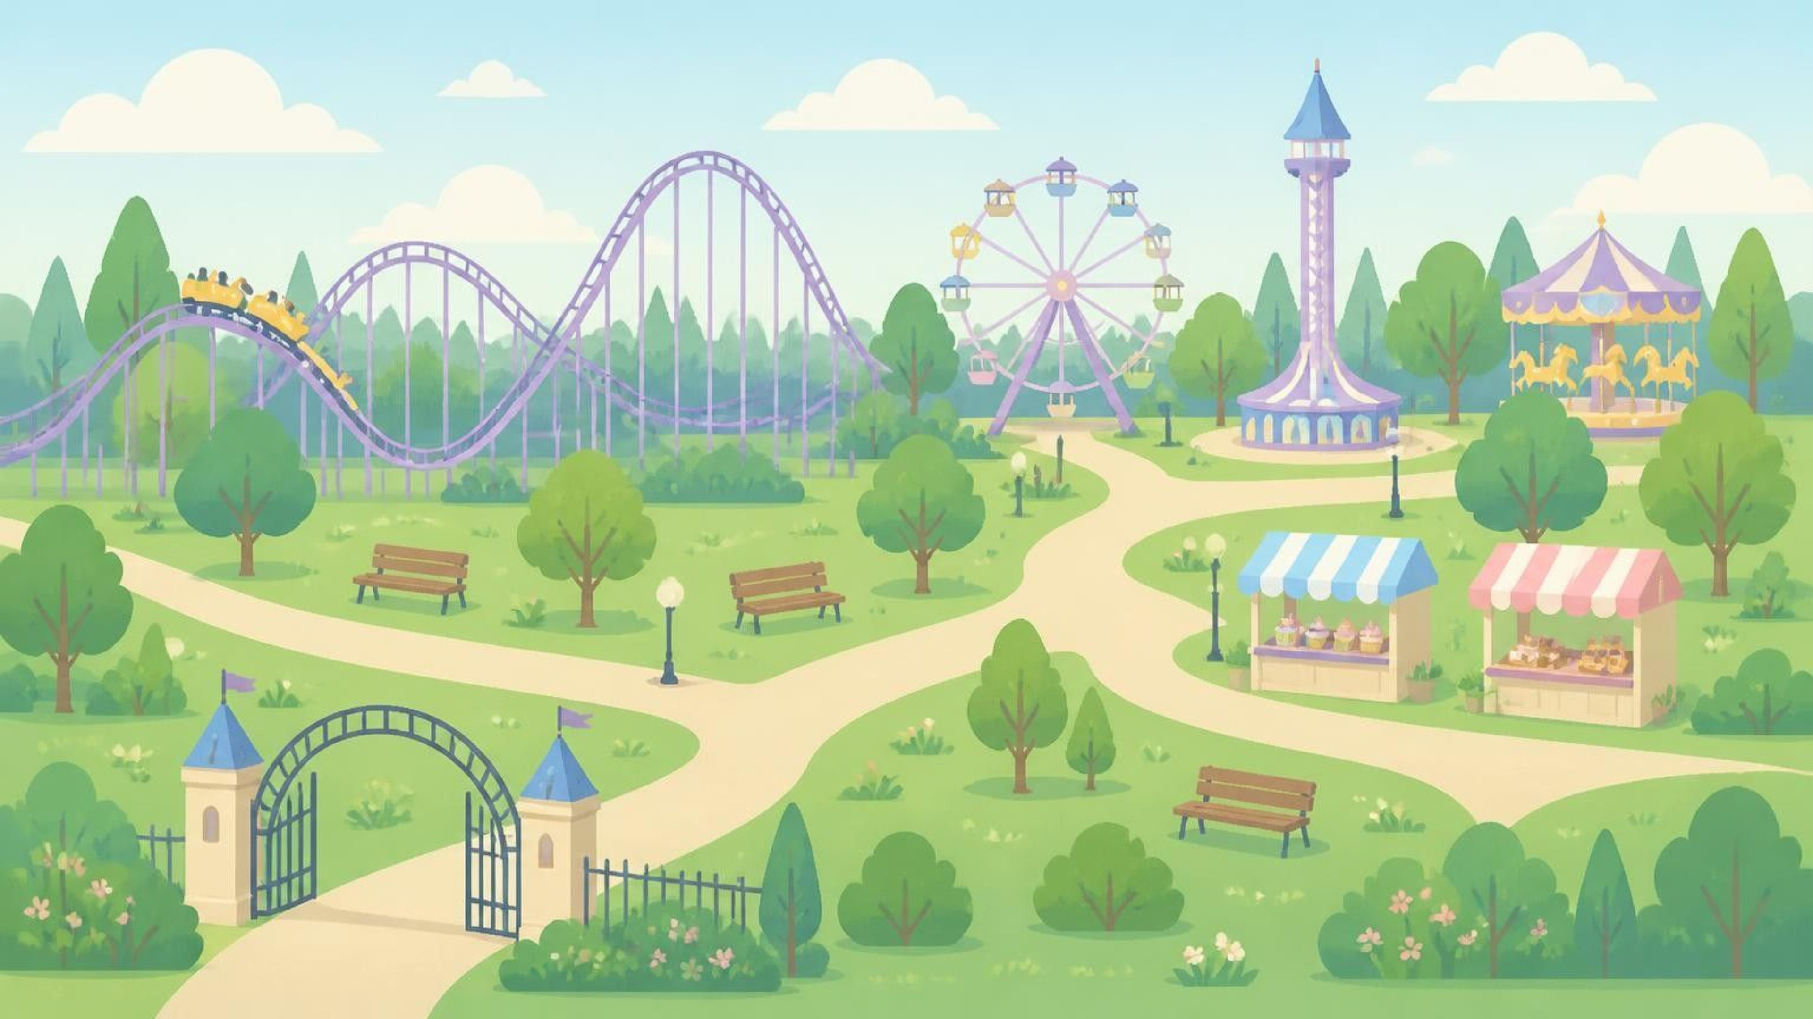
8
FLOW 03 — THE FRIENDS JOURNEY
Different Interests, A Shared Experience
1
2
3
Create and invite
Join and confirm
Share preferences
Set up the visit and share the group code.
Friends join and respond to attendance.
Each member provides their interests and relevant profile details.
Entrance
➜
➜
6
5
4
Review and approve
Generate the itinerary
Choose a group mode
Ready to Enjoy
The organizer reviews the proposal before the visit begins.
←
Build a plan considering members’ preferences and eligibility.
←
Decide how the group wants to experience the park.
Coordination and balanced preferences give every friend a place in one shared plan.
Notes:
One group's journey: the organizer creates the visit, friends join and confirm, each member gives preferences, the supported group mode is chosen, and the organizer reviews and approves the plan.

Slide 9
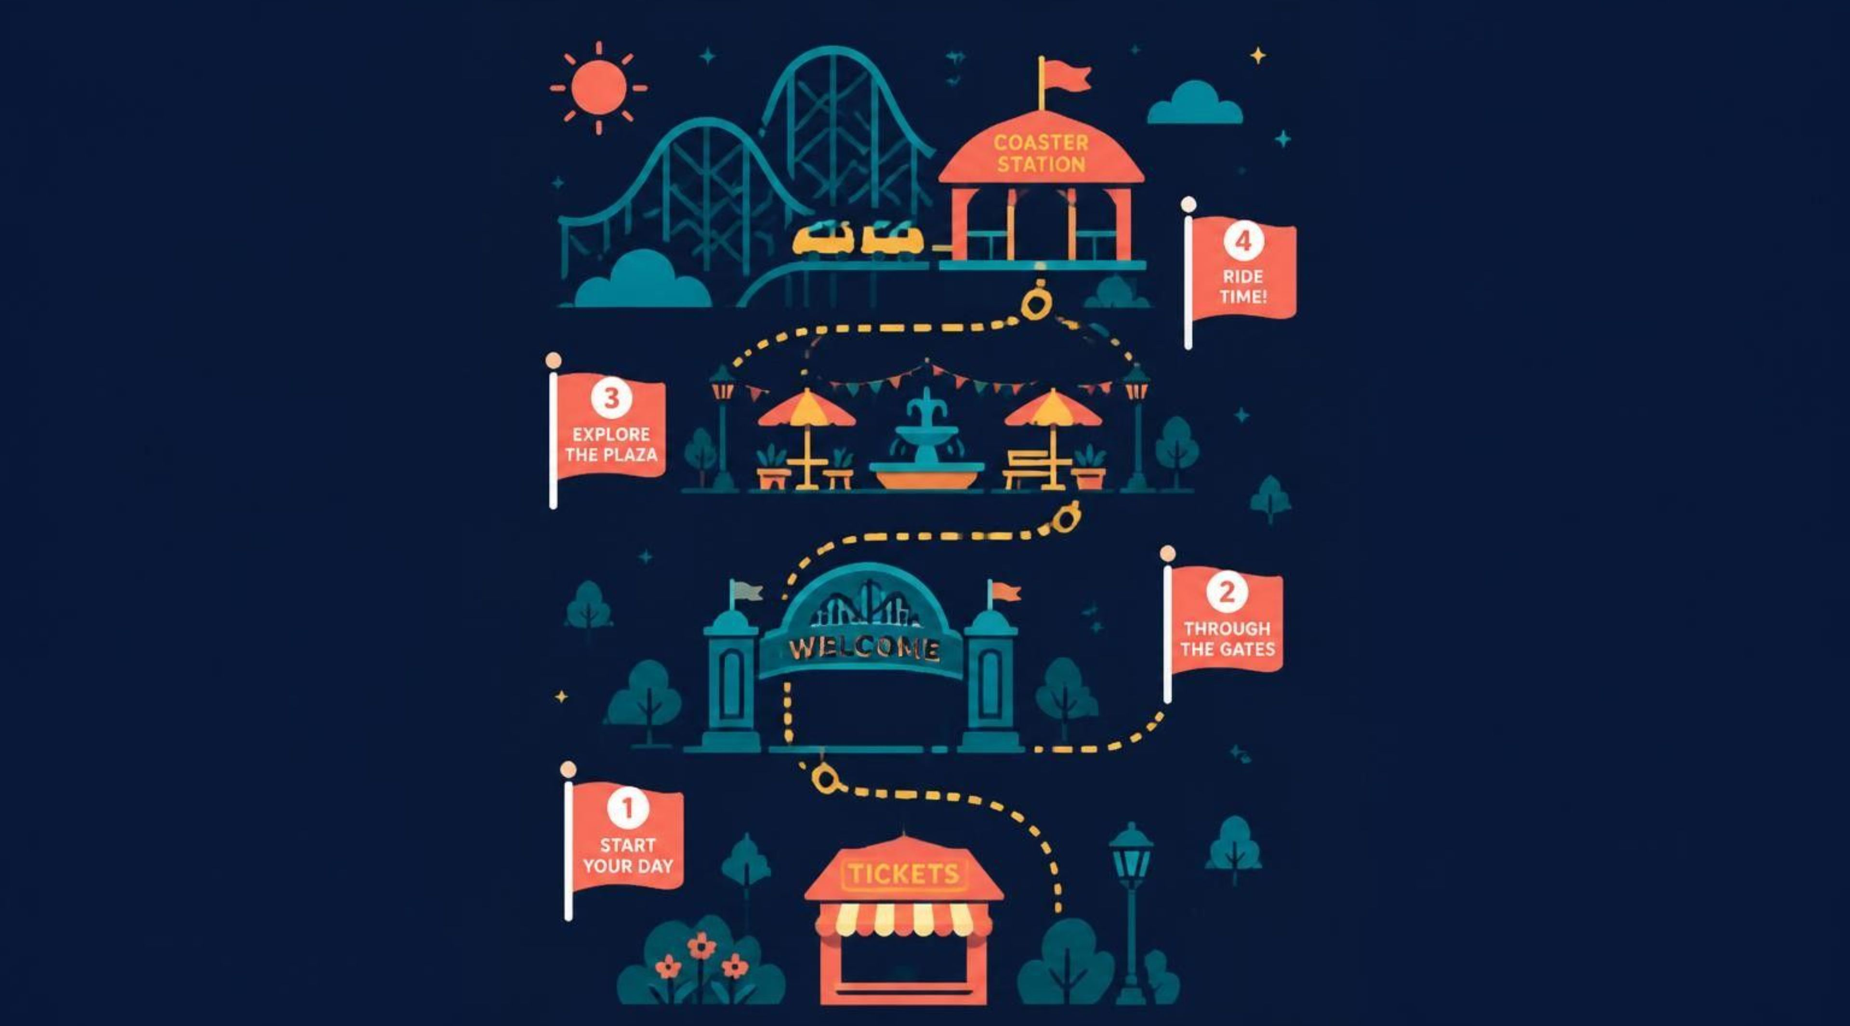




9
DURING THE VISIT
From Plans to Experiences
NEXT ACTIVITY
WALKING ROUTES
See what’s coming next in your itinerary.
Follow estimated routes between park locations.
PROGRESS & REMINDERS
PLAN ADJUSTMENTS
Track activities and receive reminders for upcoming activities and meal stops.
Review and approve proposed changes before they apply.

Slide 10
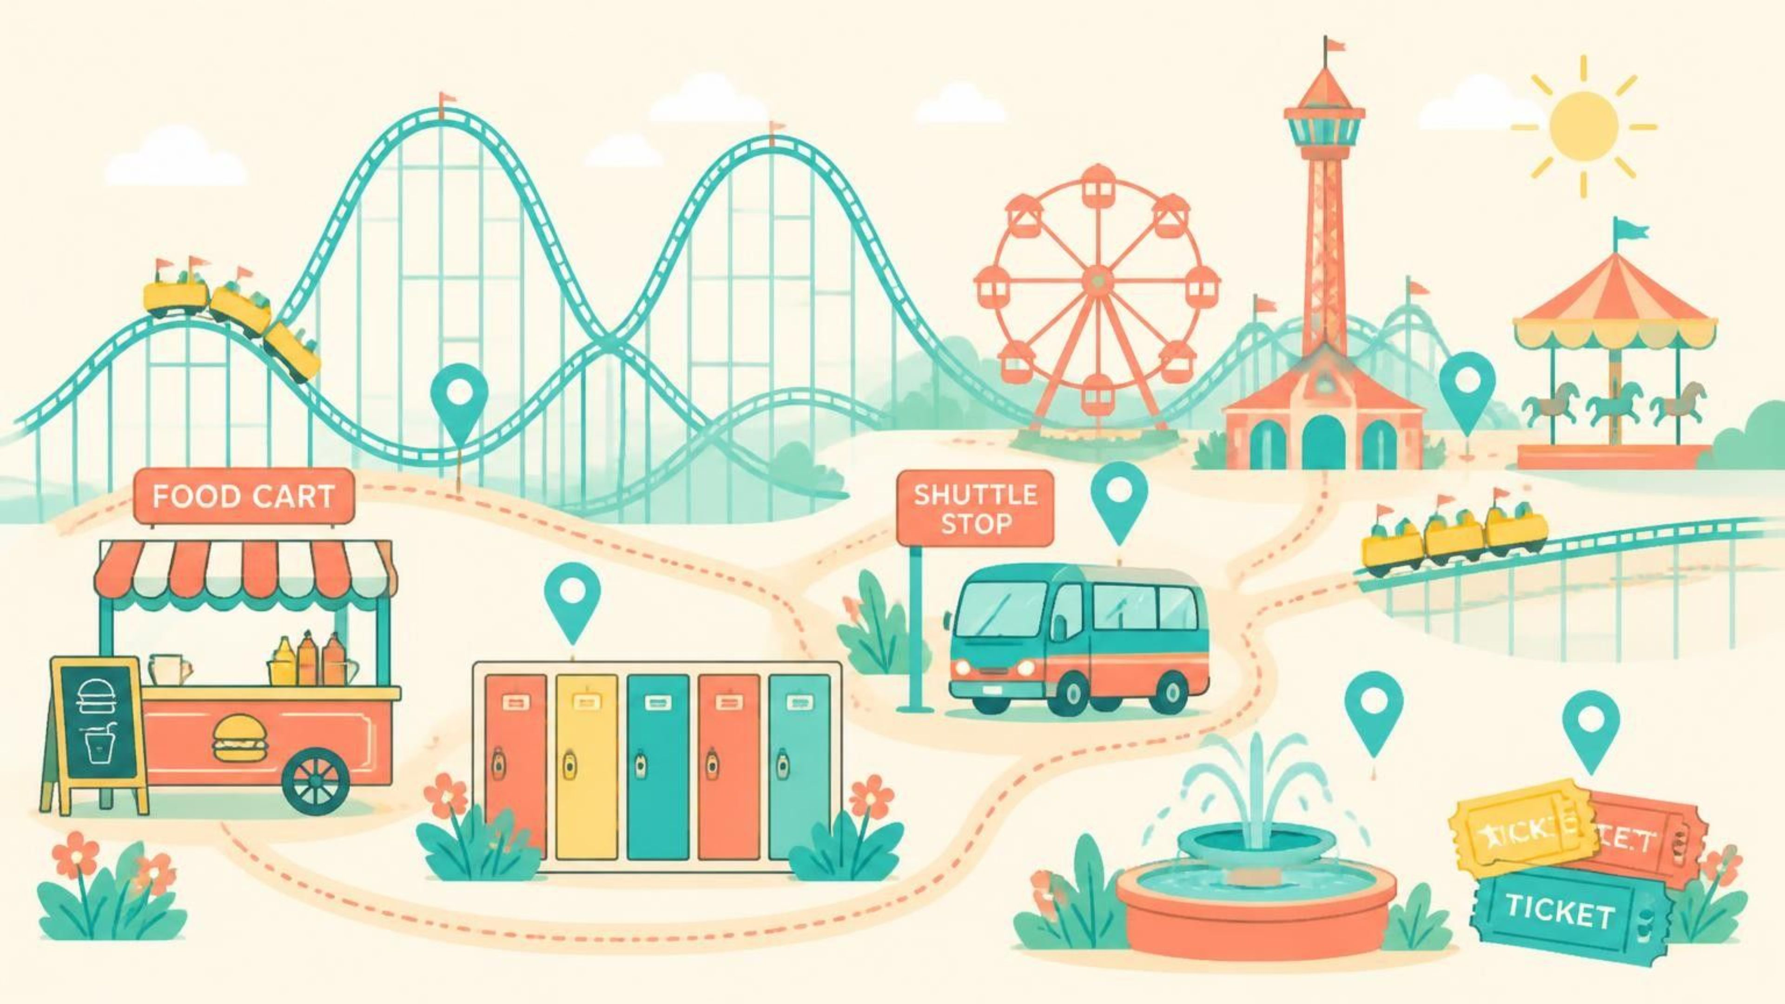


10
AFTER THE VISIT
A Great Day, Worth Sharing
COMPLETE YOUR VISIT
RATE YOUR EXPERIENCE
Finish your day and view a summary of your visit.
Give your visit a rating and share your feedback.

Slide 11






11
The Technology Behind SIKKA
Notes:
Technologies used in the project: Java, Spring Boot, Spring Security, Spring Data JPA, Hibernate, MySQL, Jakarta Validation, Lombok and Maven.

Slide 12







12
Connected Services Behind SIKKA
OpenAI API
Aladhan API
Google Calendar API
Gmail SMTP
Generates individual and group itineraries and supports AI replanning.
Provides prayer times for inclusion in visit schedules.
Sends email verification, password recovery, and account messages.
Connects Google accounts and syncs, updates, or removes approved itinerary events.
UltraMsg WhatsApp API
Moyasar API
n8n Webhook
Verifies payments and checks transaction status.
Automates notifications by forwarding system events to messaging services.
Supports phone verification and WhatsApp messaging.

Slide 13

×
Thank you
Nawaf Alghamdi
Abdulaziz Shafae
Mohammed Aljubaili
Java Web Development and AI Integration Bootcamp
Tuwaiq Academy

