Slide 1

Learn python for Django
Just Enough python to get into web development!

Slide 2
Data Types in Python
< SP />

Slide 3
Examples of each data types and structures in python
STRINGS : ‘Hello pythonista ‘ , “Earth is green”, ‘computers’
INTEGERS: 100, 365, 786
FLOATS: 12.6, 10.0, 3790.12
LISTS: [ 100, ”computers”, 12.6, ”Earth is green” ]
DICTIONARIES: { “name”:”pythonista”, “number”:1, “height”:”5.5 ft” }
TUPLES: (100, ”computers”, 12.6, “Earth is green” )
SETS: { “python”, “C”, “Java”, “JavaScript” }
NOTE:- I will show you each data types in more detail on using it in coming slides..

Slide 4
Variables, Operators & Inputs
< SP />

Slide 5
What is a variable?
Stores data or value
Needs to be assigned
Can store anything
Can be called only after assigning it
E.g:-
name = “Pythonista”
‘ = ‘ Tells python to assign Pythonista string to name
* Here name is a variable and pythonista is a stored string value

Slide 6
Conventions of naming variables
Make it descriptive / easy to read
Constant values can be uppercase
Should not begin with numbers
Words can be separated by underscore
Don’t use python reserved keywords
* I will give you example of it throughout the series

Slide 7
OPERATORS
Arithmetic operators +, -, *, /,% , //, **
Comparison operators >, <, ==, !=, <=, >=
Assignment operators =, +=, -=, *=, //=, %=, **=
Membership & Identity operators (and,is,not,or,in)

Slide 8

INPUT
Uses input()
Can be stored in variable: name = input(“Enter Name: ”)
Takes string values by default
Integer input by: age = int(input(“Enter Age: ”))
Throws errors when user give unexpected input data

Slide 9
COMMENTS
Here, anything after # will not be executed but it explains what that line of code is doing by writing a comment.
Starts with #
Whatever comes after # is ignored by computer
Use to explain what your code is doing

Slide 10
Built-in Functions & Methods
< SP />

Slide 11
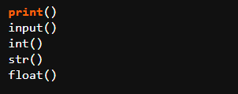
Built-in Functions
Special Functionality in python
Syntax is like name()
Already defined in python

Slide 12

Built-in Methods
Associated to end of specific data types
Syntax : value.method()
Does something to that value
Strings, Lists, Dictionaries all have their own methods
* They will be discussed on seperate videos on more detail.

Slide 13
STRINGS IN PYTHON
< SP />

Slide 14
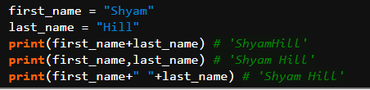
Adding Strings by Concatenation
* Note that python is case-sensitive
name is not equal to Name in python.

Slide 15
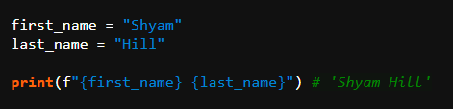
String Interpolation
* Note that variables must be inside { } and ‘ f ’ should be at beginning.

Slide 16
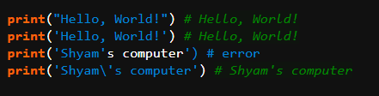
String Options:
* You can find more about escape characters in course reference guide too.

Slide 17
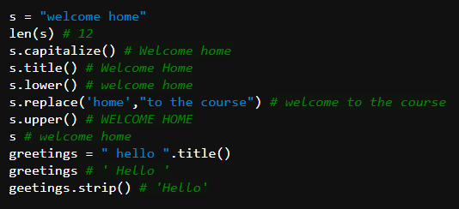
String Built-in Methods:

Slide 18
NUMBERS IN PYTHON
< SP />

Slide 19
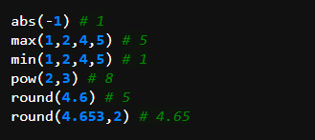
Methods related to numbers

Slide 20

Number type conversion

Slide 21
LISTS IN PYTHON
< SP />

Slide 22
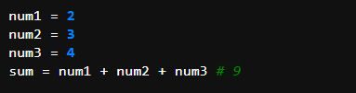

What is list and why use it?
Collection of values
Each value separated by comma
Simplifies data handling
Can do large computation without more hassle

Slide 23
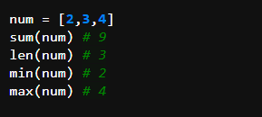
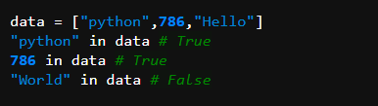
List Functions
Check whether item is in list

Slide 24
How to access list values ?
List indexes every values gradually and we can access those values by referring to their index number
Two ways of accessing list values:
Forward Indexing
Backward Indexing
List[ index ]

Slide 25
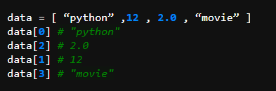
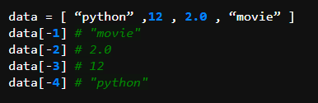
FORWARD
BACKWARD
[ “python” ,12 , 2.0 , “movie” ]
[ “python” ,12 , 2.0 , “movie” ]
-4
-3
-2
-1
0
1
2
3
Starts with 0
Starts with - ve sign

Slide 26
List Slicing to get sublist
[ start : end ]
Slices list including value of start index
Slices Upto end index but does not include end index value
Returns the sliced list

Slide 27
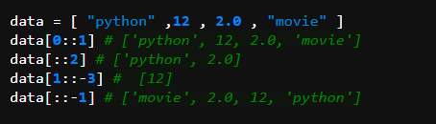
Third Slicing Parameter
[ start : end : step ]
Skips specific steps while slicing
Default step value is 1
Includes beginning index and skips the number of index in step

Slide 28
List Methods
append( object )
count( object )
extend( list )
index( object )
insert( index , object )
pop( object )
remove( object )
reverse()
sort()

Slide 29
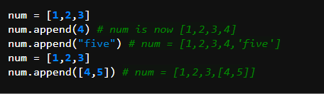
APPEND
Adds an element to the end of the list

Slide 30
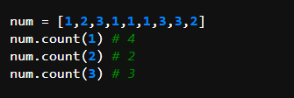
COUNT
Returns the number of time a element is in the list.

Slide 31
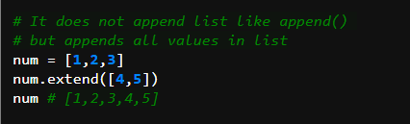
EXTEND
Appends all the elements in the list to the original list

Slide 32
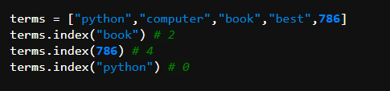
INDEX
Returns the index number of the first occurence of element in the list.

Slide 33
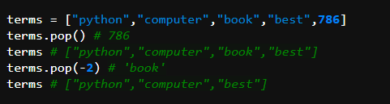
POP
Removes the element at given index number and returns it.
If no parameter is passed then it removes last value of list and returns it.

Slide 34
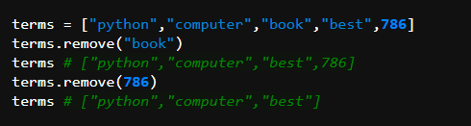
REMOVE
Removes the first occurence of the passed element from the list.

Slide 35
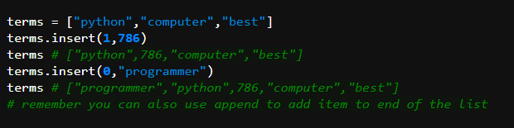
INSERT
Takes two parameters (x,object)
Inserts object at index x
Hold on! Still 2 more methods left!

Slide 36

REVERSE
Reverses the elements in the list
Remember you can also use list slicing technique to reverse a list using [ : : -1]

Slide 37
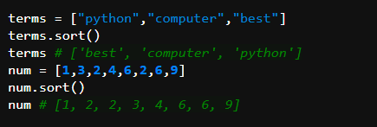
SORT
Sorts the elements in the list in ascending order.
Remember you can also use list slicing technique to reverse a list using [ : : -1]

Slide 38
DICTIONARIES
< SP />

Slide 39
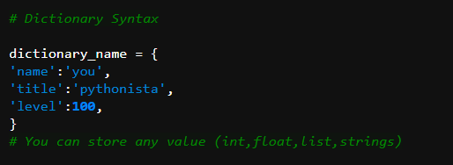
What is dictionary and why even use it ?
Dictionary is a collection of variable and value or key and values
It helps to store detail information with informative key
You can GET , EDIT and DELETE values using the key

Slide 40
DICTIONARY OPERATIONS
ADDING VALUES: dictionary_name[ new_key ] = value
EDITING VALUES: dictionary_name[ key_to_change_value ] = value
DELETING VALUES: del dictionary_name[ key ]
Is Key in a DICTIONARY?
“key” in dictionary_name
# returns True or False whether key is in the dictionary or not !

Slide 41
DICTIONARY METHODS
KEYS() : returns sequence of dictionary keys in tuple
values() : returns sequence of dictionary values in tuple
items(): returns sequence of ( keys , values )
clear(): deletes all entries in dictionary
get( key ): returns the value for the KEY

Slide 42
Tuples & Sets
< SP />

Slide 43
What is tuple and why even use it ?
Tuple are like lists but their elements are fixed.
You can’t ADD , EDIT , REPLACE , REORDER or DELETE elements in it.
You can use it to prevent some data from being changed.
Syntax of tuple is like:
tuple_name = ( 1,2,3,4 )
Tuple uses small brackets not square brackets.
You can use len() , max(), min(), sum() functions in tuples also.
You can also slice tuples as same as in list

Slide 44
What are sets and why even use them ?
Sets are also like lists but their elements are not ordered in sequence.
If your application does not care about the order of data, then sets are helpful.
Syntax of set is like:
set_name = { 1,2,3,4 }
Set uses curly brackets not square brackets.
You can use len() , max(), min(), sum() functions in sets also.
You can’t have duplicate item in tuple.

Slide 45
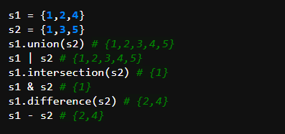
Set Operations
UNION : union() or ‘ | ‘
Intersection : intersection() or ‘ & ‘
Difference : difference() or ‘ - ‘

Slide 46
Conditionals - if with else
< SP />

Slide 47
Adding Logic to the code
What to do if something happens?
Runs specific code for specific condition
Condition may be True or False
SYNTAX

Slide 48
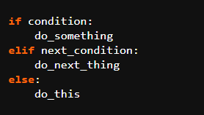
SYNTAX
If condition in if statement does not matches then it checks in elif statement
And if nothing matches in elif too then code in else will run
* elif is optional

Slide 49
HOW TO KNOW TRUE or FALSE?
Assignment operators =, +=, -=, *=, //=, %=, **=
Using ‘ or ’ , ‘ and ’ , ‘ not ’ together
Combine True or False for complex logic

Slide 50
Combining True with False
True or True => True
True or False => False
True and True => True
True and False => False
not True => False
not False => True

Slide 51
Loops - while & for
< SP />

Slide 52


Why Loops?
Helps to run specific code repeatedly
Runs until certain condition is met
Versatile - for and while loop
SYNTAX

Slide 53
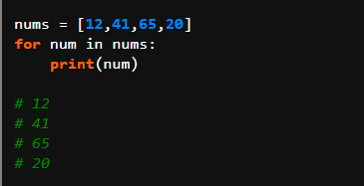
For Loop
Goes through each number in nums list
For each time num variable is assigned to that number
Next time that num variable is assigned to the next number in the list
We can add our code to do specific operation for each loop

Slide 54
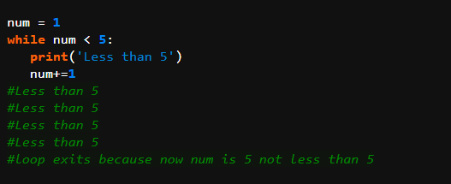
While Loop
Takes Given condition and if it is True then,
It will run its code else it will not
Remember if the condition is True always then,
Code will run forever so we here incremented num by 1 every time

Slide 55
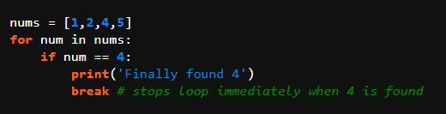
Adding Logic with Loops
Above code will return ‘Finally found 4’ when num is 4 in loop then ,
Exits from doing next loop because of break keyword
Use break keyword to prevent infinite loop or to terminate loop.

Slide 56
Functions
< SP />

Slide 57
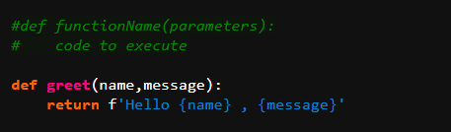
What is it & Why ?
Starts with def keyword
Can take input as parameter
Block of reusable code
Needs to be defined before using it
Can return the value based on parameters
Can be used many time by calling it

Slide 58



Calling the function
Parameters
Arguments
Positional Arguments

Slide 59




Passing default value in parameter

Slide 60
Working with Functions
Needs to return something to save output in a variable
Can have not any parameters too
Functions with parameters need to be called with arguments
Arguments can be passed with parameter name for readability
Can combine complex logic in the function
Use it to run repetitive programming task

Slide 61
Object Oriented Programming
< SP />

Slide 62
What is OOP exactly?
OOP is the use of objects to create the program
Object can be referred to anything - book,movie,toy etc
Helps to assign specific functions,qualities,attributes in base class to create many objects from it effectively

Slide 63
How class and objects work?
Base Book
Title
Author
Book Class
Book 1
Book 2
Book 3
The Alchemist
Paulo Coelho
Harry Potter 1
J.K Rowling
Odyssey
Homer
Book Object
Book Object
Book Object

Slide 64
SYNTAX
Creating class
class ClassName:
initializer
methods
Creating objects from class
object = ClassName()
Accessing object properties & methods
object.property
object.method()

Slide 65
Important Term
Initializer : special __init__ function to set variables or attributes to the object
Methods : functions defined in the class
What does __init__ do ?
It is a special function that gets called automatically when new object is created from given data values

Slide 66
IMPORTANT NOTE
Every functions should have ‘ self ’ parameter in the class.
Every variable should also be accessed through ‘ self.variable ’

Slide 67
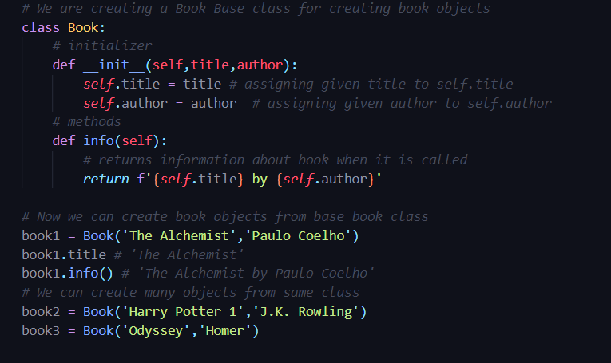
Creating book object from base class
You can also edit object properties like : book2.title = “Harry Potter 2”

Slide 68
Python Package Manager - PIP

Slide 69
What is PIP ?
PIP
Python Packages
Computer
https://pypi.org/
Scrapy
Kivy
OpenCV
NumPy
Flask
Django
pip install django
pip uninstall django
Pygame
Pyramid
SciPy

Slide 70
Useful standard library
Useful pip packages
RE
Random
Datetime
OS
Tkinter
Math
CSV
Pipenv
BeautifulSoup
Django
Flask
Pygame
Numpy
Tensorflow

