Slide 1
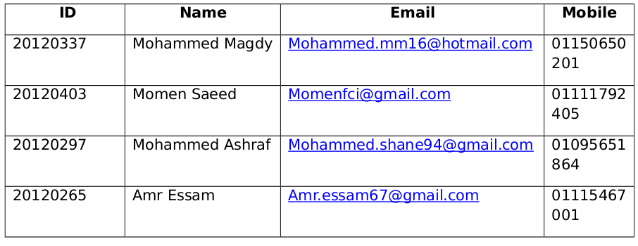
Developers

Slide 2
Overview
back-end API for social network that is
able to manage interactions between users,create and manage groups and
pages, manage different type of posts and retrieve current posts in specific
hashtag and sort these posts according to the most important post.

Slide 3
Project Requirements
Premium users posts are seen by every one.
Create groups either private or public and managed by a set of people chosen
by the group creator.
Create pages for specific entities or companies and keep track of the number of
likes they have.
Posts are written by the users and have different attributes the number of
people who like this post and a share option to share the post on their personal
wall.
Posts have different kinds, posts on groups and if the user owns a page can post
to this page.
Users could use the hash tag to write what they think about a certain topic, and
what they write in this hash tag can be seen by others who access this hash tag.
Users should be able to write messages to each others and can make group
chats.
This is an api that can be used in different social network.

Slide 4
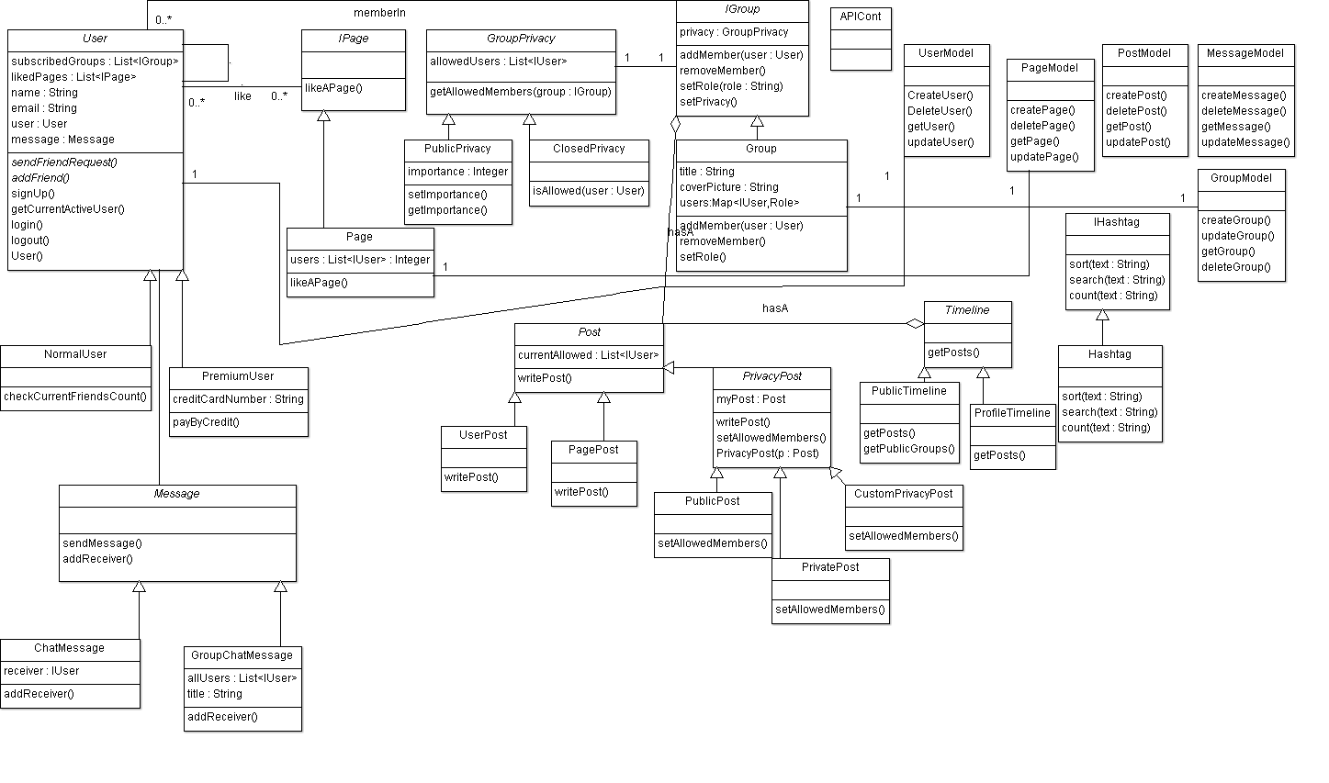
Class Diagram

Slide 5
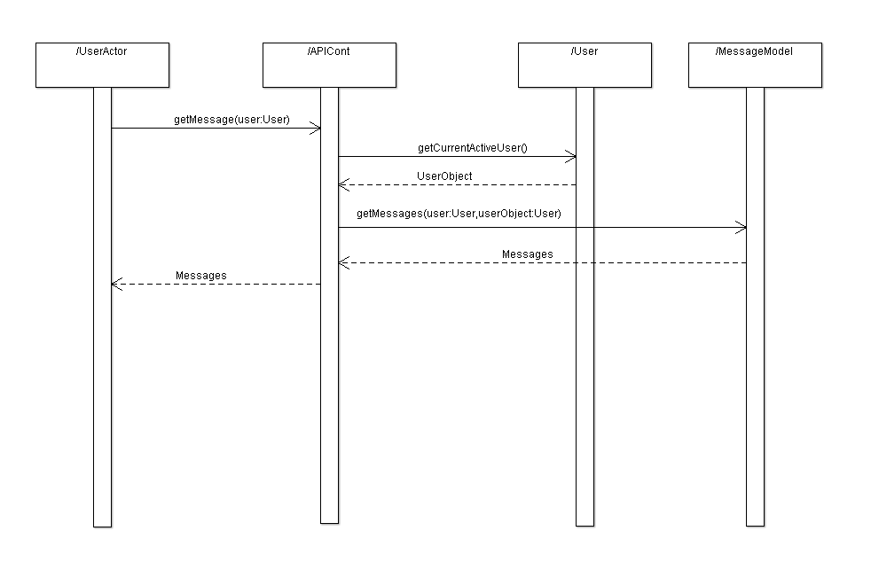
Sequence Diagrams

Slide 6
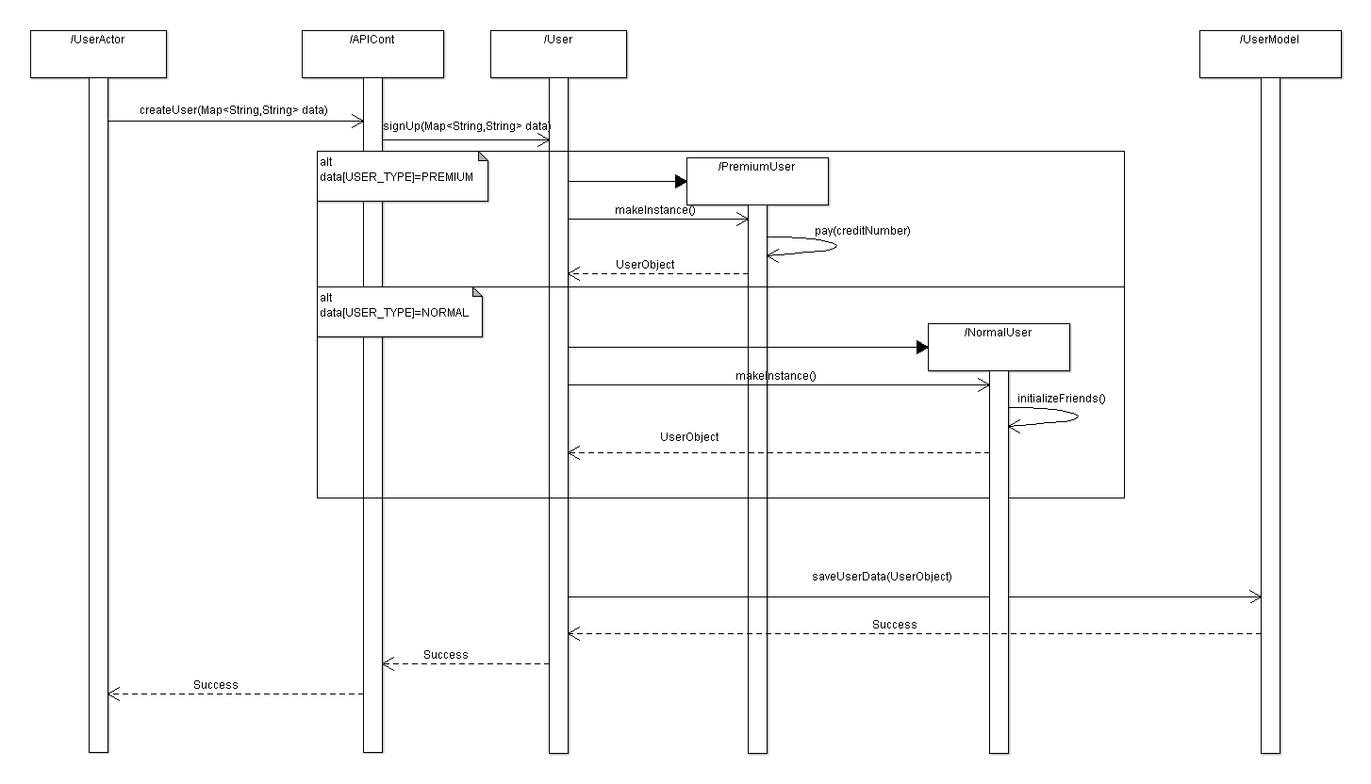
Sequence Diagrams

Slide 7
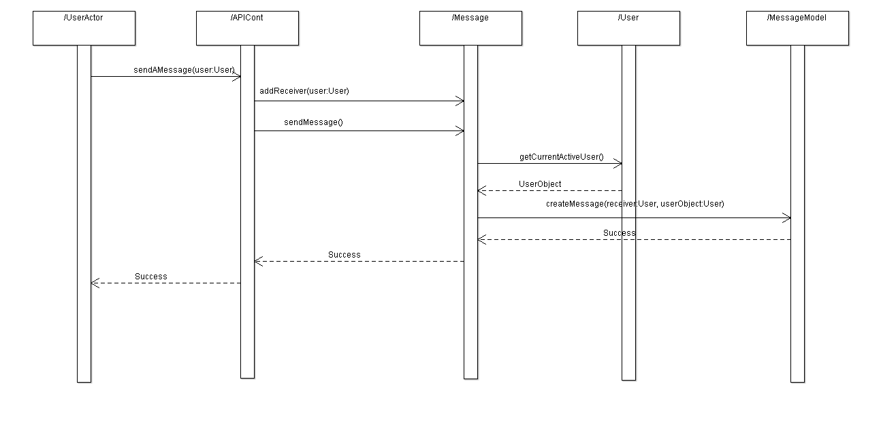
Sequence Diagrams

Slide 8
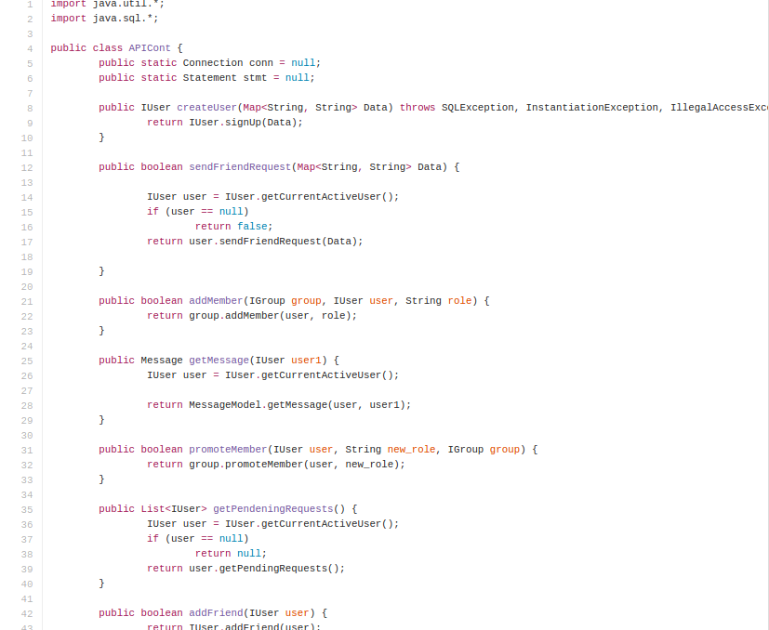
Code Style

Slide 9
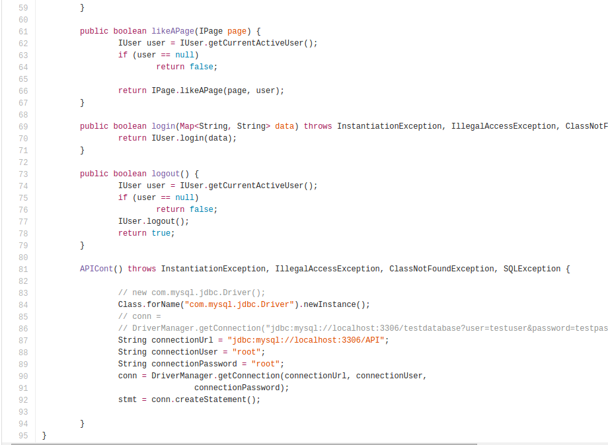
Code Style

Slide 10
Demo of Social Network API

Slide 11
The challenges and difficulties your team faced

Slide 12


Slide 13


Slide 14


Slide 16
Lessons your team learned from this project

Slide 17


Slide 18


Slide 19
From The Software

Slide 20
What you would do better or different next time

Slide 21

Set Rules for the Team

Slide 22

Set A good Plan To get Best Performance

Slide 23

Learning from Different resources

