Slide 1


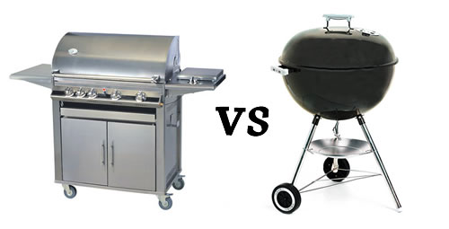
Case Study – Grill Test
Mohammed Shayerwala

Slide 2
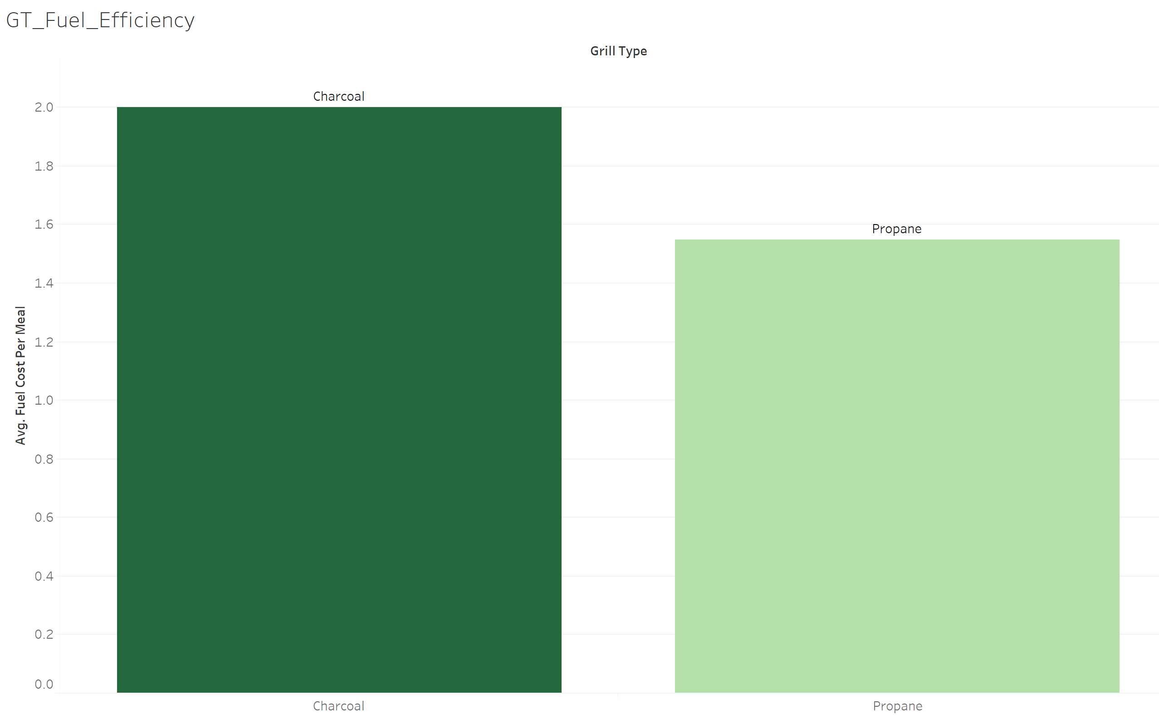
Why Charcoal or Propane?
Fuel Efficiency
We can see that the Cost of Fuel per meal for Charcoal is $2.
Where are Cost of Fuel per meal for Propane is $1.55.
Based on Cost of Fuel per meal we would prefer Propane which is more Fuel Efficient.
So, Propane Wins over Charcoal.

Slide 3
What if we calculate fuel on a long run?
As we know Cost of Fuel per meal for each grill type, we calculated it for 3 year where an average American grills 48 times with grill life of 3 years (1 year = 16 cookoff).
According to the graph we can see that:
Cost_of_Charcoal = $96
Cost_of_Charcoal = $74.4
Which supports our previous conclusion of Fuel Efficiency.

Slide 4
What if we consider Total Cost?
When we consider the total cost for 3 years, i.e. Initial cost(Setup) + Fuel Cost we can see from the graph that:
Total Cost of Charcoal = $167.
Total Cost of Propane = $201.
When we go for a long run, we can also see that on the 8th year charcoal costs more than propane.
But as an average American uses grill for only 3 years, we can say that here Charcoal wins over Propane.

Slide 5
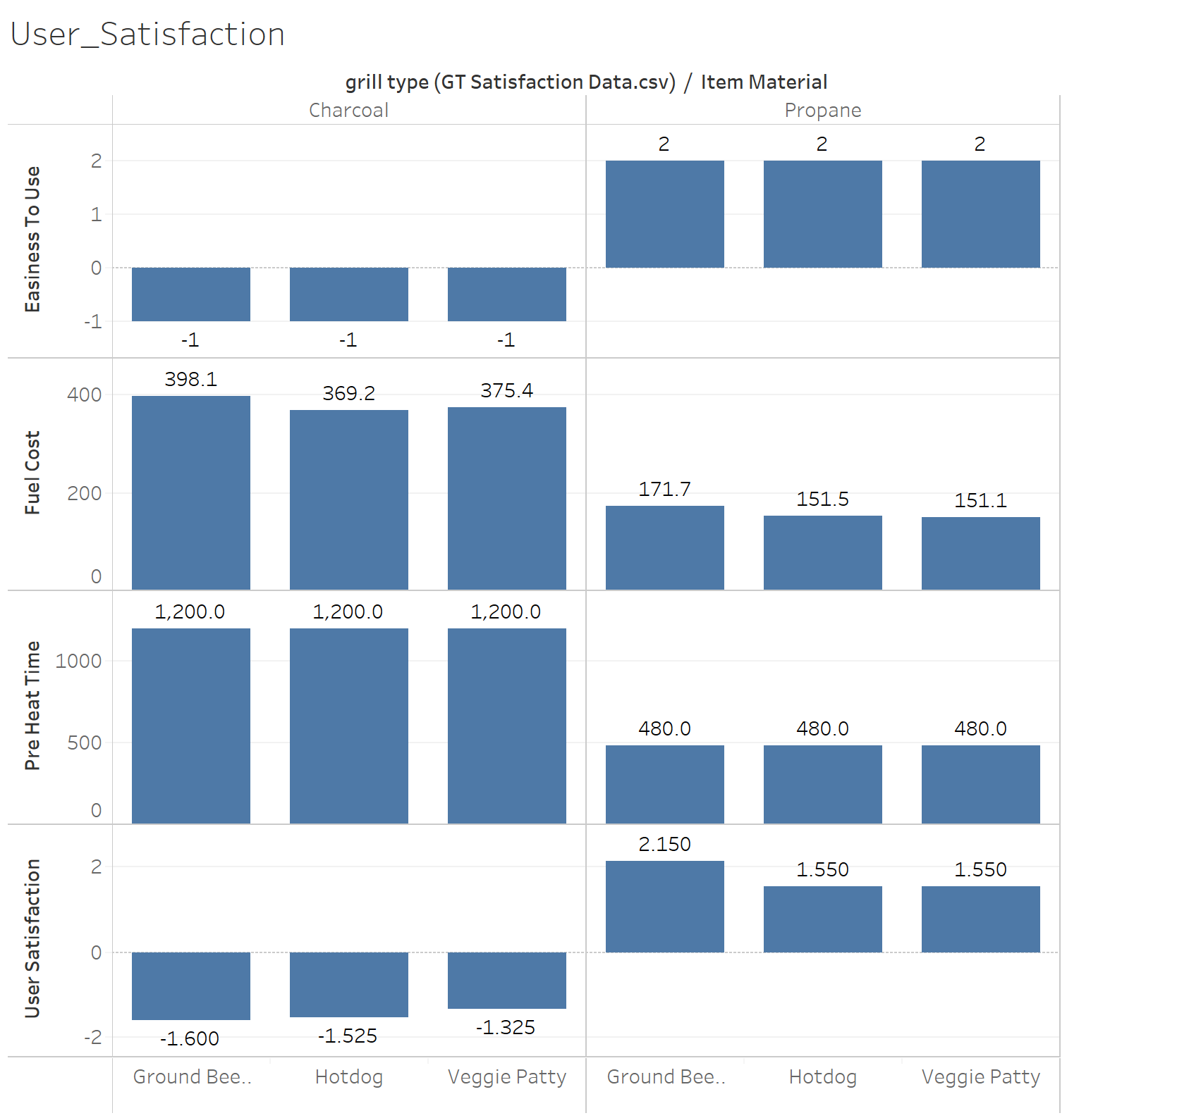
Can user satisfaction score help us decide?
User Satisfaction can be one of the most important factors effecting the choice of Grill.
We can see that there are various factors which effect User Satisfaction from the graph:
Propane is easier to use
Pre-heat time for propane is less
Fuel Cost for Propane is way lesser than charcoal
And hence the survey data from GT_Satisfaction_Data shows us that User Satisfaction of Charcoal is way less than Propane.
And hence based on user satisfaction Propane wins.

Slide 6
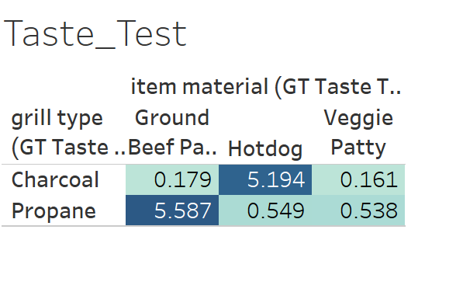
How does Taste define?
Taste data playes an important role in defining the grill type.
According the test data set we can see that the thumbs up score veries as:
Ground beef patty – Propane is preferred over Charcoal.
Hot dog - Charcoal is preferred over Propane.
Veggie Patty – Users have no significant preference.

Slide 7
Recommendations to manfacturers
Based on the above data we can recommend manufacturers to target customers based on patty the user has to make.
For Ground beef patty: Propane should be recommended
For Hotdog: Charcoal should be recommended
For Veggi Patty: Users have no specific preferences

Slide 8
Recommendations to Users
Based on the taste data:
Users should buy according to the usage or patties they like.
For Ground Beef Patty: Propane grill is preferred
For Hotdog: Charcoal grill is preferred
For Veggie patty: No specific perferences

Slide 9
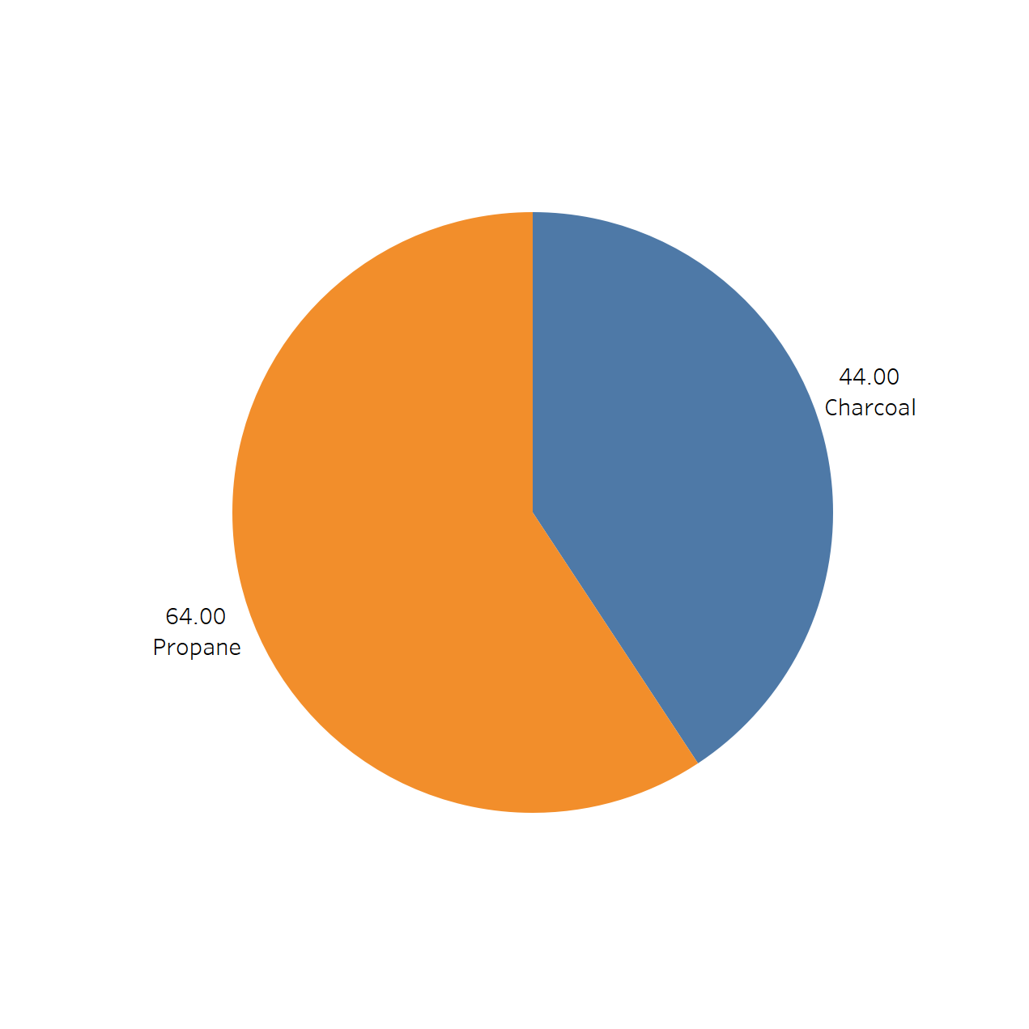
Market Share
According to the Data, the Market Share for Grills are split into:
Propane: 64%
Charcoal: 44%
Based on all the above conclusions we can justify that Propane Grill has a bigger market share than Charcoal Grill.

Slide 10


Thank you

