Slide 1
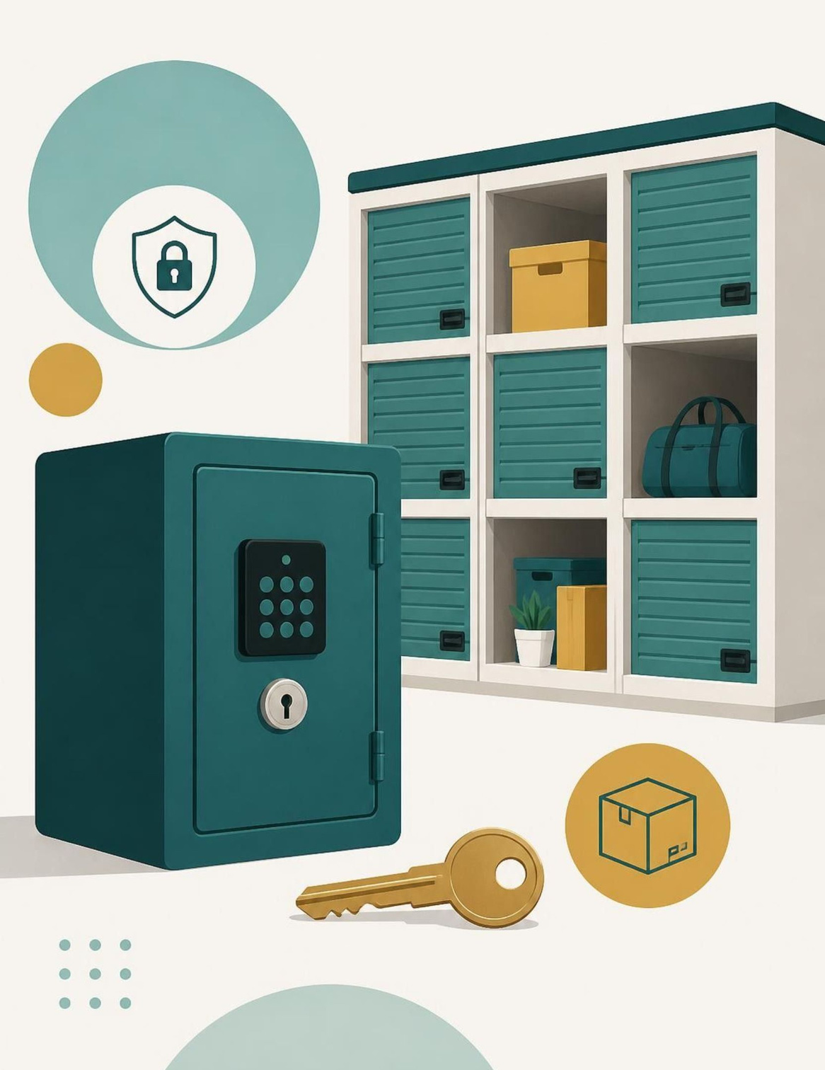

ACADEMIC YEAR 2026–2027
RentSphere
Peer-to-Peer Asset Rental & Micro-Storage Management System
Object-Oriented Technology Lab Project
Team Members:Mohammed Faaris Khan 2664
Ketan Naik 2623
Nikhil baiju 2665
Deepak Devan 2616
Notes:
Introduce the lab project: RentSphere, a peer-to-peer asset rental and micro-storage management system developed for Object-Oriented Technology. State team details and acknowledge faculty guidance.
1

Slide 2
The beginning
Introducing RentSphere
Bridging idle capital and temporary utility through a single verified platform.
Idle Assets & Storage
RentSphere Core
Verified Utility
Underutilized personal goods and empty storage slots sit unused.
Central platform coordinates listings, reservations, and state control.
Renters gain affordable short-term access without full ownership.
Asset Rental Flow
Micro-Storage Flow
Asset Owner → RentSphere Engine → Verified Renter with explicit lease tracking.
Space Owner → RentSphere Slot Allocator → Temporary Storage User.
Notes:
Explain the core premise: owners have idle assets or spare storage space, while borrowers need short-term access. RentSphere serves as the reliable coordination engine for both asset leasing and space allocation.
2

Slide 3
CHALLENGES & OBJECTIVES
The Problem We Want to Solve
Core Project Objectives
Current Operational Challenges
  Organize assets and storage spaces.
  Track availability and reservations.
  Model the rental lifecycle with clear state transitions.
  Apply Java OOP for maintainable software.
  Validate operations and handle invalid requests.
  Hard to discover suitable assets or storage.
  Unclear availability and rental status.
  Manual booking and contract tracking.
  Risk of inconsistent rental operations.
  Returns and inspections must be managed.
Notes:
Contrast existing peer-to-peer rental pain points on the left with our five technical objectives on the right. Highlight that manual tracking leads to double-booking and disputes, which our state machine directly solves.
3

Slide 4
FUNCTIONAL SCOPE
Core Features
Core modular capabilities designed for deterministic rental operations.
01
02
03
04
05
Proposed
Proposed
Proposed
Proposed
Proposed
Asset Listing
Availability Management
Reservation Management
Rental Lifecycle
Micro-Storage Management
Display rentable items.
Check whether an asset can be reserved.
Handle requests for available assets.
Reservation, active lease, return, and inspection.
Represent and manage storage slots.
END-TO-END USER JOURNEY
Browse
Select
Reserve
Rent
Return
Inspect
Notes:
Present the five main functional modules of RentSphere. Note that all five modules currently carry the "Proposed" status tag, ready to be marked "Implemented" as lab development proceeds.
4

Slide 5
LANDSCAPE COMPARISON
Where RentSphere Fits
Comparing verified competitor information with RentSphere’s implemented capabilities.
Platform | General discovery | Product rental | Storage management | Explicit lifecycle tracking
OLX | Yes, local classifieds to buy, sell and rent used goods | Limited: rent ads exist, mainly property | Not offered | No rental lifecycle (ad listings only)
SharePal | Browse by category and city | Yes: trekking and riding gear, cameras, consoles | Not offered (delivery and return model) | Not publicly documented
StoreSpace | No, it’s a B2B warehouse service | No | Yes: pay-as-you-go warehousing | Inventory tracking only (WMS), not a rental lifecycle
RentSphere (Proposed) | Peer-to-peer asset discovery | Product rental | Micro-storage management | 5 explicit states with validated transitions
Notes:
Compare only the capabilities supported by the cited sources; all other competitor cells are marked Not verified. Present RentSphere’s lifecycle and micro-storage design as proposed.
6

Slide 6
FINANCIAL SUSTAINABILITY
How RentSphere Could Generate Revenue
Theoretical monetization avenues for platform self-sufficiency.
Transaction Fee
Storage Cut
Discovery
Protection
Rental Commission
Storage Fees
Promoted Listings
Trust & Verification
Percentage-based platform fee deducted upon successful booking settlements.
Fixed platform slice per micro-storage time slot booked by users.
Optional paid search placement tier for owners seeking rapid bookings.
Optional security verification charge, subject to technical and legal feasibility.
Consider an item leased at a transaction value of ₹1,000. Under a hypothetical 10% platform commission, RentSphere retains ₹100 gross platform margin prior to hosting and infrastructure expenses. Presented purely for conceptual mechanism demonstration; no commercial figures or market projections assumed.
Notes:
Walk through potential revenue channels: transaction commission, storage allocation fees, sponsored item listings, and verification protection. Clarify that the ₹1,000 example is strictly an illustrative simulation of platform mechanics.
5

Slide 7
SYSTEM ARCHITECTURE
Technology stack
Presentation Layer ↓ | HTML5, CSS3 and JavaScript
Application Layer ↓ | Java SE 17+ with the built-in JDK HttpServer on port 8080. REST API with JSON.
Business Logic Layer ↓ | Asset lifecycle management; reservation validation; rental contracts; storage-slot management
Data Layer | Zero database. In-memory ConcurrentHashMap saved to pipe-delimited flat files in data/, with an append-only audit log.
Tech Stack Verification
Core Language: Java 17+
Application Framework: JDK HttpServer
UI Layer:Web UI (HTML, CSS, JS)
Database: Flat files, no H2 and no SQL
Notes:
Describe the four architectural layers from top to bottom. Emphasize that the business logic layer houses the OOP domain entities independently of the web framework, and call attention to the stack checklist tagged for lab verification.
7

Slide 8
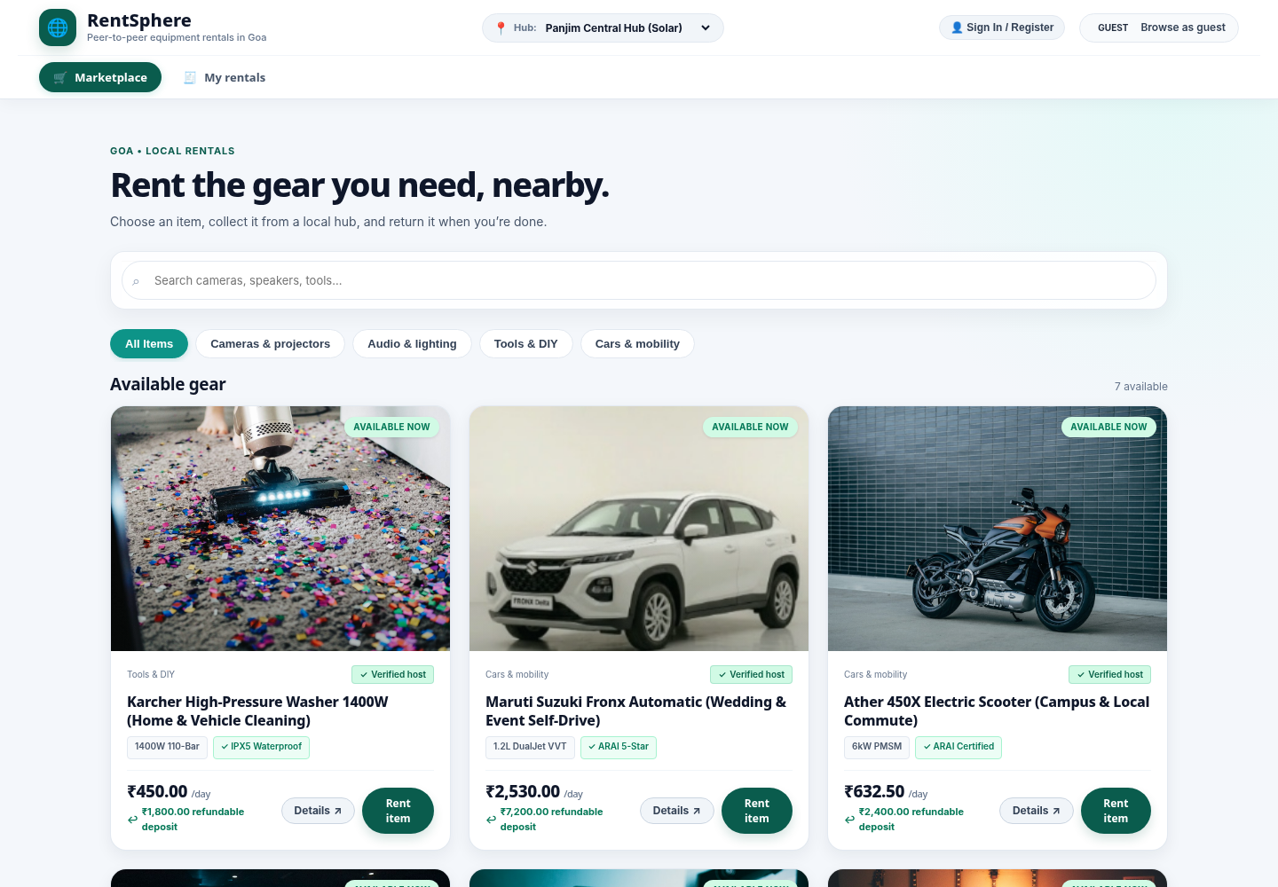
SYSTEM VERIFICATION & DEMO
RentSphere in Action
RentSphere Marketplace and Equipment Listing interface.
Notes:
Conclude with the demo plan. Highlight the four demonstration steps: browsing, reserving, updating state to active lease, and finally showing the terminal exception when attempting an illegal concurrent reservation.
10

Slide 9
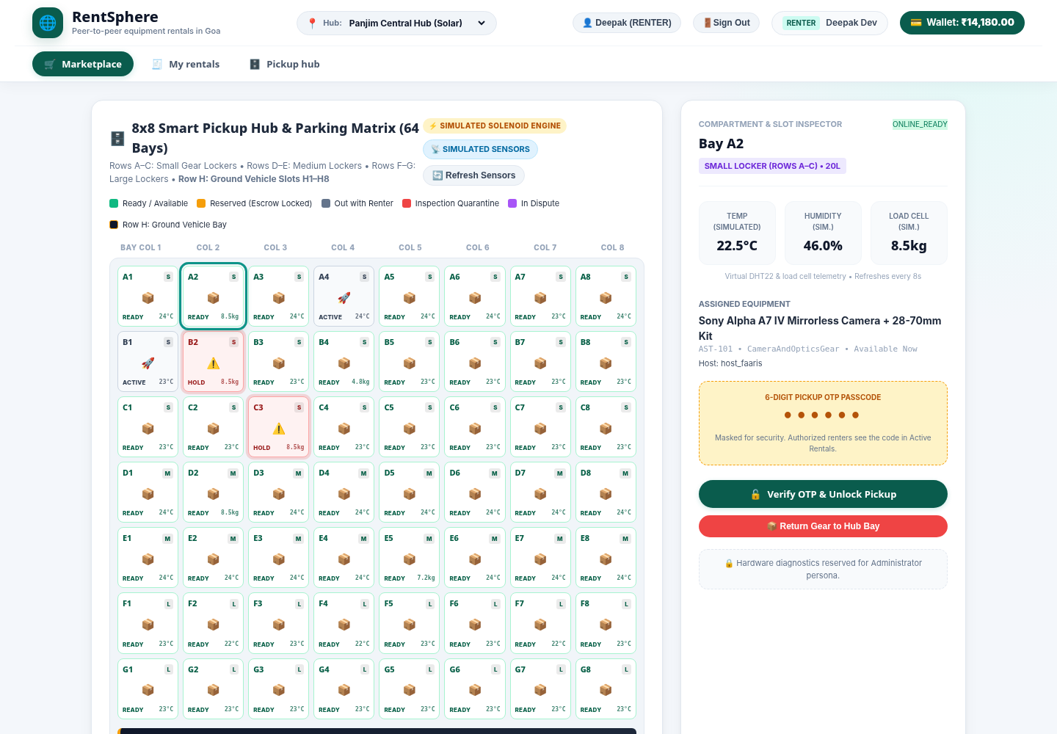
SYSTEM VERIFICATION & DEMO
RentSphere in Action
RentSphere 8×8 Smart Pickup Hub and Parking Matrix.
Notes:
Conclude with the demo plan. Highlight the four demonstration steps: browsing, reserving, updating state to active lease, and finally showing the terminal exception when attempting an illegal concurrent reservation.
10

Slide 10
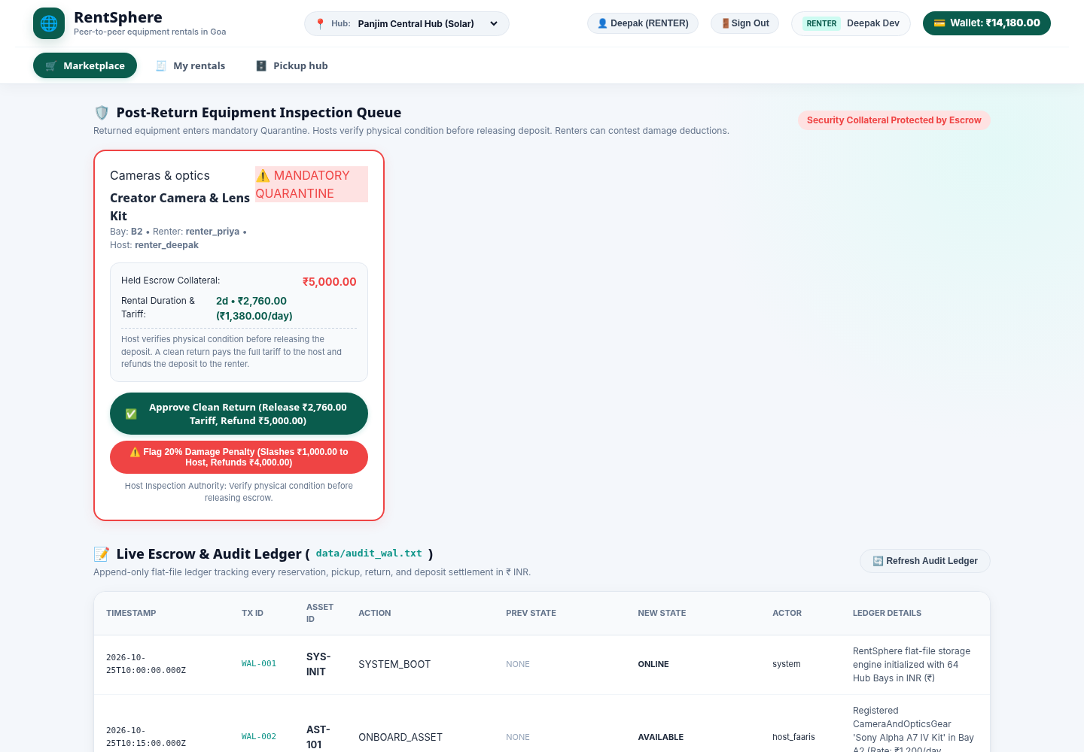
SYSTEM VERIFICATION & DEMO
RentSphere in Action
RentSphere Post-Return Inspection, Escrow and Audit Ledger interface.
Notes:
Conclude with the demo plan. Highlight the four demonstration steps: browsing, reserving, updating state to active lease, and finally showing the terminal exception when attempting an illegal concurrent reservation.
10

Slide 11
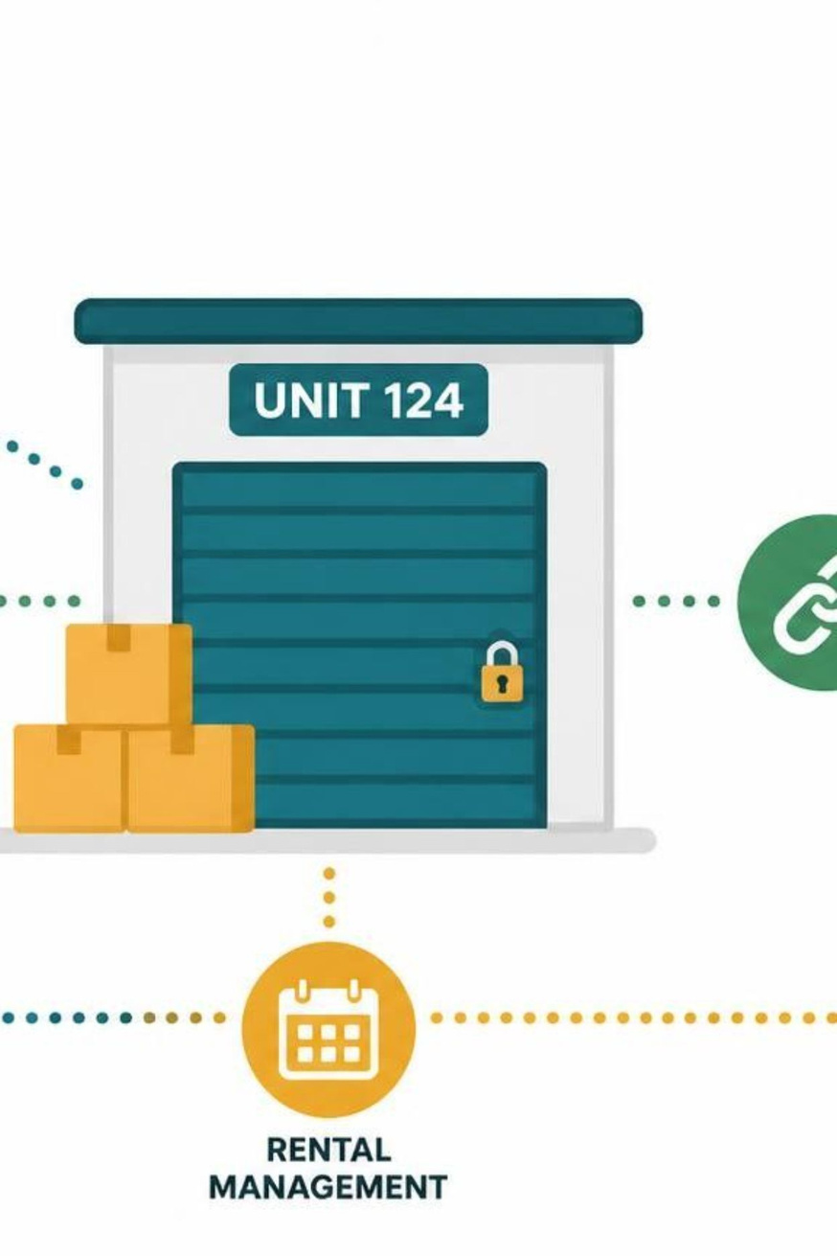
CONCLUSION & FUTURE SCOPE
From Asset Sharing to Structured Rental Management
RentSphere implements a peer-to-peer asset rental and micro-storage platform. Java OOP structures users, assets, contracts and rental operations.
The five-state lifecycle is the key technical design. Validation and state management help prevent inconsistent rental operations.
FUTURE SCOPE
  Real payment gateway
  Real IoT locker hardware
  SQL database for scale
  Native mobile app
  Multi-hub network
  Aadhaar / DigiLocker KYC
Notes:
12

Slide 12
Thank you

