Slide 1

[Nurseries Network ]
[https://github.com/mohammed37773/ITI-Graduation-Project.git]
Ahmed Mohamed
Waleed Salah
Mohamed Mahmoud
Abdulrahman Ahmed
Hatem Mostafa
Soha Ahmed

Slide 2
Project Idea
Project Description: Nurseries Network – A smart platform that helps parents find the best nursery using AI Trinity (LLMs + RAG + AI Agents).
Problem: Difficulty finding a suitable nursery based on price, location, and the child's age in a structured and efficient way. There is no unified platform that combines searching, booking, and payment in one place.
Users:Parents | Nursery Admins | System Administrator (Admin(
Feasibility: Highly feasible using existing AI technologies and cloud-based infrastructure.

Slide 3
Project Features
Functional Requirements:Sign Up / Login | Nursery Search (Filter by Price, Location & Rating) | Online Booking & Payment (Paymob + PayPal) | Reviews & Ratings | AI Assistant (Chat + Recommendations + AI Agent) | Admin Dashboard
Non-Functional: JWT Authentication |File Validation | Clean Architecture | Semantic Search (RAG) | Fallback AI Strategy (Gemini + Groq)
Roles: Parent- Searches, books, and pays | Nursery Admin- Adds and manages their nursery | Admin- Oversees the entire platform.

Slide 4
Tools & Technologies
Technologies: .NET 10 (ASP.NET Core Web API) | Entity Framework Core + SQL Server | ASP.NET Identity + JWT | Gemini AI (LLM + Embeddings) + Groq Fallback | Paymob + PayPal | MailKit (Email) | ngrok (Webhooks) | Swagger (API Docs)
Architecture: Clean Architecture (4 Layers) | Core (Entities + Interfaces + DTOs) | Infrastructure (Repositories + Services + DB) | AI Layer (Gemini + RAG + Agents) | API Layer (Controllers + Middleware) | Patterns: Repository + UnitOfWork + Strategy + Factory

Slide 5
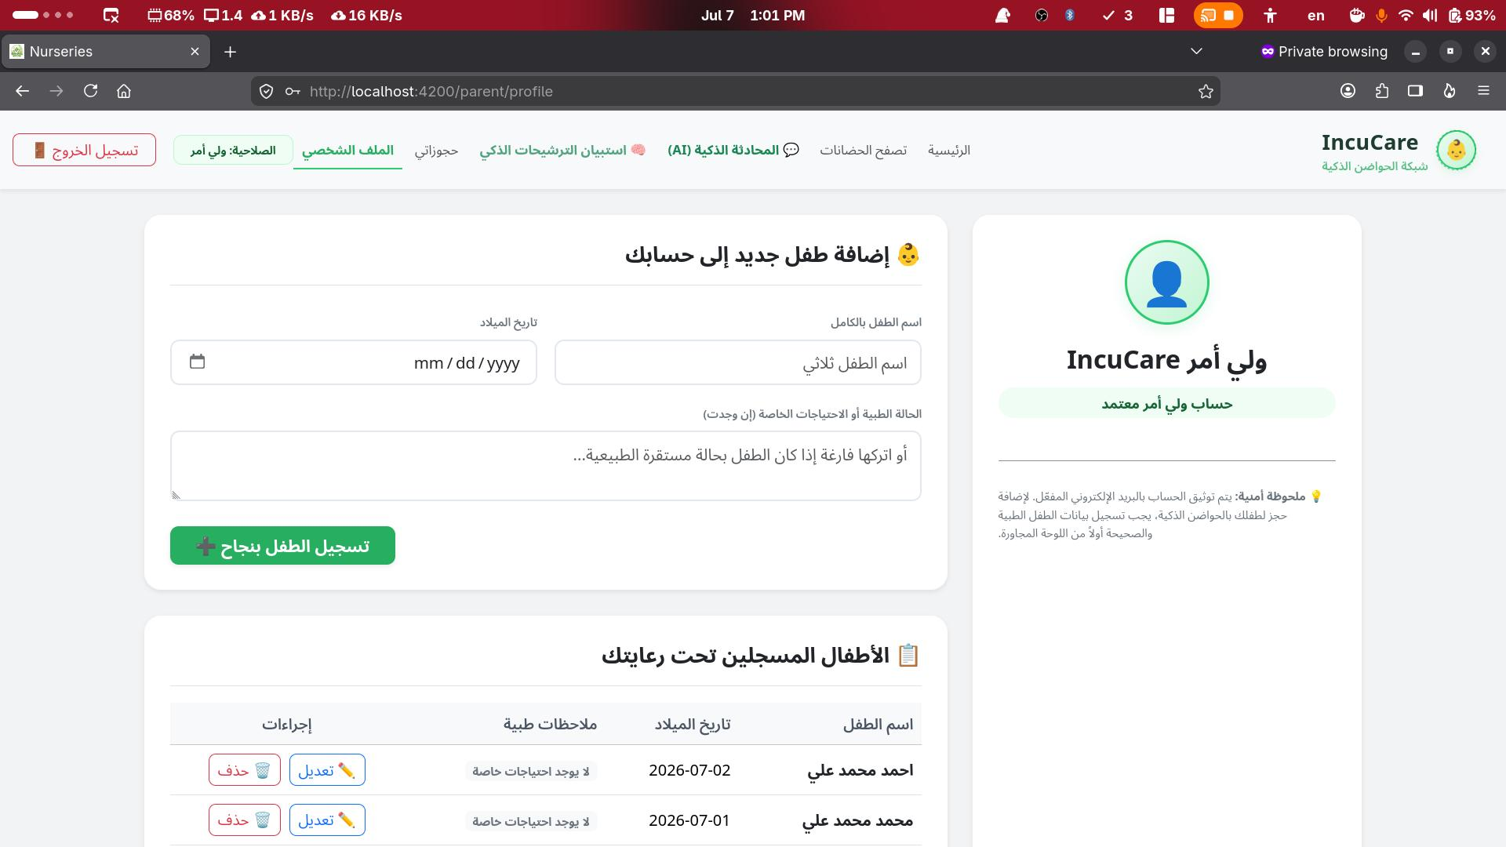
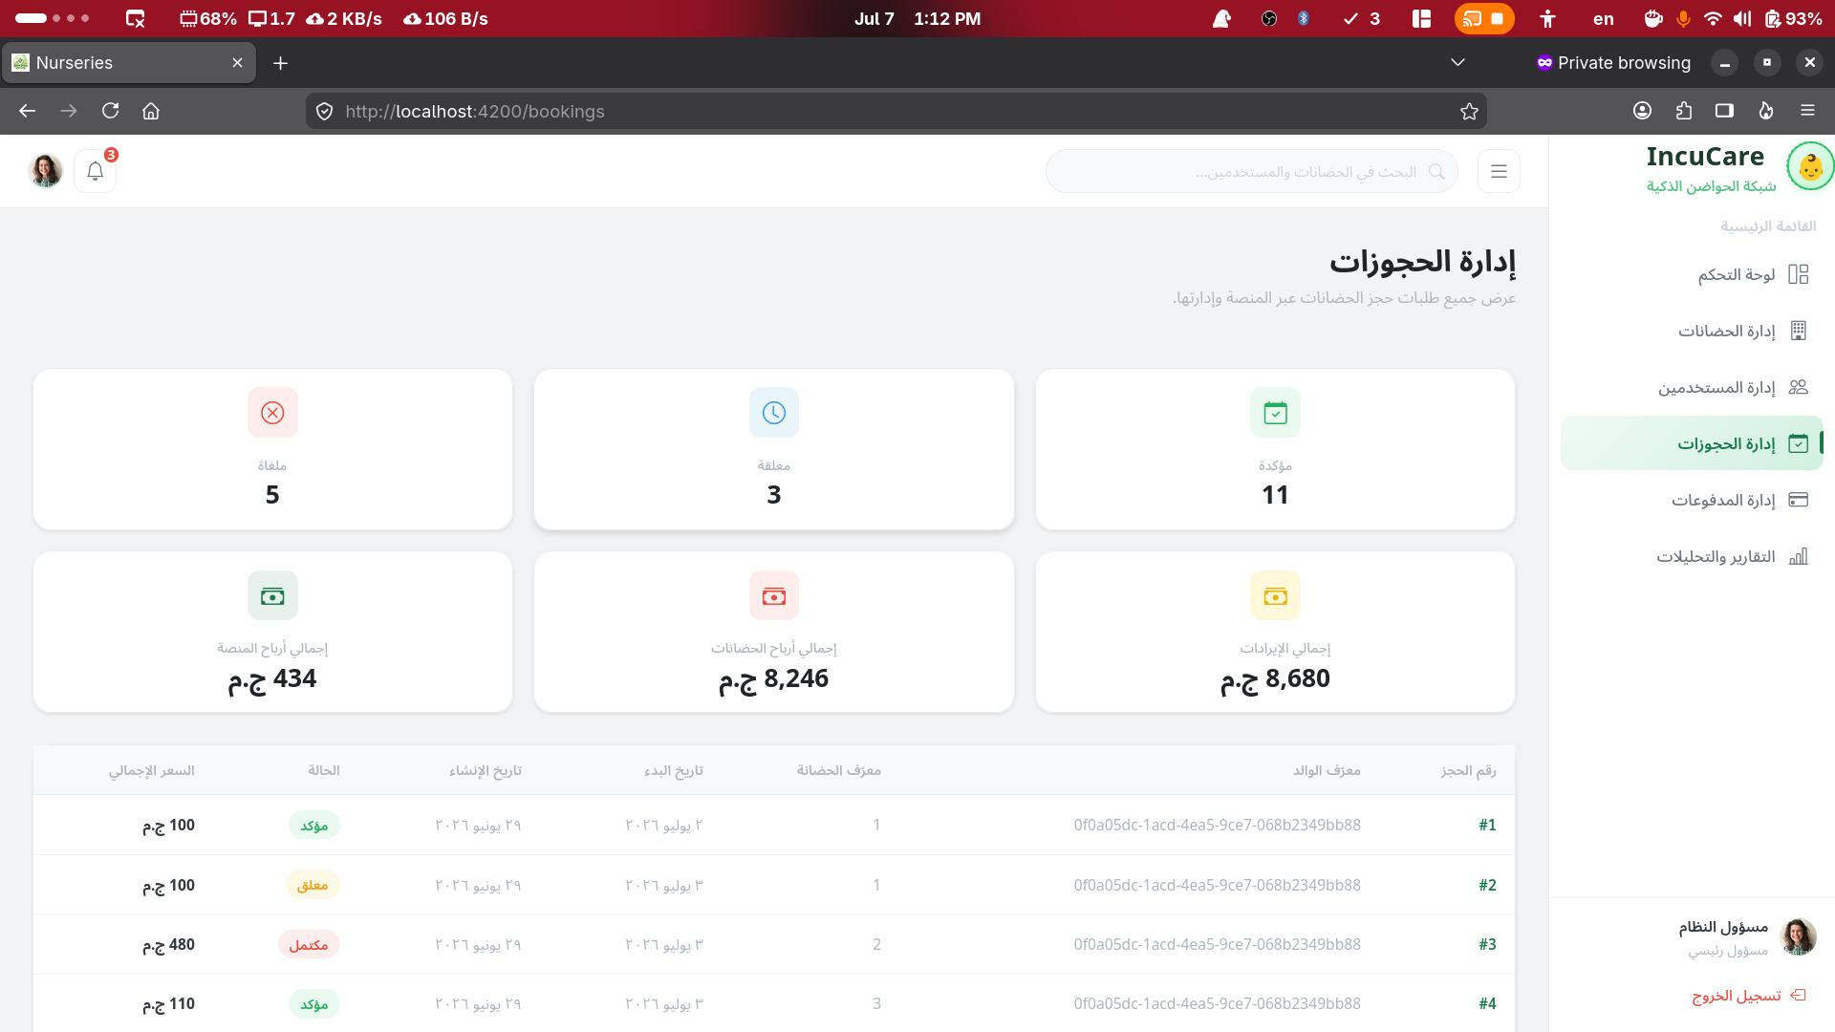
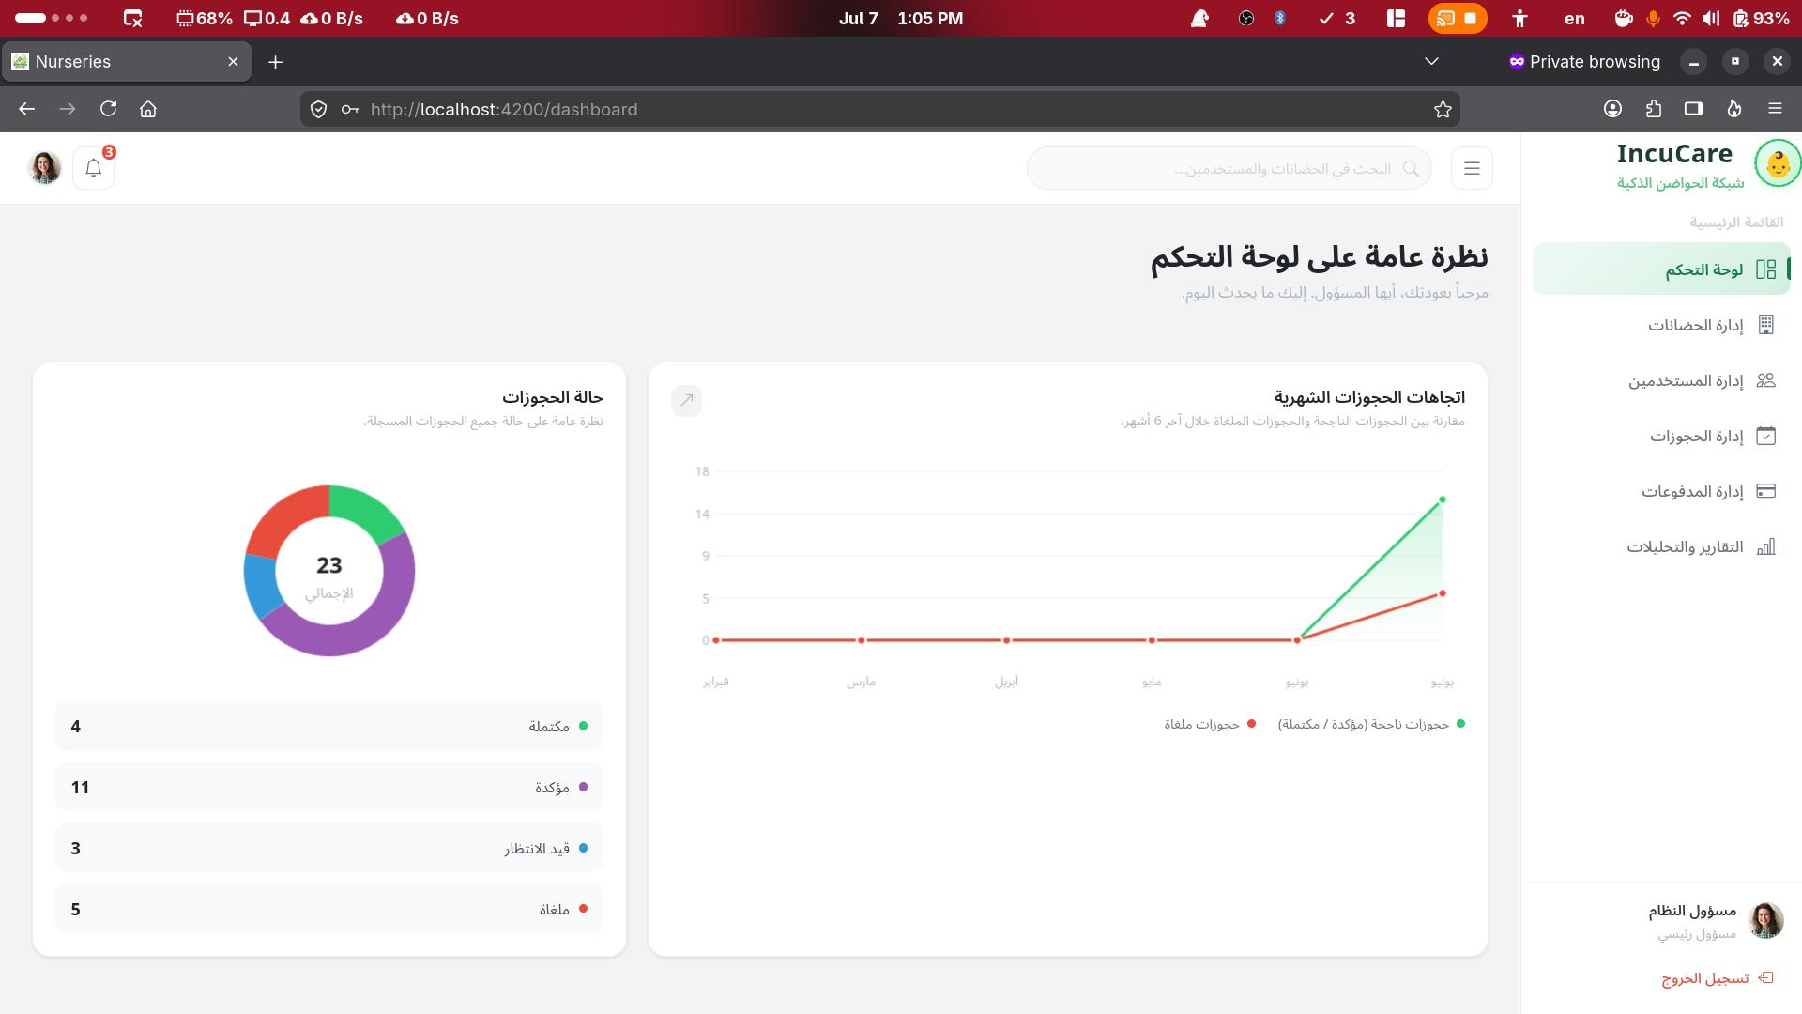

Slide 6
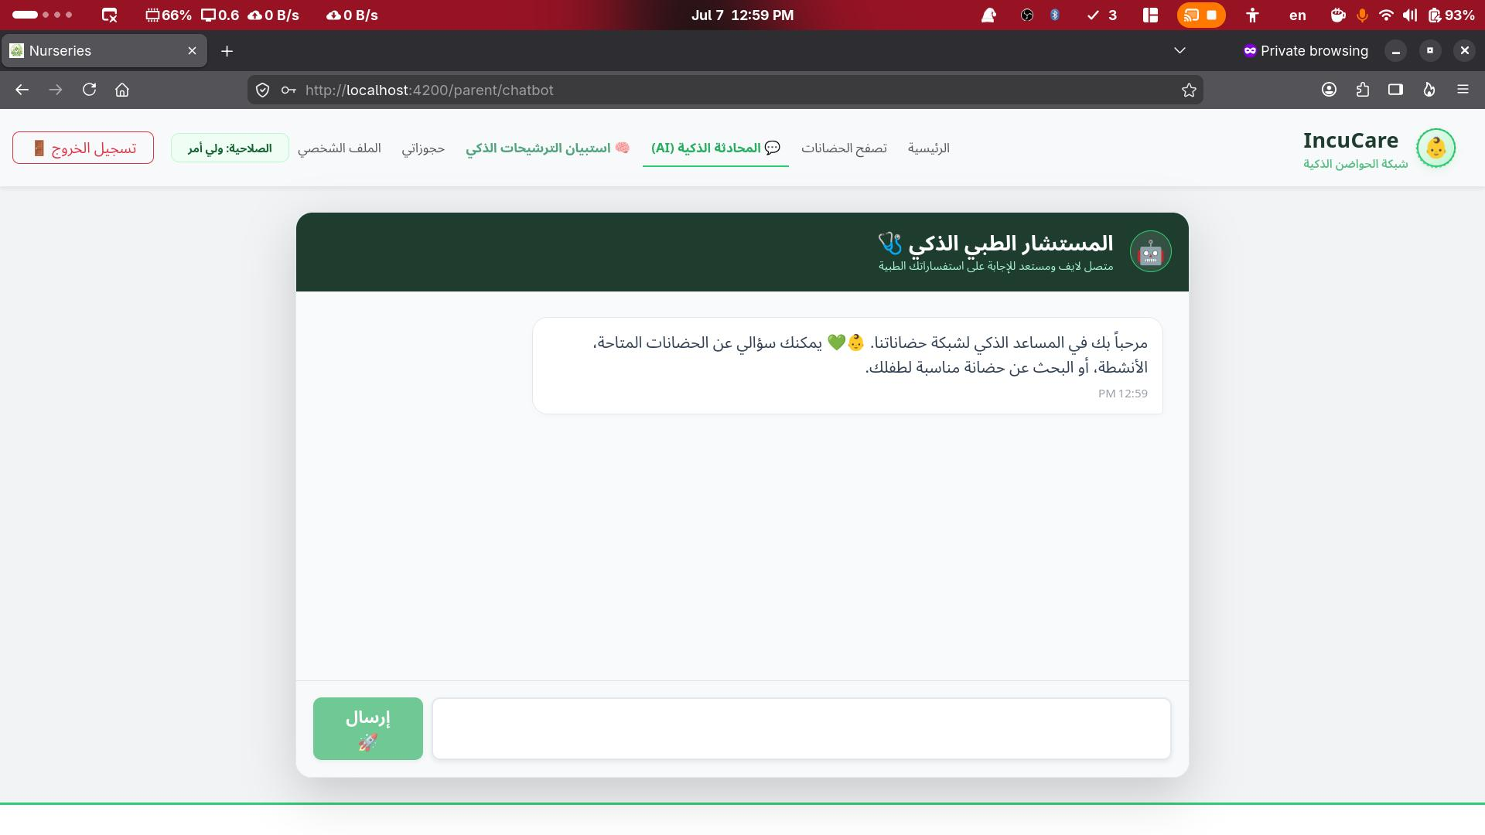
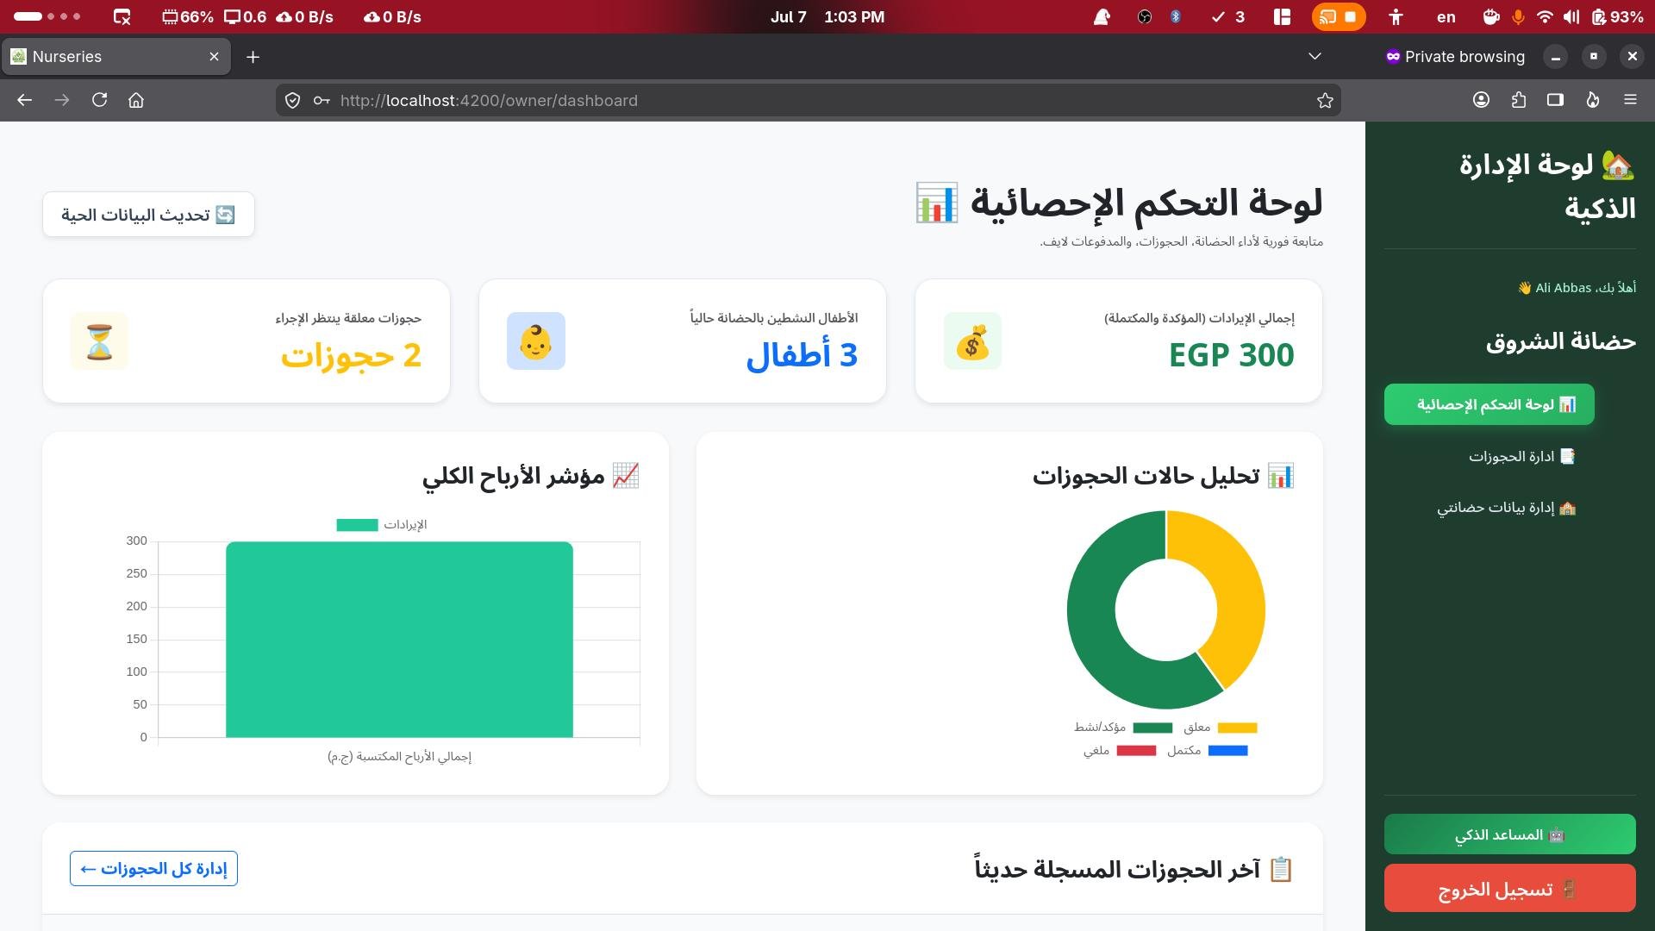
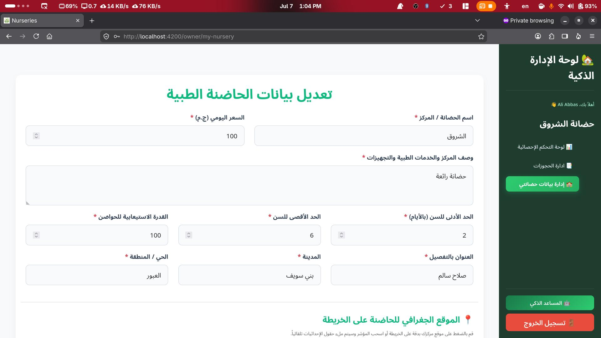

Slide 7
