Slide 1


You can hold it without using your hand or arms. What is it?

Slide 2

The secret number is less than 100, but greater than 60. It's an odd number with a seven in the tens place. To find the number in the ones place, you add two and one.

Slide 3
I am very heavy, But backwards, I'm not

Slide 4
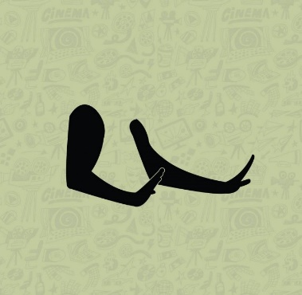
Can you guess the actor

Slide 5

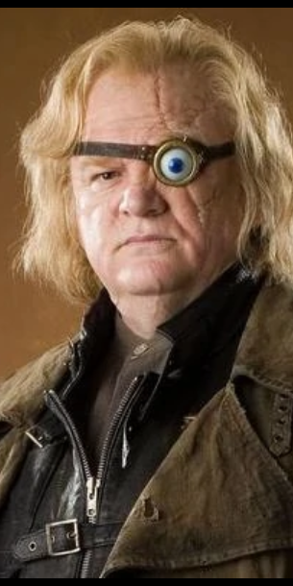
Identify this Harry potter character.

Slide 6
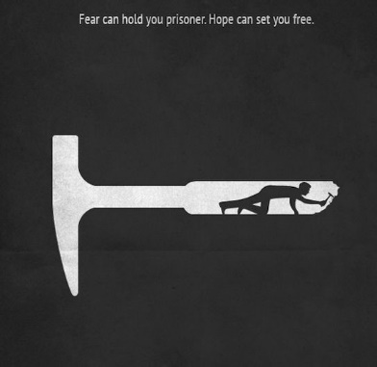
Guess the movie

Slide 7

Can you solve this math puzzle?
2 + 2 + 2 + 2 + 2 + 2
2 + 2 + 2 + 2 + 2
2 + 2 + 2 + 2
2 + 2 + 2
2 X 2
2 =

Slide 8
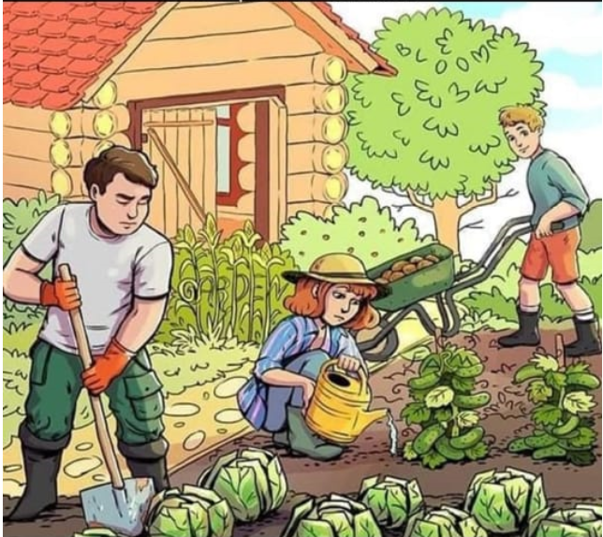
CAN YOU FIND THE THREE HIDDEN WORDS? ANSWER IN ALPHABETICAL ORDER.

Slide 9

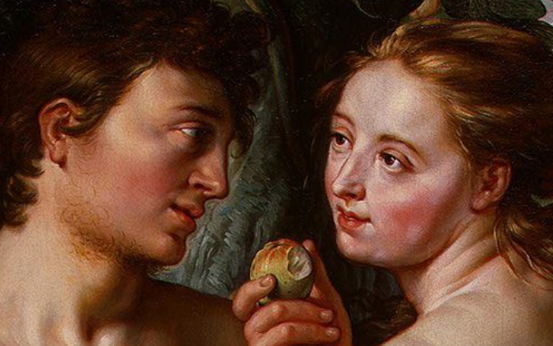
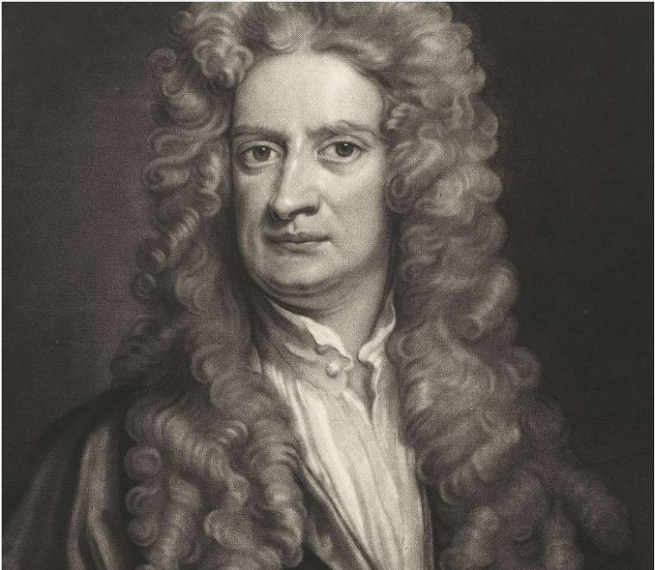

Slide 10
U | C | H | I | L | E | W | O
S | H | L | N | O | O | E | R
M | A | L | D | A | V | S | E
A | D | A | I | H | L | T | O
T | I | C | V | A | L | E | X
S | O | H | A | D | O | R | A
M | O | G | L | A | G | O | N
A | T | K | O | K | O | S | O
Find three countries in alphabetical order. (Country names are forward horizontal, vertical and diagonal only)

