Slide 1

Mohammed Assiri
Project

Slide 2
Outline
Introduction
Scrapping all data
Linear Regression
Ridg Regression
Lasso Regression
Assumptions
Conclusion

Slide 3
Introduction
In this Project, I will request data from the amazon website on a page of the bestsellers of video Games. Because I want to know about the market of the Games and their Prices.

Slide 4
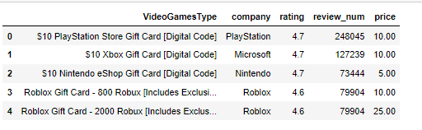
Scrapping all Data
I requested two pages
from Best Sellers in Video Games ,
then I Combined them

Slide 5
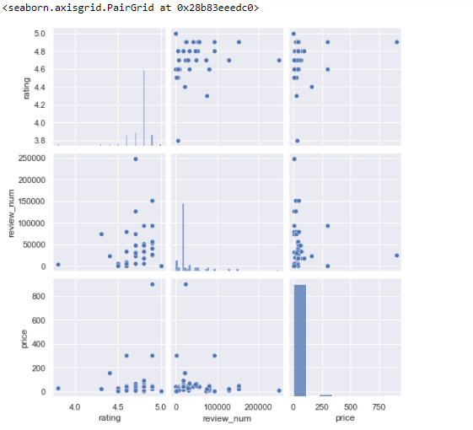
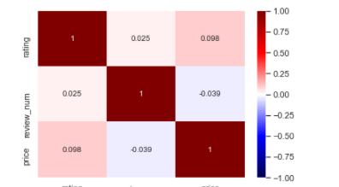
Relations

Slide 6
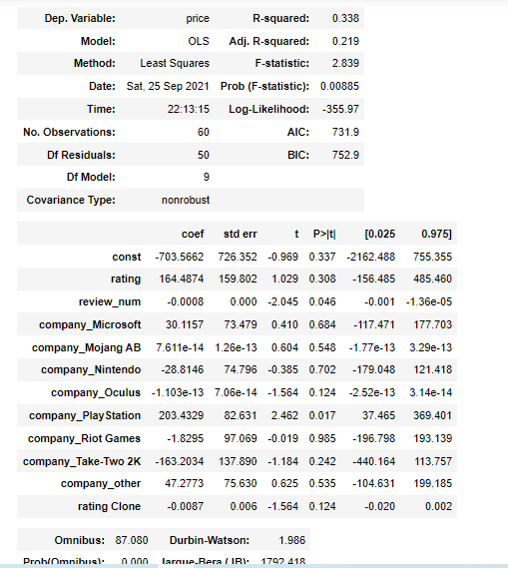
OLS Regression Results

Slide 7
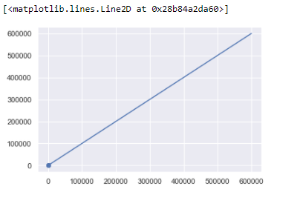
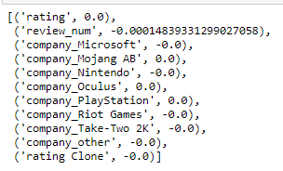
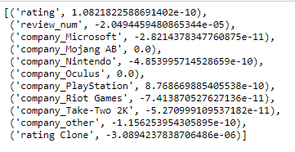
Ridge And Lasso

Slide 8
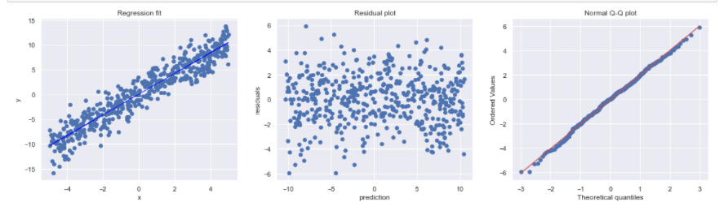
Assumption

Slide 9
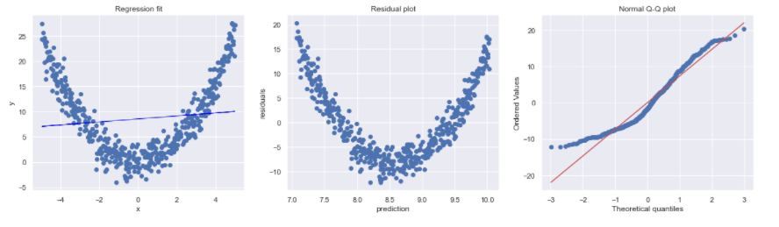

Slide 10
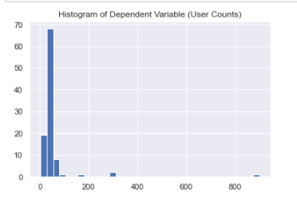
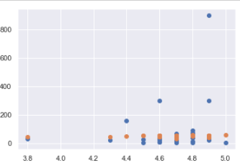
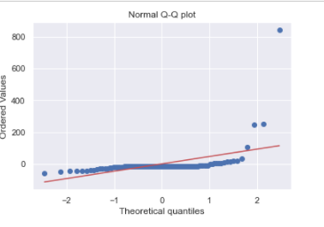

Slide 11
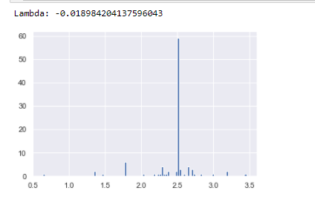
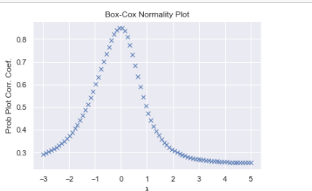

Slide 12
Thank you

