Slide 1
Smart Water Quality Monitoring System Using Iot Technology.
MOHAMMED AFNAN PP
MES20MCA-2026
PRODUCT OWNER: Mrs FEBIN AZIZ

Slide 2
TABLE OF CONTENTS
Introduction
Methodology
Blok Diagram
Proposed System
Developing Environment
Project Plan

Slide 3
INTRODUCTION
The economical and effective system of water quality observation is the most robust implementation of impure water. Drinking water could be precious for all people as water utilities face more challenges. These challenges arise due to the high population, fewer water resources, etc. So, different methods are used to monitor in the real-time water quality. To make sure that safe distribution of water is done, it must be observed in real time for a new method in the “Internet of Things (IoT)” based water quality has been projected. Real-time water quality observation is examined by data acquisition, method, and transmission with an increase in the wireless device network method in the IoT. Microcontroller and the processed values remotely to the core controller ARM with a WI-FI protocol are used to interface the measured values from the sensors. This projected the water quality observation interface sensors with quality observation with IOT setting. WQM selects parameters of water like temperature, pH level, water level ,multiple different device nodes. This methodology sends the information to the web server. The data updated at intervals within the server may be retrieved or accessed from anyplace within the world.

Slide 4
Measurement parameters of WQM system.
Basically, there are many parameters that are needed to
Measured for water quality Analysis.However,the WQM system proposed measures the key water parameters:-
Water’s pHvalue.
Turbidity of the water.
Water level present in the tank.
Temperature and humidity of the surrounding atmosphere.

Slide 5
METHODOLOGY
The proposed system uses four sensors which are pH, turbidity, ultrasonic, DHT-11, microcontroller unit as the main processing module and one data transmission module ESP32 Wi-Fi module (NodeMCU). The microcontroller unit is a significant part of the system developed for water quality measurement because The Arduino uno consumes low power, and it is a small size, where the size is a good use for a crucial point-of-sale technology criterion. Among four sensors, two of the sensors collect the data in the form of analog signals the MCU has an on-chip ADC that translates the sensor analog signals into the digital format for further study. So, to get this analog output from the sensor, the sensor's analog output of will be connected to the MCU's analog pins. Whereas the other two sensors output directly connected to the digital pins of the MCU units. All the sensors data processed by the MCU and updated to the ThingSpeak server using the Wi-Fi data communication module ESP32(NodeMCU) to the central server.

Slide 6
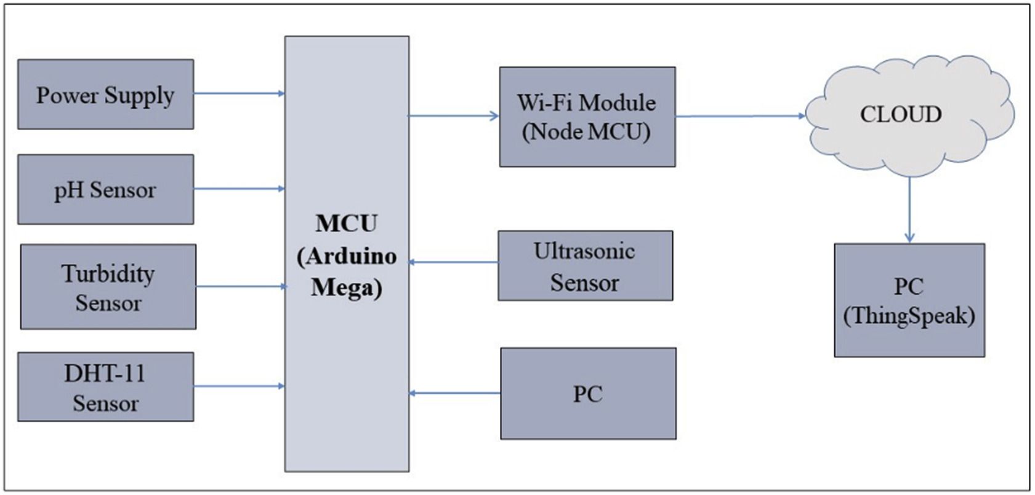
The Block Diagram of the system

Slide 7
PROPOSED SYSTEM
The serial monitor of Arduino is initialized with 115200 baud rate. Later the ESP Wi-Fi module and the Thing Speak Server is also initialized.
The four sensors are being connected and the values are read into the sensors. The algorithm flow of the ultrasonic and DHT 11 sensor flow is explained. The Ultrasonic sensor reads the digital value directly so it is considered as the duration of time in seconds. With the help of the duration, distance is calculated using a equation. The DHT 11 Sensor reads the analog values of temperature and humidity. Later the same values are sent into the Thing Speak server and the same values are updated in the Serial monitor.

Slide 8
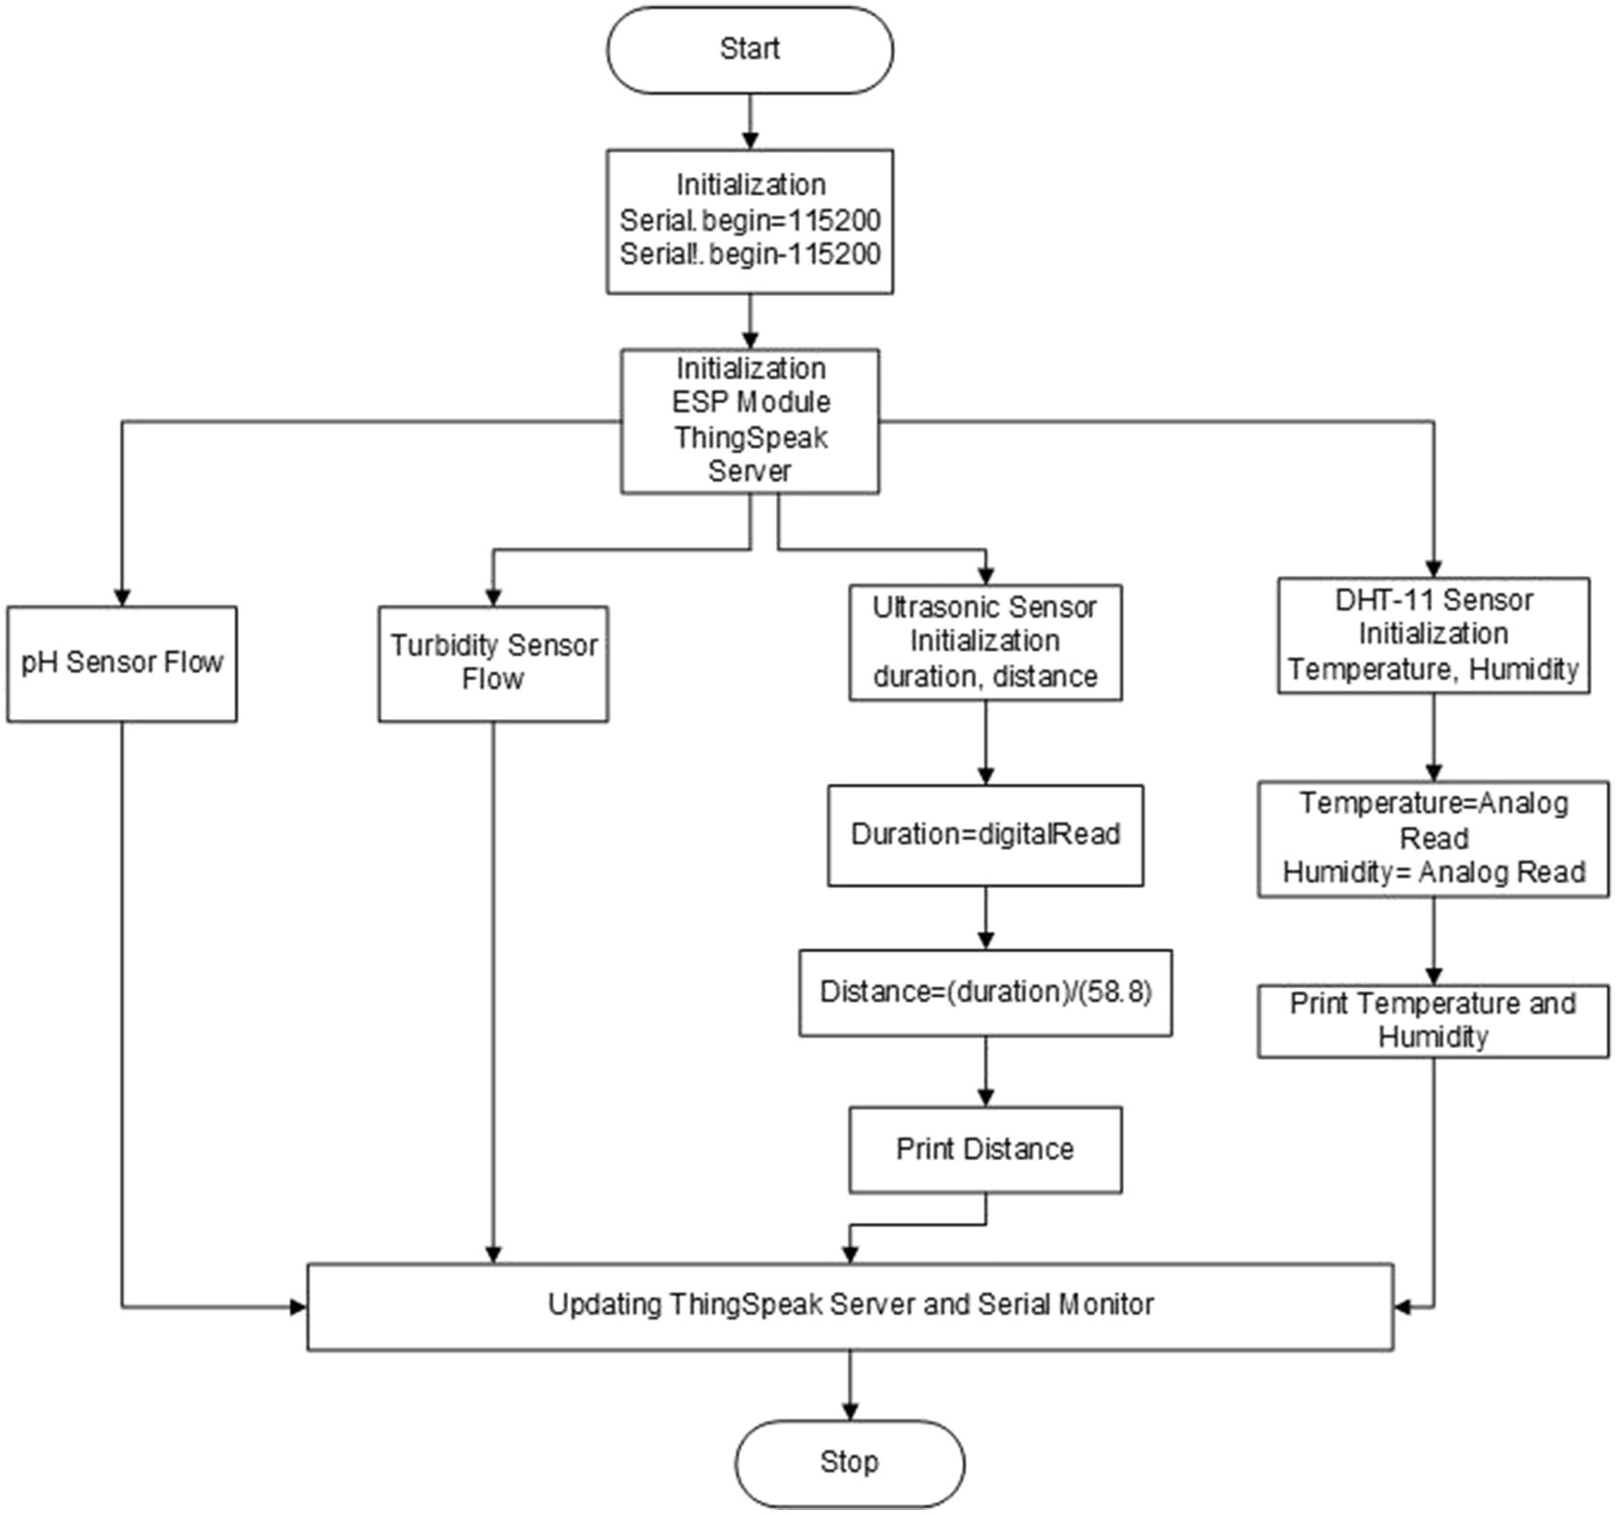
Overall Algorithm for the proposed system.

Slide 9
DEVELOPING ENVIRONMENT
Processor - Dual-Core 32-bit LX6 microprocessor
Speed - 1.1 ghz
RAM – 2Gb (min)
Hard disk - 500HDD
Microcontroller-ESP32
Operating system - windows 7or Above
Platform used – Arduino IDE,ThingSpeak
Power Requirement-Operating Voltage: 2.2V to 3.6V
On-board 3.3V 600mA regulator.

Slide 10
PRODUCT BACKLOG
User Story ID | Priority <High/Medium/Low> | Size (Hours) | Sprint <#> | Status <Planned/In progress/Completed> | Release Date | Release Goal
1 | Medium | 2 | 1 | Completed | 02/05/2022 | Planning
2 | High | 3 |  | Completed | 09/05/2022 | Hardware Purchasing
3 | High | 5 |  | Completed | 08/01/2022 | Basic coding
3 | High | 5 | 2 | Completed | 18/05/2022 | Circuit Designing
4 | Medium | 5 |  | Completed | 20/05/2022 | Preprocessing
5 | High | 5 | 3 | Completed | 04/06/2022 | PCB designing
6 | medium | 5 |  | Completed | 05/05/2022 | Page designing
7 | Medium | 5 | 4 | Completed | 24/06/2022 | Soldering
8 | High | 5 |  | Completed | 30/06/2022 | Output generation

Slide 11
PROJECT PLAN
User story ID | Task name | Start date | End date | Days | Status
Sprint1
1 | Planning | 20/04/2022 | 02/05/2022 | 3 | Completed
2 | Hardware Purchasing | 03/05/2022 | 09/05/2022 | 2 | Completed
3 | Hardware Testing | 10/05/2022 | 15/05/2022 | 5 | Completed
Sprint2
4 | Circuit designing | 15/05/2022 | 18/05/2022 | 2 | Completed
5 | Coding | 19/05/2022 | 21/05/2022 | 1 | Completed
6 | PCB Designing | 22/05/2022 | 29/05/2022 | 6 | Completed

Slide 12
User story ID | Task name | Start date | End date | Days | Status
Sprint3
7 | PCB designing | 01/06/2022 | 05/06/2022 | 2 | Completed
8 | Coding | 28/05/2022 | 20/06/2022 | 1 | Completed
9 | Soldering | 21/06/2022 | 24/06/2022 | 9 | Completed
10 | Testing& Output generation | 25/06/2022 | 30/06/2022 | 1 | Completed

Slide 13
SPRINT BACKLOG PLAN
Backlog Item | Status & completion date | Original estimate in hours | Day1 | Day2 | Day3 | Day4 | Day5 | Day6 | Day7 | Day8 | Day9 | Day10 | Day11 | Day12 | Day13 | Day14
#1,#2,#3,#4 |  | hrs | hrs | hrs | hrs | hrs | hrs | hrs | hrs | hrs | hrs | hrs | hrs | hrs | hrs | hrs
Planning | 25/04/2022 | 2 | 1 | 1 | 0 | 0 | 0 | 0 | 0 | 0 | 0 | 0 | 0 | 0 | 0 | 0
Hardware Purchasing | 05/05/2022 | 3 | 0 | 0 | 0 | 1 | 1 | 1 | 0 | 0 | 0 | 0 | 0 | 0 | 0 | 0
page design | 08/05/2022 | 5 | 0 | 0 | 0 | 0 | 0 | 0 | 0 | 0 | 0 | 1 | 1 | 1 | 1 | 1
Hardware Testing | 13/05/2022 | 5 | 0 | 0 | 0 | 0 | 0 | 0 | 0 | 0 | 0 | 1 | 1 | 1 | 1 | 1
Circuit designing | 17/05/2022 | 5 | 1 | 1 | 1 | 1 | 1 | 0 | 0 | 0 | 0 | 0 | 0 | 0 | 0 | 0
PCB Designing | 25/05/2022 | 5 | 0 | 0 | 0 | 0 | 0 | 0 | 0 | 1 | 0 | 1 | 1 | 1 | 0 | 1
Soldering | 23/06/2022 | 5 | 1 | 1 | 1 | 1 | 1 | 0 | 0 | 0 | 0 | 0 | 0 | 0 | 0 | 0
Testing& Out Put Generation | 28/06/2022 | 5 | 0 | 0 | 0 | 0 | 0 | 0 | 0 | 0 | 0 | 2 | 1 | 1 | 1 | 1
Total |  | 40 | 4 | 4 | 2 | 4 | 3 | 2 | 0 | 2 | 0 | 5 | 4 | 4 | 3 | 4

Slide 14
Backlog Item | Status & completion date | Original estimate in hours | Day1 | Day2 | Day3 | Day4 | Day5 | Day6 | Day7 | Day8 | Day9 | Day10 | Day11 | Day12 | Day13 | Day14
#1,#2,#3,#4 |  | hrs | hrs | hrs | hrs | hrs | hrs | hrs | hrs | hrs | hrs | hrs | hrs | hrs | hrs | hrs
Planning | 25/04/2022 | 2 | 1 | 1 | 0 | 0 | 0 | 0 | 0 | 0 | 0 | 0 | 0 | 0 | 0 | 0
Hardware Purchasing | 05/05/2022 | 3 | 0 | 0 | 0 | 1 | 1 | 1 | 0 | 0 | 0 | 0 | 0 | 0 | 0 | 0
page design | 08/05/2022 | 5 | 0 | 0 | 0 | 0 | 0 | 0 | 0 | 0 | 0 | 1 | 1 | 1 | 1 | 1
Hardware Testing
Circuit designing
PCB Designing
Soldering
Testing& Out Put Generation
Total |  | 15 | 1 | 1 | 0 | 1 | 1 | 1 | 0 | 0 | 0 | 1 | 1 | 1 | 1 | 1

Slide 15
Backlog Item | Status & completion date | Original estimate in hours | Day1 | Day2 | Day3 | Day4 | Day5 | Day6 | Day7 | Day8 | Day9 | Day10 | Day11 | Day12 | Day13 | Day14
#1,#2,#3,#4 |  | hrs | hrs | hrs | hrs | hrs | hrs | hrs | hrs | hrs | hrs | hrs | hrs | hrs | hrs | hrs
Planning | 25/04/2022 | 2 | 1 | 1 | 0 | 0 | 0 | 0 | 0 | 0 | 0 | 0 | 0 | 0 | 0 | 0
Hardware Purchasing | 05/05/2022 | 3 | 0 | 0 | 0 | 1 | 1 | 1 | 0 | 0 | 0 | 0 | 0 | 0 | 0 | 0
page design | 08/05/2022 | 5 | 0 | 0 | 0 | 0 | 0 | 0 | 0 | 0 | 0 | 1 | 1 | 1 | 1 | 1
Hardware Testing | 13/05/2022 | 5 | 0 | 0 | 0 | 0 | 0 | 0 | 0 | 0 | 0 | 1 | 1 | 1 | 1 | 1
Circuit designing | 17/05/2022 | 5 | 1 | 1 | 1 | 1 | 1 | 0 | 0 | 0 | 0 | 0 | 0 | 0 | 0 | 0
PCB Designing
Soldering
Testing& Out Put Generation
Total |  | 25 | 3 | 3 | 1 | 2 | 2 | 1 | 0 | 0 | 0 | 2 | 2 | 2 | 2 | 2

Slide 16
THANK YOU

