Slide 1
wedding planner needed tables Counter
Algorithms
د.مروة عبد الفتاح د.غادة
20180497محمد سامي عطية خليل

Slide 2
The problem
2- The Wedding Planner (one solution)
You are planning the seating arrangement for a wedding given a list of guests, V Suppose you are also given a lookup table T where T[u] for u ∈ V is a list of guests that u knows. If u knows v, then v knows u. You are required to arrange the seating such that any guest at a table knows every other guest sitting at the same table either directly or through some other guests sitting at the same table. For example, if x knows y, and y knows z, then x, y, z can sit at the same table. Describe an efficient algorithm that, given V and T, returns the minimum number of tables needed to achieve this requirement.
---------------------------
Sample Input: V = [b,c,x,y,w,z] Tc = [x,w] Tb = [y,z] Tx = [c] Tw = [c] Tb = [y] Tb = [z]
----------------------------
Sample Output: Number of tables: 2

Slide 3
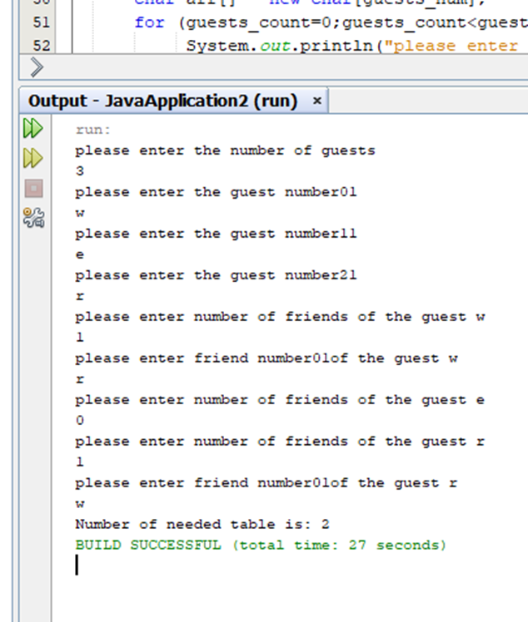
Input example documentation
W
R
E

Slide 4
example
A
B
C
A
E
B
A
B
C
A
D
F
D
C
C
E
F
D
F
E

Slide 5
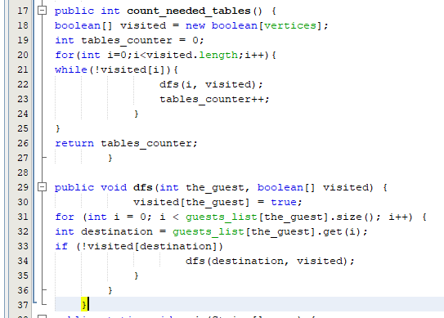
Table_counter =0
Table_counter =1
Table_counter =2
A
B
C
B
A
C
A
D
D
C
E
F
F
E

Slide 6
Time comlexity
n
1∑
i=0
n=number of vertices and edges
-------------------------------------------------
n-0+1=n
Θn
Θ|V+E|

Slide 7
Thank you

