Slide 1
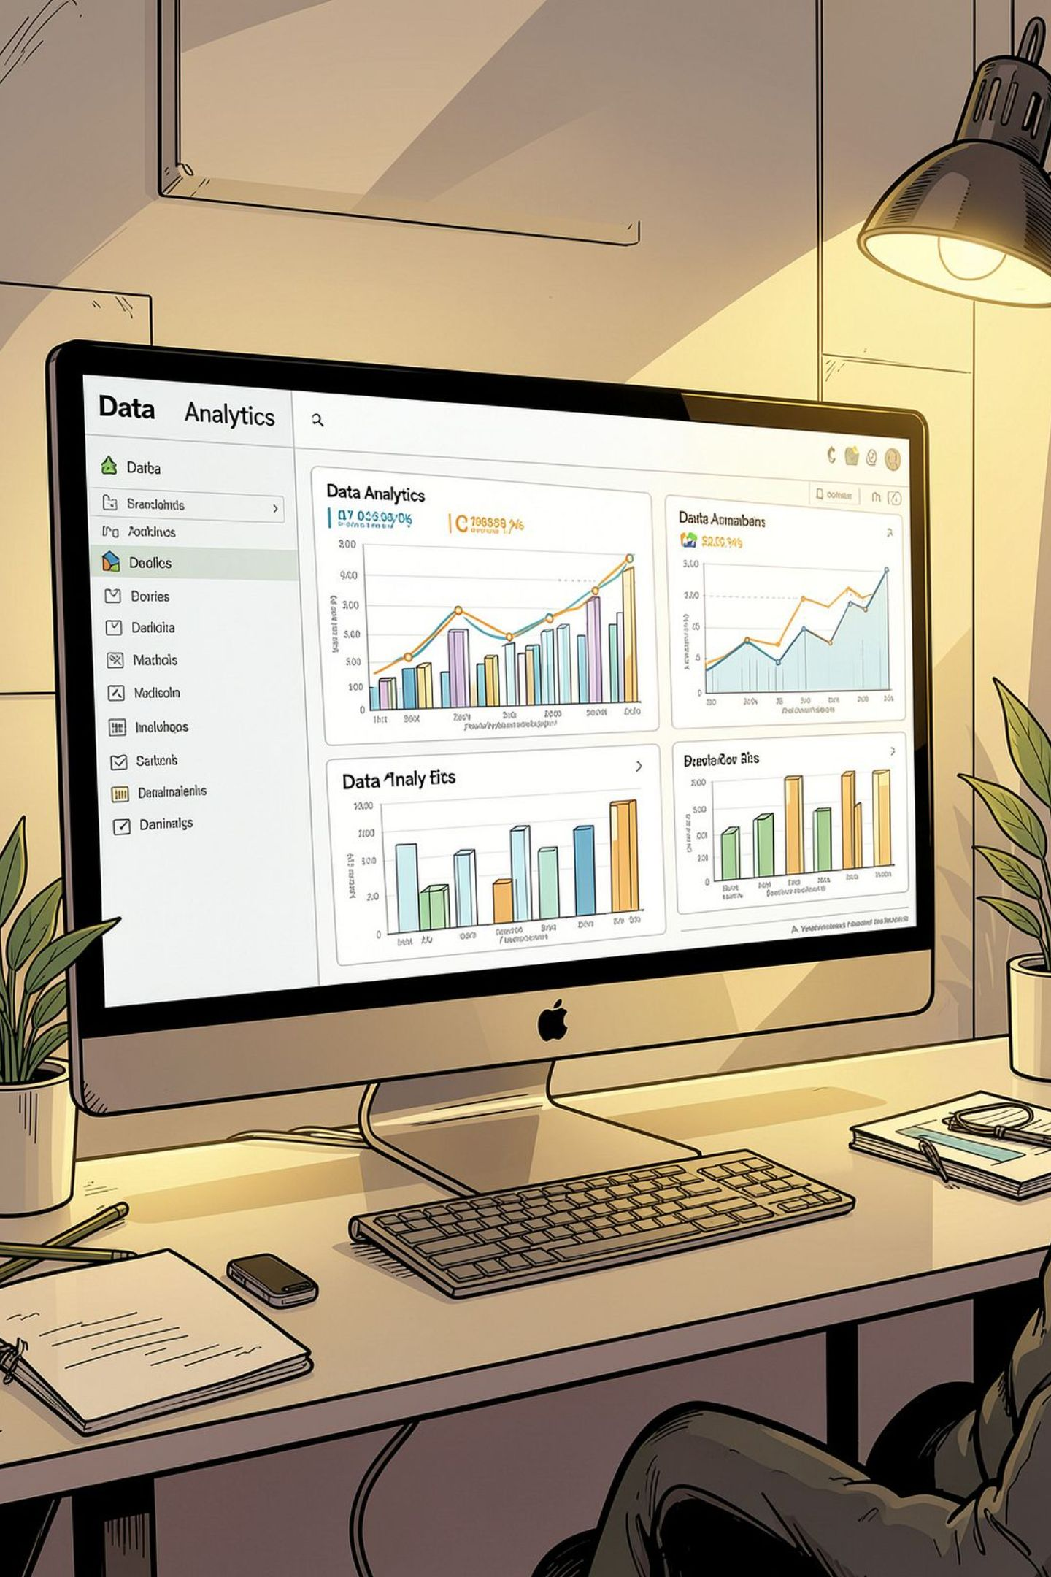
Customer Shopping Behavior Analysis
3,900 purchases • 18 features • Goal: spending patterns, segments, product & subscription insights

Slide 2
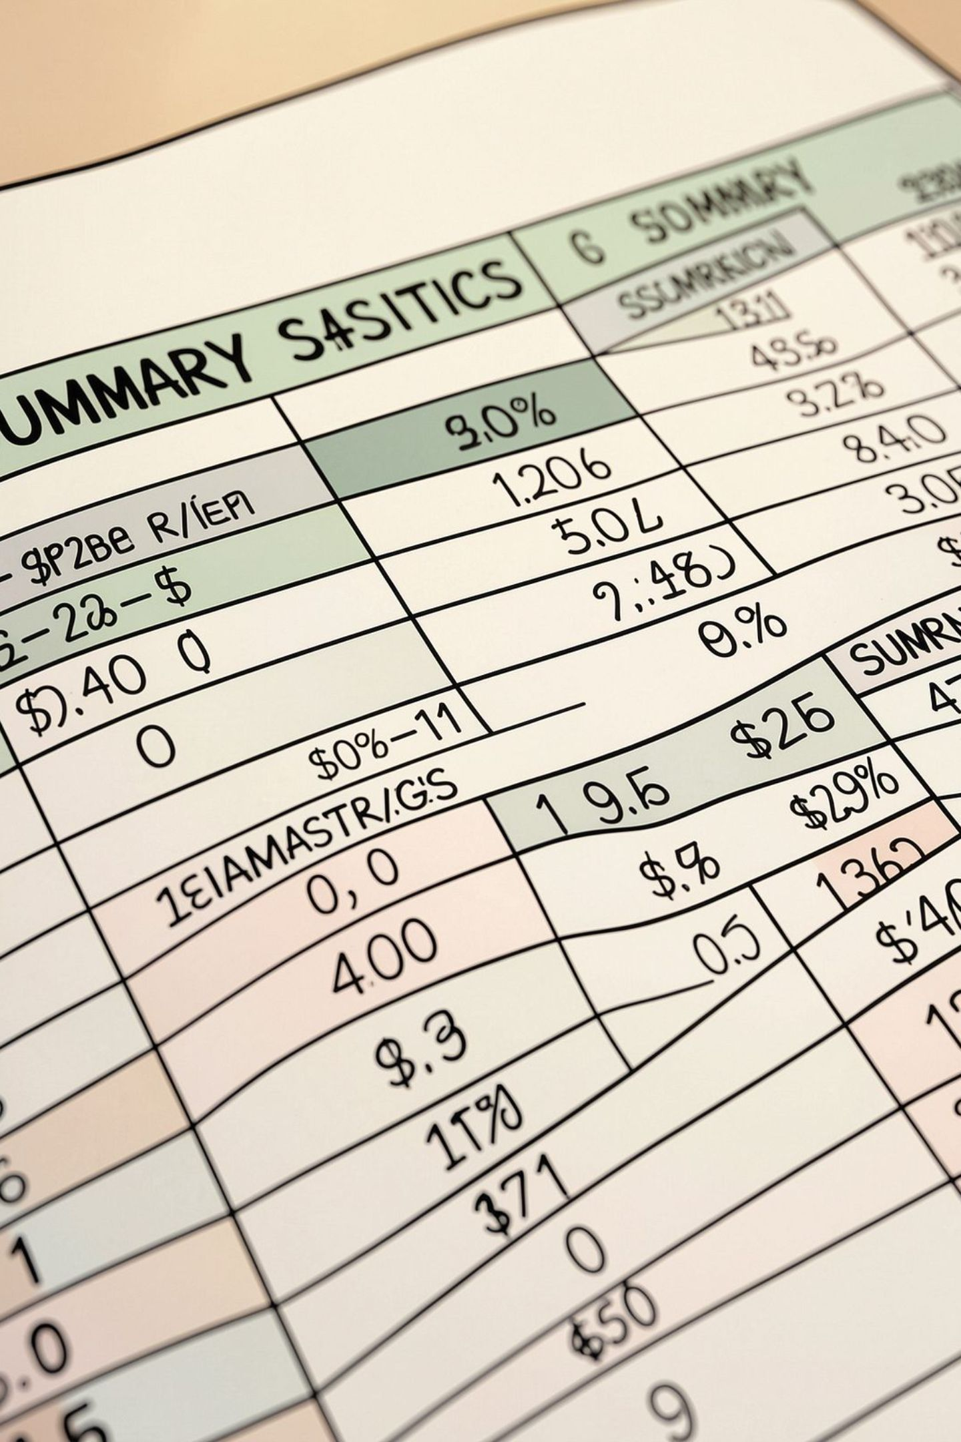
Dataset Summary
Rows & Columns
Key Features
3,900 rows • 18 columns
Demographics, Purchase details, Behavior, Shipping
Missing Data
37 nulls in Review Rating

Slide 3

Data Prep & EDA (Python)
01
Load & Inspect
pandas: df.info(), .describe()
02
Missing & Impute
Imputed Review Rating by category median
03
Standardize & Engineer
snake_case columns; age_group; purchase_frequency_days
04
DB Load
Export to PostgreSQL for SQL analysis

Slide 4
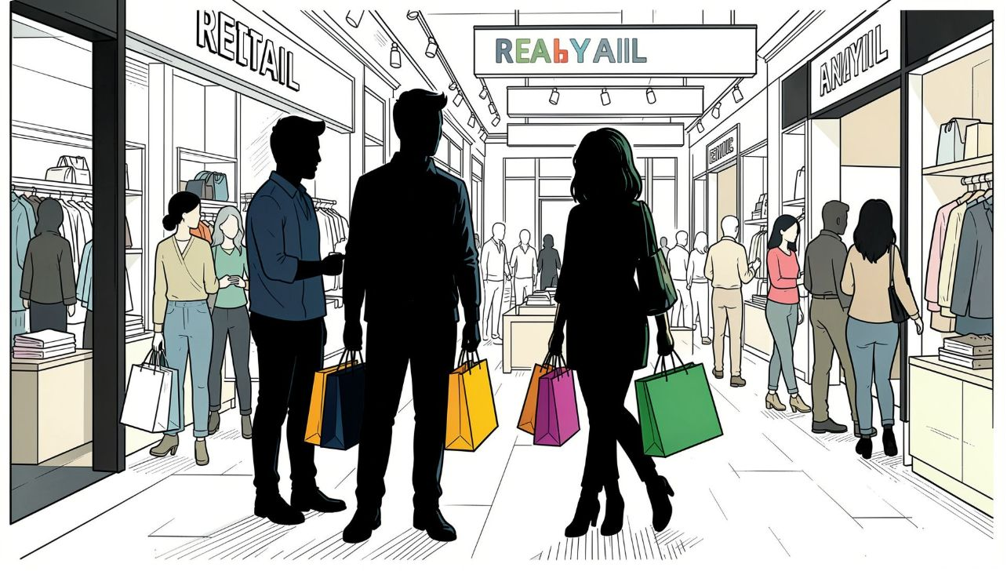

Revenue by Gender
Female: 75,191 • Male: 157,890
Male revenue notably higher

Slide 5
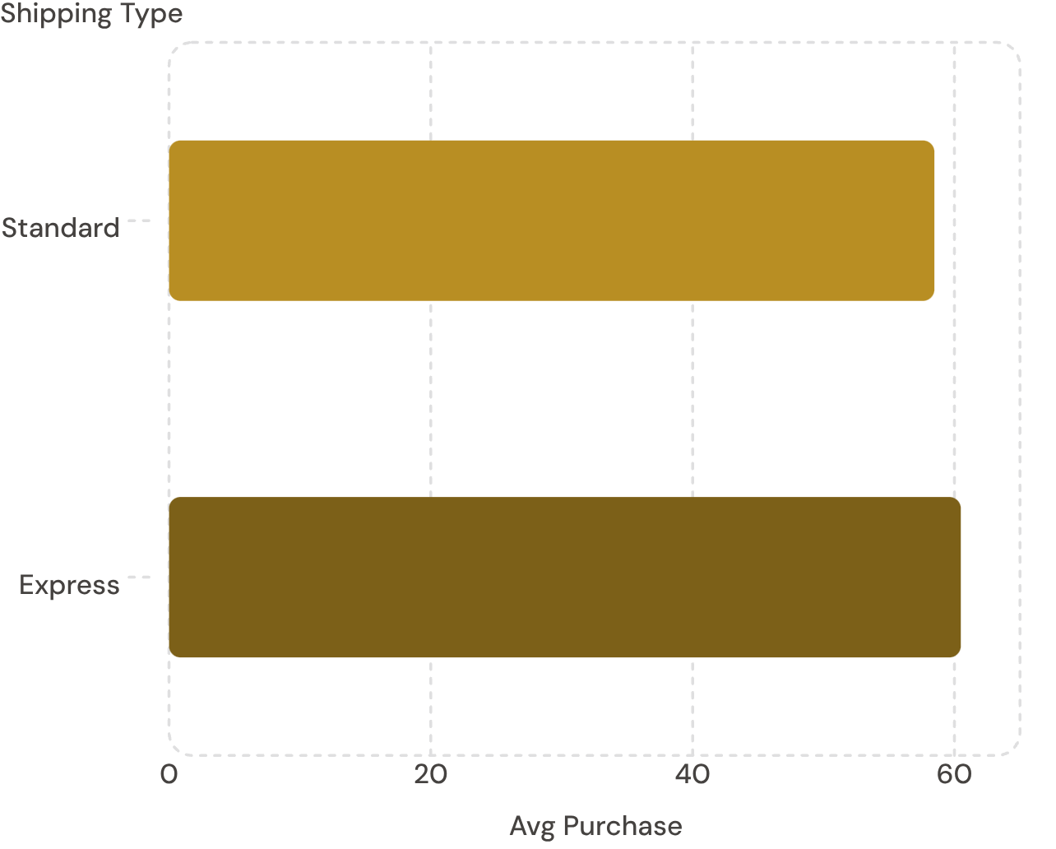
Shipping Comparison
Express avg: $60.48 • Standard avg: $58.46
Small difference — consider shipping-driven promo tests

Slide 6
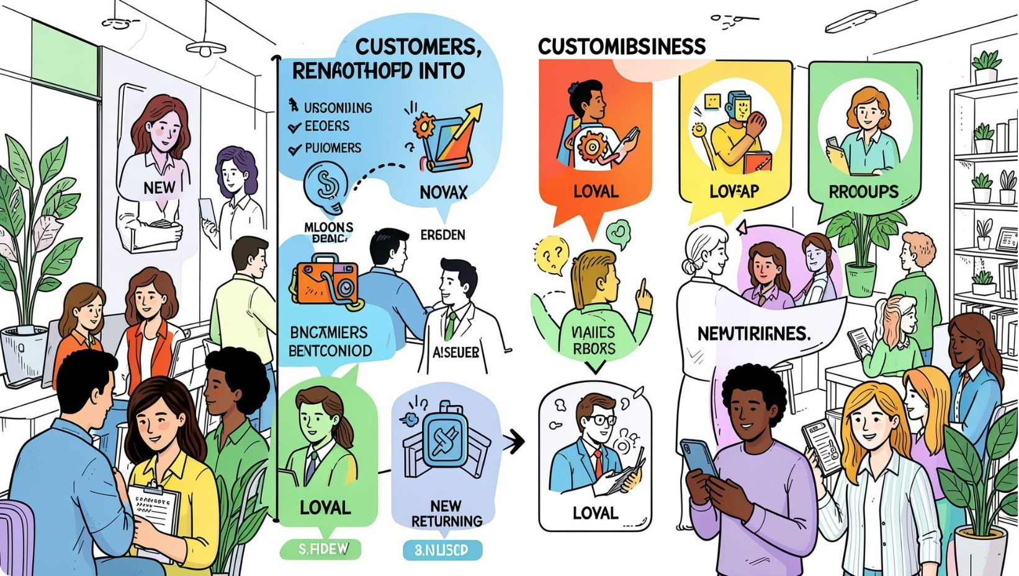




Customer Segmentation
Loyal
3,116 customers
New
83 customers
Returning
701 customers
Target loyalty programs to move Returning→Loyal

Slide 7
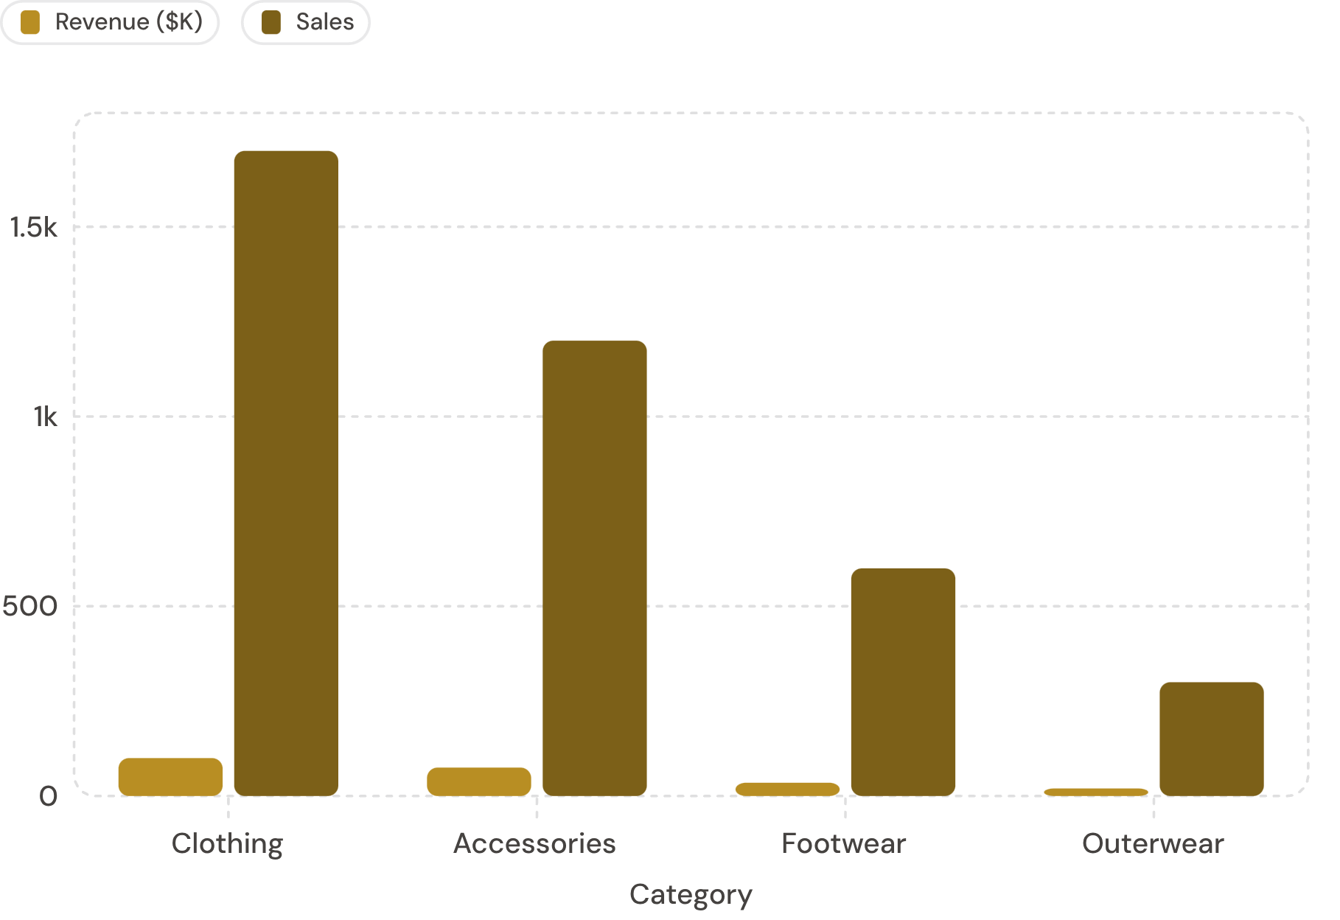
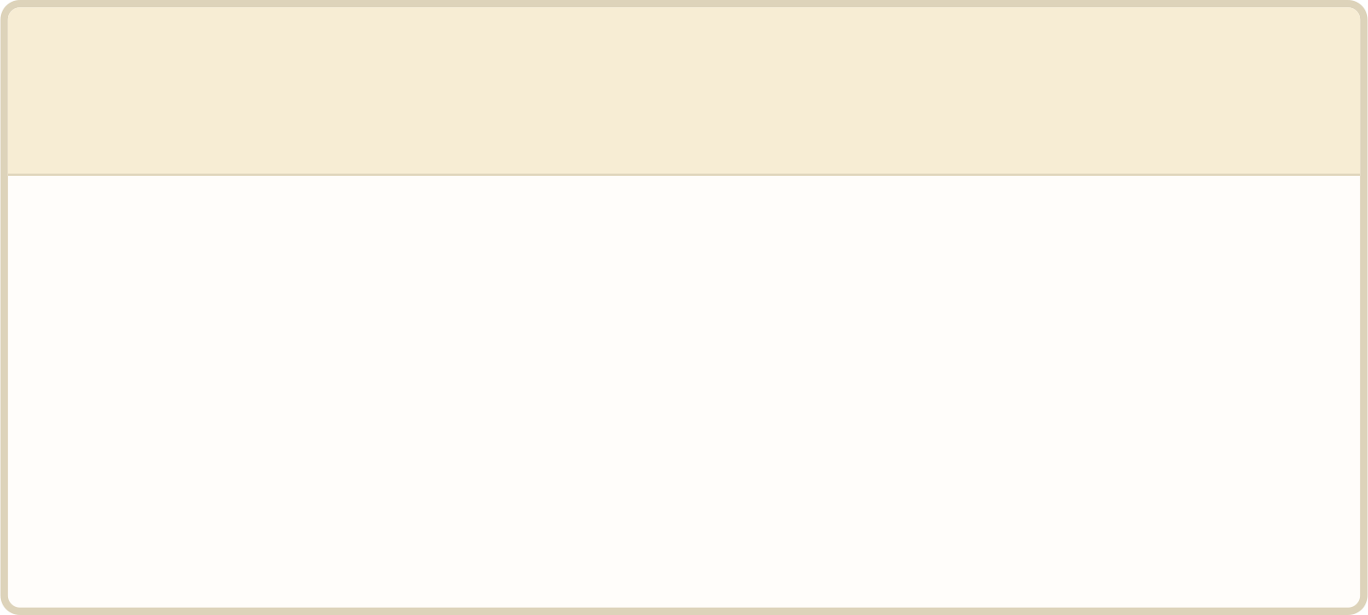
Top Categories
Clothing leads in revenue & sales. Accessories strong revenue per unit.
1
Top products
Blouse, Pants, Shirt; Accessories: Jewelry, Sunglasses, Belt

Slide 8
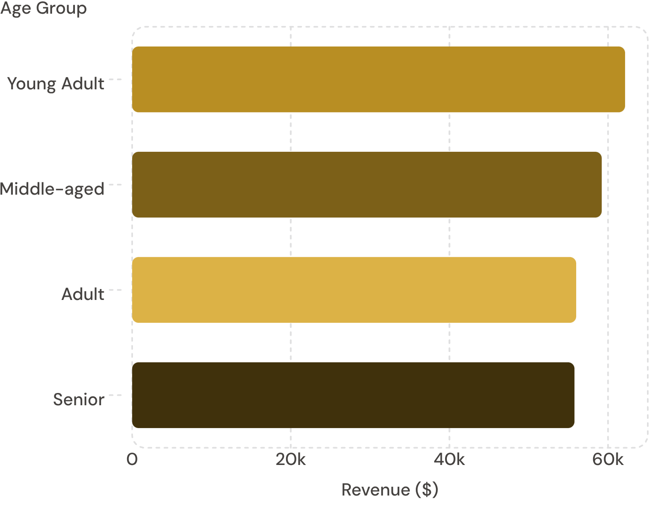
Revenue by Age Group
Young Adult highest contributor • Middle-aged close behind
Focus targeted marketing on Young Adults & Middle-aged

Slide 9
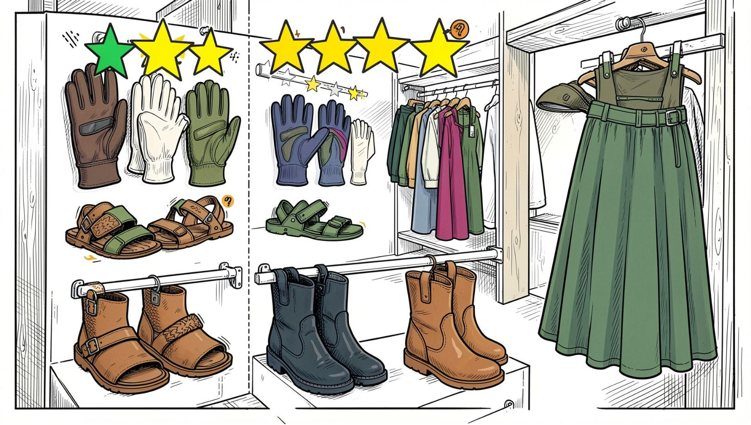
Product Insights
Top rated: Gloves (3.86), Sandals (3.84), Boots (3.82), Hat (3.80), Skirt (3.78)
Discount-dependent: Hat 50%, Sneakers 49.66%, Coat 49.07%, Sweater 48.17%, Pants 47.37%
High-spend discount users: 839 rows identified (examples shown)

Slide 10
Recommendations
Boost Subscriptions
Loyalty Programs
Review Discounts
Promote exclusive subscriber benefits
Reward repeat buyers to grow Loyal segment
Balance volume vs margin; target discount-dependent items
Product Positioning
Targeted Marketing
Highlight top-rated & best-sellers in campaigns
Focus on high-revenue age groups & express-shipping users
Interactive dashboard built in Power BI to track these KPIs

