Slide 1
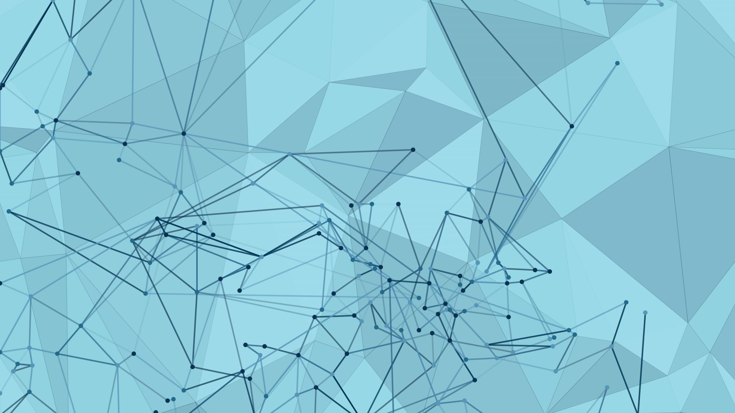
Image Captioning, Translation, and Text-to-Speech
:Made by
Supervised by:
Eng. Ehab Ibrahim
Mohammed Adham El Sayed

Slide 2
Overview
In this project, we developed an application that generates image captions using the BLIP model, translates these captions into Arabic using the MarianMT model, and finally converts the translated text to speech using gTTS. The application is designed to streamline the process and provide instant, accurate results

Slide 3
Model Descriptions
Image Captioning using BLIP
n this phase, we use the BLIP model to generate captions for images. The model processes the image and produces a text-based caption that describes its content. This is done through:
Loading the image using BlipProcessor.
Processing the image via the BlipForConditionalGeneration model.
Generating the caption that describes the image.

Slide 4
Model Descriptions
Translation using MarianMT
After generating the caption, we use the MarianMT model to translate the text from English to Arabic. This model is based on the Helsinki-NLP library, which supports translation between many languages.
The text to be translated is input.
The model generates the translated text

Slide 5
Model Descriptions
Text-to-Speech using gTTS
Finally, we convert the translated text into speech using gTTS (Google Text-to-Speech). This step allows users to listen to the translation in Arabic, providing an enhanced user experience.
The text is converted into an MP3 audio file.
The audio is played directly in the app

Slide 6
User Interface with Streamlit
The user interface was built using Streamlit, a platform that allows for easy and fast web application development. Users can upload an image through a simple interface, and the generated caption, translation, and audio are displayed directly.
The uploaded image appears on the left side of the screen.
The caption, translation, and audio are shown on the right side.

Slide 7
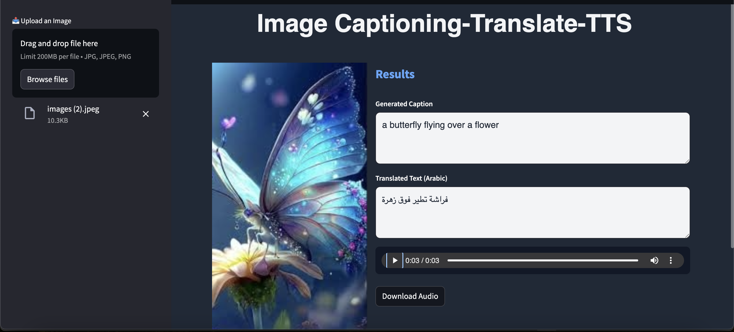
User interface

Slide 8
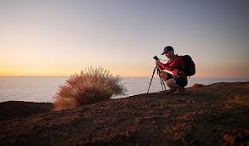

Results
Upload Image
Generate Caption
a man taking a picture of a sunset
Translate Caption
رجل يلتقط صورة لغروب
Generate Audio

Slide 9
Conclusion
In this project, we successfully built an application that generates image captions, translates them, and converts them to speech using artificial intelligence. This application can be useful in various fields such as education, communication for people with disabilities, and enhancing user experience in different apps.

Slide 10


