Slide 1
AI-Enhanced Intrusion Detection System with Risk Assessment
Project (2) -- Final Presentation
Project team details omitted for public portfolio
Supervisor: Dr. Omer Elsier Tayfour

Slide 2
Outline
Introduction
Problem Statement
Needs and Design Requirements
Design Alternatives
Design Alternatives Evaluation Criteria
Selected Design Alternative (Block Diagram of the Project)
Hardware/Software Requirements
Related Standards
Realistic Constraints and Metrics
Detailed Design Description
Modeling and/or simulation (if applicable)
Implementation (Software and/or Hardware)
System Testing, Results and Discussion
Conclusions and Recommendations
References

Slide 3
Introduction
Cyber threats are rising with the rapid growth of digital systems, and traditional IDS struggle to detect new or unknown
This project implements an AI-driven IDS that analyzes network traffic, detects anomalies, and assigns risk scores.
Traditional IDS systems such as Snort depend on set rules. They can detect known attacks, but they create many alerts that are not organized or prioritized.

Slide 4
Problem Statement
Traditional IDS systems generate many alerts without proper prioritization. As a result, security teams may waste time analyzing normal alerts while critical attacks receive the same priority level, delaying response to dangerous threats. so, a risk-scoring mechanism is needed to prioritize attacks from highest to lowest severity.

Slide 5
Needs and Design Requirements
Needs | Design requirements
Able to monitor network traffic | Has Snort IDS installed on Raspberry Pi Captures real-time network packets
Able to detect and classify threats | Has Random Forest Machine Learning model Classifies alerts into Normal, Low, Medium, High, Critical
Able to prioritize and assign risk | Calculates risk score for each alert Sorts alerts based on severity to focus on critical threats
Able to alert and notify users | Has dashboard or interface to display alerts Can send notifications for high-risk threats
Able to store and process data | Has storage for logs and network data Has processing unit to run ML model and Snort efficiently

Slide 6
Design Alternatives
Design Alternative 1: Traditional Snort Signature-Based IDS
Design Alternative 2: Snort + Deep Learning on (Jetson Orin)
Design Alternative 3: Snort + Random Forest + Risk Scoring
1
2
3

Slide 7
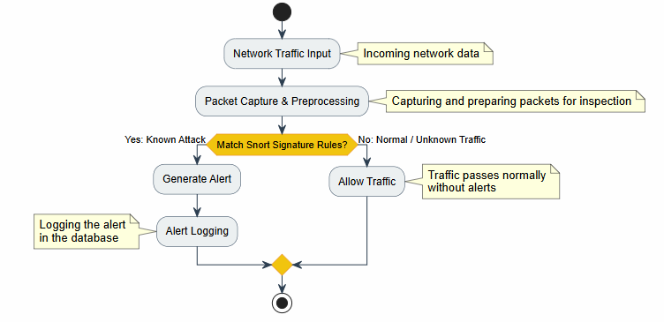
Design Alternatives 1
Design Alternatives 1: Traditional Snort Signature-Based IDS
Description:
Uses Snort only for signature-based detection
Simple and low-cost
Good for known attacks
Limitations:
Cannot detect new or unknown attacks
Higher false-positive rate
No risk scoring

Slide 8
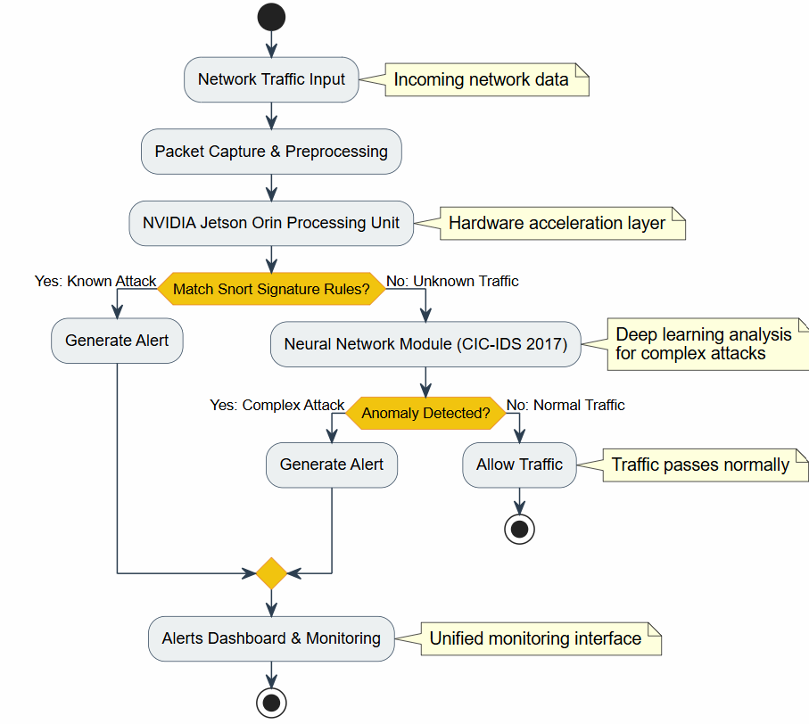
Design Alternatives 2
Design Alternatives 2: Snort + Deep Learning on (Jetson Orin)
Description:
Adds a neural network model trained on CICIDS2017
Limitations:
Expensive hardware (Jetson Orin)
Higher detection accuracy
Better for complex attacks
Higher power consumption
Not suitable for small devices

Slide 9
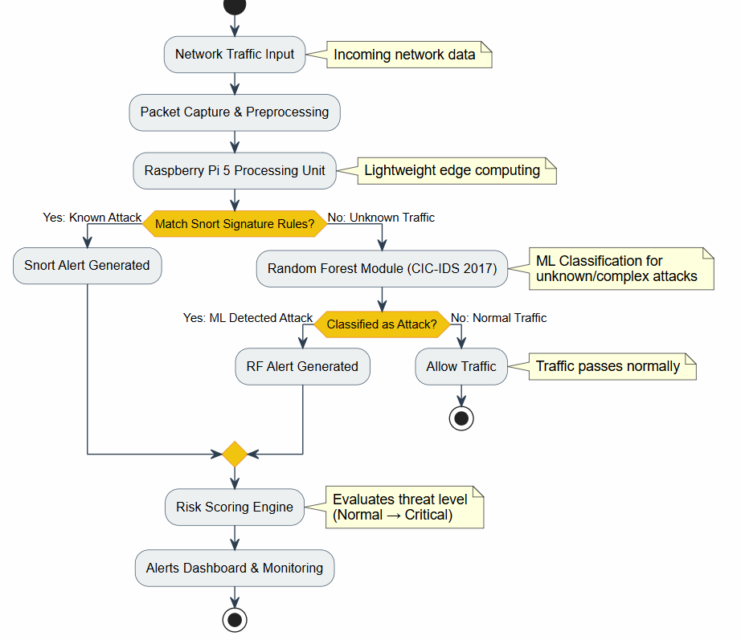
Design Alternatives 3
Design Alternatives 3: Snort + Random Forest + Risk Scoring
Description:
Combines Snort with a Random Forest ML model
Limitations:
Needs model updates
Lower false positives
Adds risk scoring (Normal → Critical)
Works well on Raspberry Pi
More complex than Snort-only

Slide 10
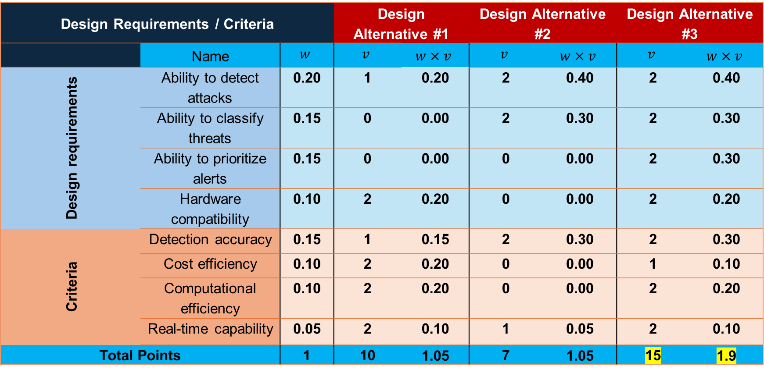
Design Alternatives Evaluation Criteria
Design Requirements / Criteria |  |  | Design Alternative #1 |  | Design Alternative #2 |  | Design Alternative #3
 | Name | $$w$$ | $$v$$ | $$w×v$$ | $$v$$ | $$w×v$$ | $$v$$ | $$w×v$$
Design requirements | Ability to detect attacks | 0.20 | 1 | 0.20 | 2 | 0.40 | 2 | 0.40
 | Ability to classify threats | 0.15 | 0 | 0.00 | 2 | 0.30 | 2 | 0.30
 | Ability to prioritize alerts | 0.15 | 0 | 0.00 | 0 | 0.00 | 2 | 0.30
 | Hardware compatibility | 0.10 | 2 | 0.20 | 0 | 0.00 | 2 | 0.20
Criteria | Detection accuracy | 0.15 | 1 | 0.15 | 2 | 0.30 | 2 | 0.30
 | Cost efficiency | 0.10 | 2 | 0.20 | 0 | 0.00 | 1 | 0.10
 | Computational efficiency | 0.10 | 2 | 0.20 | 0 | 0.00 | 2 | 0.20
 | Real-time capability | 0.05 | 2 | 0.10 | 1 | 0.05 | 2 | 0.10
Total Points |  | 1 | 10 | 1.05 | 7 | 1.05 | 15 | 1.9

Slide 11
Selected Design Alternative
Selected Design Alternative — Alternative 3
Highest evaluation score
Detects known and unknown attacks
Integrated risk scoring module
Real-time alerting dashboard
risk scoring help to prioritize threats
Supports modern cybersecurity needs
Lower false-positive rate compared to Snort-only
1
2
3
4
5
6
7

Slide 12
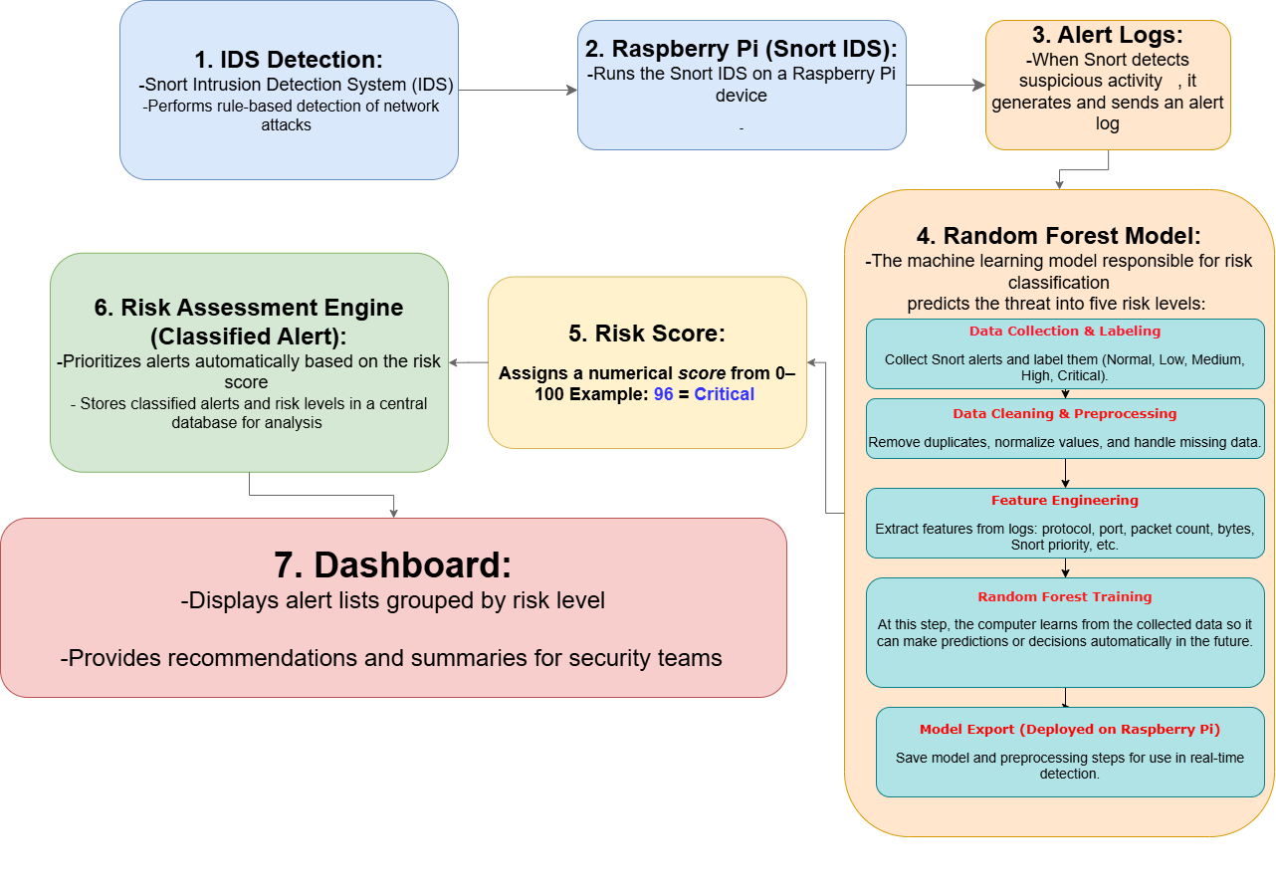
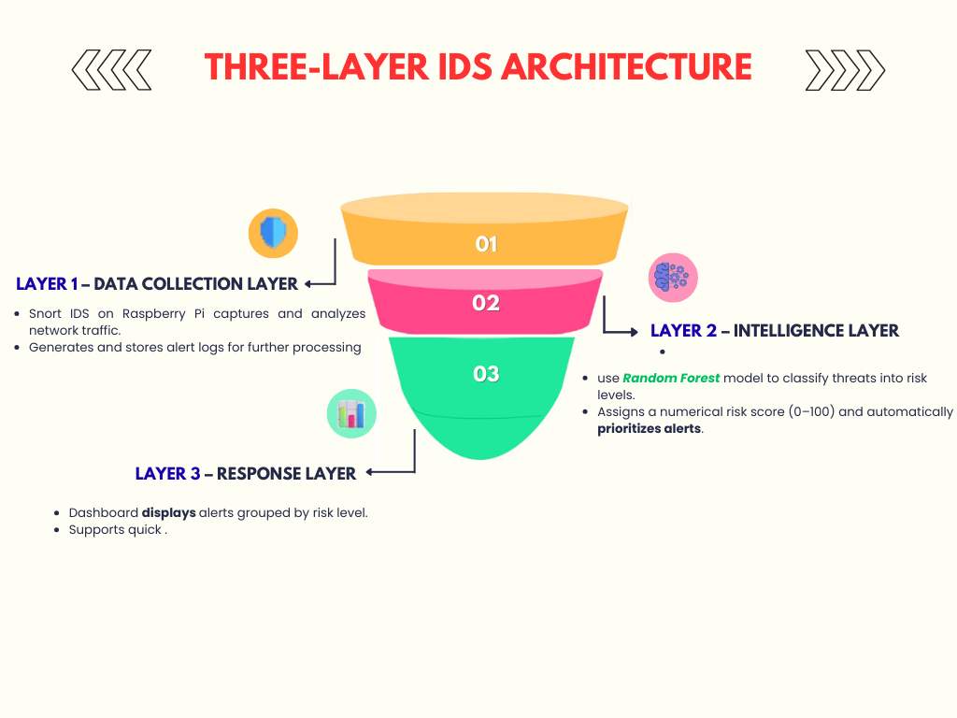
Selected Design Alternative

Slide 13
Hardware/Software Requirements
Hardware Component | Description
Raspberry Pi 5 | Main device running Snort and ML
MicroSD (256GB) | Stores OS, logs, and datasets
Network Interface | Captures traffic in real time
Power Supply (5V/3A) | Stable power for operation
Protective Case | Protects the Raspberry Pi
Cooling Fan(optional) | Keeps temperature safe

Slide 14
Hardware/Software Requirements
Software | Description
Snort IDS | Real-time packet inspection
Python 3 | ML and data processing
Scikit-Learn | Random Forest model
Ubuntu OS | Runs all system software
Flask Dashboard | Shows alerts and risk levels

Slide 15
Related Standards
Category | Standard | Application
Ethernet | IEEE 802.3 | Wired network compatibility
Wi-Fi | IEEE 802.11 | Wireless traffic support
OS | POSIX | Ensures system compatibility

Slide 16
Realistic Constraints and Metrics
Type | Item | Description
Constraint | Economic | Low project cost
Constraint | Environmental | Low power usage
Constraint | Ethical | Respect user privacy
Constraint | Political | Comply with local regulations
Constraint | Physical | Limited Pi resources
Metric | Accuracy | Attack detection level
Metric | False Positives | Wrong alerts rate
Metric | Resource Usage | CPU/RAM load
Metric | Latency | Processing delay
Metric | Risk Score Quality | Correct severity level

Slide 17
Detailed Design Description
Snort is used to analyze network traffic
Alerts are collected and processed
A machine learning model is used for classification
A risk score is assigned to each alert
A dashboard is used to display the results

Slide 18
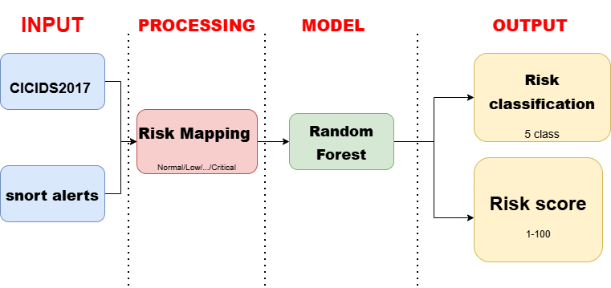
Detailed Design Description
CICIDS2017 dataset was used
Data preprocessing was applied
Random Forest was used as the model
The system classifies normal and attack traffic
The output is converted into five risk levels

Slide 19
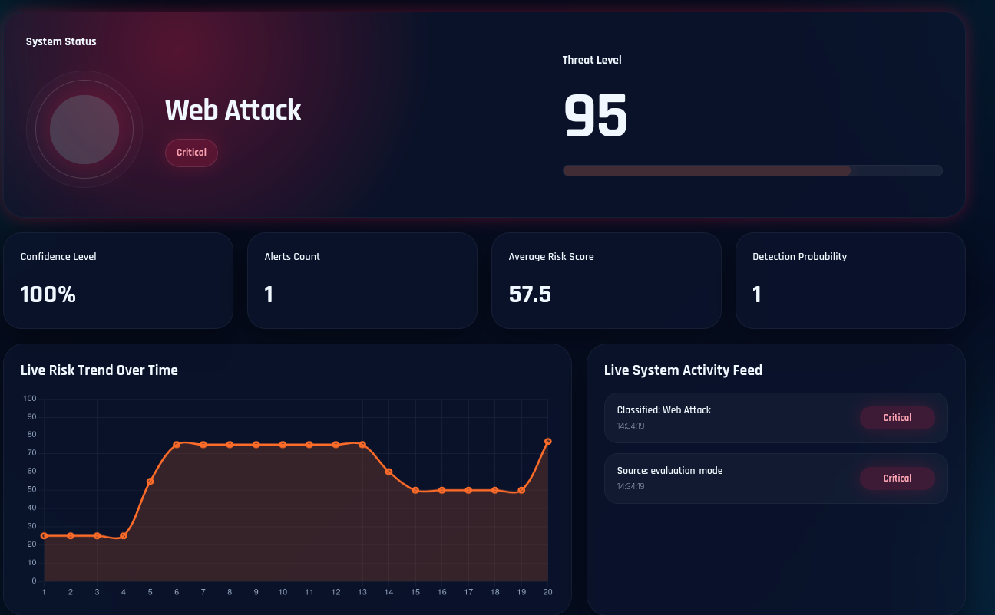
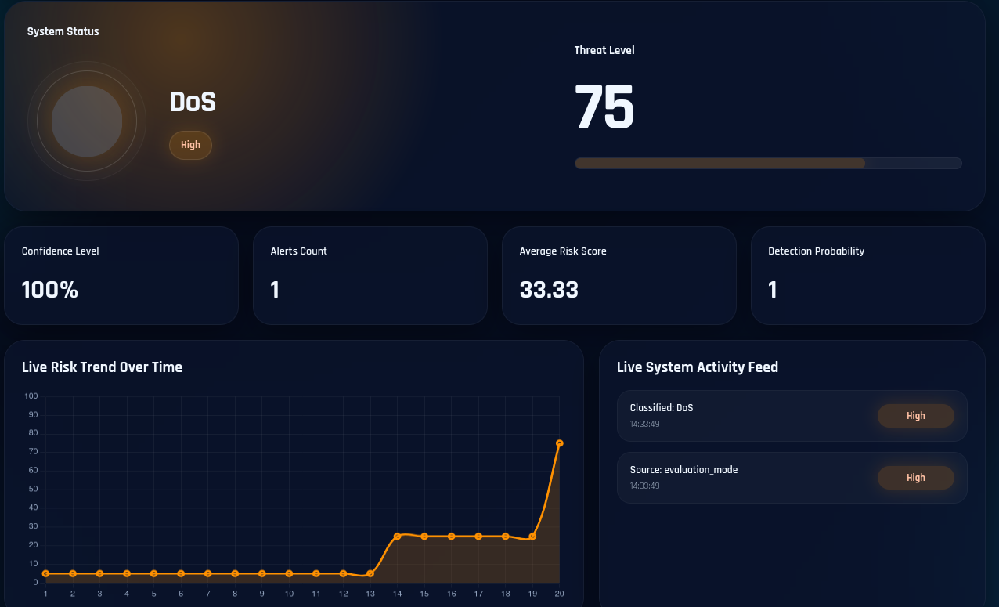
Modeling and/or Simulation (If applicable)
Demo:

Slide 20
Implementation (Software and/or Hardware)
Installed Snort IDS on Raspberry Pi 5
Used Python and Scikit-Learn for ML integration
Trained Random Forest model using CICIDS2017 dataset
Processed Snort alerts and assigned risk scores
Displayed alerts using Flask dashboard

Slide 21
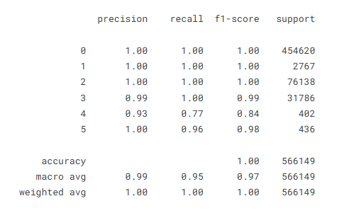
System Testing, Results and Discussion
The system was tested using simulated network traffic and attack scenarios
Snort generated alerts which were analyzed using the Random Forest model
The model achieved an overall accuracy close to 99%
Most attack classes achieved high precision and recall values
The results demonstrate effective attack classification performance
The system successfully classified attacks into different risk levels in real time

Slide 22
Conclusions and Recommendations
Successfully integrated Snort with Random Forest ML
Improved intrusion detection and alert prioritization
Low-cost and lightweight IDS solution
Suitable for small networks and educational environments
Future work: add deep learning and automatic response features

Slide 23
References
Flenman, S. (2025). Machine learning for intrusion detection in network traffic (Bachelor’s thesis, Malmö University).
Supervisor: Erdal Akin.
Chavan, O. (2025). A high-accuracy approach using CIC-IDS 2017. International Journal of Computer Applications.
De Paola, A., et al. (2024). Detecting zero-day attacks under concept drift: An online unsupervised threat detection system. CEUR Workshop Proceedings.
Kumar, R., Shah, S., & Singh, M. (2025). Snort-AI integration: AIML-Snort framework for cloud networks. Journal of Information Systems Engineering & Management.
Vadher, P., Siddiqui, M., 2020, "Snort IDPS using Raspberry Pi 4", International Journal of Engineering Research & Technology, Vol. 9, Issue 7, pp. 1234-1240.
Karahan, O., Kaya, B., 2020, "Raspberry Pi Firewall and Intrusion Detection System", Journal of Intelligent Systems Theory and Applications, Vol. 3, No. 2, pp. 21-24.

Slide 24
THE END
Thank You

