Slide 1
MACHINE LEARNING PROJECT
Phase 1: Data Preparation
& EDA Report
Islamic University of Madinah · Dr. Fayçal Hamdi & Mr. Ali Dumlu
3,000
24
Academic Year 2025–2026 · Semester 2
Customers
Features
36.2%
6
1. EDA Before Cleaning
2. Missing Value Analysis
3. Outlier Analysis
4. Correlation & Covariance
Churn Rate
Missing Cols
5. Chi-Square Tests
6. Feature Engineering

Slide 2
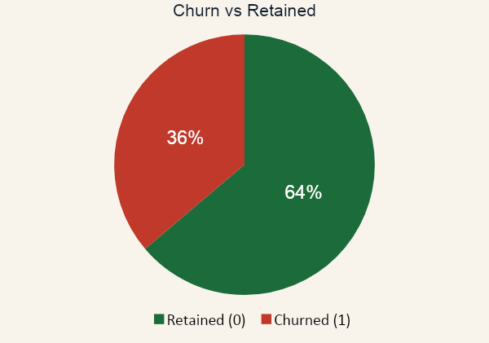

STEP 1 — OVERVIEW
The Dataset at a Glance
3,000
24
Total Customers
Total Features
36.2%
63.8%
Churn Rate
Retention Rate
15
6
Numeric Features
Categorical Features
Class imbalance detected (63.8% / 36.2%) → Accuracy alone is misleading. Primary metrics will be F1-Score and Recall.

Slide 3

KEY PRINCIPLE
EDA Before Cleaning — Why It Matters
The Project Rule
Our EDA Sequence
"Do not immediately fill missing values,
remove outliers, or encode variables
without first analyzing them."
1
Counted missing values per column
2
Compared churn rate: missing vs. present
3
Plotted distributions — histograms & boxplots
Cleaning without looking first destroys evidence
4
Computed correlation & covariance matrices
Outliers may be the most predictive values
Missingness itself can carry a churn signal
5
Ran Chi-square tests on categorical features
Chi-square & correlation results guide what to drop
6
Only then: designed imputation & cleaning strategy

Slide 4
STEP 2 — MISSING VALUES
Missing Value Analysis — Feature by Feature
Feature | Missing | Skewness | MNAR? | Method V2 | Reason + MAE improvement
monthly_spend | 92 (3.1%) | 7.75 ↑↑ | No | Group median (sub_type × region) | Group medians: Basic=31, Standard=56, Premium=93. Global median (50) is wrong for Premium. MAE: 24.3→12.7 (−48%)
avg_session_minutes | 123 (4.1%) | 6.12 ↑↑ | No | Formula-derived weekly_min ÷ sessions | Mathematical definition of the feature. Corr=0.44 with actual values. MAE: 5.97→2.76 (−54%). Fallback: global median when sessions=0.
support_tickets_90d | 60 (2.0%) | 4.94 ↑↑ | YES ⚠ | Fill 0 + Flag | MNAR: 43.3% churn when missing. Cannot fill randomly — missing = no ticket opened. Flag preserves the risk signal.
last_login_days_ago | 70 (2.3%) | 2.11 ↑ | No | Group median (engagement bin) | Corr(engagement, last_login)=−0.68. Low-eng bin=9.81d, med=5.34d, high=3.27d. MAE: 4.27→3.59 (−16%).
estimated_income | 103 (3.4%) | 0.16 ≈ | No | Group median (region × sub_type) | Income varies by geography and plan tier (52k–66k range). Group median is conceptually correct. MAE: 14,488→14,166.
engagement_score | 279 (9.3%) | -0.53 | YES ⚠ | Regression (R²=0.13) + Flag | MNAR: 40.9% churn when missing. Linear regression on usage features. MAE: 12.08→11.21. Flag mandatory regardless of fill method.
⚠ MNAR = Missing Not At Random — the fact that data is missing is itself a signal. We cannot impute these randomly; we must flag them.

Slide 5
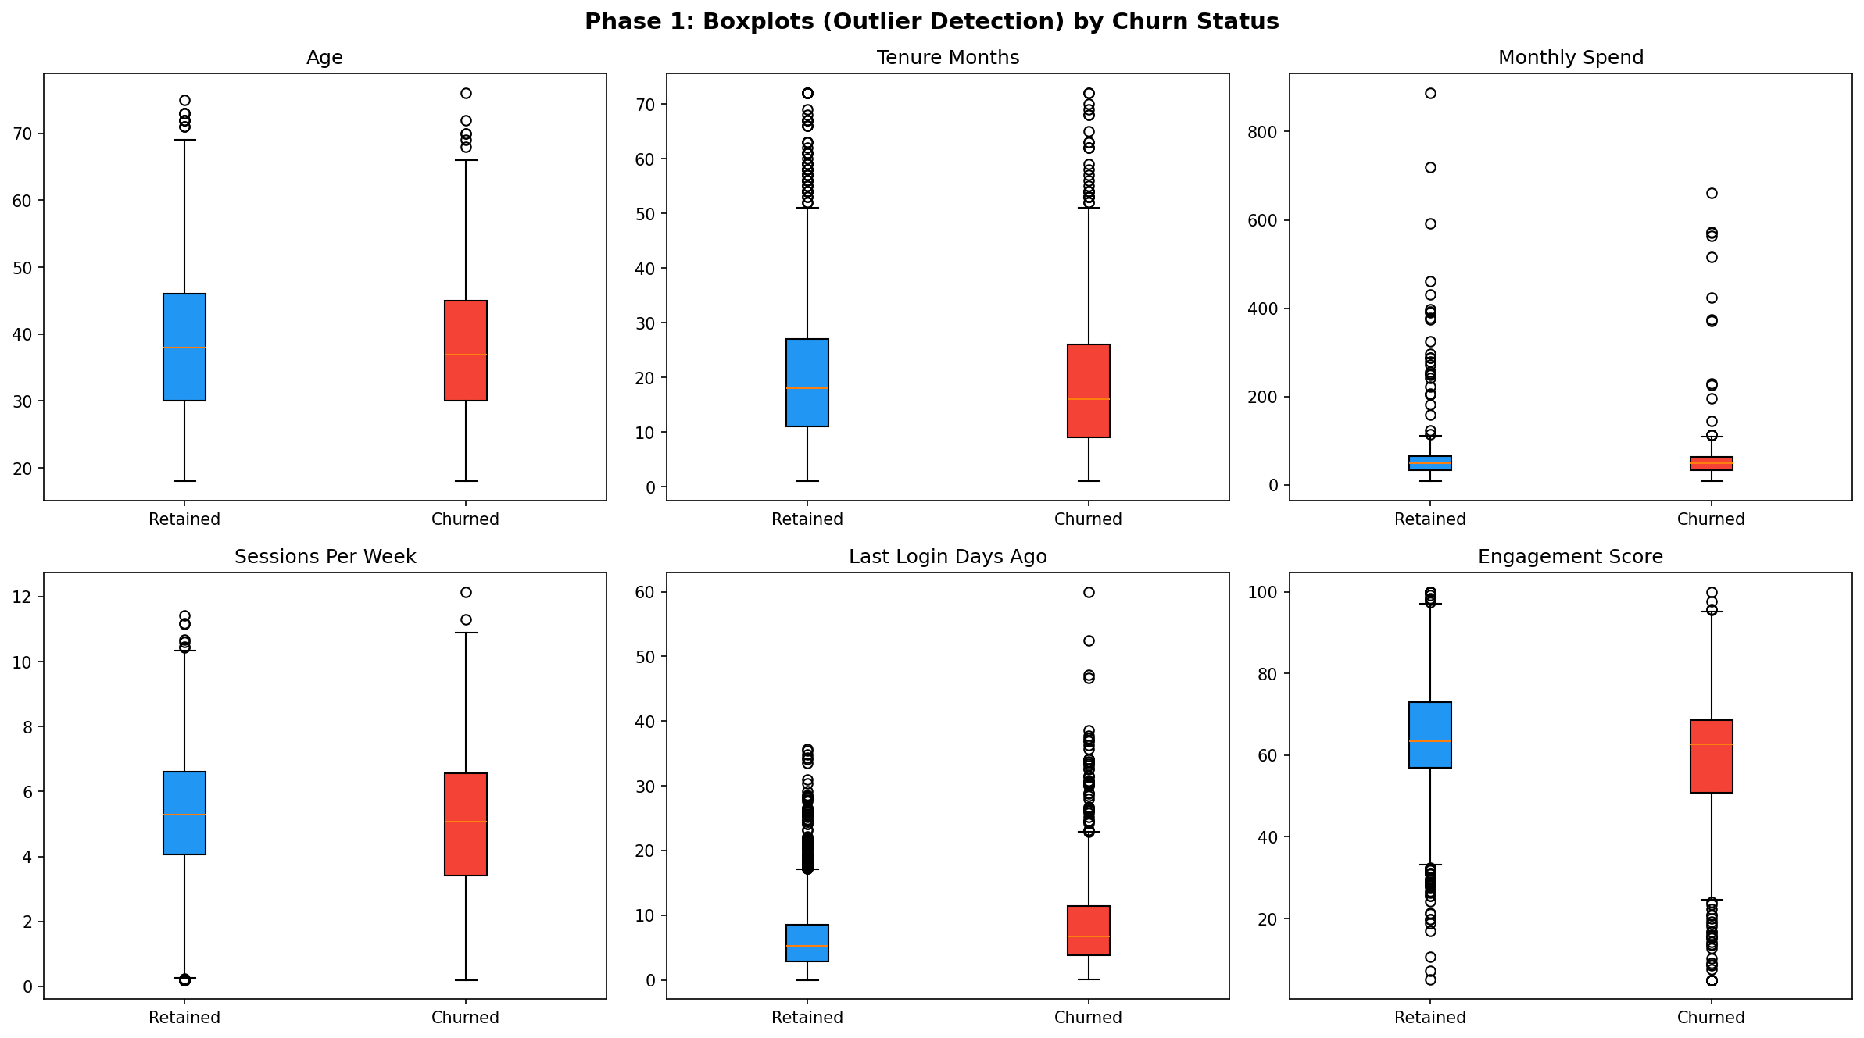
STEP 3 — OUTLIERS & DISTRIBUTIONS
Outlier Analysis — Retain or Remove?
support_tickets_90d
225 outliers
✓ Retain: Real angry customers — most informative data points
spend_per_session
215 outliers
✓ Retain: Genuine high-cost-per-session users
last_login_days_ago
159 outliers
✓ Retain: Inactive users = churn risk — must keep
payment_delays_6m
101 outliers
WHY RETAIN ALL OUTLIERS?
Synthetic dataset — extremes are intentional
✓ Retain: Financial friction signal — remove = lose signal
Tree models are naturally outlier-robust
Outliers here = high-risk customers (the ones we want to predict)
Removing them = discarding our strongest signals

Slide 6
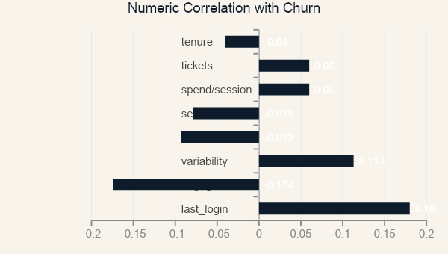
STEP 4 — STATISTICAL ANALYSIS
Correlation · Covariance · Chi-Square Tests
Chi-Square Tests — Categorical vs. Churn
Feature
χ²
p-value
Result
contract_type
170.21
<0.001
SIG ✓
auto_renew
36.14
<0.001
SIG ✓
region
15.53
0.004
SIG ✓
promo_opt_in
2.15
0.143
—
payment_method
1.83
0.400
—
subscription
0.98
0.611
—
device_type
0.30
0.861
—
KEY FINDING — Covariance Matrix
last_login ↔ engagement
engagement_score ↔ churn
last_login_days_ago ↔ churn
Cov = −58.93
Cov = −1.16
Cov = +0.54
Strongest joint relationship: inactive users are disengaged. Both features point to churn from opposite directions.
Negative: lower engagement → higher churn probability
Positive: longer absence → higher churn probability

Slide 7
STEP 5 — FEATURE ENGINEERING V2
3 Engineered Features — Ranked by Signal Strength
Correlation with churn →
1. disengagement_index +0.133
2. spending_efficiency +0.047
3. risk_score +0.018
1st · Disengagement Index (+0.133)
2nd · Spending Efficiency (+0.047)
Disengagement Index
monthly_spend ÷ weekly_minutes
last_login ÷ (engagement_score + 1)
Captures value perception. Overpaying users churning more than cost-effective users → unique signal angle.
top 2 numeric correlates (+0.18 & −0.17)
covariance = −58.93 — they oppose each other
3rd · Risk Score (+0.018 — supplementary)
ratio captures compound behavioral risk
payment_delays_6m × support_tickets_90d
+1 prevents division by zero
Multiplicative interaction: dual friction (financial + service) > sum of parts. Natural sparsity when either = 0.
+ 2 MNAR flag columns: tickets_missing_flag & engagement_missing_flag — preserve missingness as a predictive signal

Slide 8





SUMMARY — V2 FINAL
Key Findings → Ready for Phase 2
Strongest Numeric Predictors
Categorical: 3 Significant
2 MNAR Features
last_login_days_ago (+0.18) & engagement_score (−0.17). No single feature dominates → ensemble model needed.
contract_type (χ²=170) and auto_renew (χ²=36) are the strongest. subscription_type & device_type are NOT significant.
engagement_score & support_tickets_90d. Regression + group median used. Flag columns mandatory to preserve risk signal.
All Outliers Retained
5 New Features (V2)
Ready for Phase 2
All extreme values are real high-risk behaviors. Tree-based models handle them naturally — no removal needed.
disengagement_index (+0.133), spending_efficiency (+0.047), risk_score (+0.018) + 2 MNAR flags. All EDA-grounded.
Dataset: 3,000 rows × 29 columns. V2 imputation improved MAE 16–54%. Primary metrics: F1-Score & Recall.

Slide 9
PHASE 2 — ALGORITHM SELECTION
Phase 2 Overview
3
Same
Goal
63/36
Models Tested
Pipeline for All
Compare → Best
Imbalanced Dataset
Pipeline: Scaling + One-Hot Encoding + Stratified Split
Models: Logistic Regression · Random Forest · Gradient Boosting
Key Constraint: Dataset imbalance → Accuracy is misleading
Primary Metrics: Recall & F1-score

Slide 10
MODEL TYPES & PURPOSE
Models Compared
Logistic Regression
Random Forest
Gradient Boosting
Linear
Ensemble (Bagging)
Ensemble (Boosting)
Simple · Interpretable
Handles non-linearity
Learns from errors
Different model types → fair comparison of linear vs non-linear behavior

Slide 11
MODEL EVALUATION RESULTS
Model Evaluation Results
Model Accuracy Recall (Churn) F1-score
Logistic Regression 0.67 0.35 0.43
Random Forest 0.67 0.29 0.39
Gradient Boosting 0.65 0.32 0.40
Best Model: Logistic Regression → Highest Recall (0.35) & F1-score (0.43)

Slide 12
EVALUATION INSIGHT
Evaluation Insight
~64%
Recall
Accuracy if all predicted Retained
The metric that matters
⚠ Accuracy is NOT reliable
A model that predicts all customers as Retained is still ~64% accurate.
✔ Recall is Critical
Recall measures the model's ability to detect actual churn customers.
Result: Logistic Regression detects more churn customers than other models.

Slide 13
FINAL MODEL SELECTION
Final Model Selection
Logistic Regression
Selected Model
Why Logistic Regression?
✔ Highest Recall (0.35)
✔ Highest F1-score (0.43)
✔ More balanced predictions across classes
Conclusion
Simple model outperformed complex models on this dataset.

Slide 14
TRADE-OFF ANALYSIS
Trade-off Analysis
Logistic Regression
✔ Interpretable
✔ Better Recall
✘ Limited non-linear modeling
Random Forest / Gradient Boosting
✔ Capture complex patterns
✘ Lower Recall in this case
Decision: Performance > Complexity → Logistic Regression selected

Slide 15
PHASE 3 — HYPERPARAMETER TUNING
Phase 3 Overview
4
LR
+37%
0.700
Parameters
Tuned
Chosen
Model
Recall
Improved
Final
AUC-ROC
What Phase 3 Covers
Parameter
Values Tested
Key Finding
Chosen Value
C (regularization)
0.001 → 100
Underfitting at C<0.05; plateau at C≥0.5
C = 1.0
class_weight
None / balanced / 1:2 / 1:3 / 1:4
Most impactful param: Recall jumps +37%
balanced
penalty (L1/L2/EN)
3 penalty types
All converge similarly; L2 marginally best AUC
L2
solver
lbfgs / liblinear / saga / newton-cg
All produce identical results on this data
lbfgs

Slide 16
EXPERIMENT 1 — REGULARIZATION
C Parameter
⚠ Underfitting Zone (C < 0.05)
Recall collapses to 0.07 at C=0.001. The model is over-regularized — it predicts almost everyone as Non-Churner.
✓ Sweet Spot (C = 0.5–1.0)
Recall stabilizes at 0.346, F1 at 0.43. Going higher adds no benefit — model has converged.
→ Diminishing Returns (C > 1)
No change in any metric beyond C=1. This is a classic sign that the decision boundary is already well-fit.
Chosen: C = 1.0 (stable, no overfitting, max performance)

Slide 17
EXPERIMENT 2 — CLASS WEIGHT (MOST IMPACTFUL)
class_weight Parameter
Why class_weight Matters
The dataset is imbalanced (63.8% No-Churn vs 36.2% Churn). Without correction, the model is biased toward predicting the majority class.
0.346
Recall — No Weight
0.682
Recall — Balanced
+97%
Gain
Decision: class_weight='balanced' gives F1=0.587 — the best balanced metric.

Slide 18
EXPERIMENTS 3 & 4 — PENALTY & SOLVER
Penalty & Solver: Confirming Robustness
Penalty Type
Solver
Penalty, Minor Difference
Solver, No Difference
L1, L2, and ElasticNet all produce near-identical results. The dataset has no severe multicollinearity, so L1's feature-zeroing effect is minimal. L2 chosen by convention.
All 4 solvers converge to the exact same solution. This is expected for a well-scaled dataset without extreme sparsity. Confirms the preprocessing pipeline is sound.
Conclusion: Only C and class_weight meaningfully affect performance on this dataset.

Slide 19
FINAL MODEL EVALUATION
Tuned Logistic Regression — Full Results
Baseline vs. Tuned Model
Confusion Matrix (Tuned)
 | Pred: No | Pred: Yes
True: No | TN = 244 | FP = 139
True: Yes | FN = 69 | TP = 148
Reading the Matrix
✓ 148 churners correctly identified (TP)
⚠ 69 churners missed — FN (cost: lost customers)
⚠ 139 false alarms — FP (cost: retention budget waste)
✓ Tuned model catches 2× more churners vs baseline
Final Tuned Model — Summary Metrics
Accuracy
Precision
Recall ★
F1-Score
AUC-ROC
65.3%
51.6%
68.2%
58.7%
0.700

Slide 20
PROJECT SUMMARY — ALL 3 PHASES
Key Findings Across All Phases
Phase 1 — Data Preparation
Phase 2 — Algorithm Selection
Phase 3 — Hyperparameter Tuning
MNAR flags preserved for engagement_score & support_tickets
Logistic Regression selected: highest Recall (0.35) & F1 (0.43)
class_weight='balanced' most impactful: Recall 0.35→0.68 (+97%)
Formula-derived imputation for avg_session_minutes (−54% MAE)
Random Forest had worst Recall (0.28) — misses too many churners
C parameter plateau at ≥0.5 — regularization already optimal
All outliers retained — they are real high-risk signals
Gradient Boosting slightly lower F1 despite higher complexity
Penalty & solver: no meaningful difference on this data
disengagement_index becomes the #1 engineered feature (r=+0.133)
Class imbalance makes accuracy misleading — F1 & Recall are key
Final AUC=0.700, F1=0.587 — significant improvement over baseline
Limitations & Next Steps
→ AUC of 0.70 suggests moderate predictive signal — dataset may benefit from more interaction features
→ SMOTE oversampling could further improve Recall without sacrificing Precision
→ Threshold tuning (moving from 0.5 default) offers another lever to optimize Recall vs Precision trade-off

