Slide 1
DATABASE MANAGEMENT SYSTEMS
Construction Material & Site
Progress Management System
DBMS Project — Project 44 · Review 1
Presented by: Mohammed Ali
Roll No.: 25WU0102161
Course: Database Management Systems

Slide 2
Problem Identification
Construction companies need to manage project, material, contractor, site progress, and billing information efficiently. Disconnected or manual records can lead to material shortages and inaccurate progress payments. A centralized database system is therefore required to integrate these activities and maintain accurate project information.
Manual / Disconnected
Records
▼
Material Shortages &
Inaccurate Progress Payments
▼
Need for a Centralized
Database
2

Slide 3
Scope & Objectives
Scope
Project
Setup
→
Procurement
→
Delivery
→
Site
Stock
→
Material
Issue
→
Work
Progress
→
Bill
Verification
→
Payment
Objectives
Reports Generated
Manage projects, sites, contractors and work packages
Material balance
Manage materials, suppliers, purchase orders and deliveries
Work progress
Supplier performance
Track site stock and material issues
Contractor bills
Record work progress and labour teams
Cost variance
Verify contractor bills and manage payments
Project status
3

Slide 4
Users & Functional Requirements
Users
Project & Work
Proposed roles, derived from the system's functions
Manage projects, sites, contractors and work packages
Project Manager
Manage labour teams and progress entries
Site Engineer
Materials & Procurement
Procurement Staff
Manage materials and suppliers
Site / Store Staff
Create purchase orders and record deliveries
Accounts / Billing Staff
Track site stock and material issues
Management
Billing & Reporting
Verify contractor bills and record payments
Generate material balance, work progress, supplier performance, contractor bill, cost variance and project status reports
4

Slide 5
Key Business Rules
Material Issue
Cannot exceed available site stock
Progress
Must remain between 0% and 100%
Contractor Billing
Billed quantity must be within verified work
Payment
Cannot exceed the approved bill
Delivery
Delivery dates must be valid
5

Slide 6
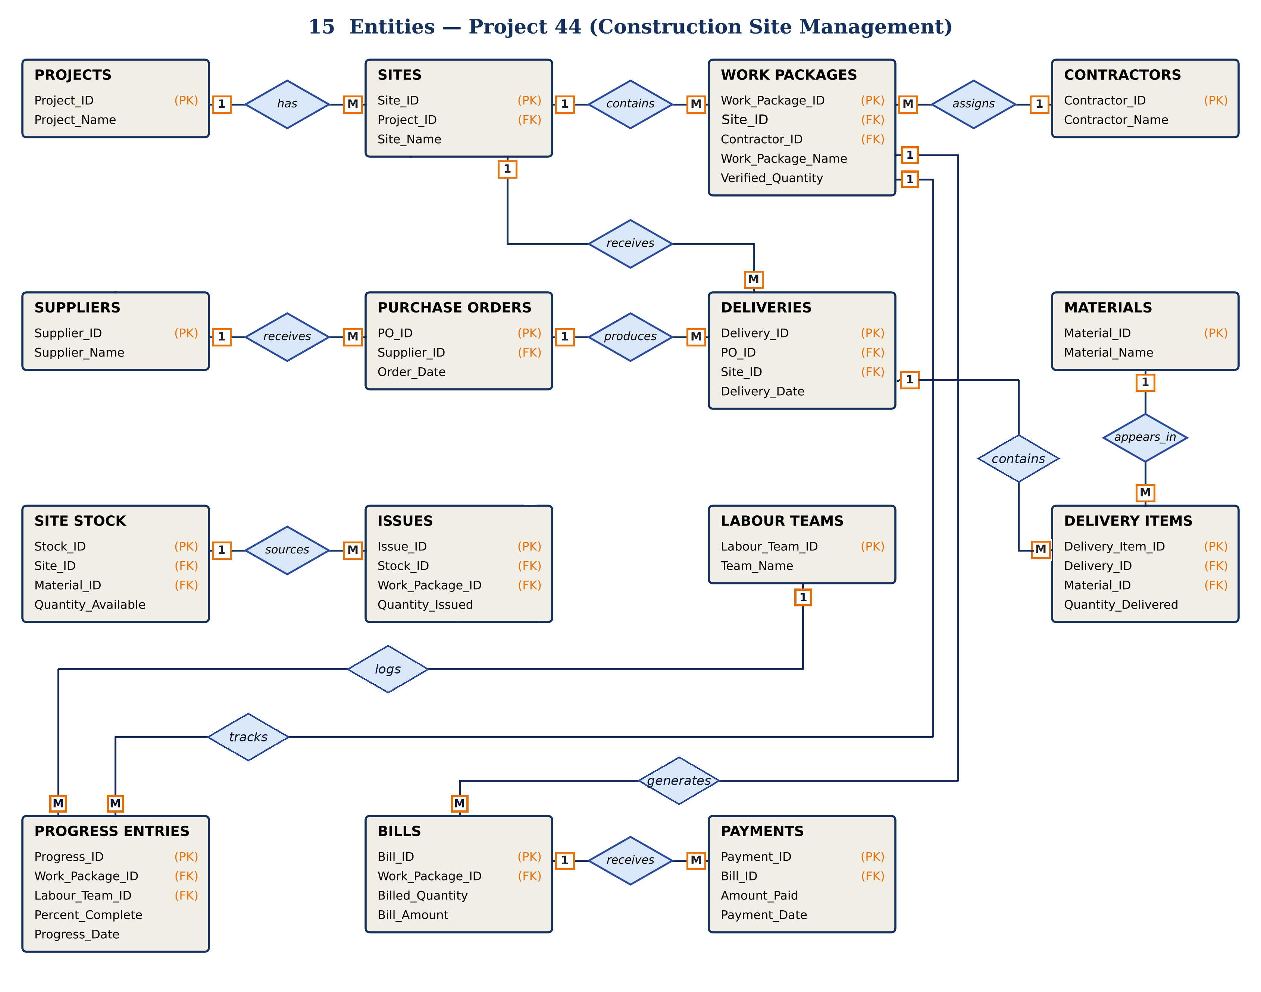
Conceptual Entity-Relationship Diagram
LABOUR TEAMS
logs
PROGRESS ENTRIES
PROJECTS
PURCHASE ORDERS
receives
SUPPLIERS
Labour_Team_ID
Team_Name
(PK)
1
M
Progress_ID
Work_Package_ID
Labour_Team_ID
Percent_Complete
Progress_Date
(PK)
(FK)
(FK)
Project_ID
Project_Name
(PK)
PO_ID
Supplier_ID
Order_Date
(PK)
(FK)
M
1
Supplier_ID
Supplier_Name
(PK)
1
1
M
has
produces
tracks
1
M
M
CONTRACTORS
assigns
WORK PACKAGES
contains
SITES
receives
DELIVERIES
Contractor_ID
Contractor_Name
(PK)
1
M
Work_Package_ID
Site_ID
Contractor_ID
Work_Package_Name
Verified_Quantity
(PK)
(FK)
(FK)
M
1
Site_ID
Project_ID
Site_Name
(PK)
(FK)
1
M
Delivery_ID
PO_ID
Site_ID
Delivery_Date
(PK)
(FK)
(FK)
BILLS
M
generates
1
1
1
Bill_ID
Work_Package_ID
Billed_Quantity
Bill_Amount
(PK)
(FK)
1
holds
contains
issued to
1
M
M
M
receives
ISSUES
sources
SITE STOCK
DELIVERY ITEMS
Issue_ID
Stock_ID
Work_Package_ID
Quantity_Issued
(PK)
(FK)
(FK)
M
1
Stock_ID
Site_ID
Material_ID
Quantity_Available
(PK)
(FK)
(FK)
Delivery_Item_ID
Delivery_ID
Material_ID
Quantity_Delivered
(PK)
(FK)
(FK)
M
PAYMENTS
Payment_ID
Bill_ID
Amount_Paid
Payment_Date
(PK)
(FK)
M
M
stored in
appears in
1
1
MATERIALS
Material_ID
Material_Name
(PK)
6

Slide 7
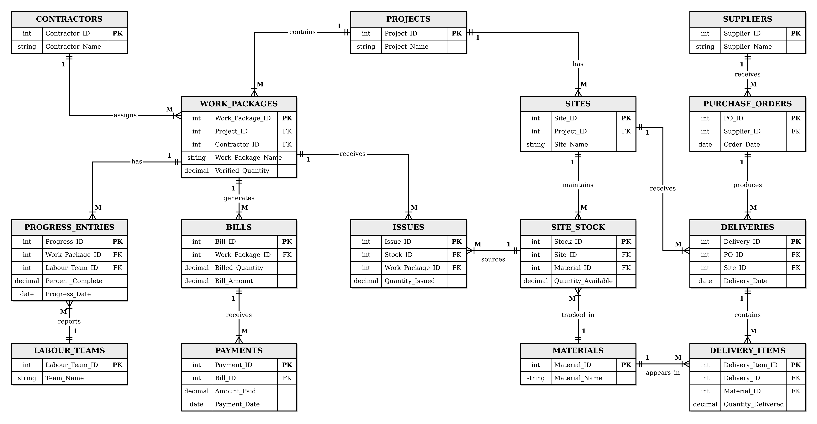
Initial Relational Schema
7

Slide 8
Normalization & Functional Dependencies
Functional Dependencies
Project_ID
→
Project_Name
1NF
Site_ID
→
Project_ID, Site_Name
Atomic attributes; no repeating groups.
Contractor_ID
→
Contractor_Name
Supplier_ID
→
Supplier_Name
↓
Work_Package_ID
→
Project_ID, Contractor_ID, Work_Package_Name, Verified_Quantity
2NF
Material_ID
→
Material_Name
No partial dependencies; tables use single-attribute primary keys.
PO_ID
→
Supplier_ID, Order_Date
Delivery_ID
→
PO_ID, Site_ID, Delivery_Date
↓
Delivery_Item_ID
→
Delivery_ID, Material_ID, Quantity_Delivered
3NF
Stock_ID
→
Site_ID, Material_ID, Quantity_Available
No transitive dependencies; non-key attributes depend only on their primary key.
Issue_ID
→
Stock_ID, Work_Package_ID, Quantity_Issued
Labour_Team_ID
→
Team_Name
Progress_ID
→
Work_Package_ID, Labour_Team_ID, Percent_Complete, Progress_Date
The final database design is normalized up to 3NF, reducing redundancy and maintaining data integrity.
Bill_ID
→
Work_Package_ID, Billed_Quantity, Bill_Amount
Payment_ID
→
Bill_ID, Amount_Paid, Payment_Date
8

Slide 9
MySQL 8.0 Implementation & Testing
Database Implementation
Business Rule Testing
Database: Construction_Site_Management
Invalid progress percentage → Rejected
15 tables created
Issue quantity exceeding available stock → Rejected
Primary Key and Foreign Key constraints
Bill quantity exceeding verified quantity → Rejected
NOT NULL, CHECK and referential integrity constraints
Invalid delivery date → Rejected
Sample data inserted across all tables
Payment exceeding bill amount → Rejected
Database relationships implemented according to the ERD
9

Slide 10
SQL Queries, Views & Reports
SQL Queries
Views
Reports
Multi-table JOIN queries
Material Balance
Material & Stock Report
Aggregate functions
Work Progress
Site Progress Report
Subqueries
Supplier Performance
Supplier Performance Report
Filtering & grouping
Contractor Bills
Contractor Billing & Payment Report
Construction, site, material, progress and billing queries
Cost Variance
Project Cost Variance
Project Status
Project Status Summary
10

