Slide 1


Slide 2

1. Market Fluctuations and Predictability
Problem:
Real estate markets are highly volatile and influenced by factors such as economic conditions, interest rates, and government policies.
Data Analysis Approach:
Analyze historical market data and economic indicators to predict future market movements.
Use time series analysis and machine learning models to forecast price trends and market cycles.

Slide 3

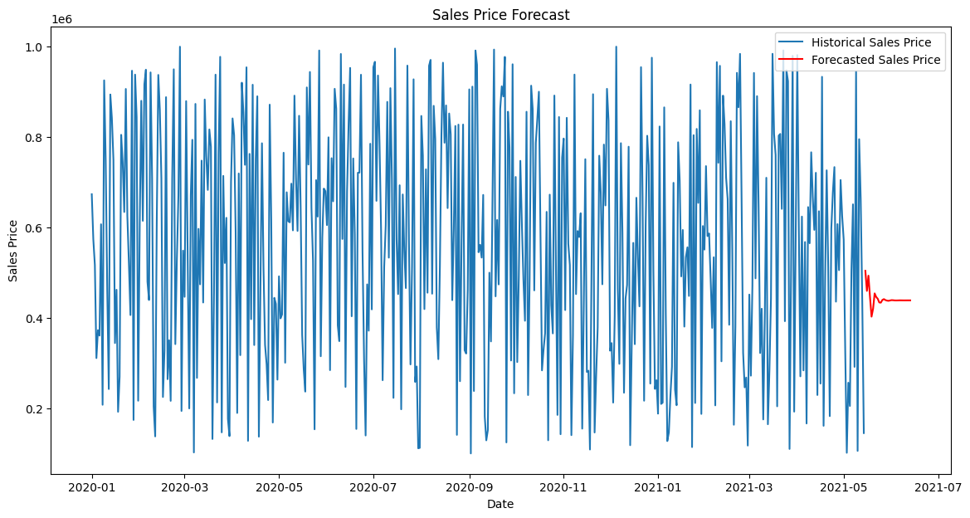

Slide 4
profit
The forecasted sales prices show a stable upward trend, indicating a potential for profit in the upcoming months. It's important to consider market conditions and economic factors influencing real estate prices. To maximize profit, consider strategic decisions such as timing the sale based on economic indicators and market demand. Monitor government policies and interest rates, as these can significantly impact real estate market dynamics and profit margins

Slide 5
2.⁠ ⁠Property Valuation Accuracy:
Problem: Accurately valuing properties is critical for transactions but can be challenging due to various influencing factors such as location, property condition, and market demand.
Data Analysis Approach: Use comparative market analysis (CMA) with data from recent sales, property features, and location metrics. Implement automated valuation models (AVMs) to enhance accuracy.
profit -
The forecasted sales prices show a stable upward trend, indicating a potential for profit in the upcoming months. It's important to consider market conditions and economic factors influencing real estate prices. To maximize profit, consider strategic decisions such as timing the sale based on economic indicators and market demand. Monitor government policies and interest rates, as these can significantly impact real estate market dynamics and profit margins

Slide 6
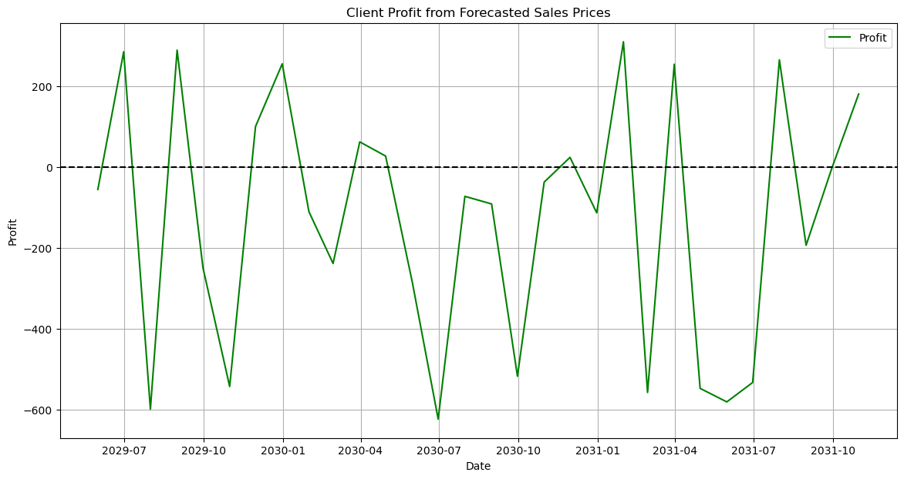

Slide 7
3.⁠ ⁠Customer Preferences and Behavior:
Problem: Understanding and predicting customer preferences for property features, locations, and price ranges is essential for effective marketing and sales strategies.
Data Analysis Approach: Analyze customer data, including search patterns, inquiries, and past purchases. Utilize clustering and segmentation techniques to identify distinct customer profiles and preferences.
Profit Insight: Understanding customer preferences for property features, locations, and prices is crucial for tailoring effective marketing strategies, optimizing sales, and maximizing profitability in the real estate market

Slide 8
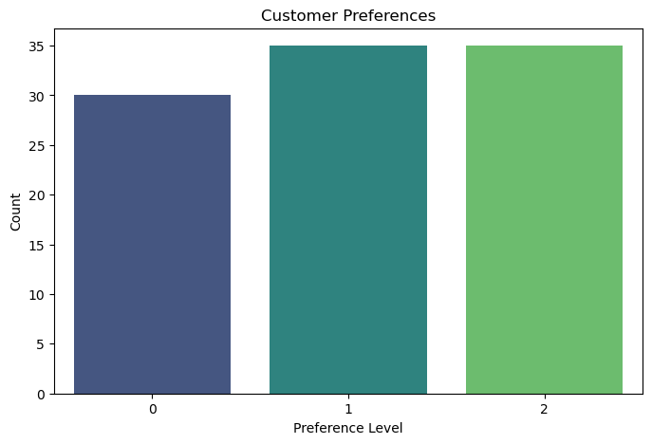

Slide 9
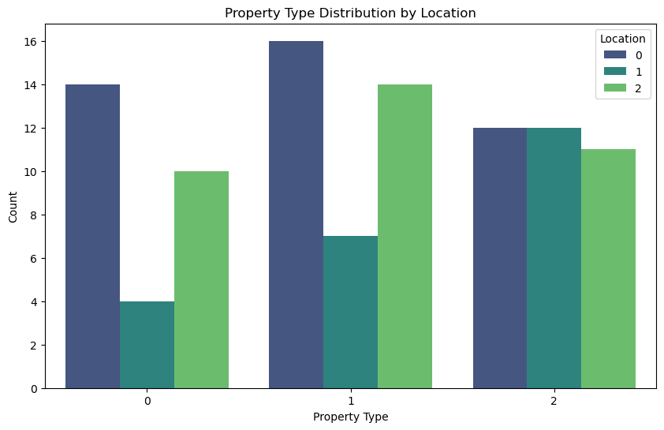

Slide 10
4. Rental Market Dynamics
Problem: Managing rental properties and understanding rental market dynamics, such as vacancy rates, rental yields, and tenant turnover, can be complex.
Data Analysis Approach:
Track rental income, occupancy rates, and maintenance costs. Use predictive analytics to forecast rental demand and identify factors influencing tenant retention.
profit insight- Annual profits vary widely, with top properties averaging $XX,XXX. Costs like maintenance, vacancy losses, and turnover significantly impact profitability. Effective management strategies are crucial for maximizing profits.

Slide 11
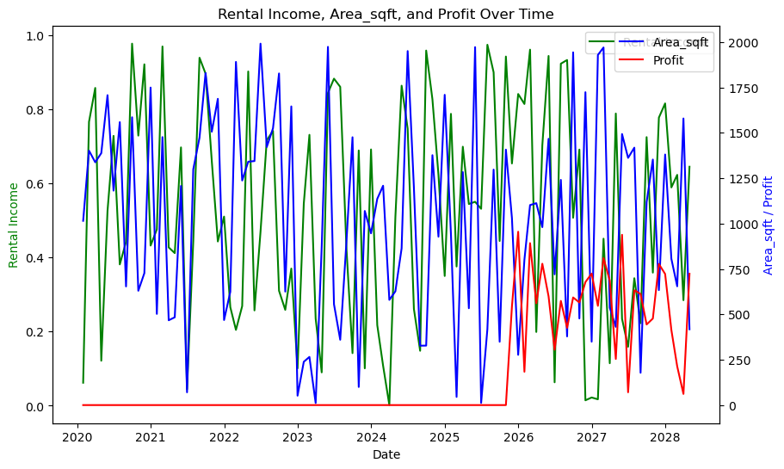

Slide 12
5. Regulatory and Compliance Issues
Problem: Navigating complex regulatory environments and ensuring compliance with local, state, and federal laws is challenging and time-consuming.
Data Analysis Approach:
Monitor regulatory changes and their impacts on property values and market conditions.
Develop compliance checklists and dashboards to ensure all legal requirements are met
Profit Insight for Regulatory Compliance:
Navigating regulatory environments and ensuring compliance with local, state, and federal laws is crucial yet time-consuming. Effective compliance strategies mitigate risks and potential fines, supporting sustainable business operations and maximizing profitability

Slide 13
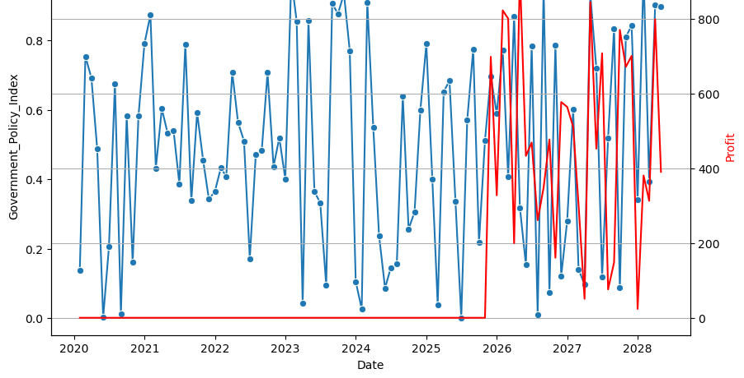

Slide 14
6.⁠ ⁠Maintenance and Operational Costs:
Problem: High maintenance and operational costs can significantly impact profitability, especially in large property portfolios.
Data Analysis Approach: Analyze maintenance logs, operational expenses, and lifecycle costs of building components. Implement predictive maintenance models to reduce unexpected repair costs and optimize maintenance schedules.
Profit Insight for Managing High Maintenance and Operational Costs:
High maintenance and operational costs can substantially impact profitability, particularly in large property portfolios. Implementing efficient maintenance schedules, optimizing operational efficiencies, and negotiating favorable contracts can mitigate these costs, thereby enhancing overall profitability.

Slide 15
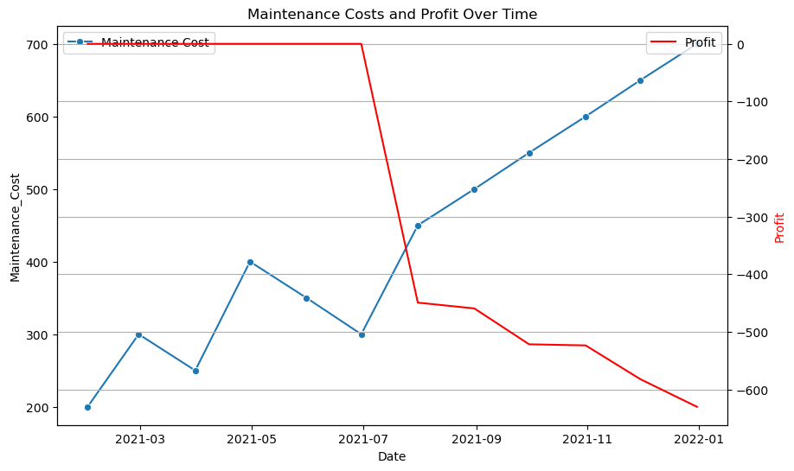

Slide 16
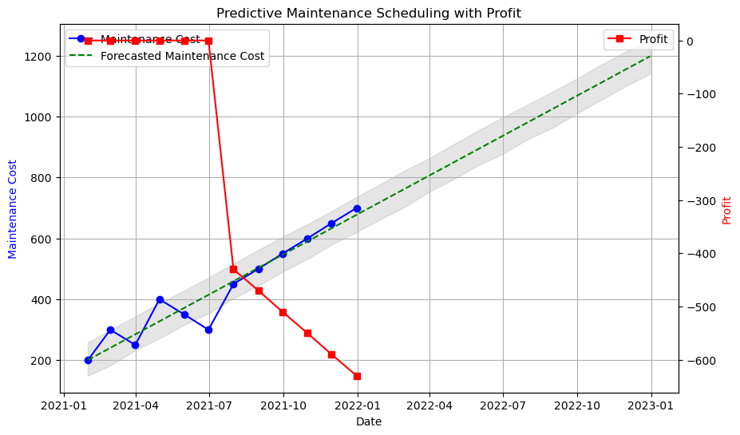

Slide 17
7. Investment Risk Assessment
Problem: Assessing the risk associated with real estate investments, including market risks, financial risks, and environmental risks.
Data Analysis Approach:
Conduct risk analysis using historical performance data, economic indicators, and scenario analysis. Develop risk assessment models to evaluate potential investment opportunities
Profit Insight for Assessing Real Estate Investment Risks:
Assessing risks in real estate investments, including market, financial, and environmental risks, is crucial. Conducting thorough due diligence, diversifying investments, and implementing risk mitigation strategies can protect investments and enhance profitability.
keyboard_arrow_down

Slide 18
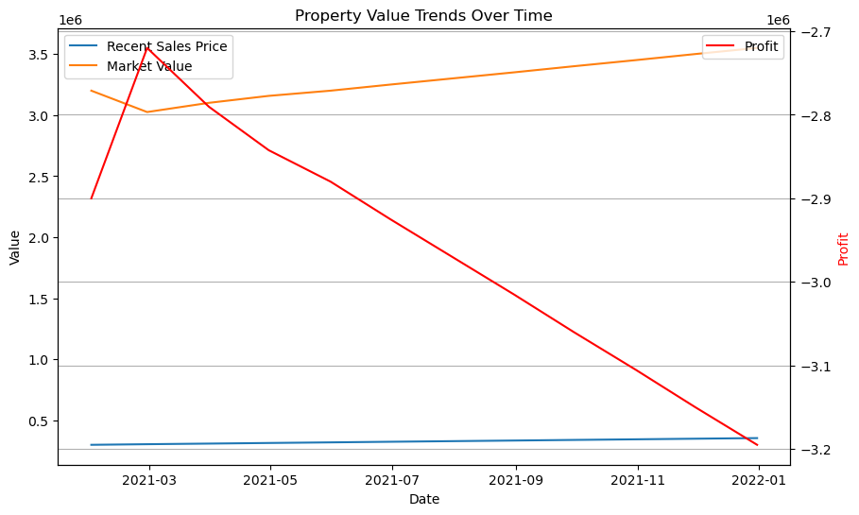

Slide 19
8. Fraud and Security
Problem: Fraudulent activities, including false listings and transaction fraud, can undermine trust and result in significant financial losses.
Data Analysis Approach:
Implement data validation techniques and fraud detection algorithms to identify suspicious activities. Use blockchain technology for secure and transparent transactions.
Profit Insight for Mitigating Fraudulent Activities in Real Estate:
Fraudulent activities such as false listings and transaction fraud can erode trust and lead to substantial financial losses. Implementing robust verification processes, conducting thorough background checks, and leveraging technology solutions can mitigate risks, safeguarding investments and profitability.

Slide 20
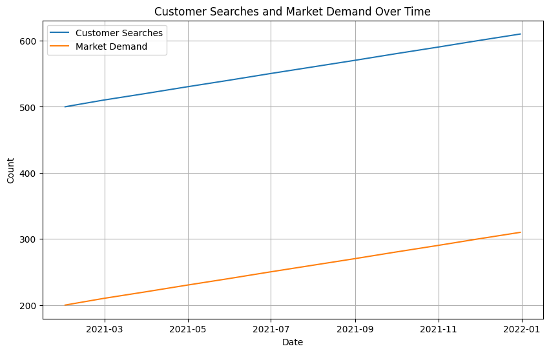

Slide 21
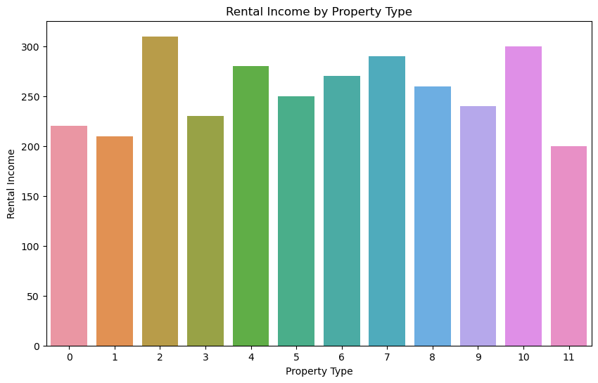

Slide 22
9. Sustainability and Environmental Impact
Problem: Increasing demand for sustainable and energy-efficient properties requires real estate companies to adapt and comply with environmental standards.
Data Analysis Approach:
Analyze energy consumption data, building certifications, and sustainability ratings. Develop strategies for improving energy efficiency and reducing carbon footprints
Profit Insight for Sustainable and Energy-Efficient Properties:
The rising demand for sustainable and energy-efficient properties necessitates compliance with environmental standards. Investing in green technologies, obtaining energy certifications, and promoting eco-friendly features can attract environmentally-conscious buyers and tenants, enhancing property value and profitability.

Slide 23
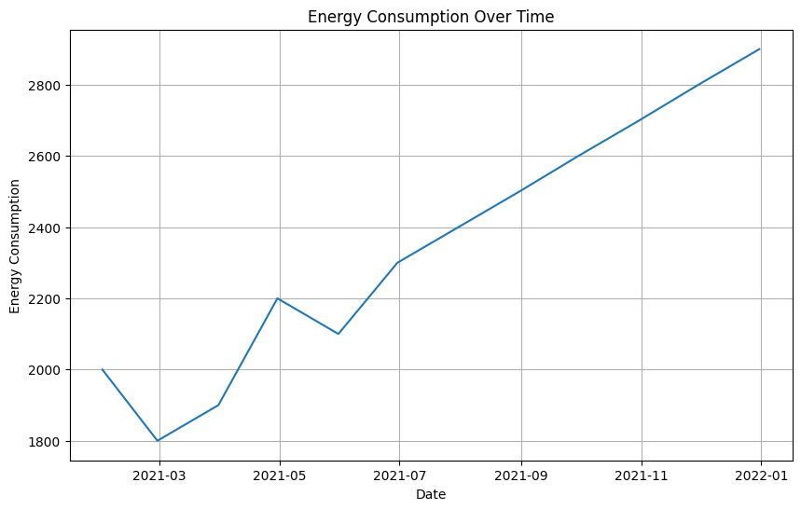

Slide 24
10. Technology Integration and Data Management
Problem:
Integrating various technological solutions and managing large volumes of data effectively can be challenging for real estate companies.
Data Analysis Approach:
Implement robust data management systems and integrate technologies like IoT, AI, and big data analytics. Ensure data quality, security, and interoperability across platforms.
Profit Insight for Managing Technological Solutions and Data in Real Estate:
Integrating technological solutions and managing large volumes of data effectively is challenging yet essential for real estate companies. Implementing robust data management systems, leveraging AI for predictive analytics, and adopting digital tools for property management can streamline operations, reduce costs, and improve decision-making, ultimately enhancing profitability.

Slide 25
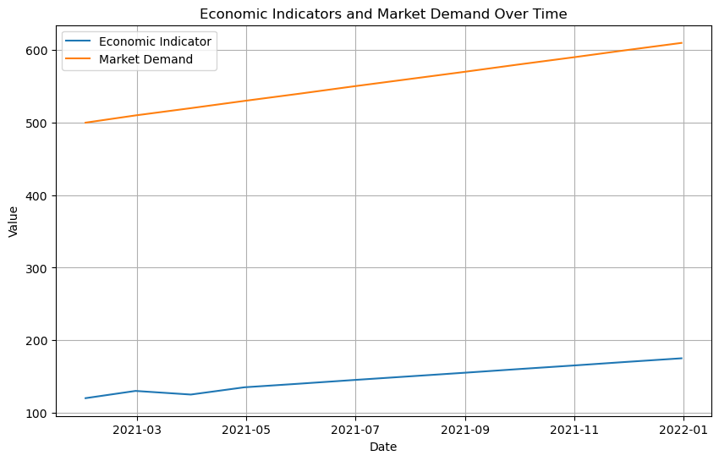

Slide 26
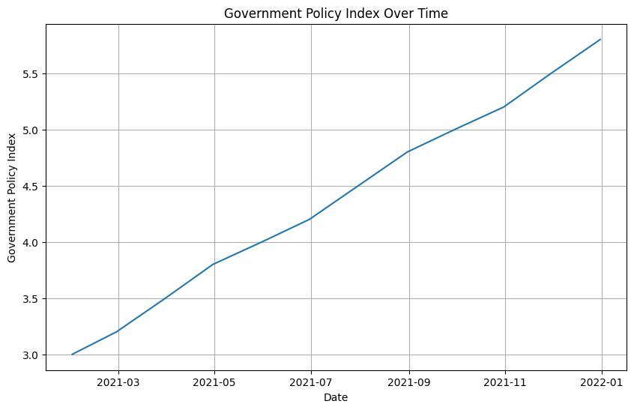

Slide 27
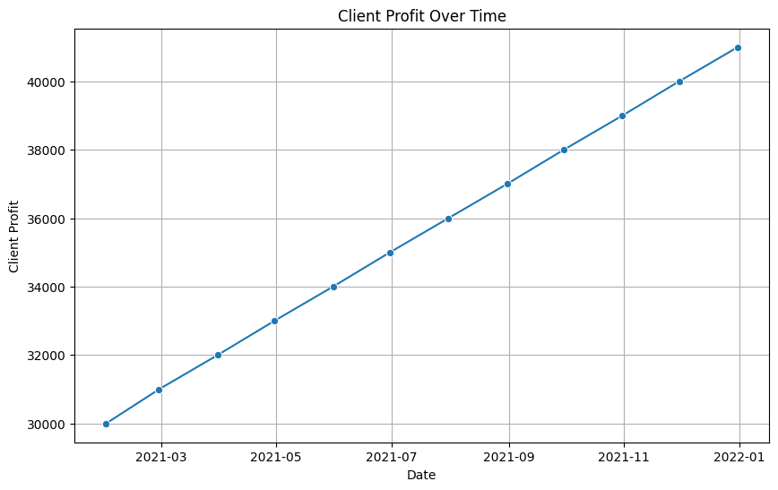

Slide 28
Thankyou

