Slide 1
Big Data project · II3 · 2026
FlowGuard
Real-time detection of unseen network attacks with an autoencoder scored in Spark Structured Streaming
Mohammed Amine Chaieb · Eya Dhambri · Mariem Hassine
Kafka · Spark 3.5 · PyTorch exported to ONNX · Cassandra · Grafana · HDFS · Docker Compose
Data: CICIDS2017 intrusion detection dataset (Sharafaldin et al., 2018)
Notes:
Title slide. FlowGuard replays recorded network flows through Kafka, scores them live in Spark with an autoencoder exported to ONNX, stores results in Cassandra, shows them in Grafana and archives the raw stream to HDFS.

Slide 2
Signature-based detection misses new attacks, so we flag flows that do not look like normal traffic
Research question
CICIDS2017 dataset
Can a model trained only on benign traffic detect attacks it has never seen, in real time, inside a Kafka and Spark pipeline?
Part | Use
Monday (benign only) | Train / validation (80/20)
Tuesday to Friday | Test: 2,069,990 flows
Attacks in test | 425,741 flows (20.6 %)
Attack families | 14 (DoS, DDoS, PortScan…)
Features per flow | 78 numeric statistics
Signature-based systems only recognise attacks that are already known
An autoencoder learns benign flows; a high reconstruction error marks an anomaly
No attack is used for training or for the threshold, so every test attack is unseen
Cleaning: infinite and missing values and duplicate rows removed; stored as Parquet.
Sharafaldin, Lashkari & Ghorbani (2018), ICISSP — CICIDS2017; split from ai_module/prepare_data.py
Notes:
The key point for questions: the autoencoder never sees an attack, neither during training nor when the threshold is chosen. Monday is benign only and is split 80/20; Tuesday to Friday are the test days.

Slide 3
Two Spark jobs read the same Kafka stream: one scores each flow, the other archives it to HDFS
Producer
Parquet rows → JSON events + send_ts
Kafka
topic:
network-telemetry
Spark: scoring
ONNX model, 5 s micro-batches
Cassandra
flows, alerts, batch metrics
Grafana
live dashboard
Spark: archive
raw messages, every 10–30 s
HDFS
Parquet, one folder per day
Each Spark job has its own checkpoint, so it restarts exactly where it stopped
Everything runs in Docker Compose; HDFS is the course Hadoop cluster (1 NameNode, 2 DataNodes)
Notes:
Data path: producer to Kafka to the scoring job to Cassandra to Grafana. In parallel the archive job reads the same topic and keeps every raw message in HDFS for retraining or re-scoring.

Slide 4
The autoencoder compresses each flow to 16 values; an error above 0.0322 raises an alert
Training
Benign Monday flows only, split 80/20 into train and validation
ReLU layers, MSE loss, Adam (lr 0.001), 30 epochs, batch 256
Decision rule
Alert if MSE > 0.0322
95th percentile of the validation error: 5.00 % of benign validation flows are flagged by design.
Model, scaler, threshold and feature order are exported (ONNX) and shared by Spark and the offline evaluation.
78
64
32
16
32
64
78
encoder
code
decoder
Input: the 78 flow features, standardised with a scaler fitted on benign training flows only
Notes:
Architecture 78-64-32-16-32-64-78 with ReLU. Attacks are reconstructed badly because the model only learned normal traffic. ONNX lets Spark run the PyTorch model through onnxruntime without PyTorch.

Slide 5
Spark scores each 5-second micro-batch and writes the results to three Cassandra tables
Per micro-batch (spark_consumer.py)
Cassandra keyspace flowguard
Read new events from Kafka (checkpointed)
Parse the JSON: id, day, send_ts, label, 78 features
Order the features as in feature_columns.json
Scaler + ONNX model inside mapInPandas → MSE
MSE > threshold → ANOMALY; latency = scoring time − send_ts
Write all flows, the alerts and one metrics row
Table | Partition | One row
all_flows | day | a scored flow
alerts | day | a flagged flow
batch_metrics | pipeline | a micro-batch: counts, latency p50/p95/p99, throughput
The Spark image pins Python 3.11, Java 17, PySpark 3.5.3, scikit-learn 1.9.1 and numpy 2.x — the versions that saved the scaler.
Notes:
Structured Streaming query with a 5-second trigger. Inference runs in mapInPandas so the model is loaded once per partition. foreachBatch writes three tables. The pinned versions fixed the incompatibility errors we had when the model was first deployed in Docker.

Slide 6
The autoencoder catches 70.8 % of attacks it never saw, while flagging 9.5 % of normal flows
Test days: 2,069,990 flows
Recall 70.8 %
Precision 65.8 %
False-positive rate 9.5 %
ROC-AUC 0.920
PR-AUC 0.789
F1 0.682 F2 0.697
Orange bars: mostly missed. Web attacks, Bot and Patator brute force produce flow statistics close to normal traffic.
301,428 attacks caught, 124,313 missed; 156,701 false alarms among 1,644,249 benign flows.
Notes:
Recall is the share of each family's flows that are flagged. DoS families and Heartbleed change packet counts and timings strongly and are caught. Web attacks, Bot and Patator look normal at the flow level and are missed.

Slide 7
Among models trained without attack labels, the autoencoder has the best recall, F1 and AUC
Model (held-out half of the test days) | Precision | Recall | F1 | F2 | FPR | ROC-AUC | PR-AUC
Autoencoder (ours) | 0.659 | 0.709 | 0.683 | 0.698 | 0.095 | 0.921 | 0.790
One-Class SVM | 0.667 | 0.602 | 0.633 | 0.614 | 0.078 | 0.794 | 0.639
Isolation Forest | 0.610 | 0.398 | 0.482 | 0.428 | 0.066 | 0.814 | 0.544
Random Forest (uses labels) | 0.996 | 0.997 | 0.997 | 0.997 | 0.001 | 1.000 | 1.000
Isolation Forest and One-Class SVM also learn from benign Monday only, with the same 95th-percentile threshold rule
PortScan recall: autoencoder 51 %, One-Class SVM 1.5 %, Isolation Forest 0.1 %
The Random Forest needs labels and fails on rare attacks: Infiltration 0 % (autoencoder 88 %), Heartbleed 50 % (100 %)
Notes:
The Random Forest is trained on a random half of the test days and every model is scored on the other half. The autoencoder accepts a slightly higher false-positive rate (9.5 % against 6.6–7.8 %) for many more detected attacks.

Slide 8
A flow is scored about 3.5 s after it is sent; under full load Spark sustains 2,345 flows/s
Run B: stress test
Full Wednesday: 610,492 flows sent as fast as possible
Processing speed 2,801 flows/s; sustained 2,345 flows/s
Latency of 19–38 s in this run is time spent queued in Kafka, not processing
Measurement
Per flow: Spark scoring time − producer send_ts. Run A: mean 3.7 s, max 10.0 s, processing speed 382 flows/s (latency_report.py).
The 5 s micro-batch trigger sets the floor: an event waits for its batch.
Notes:
Two different questions: how fast one flow is scored when traffic arrives at a realistic pace (run A), and how much Spark can absorb when Kafka is flooded (run B).

Slide 9
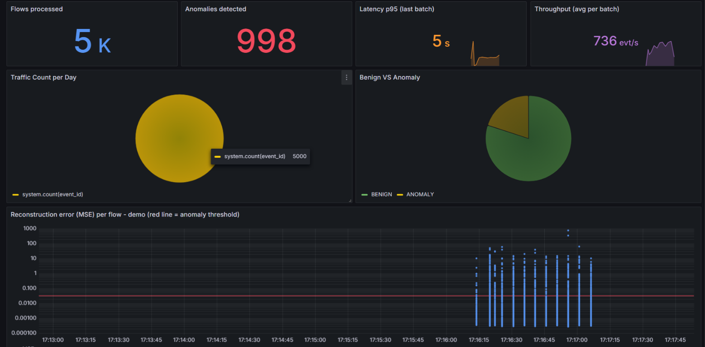
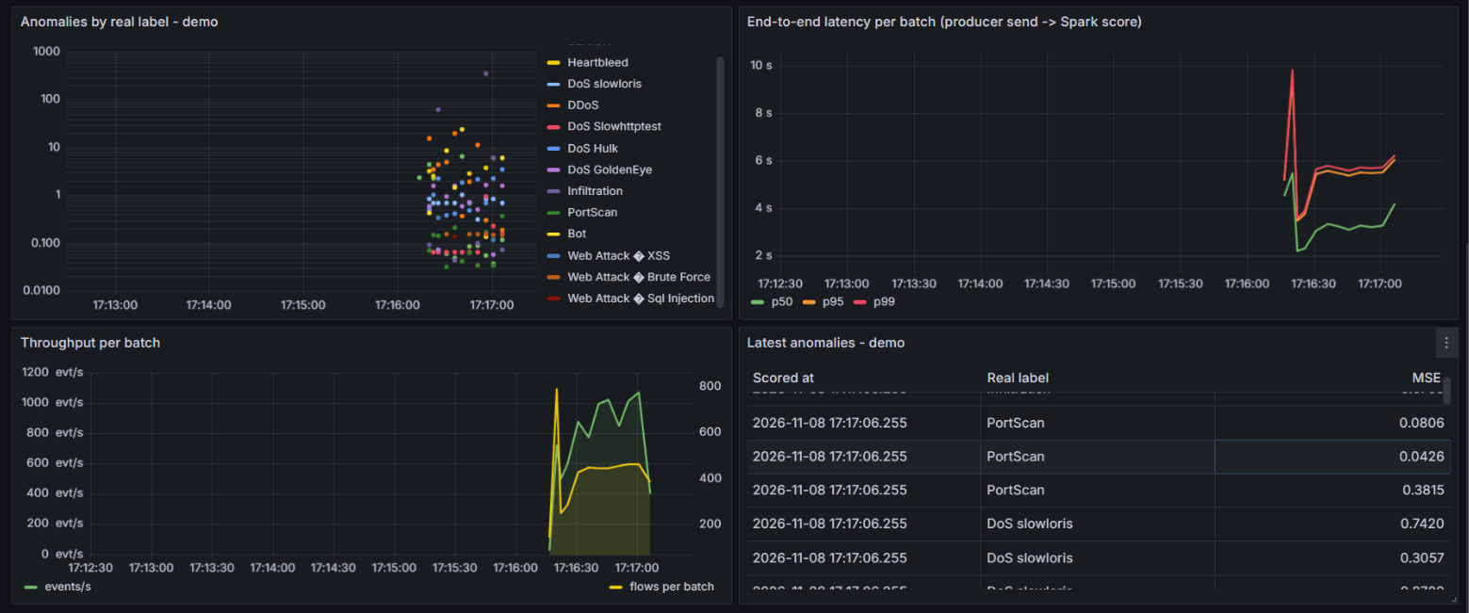
One script starts the whole pipeline, and Grafana shows the scored stream as it arrives
Demo run: 5,000 flows scored, 998 flagged
Same run: alerts by real label, latency, throughput
What scripts/run_demo.ps1 does
1. Start Docker, HDFS, Kafka, Cassandra and Grafana
2. Create the tables and reset the data
3. Start both Spark jobs
4. Replay the mixed demo file
5. Latency report, HDFS listing and summary
Notes:
Everything except HDFS is defined in docker/docker-compose.yml. cassandra-init creates the schema before Spark starts. The archive job joins the class Hadoop network to write to HDFS.

Slide 10
Next steps
Team
Tune the threshold on F2, or set one threshold per service
Add payload or session features to reach web and brute-force attacks
Combine with a supervised model for attacks that are already known
Scale out: more Kafka partitions, a Spark cluster, Cassandra replication
Mohammed Amine Chaieb
Eya Dhambri
Mariem Hassine
Code, results and demo script: github.com/mohammedaminechaieb/FlowGuard
Notes:
Closing slide, kept on screen during questions.

