Slide 1

STAFF DEMONSTRATION & TEACHER'S IMPLEMENTATION GUIDE
Edugates-ClipSAT Science Labs
Next-Generation Interactive STEM Curriculum, 45 Virtual Laboratories & Assessment Engine
• 74 Curriculum Modules across Chemistry, Biology & Physics
• 45 Interactive Mathematics-Driven Virtual Science Benches
• Automated 2-Page A4 Teacher Lesson Plans & Instant Test Generator
• 100% Offline Progressive Web App (PWA) • MAXHUB Smartboard 60 FPS Turbo Mode
Presenter: Mohammed Amy | High School STEM Department | Academic Year 2026-2027

Slide 2
EDUGATES-CLIPSAT SCIENCE LABS
Transforming STEM Education: The Laboratory Paradigm Shift
⚠️ Challenges in Traditional Science Labs
• Hazard & Safety Constraints:
Toxic reagents, high voltage, and biological pathogens restrict hands-on student exploration.
• Consumables & Budget Fatigue:
Pipettes, indicators, glassware breakages, and single-use kits incur recurring institutional costs.
• Classroom Pacing Bottlenecks:
45-minute periods are consumed by chemical preparation, clean-up, and titration calibration.
• One-Trial Limitation:
If an experiment fails, students cannot reset and re-test without waiting for the next lab session.
✨ The Edugates-ClipSAT Solution
• Zero Chemical Hazard, 100% Inquiry:
Students fearlessly manipulate strong acids, electron diffraction, and microbial cultures.
• Unlimited Instant Trial Repetition:
1-click 'Reset' or 'New Trial' enables rigorous hypothesis testing and statistical analysis.
• Real Physics & Stoichiometry Engine:
Continuous calculus numerical models (dpH/dV peaks, Young's slits, Snell's law, Beer-Lambert).
• Complete Teacher Integration:
Automated A4 lesson plans, test generation, and MAXHUB touch compliance directly built in.

Slide 3
EDUGATES-CLIPSAT SCIENCE LABS
Platform Architecture: The Four Core Pillars
⚛️
74 Modules
Curriculum Scope
23 Chemistry
27 Biology
24 Physics
Aligned with McGraw-Hill Inspire Teacher Editions.
🧪
45 Benches
Virtual Laboratories
Interactive tactile apparatus
Real-time canvas graphing
Continuous numerical simulation
Trial Store & Data Export.
📝
2,500+ Items
Assessment Suite
Custom test generation
Instant printable Bubble Sheets
DOCX & PDF export
Interactive Flashcard decks.
⚡
MAXHUB Ready
Hardware & Display
60 FPS Turbo Profile
Zero-blur canvas rendering
Day & Night contrast modes
100% Offline PWA operation.

Slide 4
EDUGATES-CLIPSAT SCIENCE LABS
Three Comprehensive Curriculum Disciplines
Inspire Chemistry Track
23 Modules • 95 Lessons
• Matter, Energy & Atomic Structure
• Periodic Trends & Electron Configurations
• Ionic, Covalent & Metallic Chemical Bonding
• Stoichiometry, Empirical Formulas & Hydrates
• Thermochemistry & Calorimetric Enthalpy
• Chemical Equilibrium & Le Chatelier's Principle
• Acids, Bases, Titration & pH Buffers
• Hydrocarbons, Functional Groups & Organic Reactions
• Electrochemistry & Galvanic Voltaic Cells
• Nuclear Chemistry, Alpha/Beta Decay & Fission
Inspire Biology Track
27 Modules • 108 Lessons
• Cellular Architecture, Membranes & Organelles
• Cellular Respiration (Glycolysis to 32 ATP)
• Photosynthesis (Light Reactions & Calvin Cycle)
• Molecular Genetics, DNA Replication & Transcription
• Mendelian & Non-Mendelian Genetics (Punnett)
• Evolution, Natural Selection & Population Genetics
• Microbiology, Gram Staining & Antibiotic Resistance
• Plant Biology, Transpiration & Vascular Transport
• Ecology, Biogeochemical Cycles & Food Webs
• Human Anatomy Atlas (3D Organ Systems)
Inspire Physics Track
24 Modules • 96 Lessons
• 1D & 2D Kinematics, Projectiles & Free Fall
• Newton's Laws of Motion, Friction & Tension
• Work, Kinetic Energy, Potential Energy & Power
• Linear Momentum & 2D Elastic/Inelastic Collisions
• Universal Gravitation & Keplerian Planetary Orbits
• Fluid Dynamics (Archimedes, Bernoulli & Venturi)
• Wave Interference, Doppler & Sound Resonance
• Geometric Optics, Lenses, Mirrors & Snell's Law
• Electrostatics, Coulomb's Law & Gauss Flux
• Electric Circuits (Ohm, Kirchhoff & RC Filters)

Slide 5
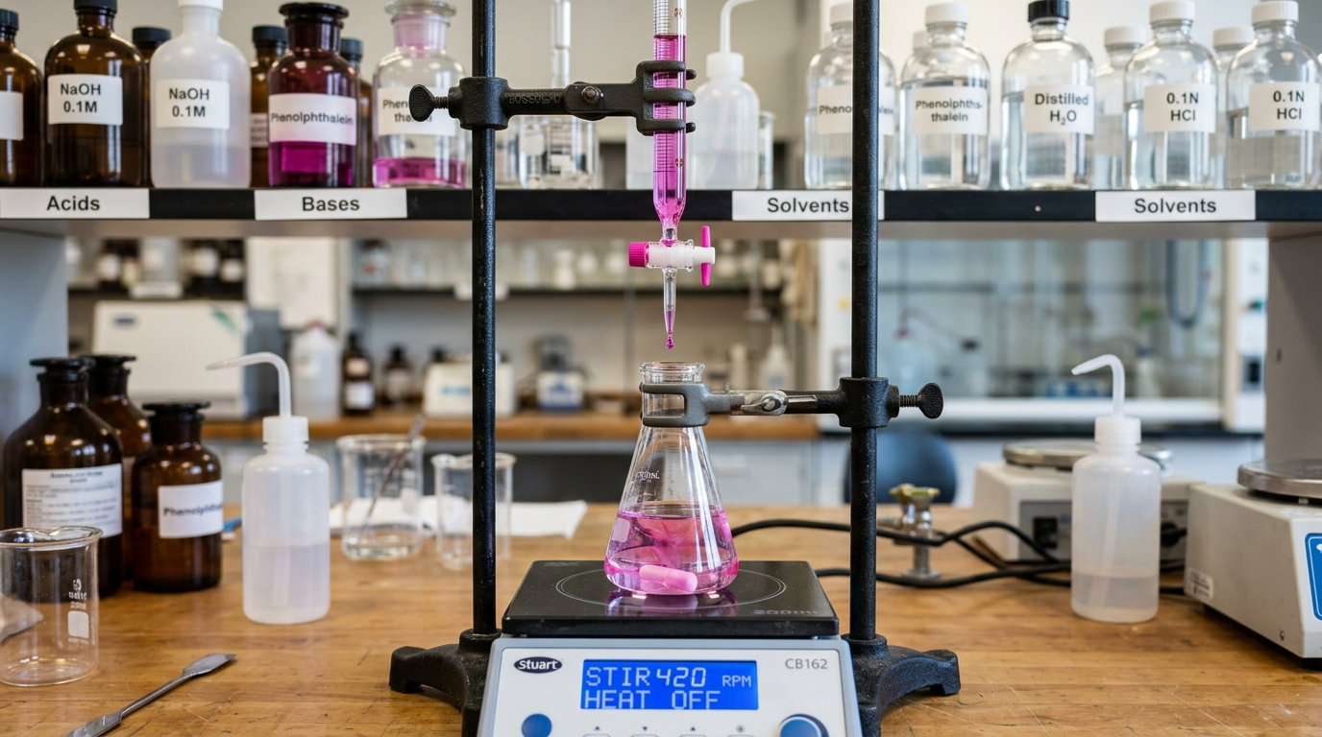
EDUGATES-CLIPSAT SCIENCE LABS
The 45 Virtual Laboratories: Mathematical Physics Engine
🔬 High-Fidelity Interactive Physics & Chemistry
• Continuous Differential Calculators:
Calculates instantaneous state transitions (stoichiometric titrations, wave PDEs, projectile drag with Reynolds numbers, damped harmonic oscillations).
• Live Canvas Real-Time Plotting:
Plots pH curves, absorption spectra, wave interference fringes, and kinetic trajectory profiles at 60 FPS.
• Tactile Hardware Emulation:
Rotary burette stopcocks, revolving microscope turret objectives, optical benches, and dual-slit barriers with tactile drag-and-drop feedback.
• Synthesized Acoustics (Zero-Memory WebAudio):
Real-time droplet clicks, mechanical turret snaps, liquid laminar jets, and discharge sparks without memory leaks.
• LabTrialStore Persistence:
Students record, compare, and export multiple trials into CSV/JSON or formatted printable reports.
Flagship Lab Bench: Acid-Base Titration
Interactive stopcock, continuous liquid jet, phenolphthalein/bromothymol indicator diffusion, live dpH/dV peak detection.

Slide 6
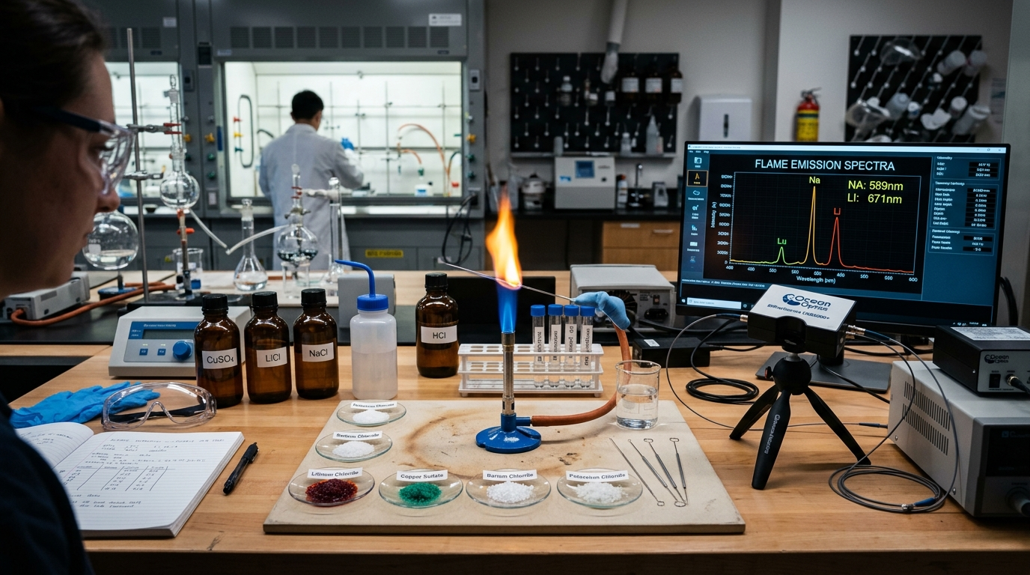
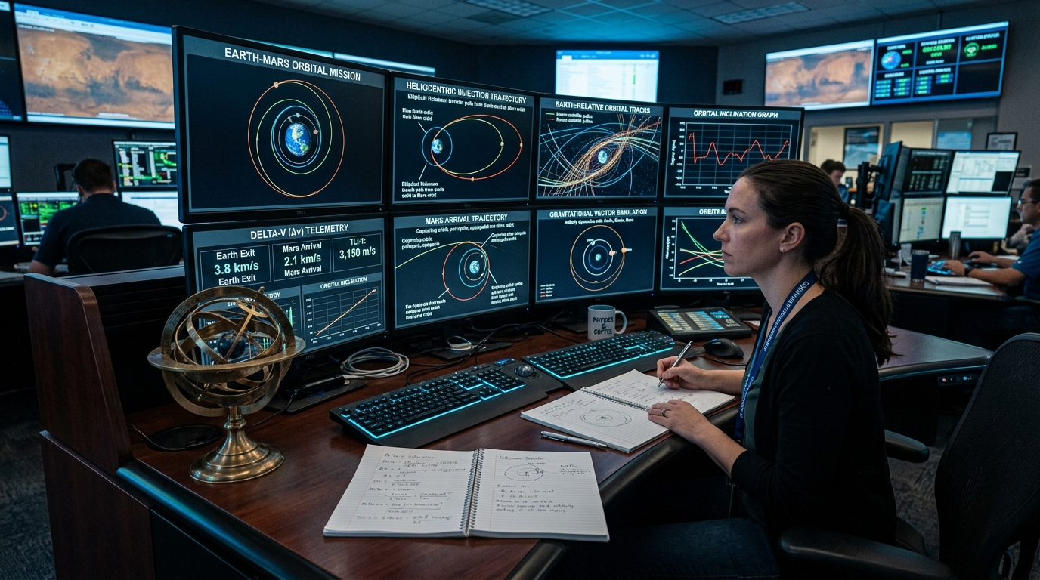
CHEMISTRY BENCH SHOWCASE
Chemistry Virtual Labs: Precision Chemical Bench
Acid-Base Titration
Volumetric burette, strong/weak acid-base combinations, dynamic titration curve, first-derivative dpH/dV equivalence point locator.
Flame Spectrophotometry
Barium, Strontium, Copper, Sodium, Potassium emission spectra with diffraction line wavelengths in nanometers.
Atomic Orbital Hybridization
3D interactive s, p, d orbitals and sp, sp2, sp3 hybrid geometry with nodal surfaces and electron probability clouds.

Slide 7
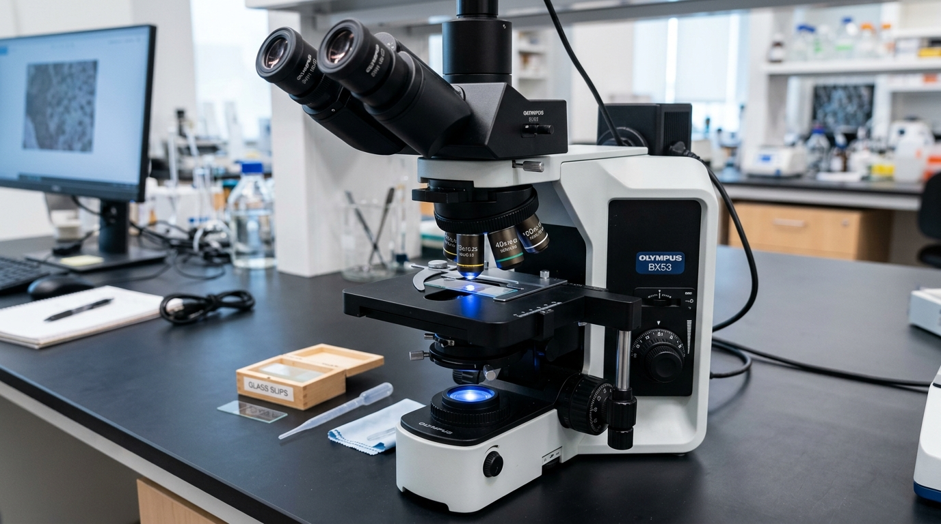
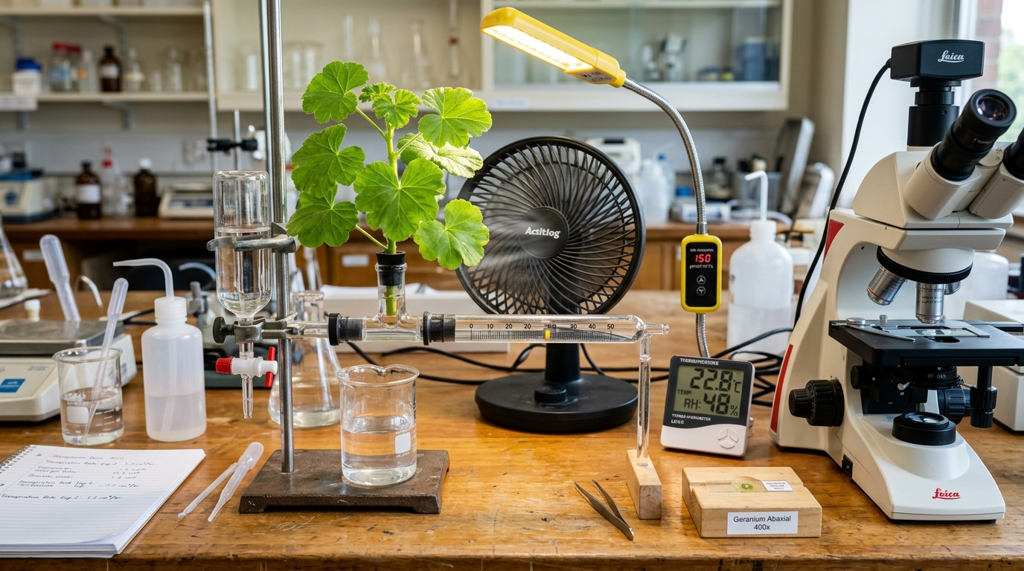
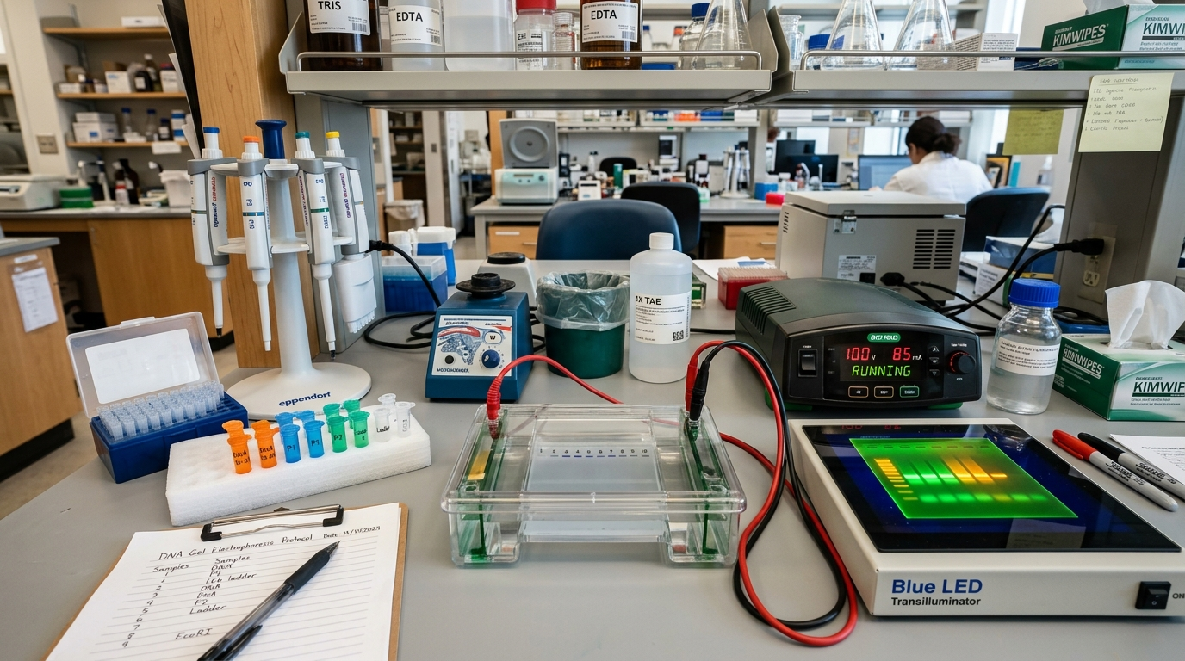
BIOLOGY BENCH SHOWCASE
Biology Virtual Labs: Microscopic to Ecological Inquiry
Research Optical Microscope
Revolving 4x, 10x, 40x, 100x turret, coarse/fine focus, NA 0.10 to 1.25 depth-of-field blur, Köhler & Phase Contrast illumination.
Plant Transpiration Photometer
Capillary air bubble photometer measuring water uptake across Wind, Light Intensity, Humidity, and Stomatal closure conditions.
Gel Electrophoresis & DNA Atlas
Agarose gel ladder sizing, restriction digest fragments, fluorescent UV transillumination, and 3D double helix nucleotide geometry.

Slide 8
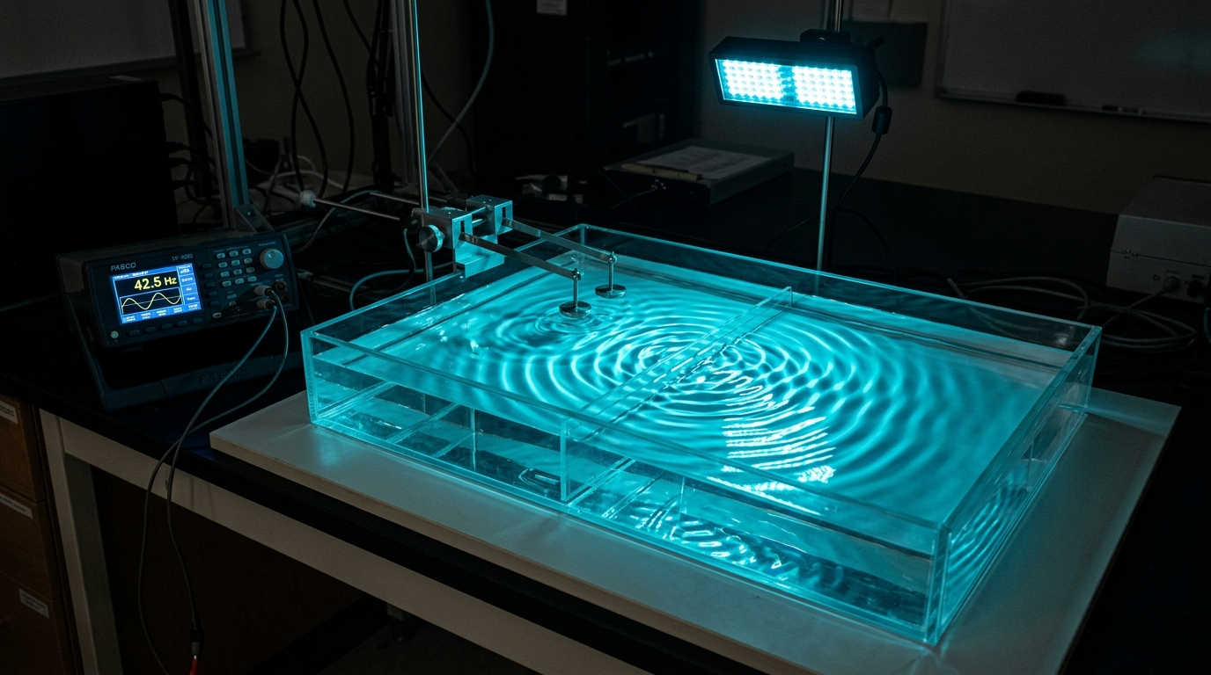
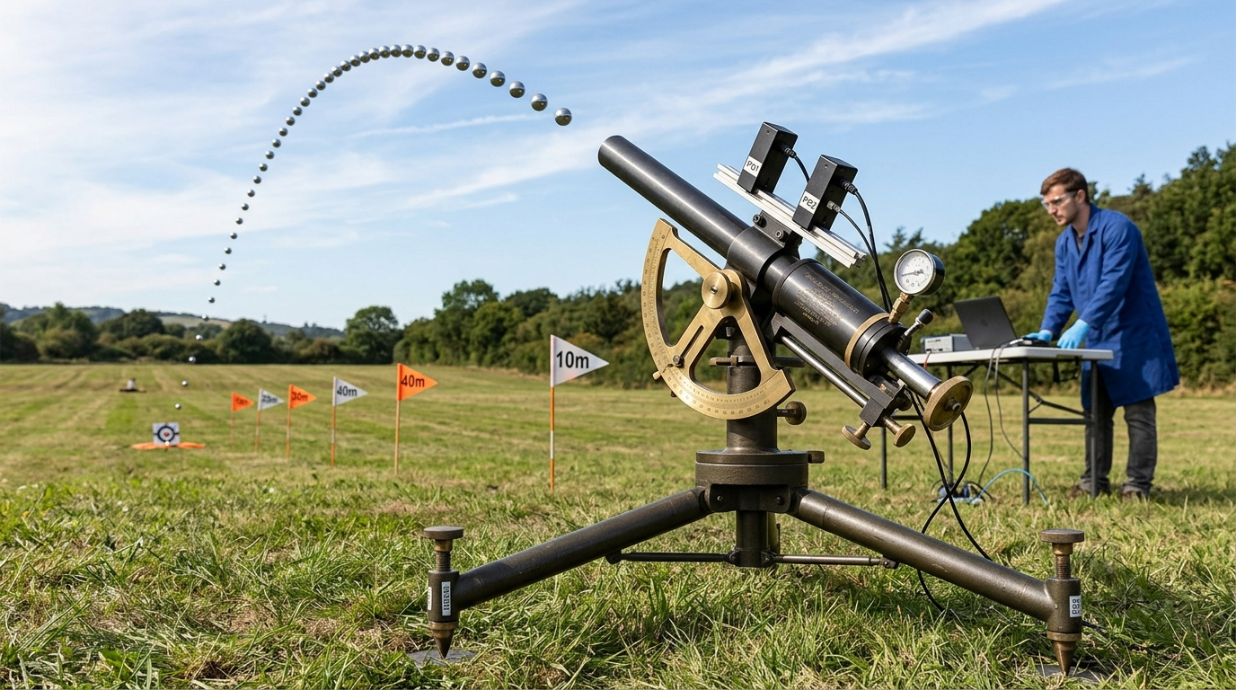
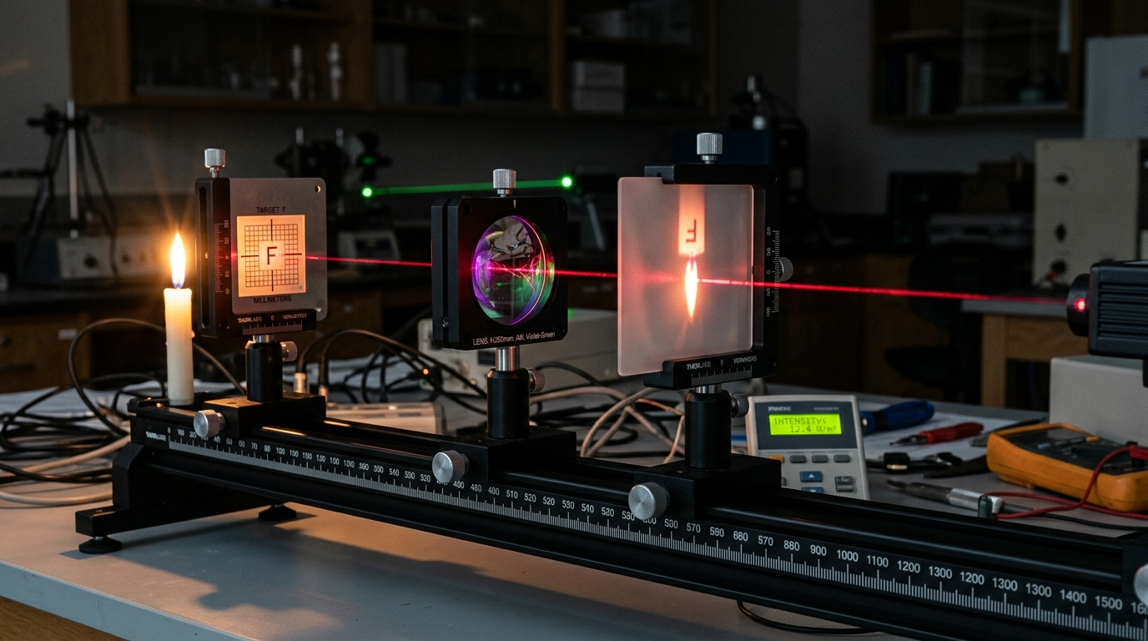
PHYSICS BENCH SHOWCASE
Physics Virtual Labs: Wave Optics & Classical Mechanics
Wave Interference Ripple Tank
2D water wave simulator with PML damping boundaries, Doppler frequency shifts, Young's double-slit fringe spacing, and tactile droplet gen.
Ballistic Projectile Launcher
Multi-angle cannon with launch velocity, adjustable gravity (Earth, Moon, Mars), cross-sectional air drag, and live trajectory telemetry.
Geometric Optics & Ray Tracing
Thin lenses, spherical mirrors, refractive media, Snell's law total internal reflection, chromatic dispersion, and focal plane ray tracing.

Slide 9
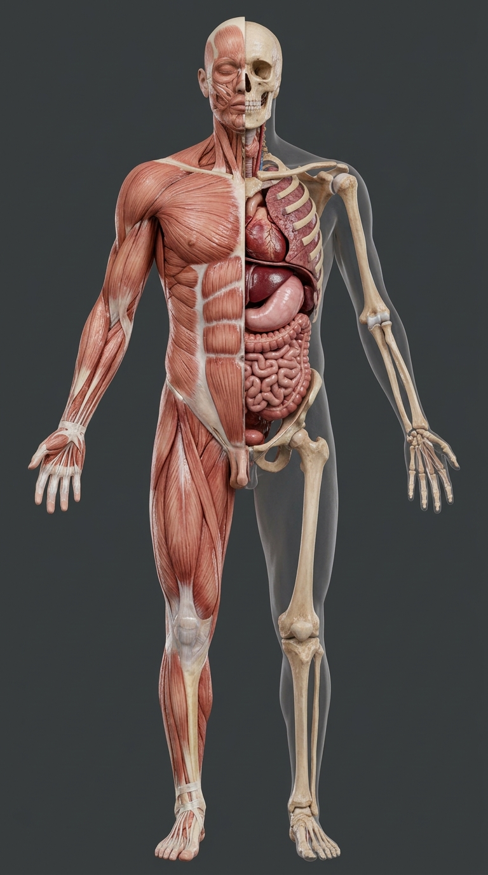
ANATOMY & PHYSIOLOGY
Flagship Feature: Interactive Human Anatomy Atlas
🫀 Multi-Layered Physiological Organ Exploration
• Layer Peeling Architecture:
Toggle between Skeletal, Muscular, Circulatory, Nervous, Visceral, and Integumentary layers seamlessly.
• Male & Female Anatomical Models:
Complete anterior and posterior views with full reproductive and pelvic system cross-sections.
• Organ Deep Dives:
8K high-resolution coronal sections for Cranial Brain, Coronal Heart Chamber, Pulmonary Alveoli, and Hepatic Systems.
• Tactile Smartboard Zoom & Pinning:
Pinch-to-zoom on MAXHUB screens with anatomical label pins, clinical notes, and histological micrographs.

Slide 10
TEACHER SUITE
Teacher Productivity: Automated 2-Page A4 Lesson Plans
📄 Ready-to-Teach Curriculum Documents with 1-Click PDF Export
• Instant Generation for All 74 Modules:
Clicking 'Teacher Lesson Plan' on any module generates an exhaustive, curriculum-aligned A4 plan formatted with zero manual prep.
• Strict 2-Page A4 Page Budget:
Precision CSS `@page` print rules guarantee exactly 2 pages with zero ragged orphans, designed specifically for teacher binder archiving.
• Structured Pedagogical Sections:
Standards Alignment (NGSS / SAT), Prior Knowledge, Core Concepts, Step-by-Step Pacing (Engage, Explore, Explain, Elaborate, Evaluate), Common Student Misconceptions, and Scaffolding.
• Differentiation Strategies:
Includes built-in strategies for Advanced Students (AP/Olympiad extension) and Emerging Learners (tactile scaffolds and visual representations).
• Dual Export Formats:
Print or save as vector PDF directly from the browser, or export to clean Word DOCX for school administrative review.
• 2,500+ Curated Question Bank:
Covering SAT Subject, AP Science, and NGSS standard benchmarks with zero duplicate guarantees across all modules.
• Interactive In-Class Quizzes:
Immediate student feedback with KaTeX mathematical typesetting, animated worked solution breakdowns, and error explanations.
• Custom Printable Exam Generator:
Select specific modules, choose question count (10, 25, 50), randomize order, and print clean formatted student test papers.
• Instant Printable OMR Bubble Sheets:
Auto-generates standardized multiple-choice answer bubble sheets with corresponding Master Answer Keys and grading rubrics.
• Student Telemetry & Mastery Tracking:
Local storage telemetry records scores, completion percentages, and domain mastery without external cloud account logins.

Slide 11
ASSESSMENT & TESTING
Assessment Engine: Test Generator & Bubble Sheets
📝 Comprehensive Assessment Workflow from Quiz to Exam Day

Slide 12
SMARTBOARD & DISPLAY TECH
Classroom Optimization: MAXHUB Smartboard & Hardware Profile
⚡ MAXHUB Turbo 60 FPS Profile
• Deactivates expensive CSS backdrop-filter blur filters on low-spec integrated GPU chipsets.
• Forces solid high-contrast opaque surfaces for rapid 60 FPS canvas redraws during live teaching.
• Touch targets expanded to 52px+ for effortless fingertip and stylus interaction.
☀️ Day & Night Contrast Modes
• Day Mode (WCAG AAA): Specially tuned for brightly lit science laboratories and high-lumen classroom projectors.
• Night Mode: Deep OLED dark slate aesthetic reducing eye strain in dimmed computer labs.
• Instant hotkey toggle with sound feedback.
⏱️ Classroom Timer & Stopwatch
• Draggable, floating countdown timer and stopwatch widget (hotkey Shift+T).
• Paced to 30 FPS on smartboards to prevent CPU throttling while running physics simulations.
• Audible synthesized chimes on countdown expiration.
🎯 Focus Presentation Mode
• Hides navigation bars, browser chrome, and peripheral controls with Shift+F.
• Allows the virtual experiment to fill 100% of the interactive display screen during demonstration.

Slide 13
OFFLINE ARCHITECTURE
Enterprise Reliability: 100% Offline Progressive Web App
📶 Zero Internet Required During Classrooms & Exams
• Complete Pre-Caching Engine:
All core code, stylesheets, mathematical fonts (KaTeX), and 45 simulation engines are cached via Service Worker (amscilab-pwa-v71).
• School Firewall & Outage Immunity:
School network bandwidth drops, Wi-Fi dead zones, or proxy blockades never interrupt a lab demonstration or student exam.
• Built-In Offline Diagnostics Suite:
Accessible via hotkey 'O' or the Smartboard Toolbar to audit and pre-cache 100% of curriculum modules with a single click.
• Privacy & Student Data Safety:
Zero external trackers, zero student account logins required, zero telemetry sent to third-party ad networks. Fully FERPA / COPPA compliant by design.

Slide 14
PEDAGOGICAL MODEL
Instructional Best Practices: The 45-Minute Lab Flow
Step 1: Bellringer & Hook
0 - 7 Minutes
• Launch Interactive Flashcards
• Review 5 key STEM definitions
• Reveal lab investigative prompt on MAXHUB screen.
Step 2: Teacher Modeling
7 - 17 Minutes
• Demonstrate apparatus setup
• Shift+F for Focus Mode
• Formulate hypothesis & make first sample observation.
Step 3: Student Active Lab
17 - 35 Minutes
• 1:1 iPad/Chromebook lab work
• Manipulate variables & record trials
• Export data table and auto-generate lab chart.
Step 4: Check for Understanding
35 - 45 Minutes
• 5-question formative test
• Teacher reviews worked examples
• Assign homework/extension from Lesson Plan.

Slide 15
CONCLUSION
Ready for Demonstration: Staff Q&A & Live Sandbox
🚀 Experience Edugates-ClipSAT Science Labs Live
Live Web Application: https://mohammedamy.github.io/EdugatesScLab/
Key Interactive Demo Milestones to Try with Staff Today:
1. Open the Subjects Dropdown Menu in the header bar (Access Chemistry, Biology, Physics, Labs, Quiz, Cards)
2. Launch Virtual Labs (Acid-Base Titration stopcock or Optical Microscope Turret)
3. Click 'Teacher Lesson Plan' on any lesson to preview and print the 2-Page A4 PDF
4. Open the Quiz & Exams Generator to preview instant printable Bubble Sheets
5. Test the MAXHUB Turbo button and Day/Night mode toggles on the smartboard
Thank you! Open for Questions & Hands-On Faculty Exploration.

