Slide 1

BOOK RECOMMENDATION SYSTEM
Project Supervisor: Ms. P. Santhiya
Name of the Student: Mohammed Arshad. A
Register Number: 40110769

Slide 2
Presentation Outline
Introduction
Objectives
Algorithms Used
System Architecture / Ideation Map
Module Implementation
Application Snapshots
Results and Discussions
Conclusion & Future work
References

Slide 3
Introduction
A recommendation system is any system that mechanically suggests content for web site readers and users. These systems evolve an intelligent algorithm, which generates recommendations to users.
Recommendation systems square have wide custom-made that uses collaborative filtering and content-based filtering severally.
Book recommendation system is the web application which is used to manage the library’s repository. This system tracks several categories like books, journals, magazines, etc.

Slide 4
Objectives
The main objective is to create a machine learning model to recommend relevant books to users based on popularity and user interests.
To provide a book recommendation system that suggest the books accurately according to the user interest.
To develop a model using both popularity and collaborative filtering algorithms

Slide 5
Algorithms Used
POPULARITY BASED RECOMMENDATION SYSTEM works with the trend. It basically uses the items which are in trend right now.
For example, if any product which is usually bought by every new user then there are chances that it may suggest that item to the user who just signed up.
Weighted average formula: (WR) = [vR/(v+m)] + [mC/(v+m)]
where,
v is the number of votes for the books m is the minimum votes required to be listed in the chart R is the average rating of the books C is the mean vote across the whole report

Slide 6
Algorithms Used
COLLABORATIVE FILTERING is a popular technique used in recommender systems to make personalized recommendations to users.
The main idea behind collaborative filtering is to find similarities between users or items, based on their historical interactions, and use those similarities to predict user-item preferences.
There are two main types of collaborative filtering:
USER BASED COLLABORATIVE FILTERING | ITEM BASED COLLABORATIVE FILTERING
These systems recommend products to a user that similar users have liked. For measuring the similarity between two users we can either use pearson correlation or cosine similarity | Instead of measuring the similarity between users, the item-based CF recommends items based on their similarity with the items that the target user rated

Slide 7
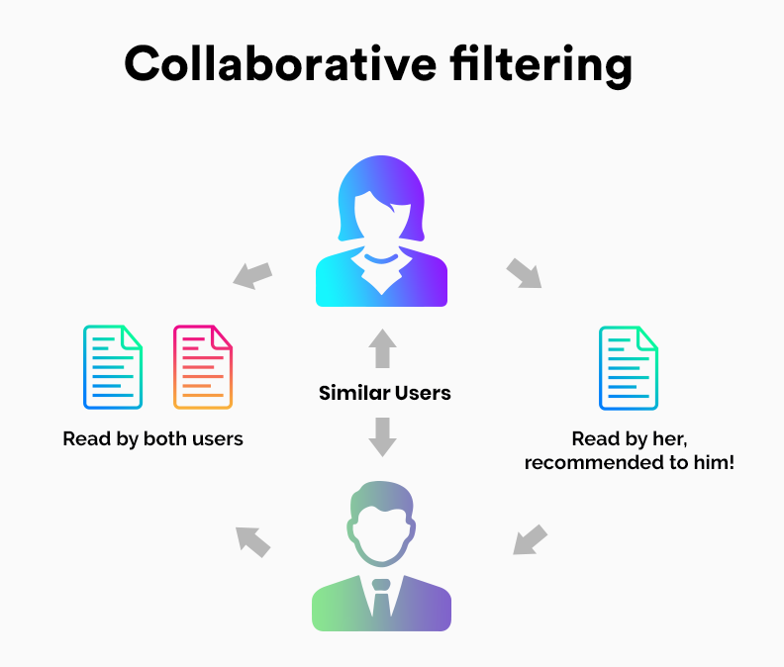
System Architecture/ Ideation Map
11 November 2021
Department of CSE
7

Slide 8
Project Implementation
Data Collection: Collect data on books and user interactions. This can be done by scraping data from online bookstores, or by using existing datasets.
Data Preprocessing: Clean and preprocess the data. This involves removing duplicates, handling missing values, and converting the data into a suitable format.
Similarity Computation: Compute the similarity between books based on user ratings or reviews. This can be done using various similarity measures such as cosine similarity, Pearson correlation, or Jaccard similarity.
Neighborhood Selection: Select a subset of similar books for each target book. This can be done by using a threshold similarity score or by selecting the top K most similar books.
Recommendation Generation: Use the selected subset of books to generate personalized recommendations for each user.
Evaluation: Evaluate the performance of the recommender system using metrics such as precision, recall, and F1 score (model’s accuracy).

Slide 9
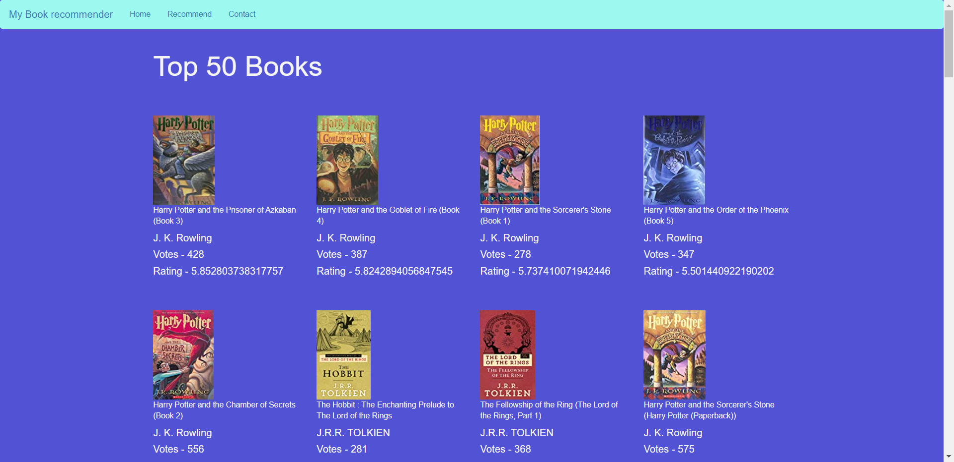
Sample Snapshot

Slide 10
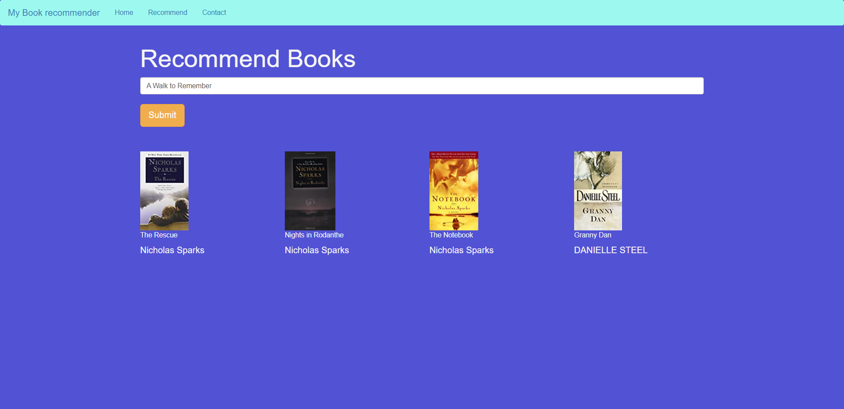
Sample Snapshot

Slide 11
Results and Discussion
The overall process of recommending books to the user of all age group category make use of popularity based filtering and collaborative filtering methodology where different users give ratings on the same book and the average number of rating is been calculated and the top-rated book is been recommended to the user.
The system mainly focuses on the easy finding of best books which does not need much time or work. The process of this system is accurate, reliable and cost-free. The income of this system is penalty fee collection when the book is not returned within the due time.

Slide 12
Conclusion
In conclusion, Collaborative filtering is a popular technique for building book recommender systems that can provide personalized recommendations to users based on their historical interactions with books.
The approach involves computing similarities between books or users, selecting a subset of similar items, and generating recommendations based on those similarities.
Overall, Collaborative filtering based book recommender systems can be a useful tool for providing personalized book recommendations to users, and can be implemented in a variety of contexts such as online bookstores, libraries, and reading apps.

Slide 13
References
[1]. Yizhu Zhao, Jun ZengSchool of Big Data and Software Engineering Chongqing University Chongqing, China, “Library Intelligent Book Recommendation System Using Facial Expression Recognition”
[2]. Build a Recommendation Engine With Collaborative Filtering
[3]. Dhirman Sarma, Tanni Mittra and Mohammad Shahadat Hossain, “Personalized Book Recommendation System using Machine Learning Algorithm” The Science and Information Organization vol.12, 2019
[4]. N. Grover, “Enabling shift in retail using data: Case of Amazon”, 2019
[5]. “Building Recommender Systems with Machine Learning and AI” by Sreenivasan (2019)

Slide 14
THANK YOU

