Slide 1

CONSTRUCTION OF SMART IRRIGATION SYSTEM USING CISCO PACKET TRACER
PROJECT SUPERVISOR
Dr. J. Jabez, M.E., Ph.D.
TEAM MEMBERS
40110129 - Atchaya
40110769 - Mohammed Arshad

Slide 2
Presentation Outline
Abstract
Introduction
Problem Statement
Literature survey
Inferences from Literature Survey
Existing System
Goal
Objective
Modules
Proposed System
System Architecture
Description of Software Implementation
Results & Discussion
Conclusion
Future Enhancement
References

Slide 3
Abstract
Irrigation system is a method used to supply water to the plants as uniformly as possible. In the Internet of Things (IoT), technology devices or sensors are connected via the internet and can be remotely operated and monitored by the user.
The implementation is done by performing the simulation for a smart irrigation system with the help of the Cisco packet tracer simulation software with new version Cisco Packet Tracer 7.3.0 (64-bit).
This technology can be implemented for developing a smart irrigation system, which consists of devices like a lawn sprinkler, temperature monitor, humidity monitor, etc., to automate the watering system and remotely monitor the environmental conditions for better growth of the plants.
All the devices are connected to the home gateway and can be remotely operated and monitored using a Tablet/PC/Smartphone.

Slide 4
Introduction
IoT technology addresses challenges faced by farmers/homeowners in maintaining proper irrigation systems amidst changing environmental conditions.
Smart irrigation systems automate watering based on water level readings from monitors, ensuring efficient water usage. Humidity sensors enable automated control of humidifiers to maintain optimal humidity levels for plant growth.
Various environmental sensors such as temperature, pressure, CO2, CO, wind, and humiture monitors contribute to monitoring plant health and growth. Smart devices are connected to a home gateway, enabling remote operation and monitoring via tablets, PCs, or smartphones. Motion detector alarms enhance security by alerting owners to animal presence near the irrigation field.
Cisco Packet Tracer simulation tool facilitates the visualization and testing of network topologies and device integration, aiding in the development of smart irrigation systems.

Slide 5
Problem Statement
The existing agricultural monitoring system exhibits critical shortcomings, primarily the absence of real-time process surveillance leading to unidentified factors causing crop rotting.
This deficiency contributes to economic losses and underscores the need for a technologically advanced approach. The current system lacks integration of Internet of Things (IoT) devices, such as NodeMCU, soil moisture sensors, weather stations, and humidity sensors.
The proposed solution involves deploying these IoT sensors to enable continuous data collection and transmission to a central control system via wireless networks.
This technological upgrade facilitates dynamic control of actuators, optimizing water usage based on real-time data rather than adhering to fixed irrigation schedules, thereby mitigating economic and operational inefficiencies in agricultural practices.

Slide 6
Literature Survey
S. No | Title | Author | Year | Content
1 | Farmer Assistance System for Better Yield Production | G. M. Karpura Dheepan, V. Sathish, Y. Vamsi Krishna | 2023 | Agriculture in developing economies faces complex challenges. This project deploys automation and IoT to combat water scarcity with irrigation. Precision sensors optimize crop growth. Data converges at the Home Gateway, controlled via smartphone.
2 | Smart Irrigation System Using IoT for Surveillance of Crop-Field | Ashwini B V | 2021 | The use of IoT in agricultural practices, focusing on its integration in irrigation systems for real-time monitoring and crop yield optimization, highlighting the importance of efficient water management.
3 | IoT Based Smart Plant Irrigation System with Enhanced Learning | Kemal Cagri Serdarog, Cem Onel, Sebnem Baydere | 2020 | The research delves into advanced IoT-based smart plant irrigation, using dynamic learning and mathematical algorithms. GBRT excels among machine learning methods. A thorough test bed ensures robust performance.

Slide 7
Inferences from Literature Survey
S. No | Title | Author | Year | Content
1 | Farmer Assistance System for Better Yield Production | G. M. Karpura Dheepan, V. Sathish, Y. Vamsi Krishna | 2023 | The project showcases Tech-Agri synergy with a Smart Irrigation System using IoT, data analytics, and cloud computing via Cisco Packet Tracer. It addresses water scarcity and boosts Agri-economy.
2 | Smart Irrigation System Using IoT for Surveillance of Crop-Field | Ashwini B V | 2021 | It highlights the importance of smart irrigation systems for agricultural efficiency and water conservation, highlighting the role of IoT technology in real-time monitoring and sustainable agricultural practices.
3 | IoT Based Smart Plant Irrigation System with Enhanced Learning | Kemal Cagri Serdarog, Cem Onel, Sebnem Baydere | 2020 | This project blends technology and rural development through advanced irrigation and predictive algorithms, aiming to empower rural communities, promote sustainability, economic growth, and harmonious urban-rural coexistence.

Slide 8
Existing System
One paper presents a greenhouse monitoring system using IoT and cloud storage, while another focuses on an automated irrigation system employing Raspberry Pi and Arduino microcontrollers.
Another paper describes a smart home system utilizing IoT technology for automation via Cisco Packet Tracer.
Another theme involves high-level monitoring and control of agricultural data using Raspberry Pi and cloud-based IoT. Utilizing advanced IoT sensors like NodeMCU, soil moisture sensors, weather stations, and humidity sensors, real-time data is collected and transmitted wirelessly to a central control system. This sophisticated system leverages the gathered data to dynamically control actuators, optimizing water usage.
Unlike traditional irrigation schedules tied to specific times and durations, the IoT-driven approach ensures a more responsive and efficient agricultural process, mitigating economic and operational disadvantages present in the existing system.

Slide 9
Goal
Develop advanced smart irrigation using Cisco Packet Tracer simulation.
Integrate IoT, enhance environmental monitoring, and optimize irrigation schedules.
Implement real-time sensor data for informed irrigation management decisions.
Apply data analytics, machine learning for dynamic irrigation schedule optimization.
Ensure seamless cloud integration for efficient data storage, retrieval and analysis.
Contribute to resource conservation, yield maximization, and intelligent agriculture solutions.

Slide 10
Objective
The objective of this research is to create and test a smart watering system using the Internet of Things (IoT) technology. We want to make it so that people can control their garden watering from anywhere using a smartphone or computer.
The system will include devices like a sprinkler and sensors to check things like temperature and humidity. We'll use a program called Cisco Packet Tracer to simulate how the system works.
Our main objectives are to set up and connect all the devices in the simulation, make sure they can communicate with each other through a central hub, and program them to automatically water the garden based on the soil's moisture level. We also want to see if this system can help people save water and keep their plants healthy.

Slide 11
Modules
The main step is to connect the home gateway device to the network and configure the home gateway to provide internet access and connect to the IoT devices.
Connect the various IoT devices such as lawn sprinkler, water level monitor, water drain, light indicator, temperature monitor, pressure monitor, humiture monitor, humidity monitor, humidifier, CO2 detector, CO detector, smartphone, and thermostat to the home gateway.
Configure each sensor to send data to the home gateway. Set up parameters such as threshold levels for different environmental factors like temperature, humidity, and pressure.
Use programming logic (e.g., if-then conditions) to control the irrigation system based on sensor readings. Define actions for the lawn sprinkler, water drain, and humidifier based on the data received from sensors.
Configure the smartphone to connect to the home gateway remotely. Develop a user interface on the smartphone for monitoring sensor data and controlling the irrigation system.
Test the system to ensure proper functioning of all components. Optimize the system settings and programming logic for efficient irrigation management.

Slide 12
Proposed System
The Smart Irrigation system is designed using a software called Cisco Packet Tracer. It involves a tablet and a home gateway that connect to different devices like temperature monitors, lawn sprinklers, and water level sensors.
The home gateway links all the sensors and uses conditions like "if-then" actions to control the lawn sprinklers.
In the future, storing data and analytics in the cloud is becoming popular. This makes it easy to access and analyze data, and allows for collaboration among farmers and experts.
Some systems also include disease and pest monitoring using cameras and special software. This helps farmers spot problems early and take action to fix them.

Slide 13
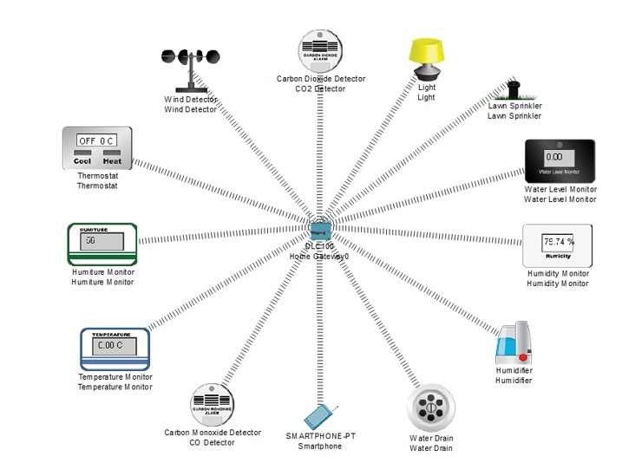
System Architecture

Slide 14
Description of Software Implementation
LIST OF COMPONENTS AND SENSORS USED
Home Gateway | Temperature Monitor
Light Indicator | Pressure Monitor
Lawn Sprinkler | Humiture Monitor
Water-level monitor | Humidity Monitor
Water Drain | Humidifier
Wind Detector | CO2 Detector

Slide 15
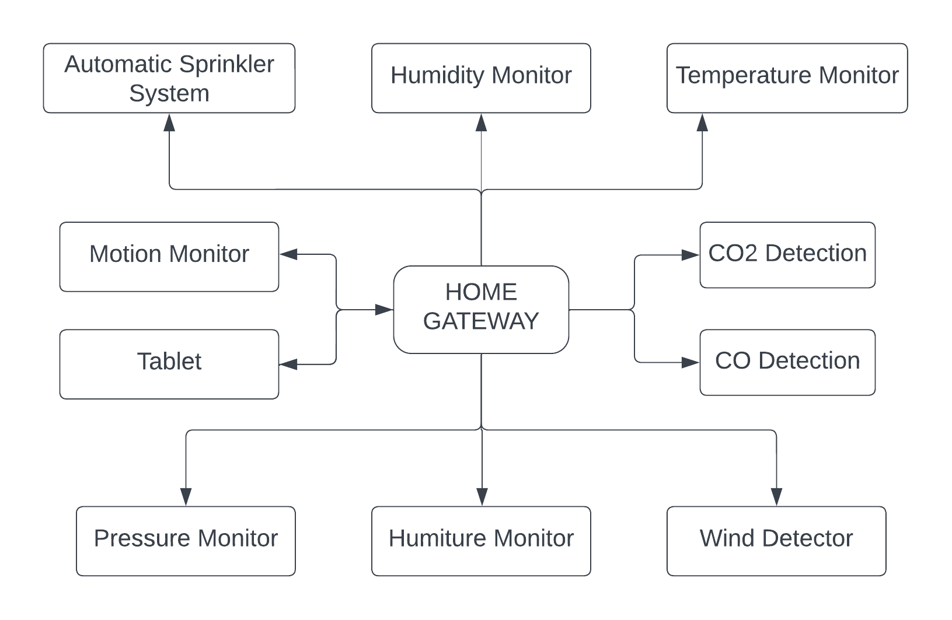
Block Diagram of Smart Irrigation System

Slide 16
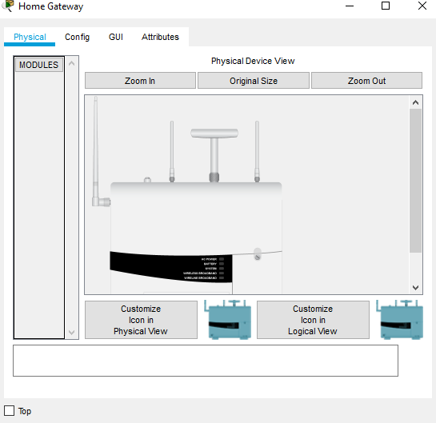
Physical Configuration of Home Gateway

Slide 17
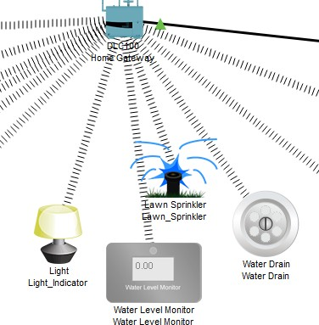
Automatic Sprinkler System

Slide 18
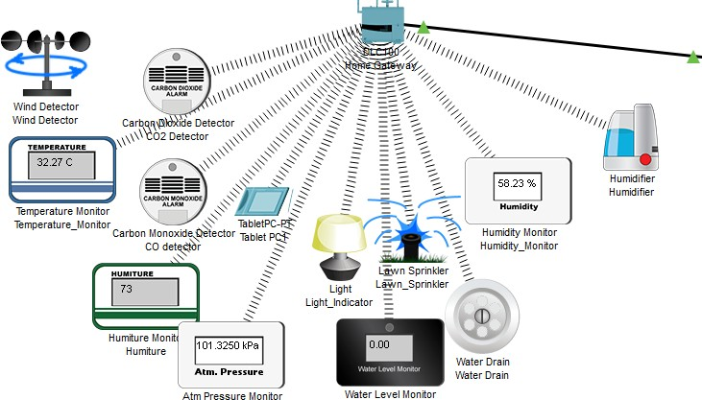
Connection of Devices to the Home Gateway

Slide 19
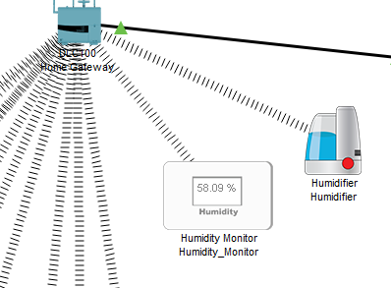
Humidity Monitoring System

Slide 20
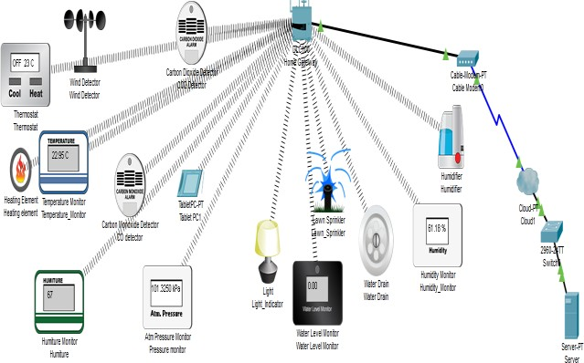
Overall Network

Slide 21
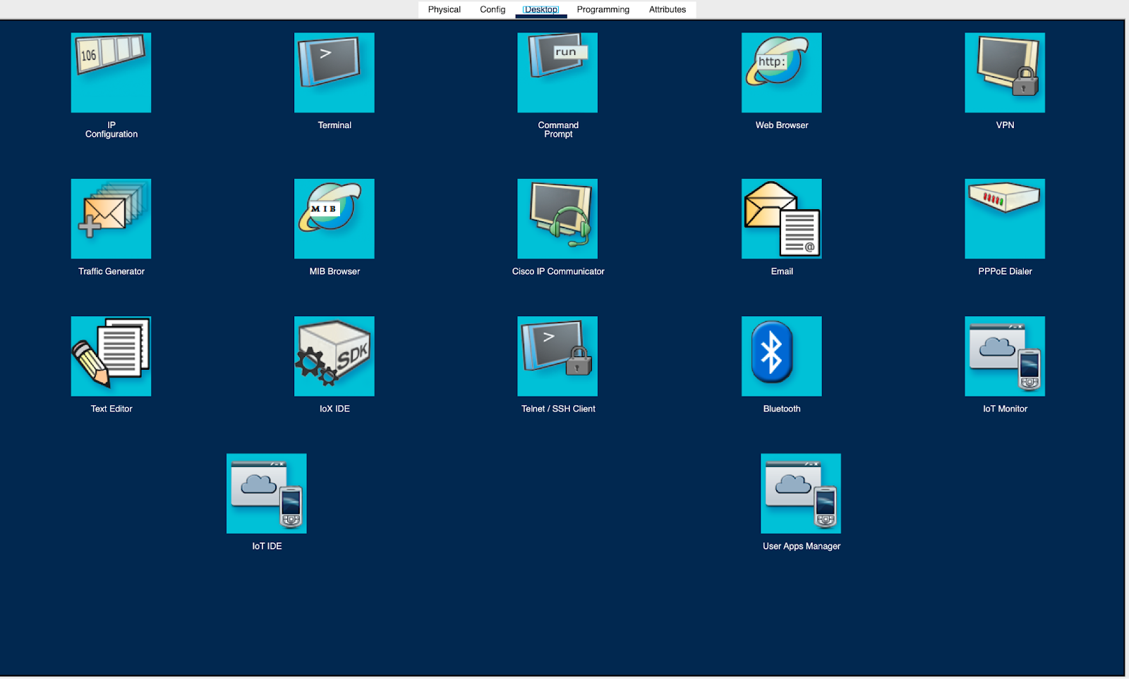
Desktop Site View on the Tablet

Slide 22
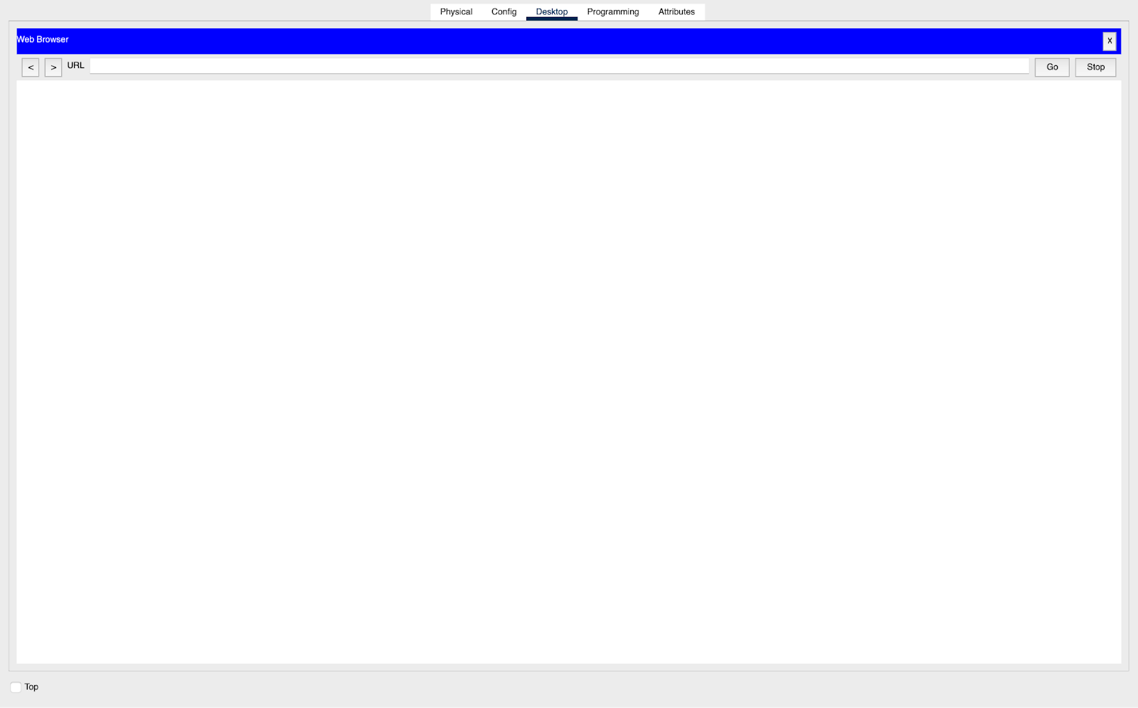
Web Browser View on the Tablet

Slide 23
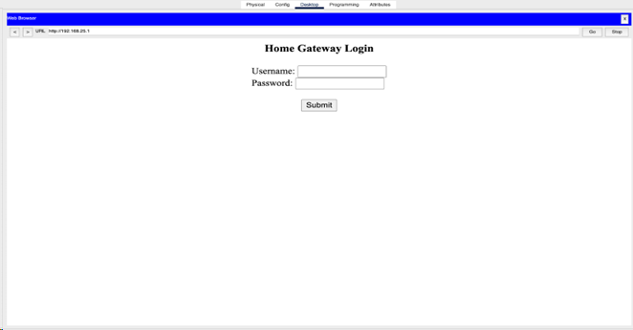
Login Page View on the Tablet

Slide 24
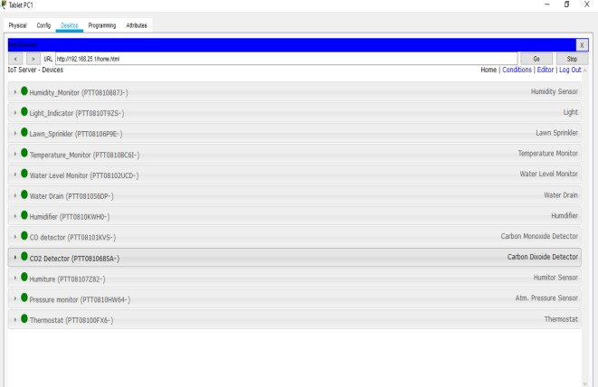
IoT devices displayed on the Tablet

Slide 25
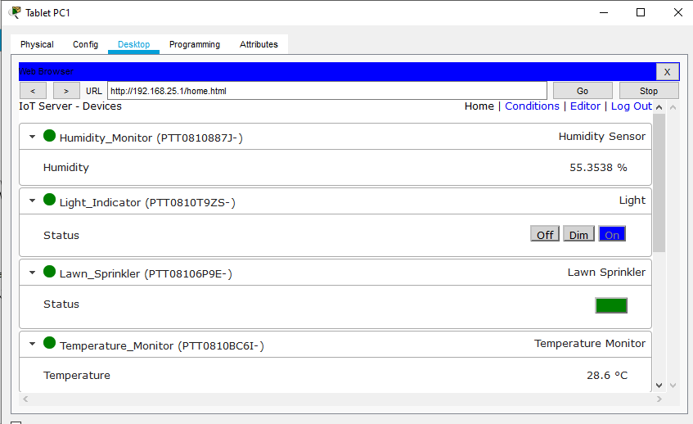
Numerical values of the sensors

Slide 26
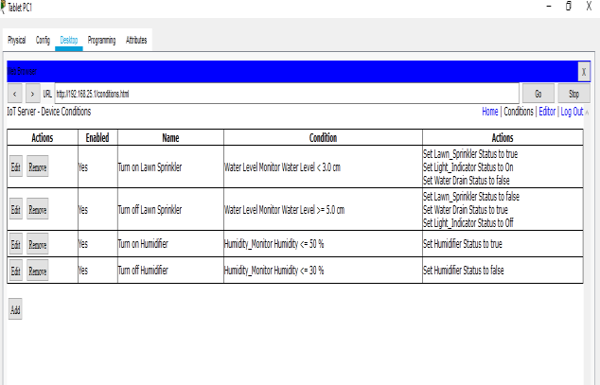
Conditions Set for the Automatic Systems

Slide 27
Result and Discussion
After registration of the devices with the home gateway, to control the IoT devices remotely using a tablet. The registered IoT devices can be viewed on the tablet.
The devices can be manually operated as well as the values can be viewed and monitored in real-time.
It shows the numerical values of the sensors that are displayed on the Tablet. It shows the status of the IoT devices registered with the home gateway.
Quick and automatic maintenance of this device is made easier thanks to the tablet interface. These devices can be manually as well as automatically monitored.

Slide 28
Conclusion
The results prove that there is an opportunity of applying this model in real life. The implementation of the automatic irrigation system can be used to reduce the use of water.
The system can be manually monitored, it can increase the energy efficiency and savings. It also makes it convenient for the user to access all the devices through the smartphone.
In the field of IoT, ensuring security should be a priority. Since the IoT devices are interconnected to each other, the network should be secured.
In this system, an authentication gateway is designed that requires password to check authenticity of the home user for security purpose. To extend this system to be more robust and efficient in the future, modifications can be made to make the system more secure.

Slide 29
Future Enhancement
Future enhancements to the smart irrigation system leveraging Cisco Packet Tracer encompass IoT integration through advanced protocols, machine learning algorithms for dynamic scheduling, scalable cloud integration for data processing, and improved user interfaces employing responsive design principles.
The implementation includes sophisticated water quality monitoring sensors, energy-efficient IoT device integration, robust security protocols with advanced encryption, and the establishment of a remote management infrastructure.
Additionally, community-based collaboration features involve the development of shared data protocols for synchronized water management practices.
These technical advancements collectively strive to optimize precision agriculture, conserve water resources, and foster a collaborative ecosystem for water management, exemplifying a holistic and technologically progressive paradigm in smart farming practices.

Slide 30
Reference
[1] Egemen Hopalı, Özalp Vayvay, “Internet of Things (IoT) and its Challenges for Usability in Developing Countries” International Journal of Innovation Engineering and Science Research, Vol. 2 , Issue. 1 January 2018
[2] Ghaliya Alfarsi, Ragad M Tawafak, Abir Alsidiri, Jasiya Jabbar, Sohail Iqbal Malik, Maryam Alsinani, “Using Cisco Packet Tracer to simulate Smart Home”, Vol. 8 , Issue 12, December 2019
[3] R. N. Rao and B. Sridhar, "IoT based smart crop-field monitoring and automation irrigation system," 2018 2nd International Conference on Inventive Systems and Control (ICISC), Coimbatore, pp. 478-483, 2018, doi: 10.1109/ICISC.2018.8399118.
[4] Isa Shemsi, “Implementing smart home using cisco packet tracer”, IJERT, Vol.4, Issue.7, January 2018.
[5] Abdulrazaq, A., A. Aboaba, G. M. Yelmis, M. Peter, S. Buba and A. Jubril. “Application of smart technology in monitoring and control of home appliances.” Arid Zone Journal of Engineering, Technology and Environment 13: 523-534, 2017

Slide 31
Thank You

