Slide 1
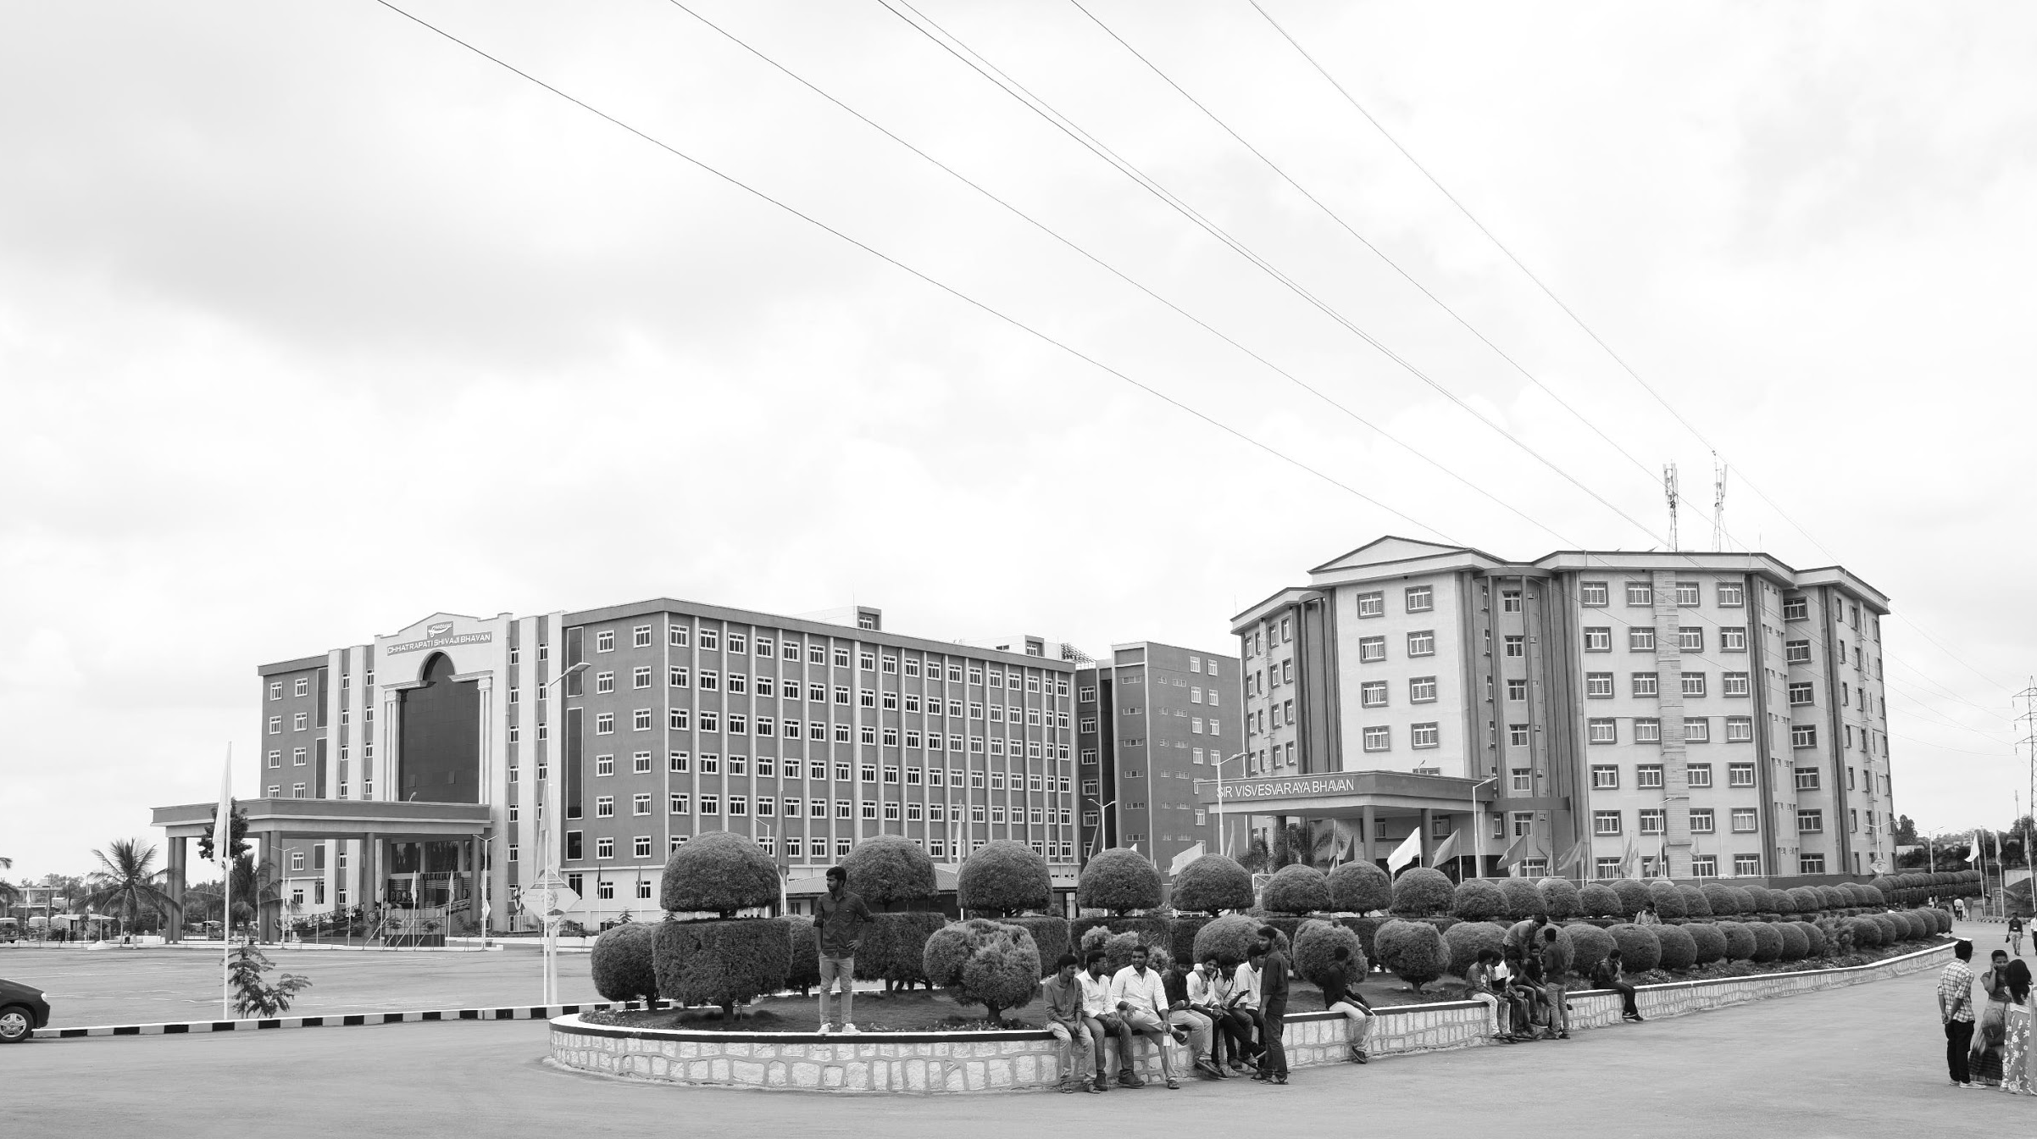

Low light image Enhancement using Retinex Theory
Major Project
Project ID: CS9
AY 2021-25
GITAM (Deemed-to-be) University
Project Team:
Mohammed Ashraf
Shaik Kashida Jabeen
Avva Praveen Babu
Department of Electrical Electronics and Communication Engineering
Project Mentor:
Dr. Pankaj Kandhway
Project In-charge:
Dr. Ambar Bajpai
www.gitam.edu

Slide 2
Objective and Goals
Objective
The primary objective of this project is to develop an image enhancement algorithm that improves the visibility and quality of images captured under low-light conditions. The algorithm should effectively restore details, reduce noise, and enhance the overall visual appearance of the image while preserving its natural color and texture.
Goals
Main Goals
Develop a robust low-light image enhancement algorithm using a combination of Gaussian filtering, guided filtering, and histogram equalization.
Implement two distinct enhancement approaches:
Approach 1: Retinex Theory.
Approach 2: BHSD
Fuse the results of the two enhancement approaches using a weighted average to produce a final enhanced image.
Validate the algorithm by testing it on various low-light images and comparing the results with the original images.
Additional Goals
Optimize the algorithm for computational efficiency to ensure it can process images in a reasonable time.
Use of algorithms, Fourier transforms for image enhancement.

Slide 3
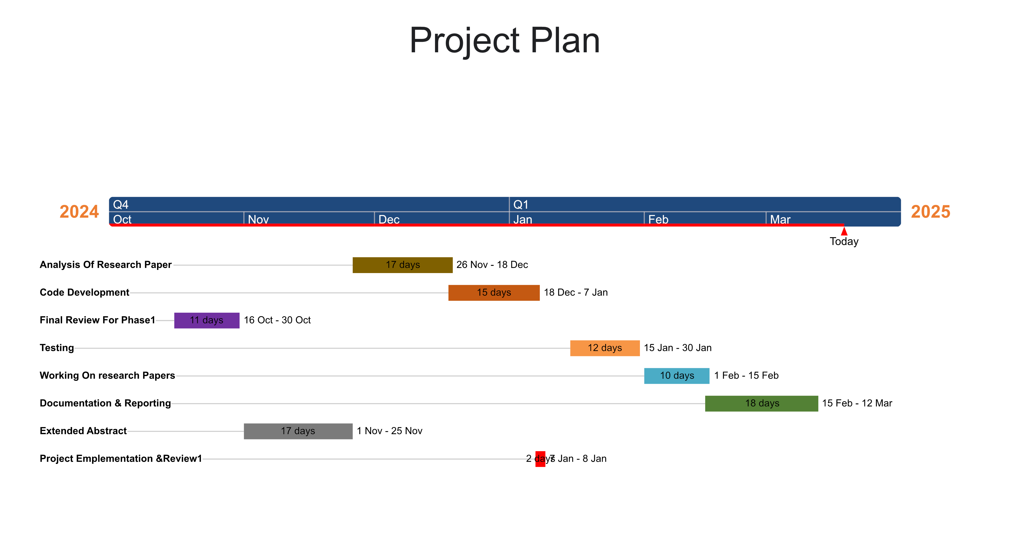
Fig 1. Gantt Chart - Milestones and Activities

Slide 4
Ref No. | Title of paper | Year | Author | Key Findings | Research gap
3. | Low-Illumination Image Enhancement Algorithm Based On a Physical Lighting Model. | JANUARY 2019 | Shun-Yuan Yu and Hong Zhu | The paper proposes a novel physical lighting model that accounts for the degradation of low-illumination images. This model considers environmental light as a point-wise variable that changes with the local light source. | This paper seeks to bridge these gaps by proposing a physical lighting model that adapts to the variable lighting conditions of low-light environments, aiming to enhance image quality without introducing unwanted artifacts and maintaining accurate color reproduction.
 | ​

Slide 5
Ref No.​ | Title of paper​ | Year | Author | Key Findings | Research gap​
1. | "Readability Enhancement of Displayed Images Under Ambient Light." | 2018,July. | Haonan Su, Cheolkon Jung, Member, IEEE, Shuyao Wang and Yuanjia Du. | Image quality in mobile displays is considerably influenced by ambient light. In the daylight condition, images on mobile displays are darkly perceived by the human visual system due to the limited dynamic range of display, which causes loss of luminance and details. In this paper, we propose readability enhancement of displayed images under ambient light by enhancing both luminance and details. | Exploration of the broader applicability of this framework to different types of displays beyond mobile screens, such as larger displays used in outdoor billboards or automotive screens, where ambient light conditions and viewing distances vary significantly.
2​. | ​"Structure-Revealing Low-Light Image Enhancement Via Robust Retinex Model." | 2018,June. | Mading Li, Jiaying Liu , Senior Member, IEEE, Wenhan Yang, Xiaoyan Sun, Senior Member, IEEE, and Zongming Guo, Member, IEEE | The method involves decomposing the image into reflectance and illumination components and then adjusting the illumination to enhance the image. RRM it ensures that noise is handled appropriately during this process. | Traditional methods based on the Retinex model do not account for the noise inherent in low-light images, often leading to suboptimal enhancement results where noise is amplified or details are lost. Additionally, the use of logarithmic transformations in these methods can exacerbate the issue.

Slide 6
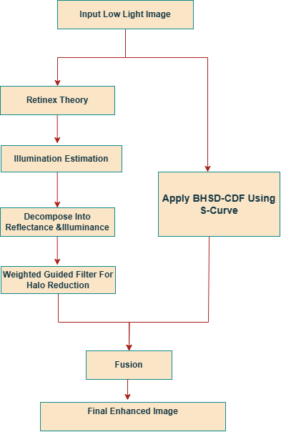
Architecture
Fig 2: Flow Chart

Slide 7
Retinex Theory
Retinex model is an image processing technique used primarily for image enhancement. It is particularly effective in improving images captured under low-light conditions.
The method operates by transforming an image into the frequency domain, where the image's illumination and reflectance components can be separately manipulated.
Applications:
Low-Light Image Enhancement: Improves visibility and detail in images captured under poor lighting conditions.
Medical Imaging: Enhances features in medical scans, aiding in diagnosis.
Remote Sensing: Enhances satellite images for better analysis and interpretation.

Slide 8
BHSD
Introduction to the Distribution:
The Beta Hyperbolic Secant (BHS) distribution is a flexible probability distribution derived from the hyperbolic secant function.
Combines properties of the beta distribution and the hyperbolic secant distribution, offering tunable shape parameters for diverse applications.
Key Features:
Flexibility: Adjustable shape parameters allow the distribution to model various data patterns, making it suitable for diverse image processing tasks.
Symmetry: The hyperbolic secant component ensures a symmetric probability density function (PDF).
Heavy Tails: Its heavy-tailed nature aids in robust processing by handling outliers effectively.

Slide 9
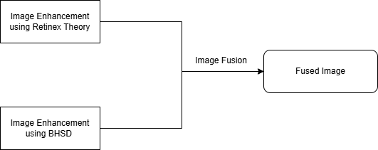
Image Fusion
Image fusion is the process of combining multiple images (or different versions of the same image) into a single composite image that contains the best features of each input image. The goal is to improve the overall quality of the image by enhancing details, reducing noise, and improving visual clarity.
Weighted Average Formula:
Fused Image= fusedImage = w1 * image1 + w2 * image2;

Slide 10
Use Cases & Testing
Use Cases
Low-Light Photography Enhancement:
Description: Enhance images captured in low-light conditions, such as night photography or indoor photography, to improve visibility and detail.
Surveillance Systems:
Description: Improve the quality of low-light surveillance footage to aid in object detection, facial recognition, and activity monitoring.
Medical Imaging:
Description: Enhance low-light medical images, such as X-rays or MRIs, to improve the clarity of critical details for better diagnosis.
Security and Forensics:
Description: Enhance low-light images or videos for forensic analysis, such as identifying suspects or analyzing crime scenes.
Consumer Applications:
Description: Improve the quality of low-light images captured by smartphones or consumer cameras.

Slide 11
Test Cases
Test Case 1: Basic Low-Light Image Enhancement:
Input: A low-light image with minimal noise.
Expected Output: Enhanced image with improved brightness, contrast, and visible details.
Test Case 2: High-Noise Low-Light Image:
Input: A low-light image with significant noise (e.g., grainy night photo).
Expected Output: Enhanced image with reduced noise and improved clarity
Test Case 3: Varying Illumination Levels:
Input: Multiple images with varying levels of illumination (e.g., very dark, moderately dark, slightly dark).
Expected Output: Consistent enhancement across all images, with improved visibility in all cases.
Test Case 5: Real-Time Performance:
Input: A low-light video stream.
Expected Output: Enhanced video with improved visibility and reduced noise in real-time.

Slide 12
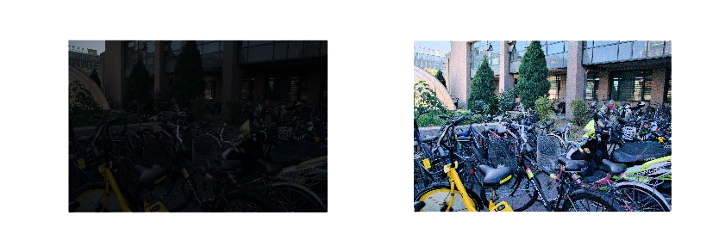
Implementation and Results
Iteration 1 : Results
Fig 5:Before and After using Retinex Model

Slide 13
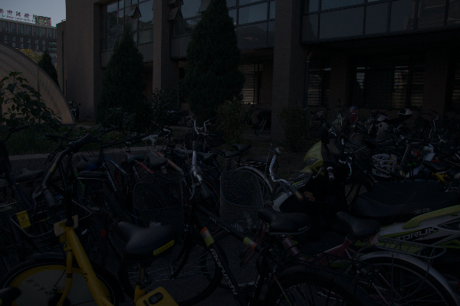
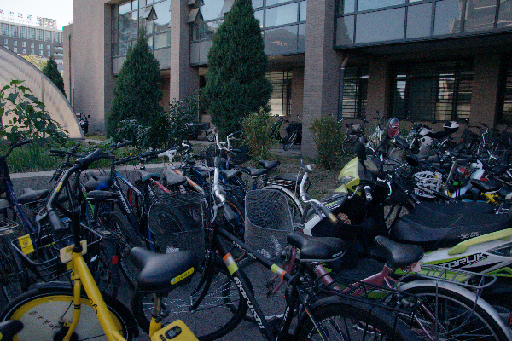
Implementation and Results
Iteration 2 : Results
Fig 4:Original and Enhanced Image using BHSD

Slide 14
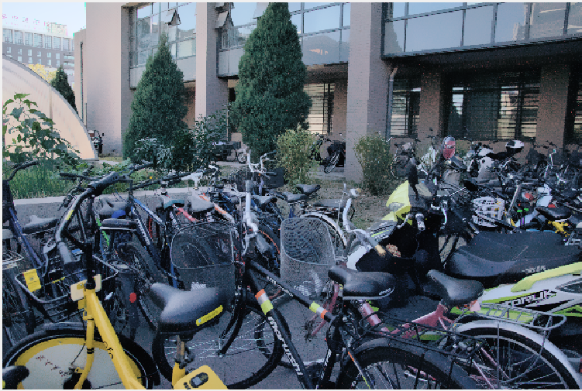
Implementation and Results
Iteration 3 : Results
Fig 4:After the fusion of two images

Slide 15
Conclusion & Future Work
Summary and Conclusion
The development of the Low-Illumination Image Enhancement Algorithm Based on Retinex Theory marks a significant advancement in the field of low-light image processing. By addressing the inherent challenges of enhancing images captured in poorly lit environments, the algorithm demonstrates superior performance compared to traditional methods and existing literature. In conclusion, this project provides a valuable contribution to the field of image enhancement by presenting a comprehensive approach that combines retinex model with iterative refinement. The results not only advance the understanding of low-light image processing but also pave the way for future innovations in this area.
Future Work
Integration with Deep Learning Techniques: Future research could explore the combination of the physical lighting model with deep learning approaches to enhance computational efficiency and effectiveness. Using convolutional neural networks (CNNs) could automate the process of parameter estimation and improve the algorithm's adaptability to various low-light conditions.
Real-Time Processing Capabilities: Further development could focus on optimizing the algorithm for real-time applications. Techniques such as model pruning, quantization, or utilizing efficient hardware (like GPUs or specialized accelerators) could be explored to reduce computational overhead while maintaining performance.

Slide 16
THANK YOU
Have a Great Day !

