Slide 1
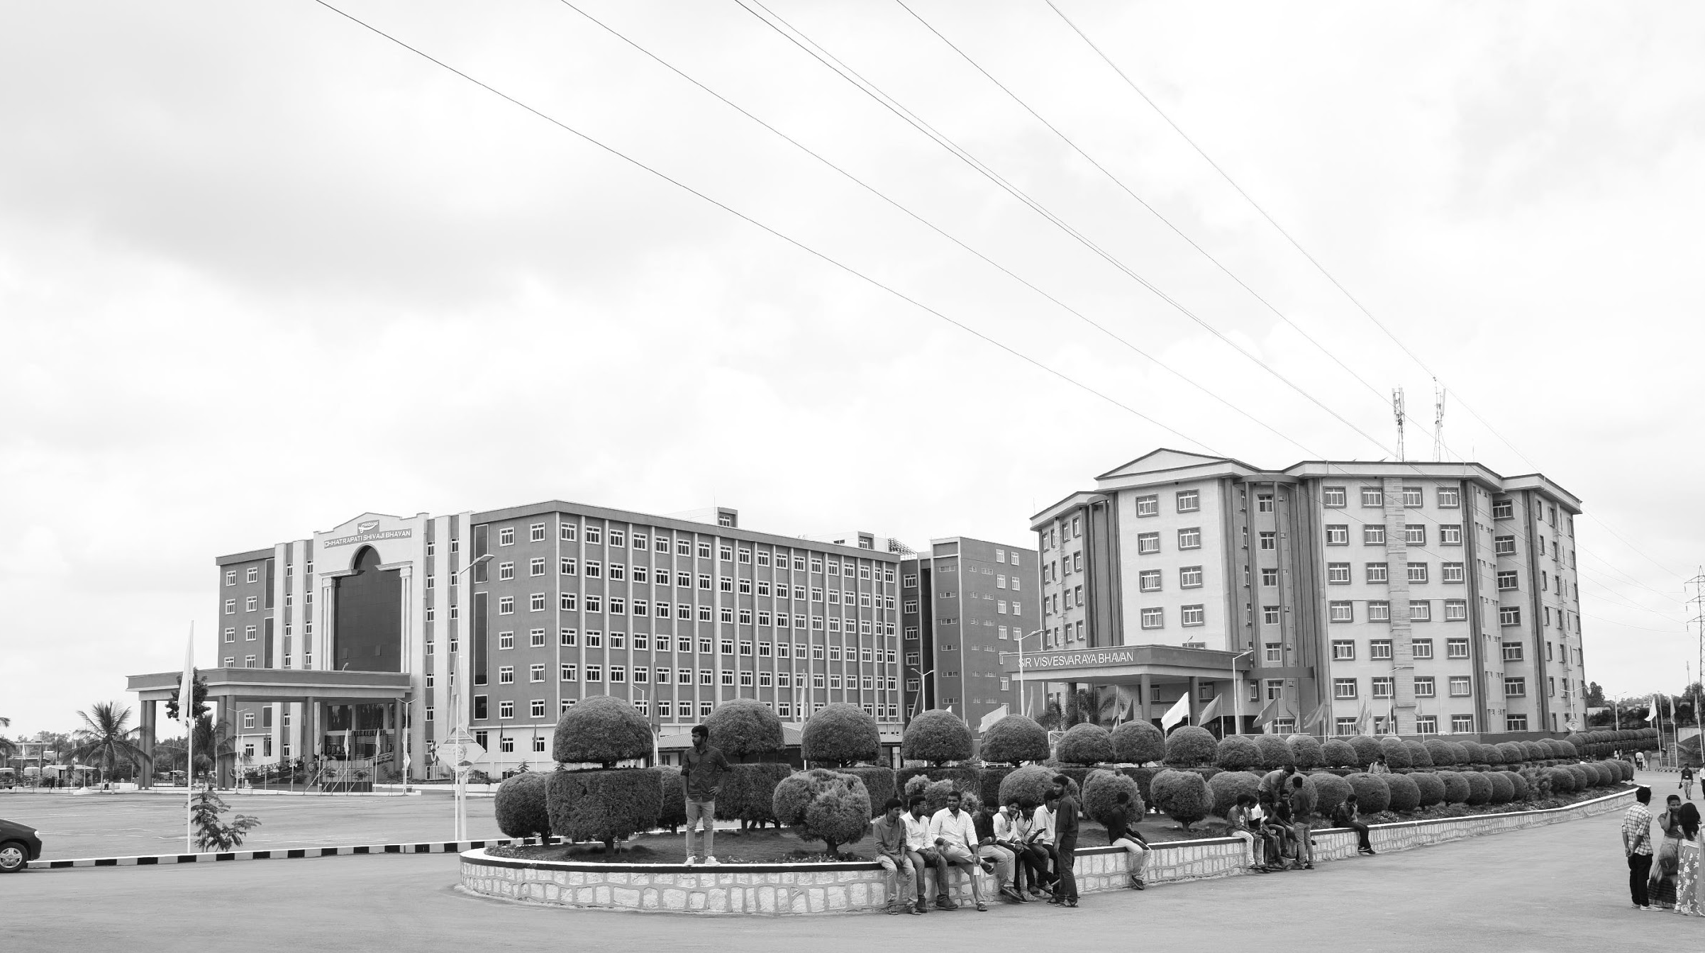

Low light image Enhancement using Retinex Theory
Mid-Review 05/2/25
Major Project
Project ID: CS9
AY 2021-25
GITAM (Deemed-to-be) University
Project Team:
Mohammed Ashraf
Shaik Kashida Jabeen
Avva Praveen Babu
Department of Electrical Electronics and Communication Engineering
Project Mentor:
Dr. Pankaj Kandhway
Project In-charge:
Dr. Ambar Bajpai
www.gitam.edu

Slide 2
Objective and Goals
Objective
Low-illumination images are typically taken in environments with limited light and may be affected by fluctuating lighting from sources like bright lights or bulbs.
Previous enhancement methods often result in halo artifacts, unnatural colours, and loss of information.
Retinex theory, which applies a homomorphic light filtering approach, assumes the incident component can be obtained using a Gaussian technique, based on primary ambient light.
Atmospheric scattering attenuation rate is adjusted according to information loss constraints.
A weighted guided filter is used to refine two parameters and reduce halo block effects.
Goals
Main Goals
Use of Retinex theory to improve image.
Increase illuminance of low light images.
Additional Goals
Use of algorithms, Fourier transforms for image enhancement.

Slide 3
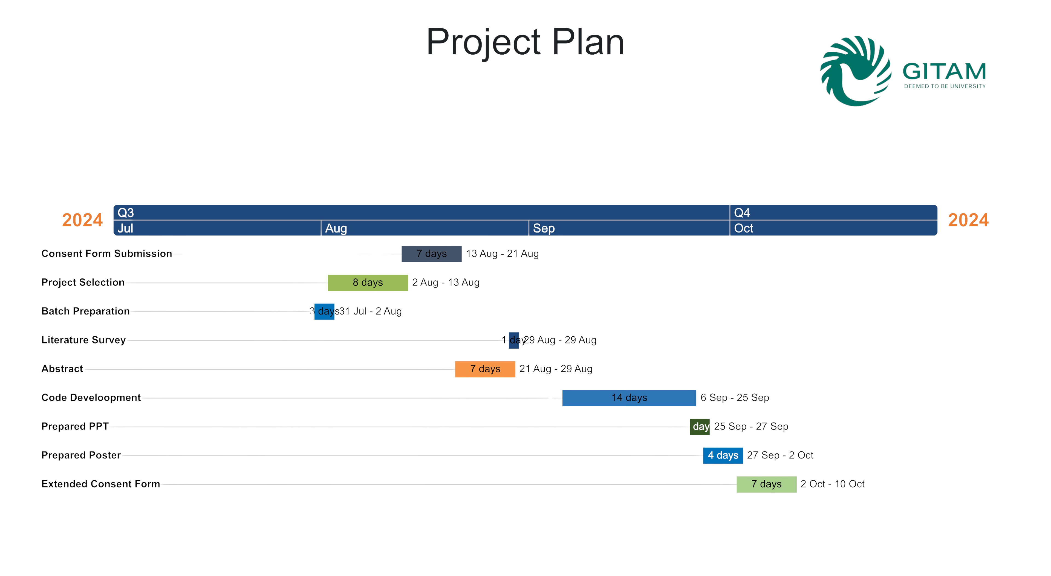
Fig 1

Slide 4
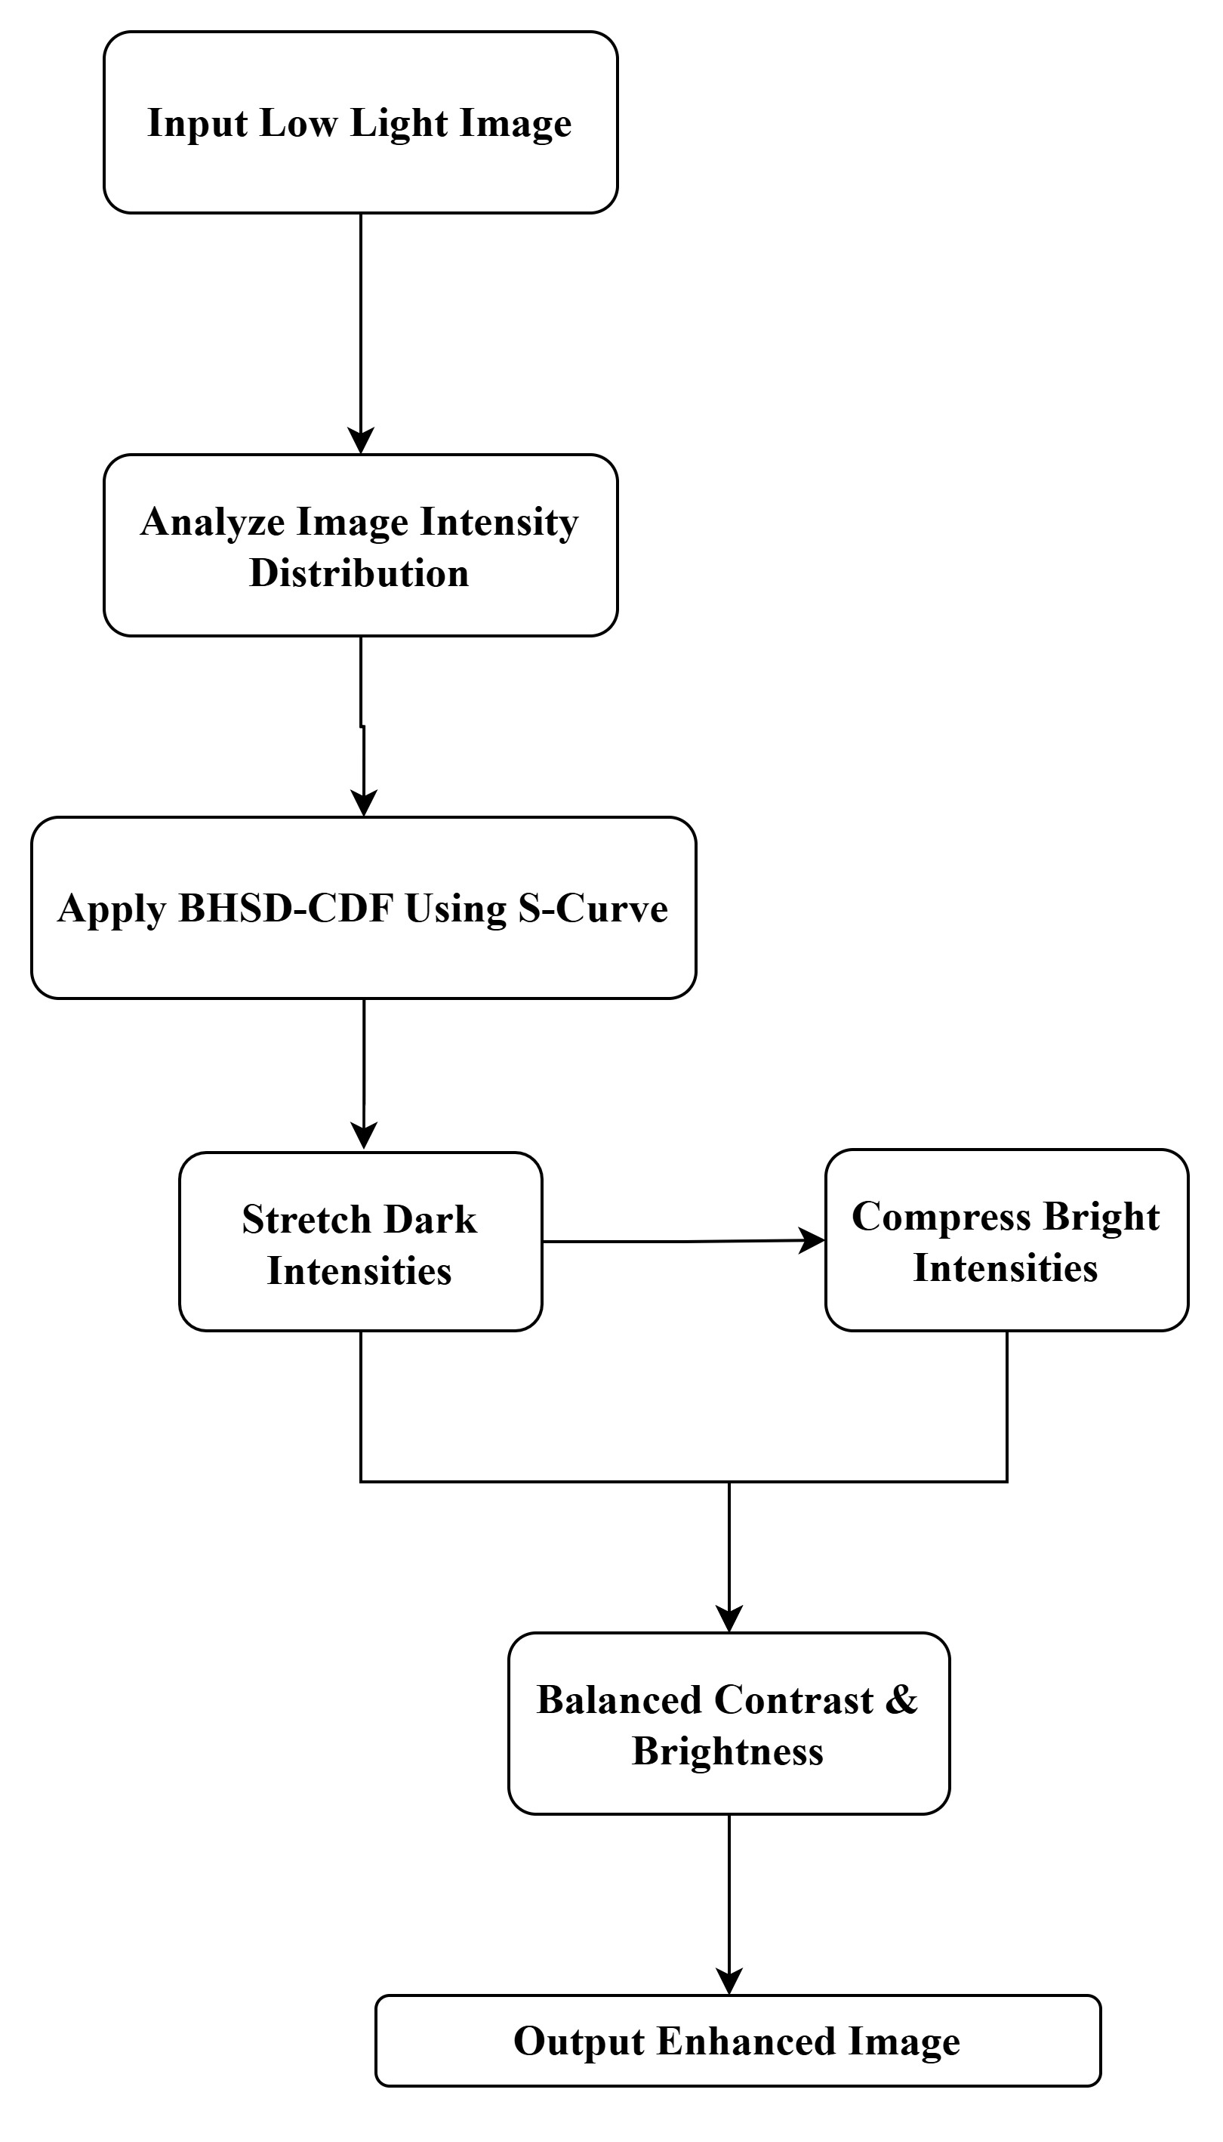
Architecture
Fig 2: Flow Chart

Slide 5
BHSD
Introduction to the Distribution:
The Beta Hyperbolic Secant (BHS) distribution is a flexible probability distribution derived from the hyperbolic secant function.
Combines properties of the beta distribution and the hyperbolic secant distribution, offering tunable shape parameters for diverse applications.
Key Features:
Flexibility: Adjustable shape parameters allow the distribution to model various data patterns, making it suitable for diverse image processing tasks.
Symmetry: The hyperbolic secant component ensures a symmetric probability density function (PDF).
Heavy Tails: Its heavy-tailed nature aids in robust processing by handling outliers effectively.

Slide 6
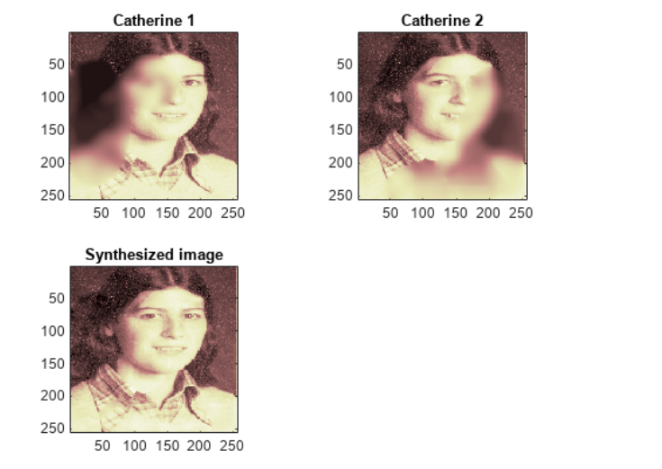
Image Fusion
The principle of image fusion using wavelets is to merge the wavelet decompositions of the two original images using fusion methods applied to approximations coefficients and details coefficients. The two images must be of the same size and are supposed to be associated with indexed images on a common colormap.
Fig 3:Sythesized image shows merged image of Catherine 1 and Catherine 2

Slide 7
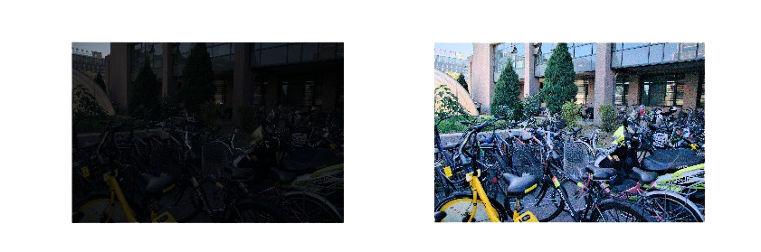
Implementation and Results
Fig 4:Original and Enhanced Image

Slide 8
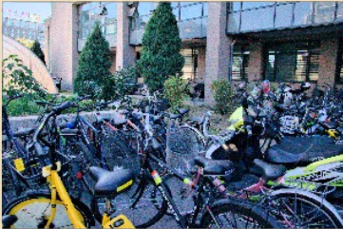
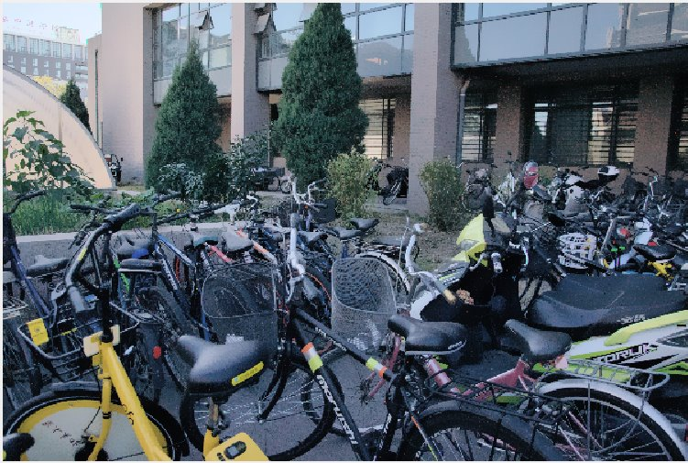
Implementation and Results
Fig 5:Before and After Fusion

Slide 9
Conclusion & Future Work
Summary and Conclusion
The development of the Low-Illumination Image Enhancement Algorithm Based on Retinex Theory marks a significant advancement in the field of low-light image processing. By addressing the inherent challenges of enhancing images captured in poorly lit environments, the algorithm demonstrates superior performance compared to traditional methods and existing literature. In conclusion, this project provides a valuable contribution to the field of image enhancement by presenting a comprehensive approach that combines retinex model with iterative refinement. The results not only advance the understanding of low-light image processing but also pave the way for future innovations in this area.
Future Work
Integration with Deep Learning Techniques: Future research could explore the combination of the physical lighting model with deep learning approaches to enhance computational efficiency and effectiveness. Using convolutional neural networks (CNNs) could automate the process of parameter estimation and improve the algorithm's adaptability to various low-light conditions.
Real-Time Processing Capabilities: Further development could focus on optimizing the algorithm for real-time applications. Techniques such as model pruning, quantization, or utilizing efficient hardware (like GPUs or specialized accelerators) could be explored to reduce computational overhead while maintaining performance.

Slide 10
THANK YOU
Have a Great Day !

