Slide 1





MENTAL HEALTH ASSESMENT
Team :A. MOHAMMED ASIF
asifcolachel@gmail.com
Guide: P. Raja, (Master Trainer, Edunet Foundation)
Disclaimer: The content is curated for educational purposes only.
Notes:
Slides: Prepare a short slide deck (10-12 slides) summarizing the project objectives, methodology, and key results.

Slide 2
OUTLINE
Abstract of the Project
Problem Statement
Proposed Solution
System Architecture
Live Demo of the Project
Embedded Video of Project
Conclusion
Future Scope

Slide 3
Abstract
Depression is a prominent cause of mental illness, which could primarily increase early death. It is possible that this is the root of suicidal ideation, and it causes severe impairment in daily life. By detecting human face traits, artificial intelligence (AI) has cleared the road for predicting human emotions. This predictive technique will be used to conduct a preliminary assessment of depression. Prediction is accomplished using a mixture of four modules namely Facial Emotion Recognition (FER), Scales Questionnaire, Speech Emotion Recognition (SER), and Doctor Chat. FER2013 dataset is used for the FER module, while for speech-based recognition, RAVDESS, TESS, SAVEE, and CREMA-D are collectively used.

Slide 4
Problem Statement
Everyone goes through tough times and that time they feel depressed, anxious, wanting to avoid people, having trouble thinking which ultimately results in mental health disorder like Anxiety, Mood disorder, Panic disorder, Depression, Bipolar disorder, etc. People with these disorders may hesitate to share his/her problems and this can be results in mental depressed situation. Sometimes because of this situation they are about to end their lives.
Mood disorders like depression and anxiety are often underdiagnosed or diagnosed late, limiting timely interventions that can improve patient outcomes. Traditional mental health assessments rely heavily on self-reported symptoms, which may be biased, subjective, or incomplete. There is a growing need for objective and continuous assessment tools that can identify changes in emotional states and enable early detection of mental health conditions.The aim of this project is to develop an AI-based facial expression recognition system that can assess patients' emotional states and monitor mental health conditions in real-time. By using artificial intelligence to analyze subtle changes in facial expressions, this tool would allow for early identification of mood disorders such as depression and anxiety, supporting healthcare providers with valuable insights for timely intervention, potentially leading to more personalized and effective treatment.

Slide 5
Proposed Solution
In order to get rid of this problem , we are providing a simplified web app for Mental Health Assessment. Here we are providing facility to detect disorder using AI technology and on the basis of that particular disorder we are trying to recognized facial emotion of the patient. Depending on the disorder we are providing recommendation about the psychiatrist.Problem Statement: Everyone goes through tough times and that time they feel depressed, anxious, wanting to avoid people, having trouble thinking which ultimately results in mental health disorder like Anxiety, Mood disorder, Panic disorder, Depression, Bipolar disorder, etc. People with these disorders may hesitate to share his/her problems and this can be results in mental depressed situation. Sometimes because of this situation they are about to end their lives. Solution: In order to get rid of this problem , we are providing a simplified web app for Mental Health Assessment. Here we are providing facility to detect disorder using AI technology and on the basis of that particular disorder we are trying to recognized facial emotion of the patient. Depending on the disorder we are providing recommendation about the psychiatrist.

Slide 6
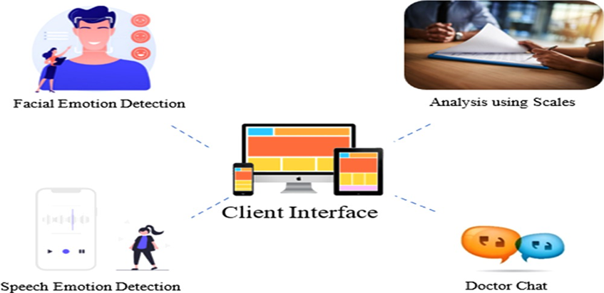
System Architecture

Slide 7
Conclusion
In conclusion, using AI-powered facial recognition for mental health assessment offers a promising, non-intrusive way to analyze emotional and behavioral indicators relevant to mental well-being. By detecting subtle facial expressions, micro-expressions, and other visual cues, such systems can provide valuable insights into an individual’s emotional state, potentially identifying signs of stress, anxiety, depression, or other mental health conditions.However, while the technology holds great potential, it must be applied with care. Ensuring accuracy, minimizing biases, and validating models across diverse demographics are essential to avoid misinterpretation and reinforce trust. Privacy and ethical considerations, including secure data handling and adherence to consent protocols, are paramount to protect users and foster confidence in the technology. Additionally, AI-driven assessments should support, not replace, professional mental health services, serving as a supplementary tool to guide care rather than a standalone diagnostic method.

Slide 8
Future Scope
Future systems will benefit from increasingly large and diverse datasets, which will help models recognize and interpret expressions across various ethnicities, age groups, and cultural backgrounds more accurately, reducing biases.
Integrating facial recognition with other data sources, such as speech, physiological signals (e.g., heart rate), or behavioral patterns, can enhance accuracy by providing a more comprehensive view of an individual’s mental state.
Facial recognition integrated into wearables, such as smart glasses or health monitoring devices, could allow real-time mental health assessments, alerting users and caregivers to emotional changes instantly.
AI could be embedded in virtual health assistants that provide 24/7 support, guidance, and encouragement, potentially decreasing the demand for in-person sessions and expanding access to care.

Slide 9
Thank you!
Notes:
thank you very much for joining this PPT, keep learning.
9

