Slide 1
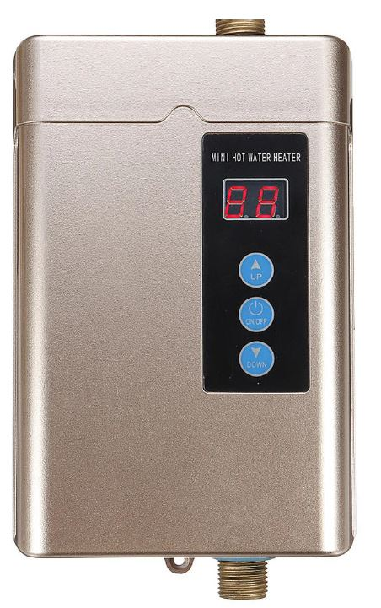

Swift Act Internship Project
Project Name : Electric Water Heater
Name : Mohamed Ahmed Awwad

Slide 2
Hardware
Hardware Configuration
Microcontroller | PIC16F877A
Simulation Tool | PICSimLabv0.8 PICGenios
Crystal Frequency | 8 MHz
Compiler | XC8
Hardware Mapping
ON/OFF Button | PORTB - PIN1
Up Button | PORTB - PIN2
Down Button | PORTB - PIN0
Heater Led | PORTB - PIN7

Slide 3
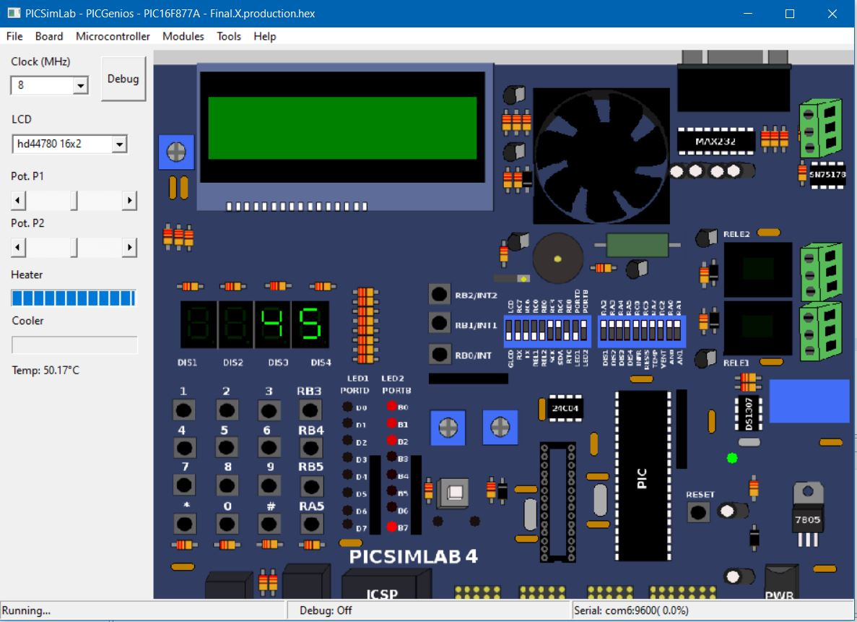
Kit Snapshot
Heater
Up Button
Cooler
ON/OFF Button
Current Water
Temperature
Down Button
External
EEPROM
7-Segment
Display
Heater LED

Slide 4
Static Design
a
fElectric Water Heater
Application
Service Layer
Scheduler
HAL
External EEPROM
Button
LED
Heater
Cooler
SSD
Temp Sensor
MCAL
I2C
DIO
ADC
Timer

Slide 5
Static Architecture
Electric Water Heater
Scheduler
Temperature Control
Heater
Cooler
SSD Display
ON/OFF Button
Heater Element
UP Button
Button
Scheduling
SSD
Button States
Cooler Element
Down Button
Button States
Heater Element
LED
Temperature Sensor
External
EEPROM
EEPROM
R/W
Temperature Display
Temperature

Slide 6
Detailed Design
Scheduler
SCH_Init_T1
SCH_Update
SCH_Add_Task
SCH_Dispatch_Tasks
SCH_Start
SCH_Sleep
SSD
SSD_Init
SSD_Update
SSD_Display_Current_Temp
SSD_Flash
SSD_Display_Set_Point_Temp
SSD_Display_OFF
Button
Button_Init
Button_Update
Heater
Heater_Init
Heater_Update
LED
LED_Init
LED_Toggle
Cooler
Cooler_Init
Cooler_Update
External_EEPROM
EPPROM_Init
EEPROM_Read
EEPROM_Write

Slide 7
System State Machine
ON/OFF Button is pressed and released / System ON
Up or Down Button is pressed
System
OFF
Normal
Mode
Setting
Mode
ON/OFF Button is pressed and released / System OFF
After 5 sec with press any button
ON/OFF Button is pressed and released / System OFF

Slide 8
Display State Machine
Up or Down Button is pressed
Current water Temp
at set point Temp interval
Up or Down Button is pressed
SSD
Display
Current
Temp
SSD Display Set point
Temp
SSD Flash
Set point
Temp
After 5 sec with press any button
+ current water Temp at set point Temp interval
After 5 sec without press any button
+ current water Temp out of set point Temp interval

Slide 9
On/Off Button State Machine
ON
ON/OFF Button is pressed / System OFF
ON/OFF Button is Released / System ON
OFF
Wait
ON
Wait
OFF
ON/OFF Button is Released / System OFF
ON/OFF Button is pressed / System OFF

Slide 10
Temperature State Machine
(Current Water Temp < Set Point Temp ) and flag=1
/ (Heater & LED) ON (Cooler ) OFF
(Current Water Temp < Set Point Temp +5) and flag=1
/ (Heater & LED) ON (Cooler) OFF
OFF
Wait
Set Point Temp
+5
Set Point Temp
-5
Set Point
Temp
(Current Water Temp < Set Point Temp ) and flag=0
/ (Heater & LED) OFF (Cooler ) ON
(Current Water Temp < Set Point Temp+5 ) and flag=0
/ (Heater & LED) OFF (Cooler ) ON

Slide 11
Time Analysis
TASK | Actions | BCET(ms) | WCET(ms) | Period of Action(ms) | Period of Task(ms)
SSD_Update | Update SSD Display | ~0 | ~0 | 10 | 10
Temp_Get | Update Temperature sample | ~0 | ~0 | 100 | 100
Button_Update | Update System State Update SSD State | ~0 | ~0 | 150 | 150
Temp_Update | Update LED , Cooler , Heater State Update EEPROM | ~0 | ~0 | 1000 | 1000
Tick(ms) |  |  |  |  | 10
Major Cycle (ms) |  |  |  |  | 1000

Slide 12
Schedulability Check
SSD_Update Task @10 ms
Button_Update Task @150 ms
Temp_Get Task @100 ms
Temp_Update Task @1000 ms
Time
(Tick)
0
10
20
30
40
50
60
70
80

Slide 13
Schedulability Check
SSD_Update Task @10 ms
Button_Update Task @150 ms
Temp_Get Task @100 ms
Temp_Update Task @1000 ms
Time
(200ms)
0
200
400
600
800
1000
1200
1400
1600

Slide 14

Contacts
Phone : 01141919874
Email : mohameda.awwad@yahoo.com
LinkedIn : www.linkedin.com/in/mohammed-awwad/

