Slide 1
Suicide Rate Worldwide
Team members
Nikhil Desai
Mohammed Bharmal

Slide 2
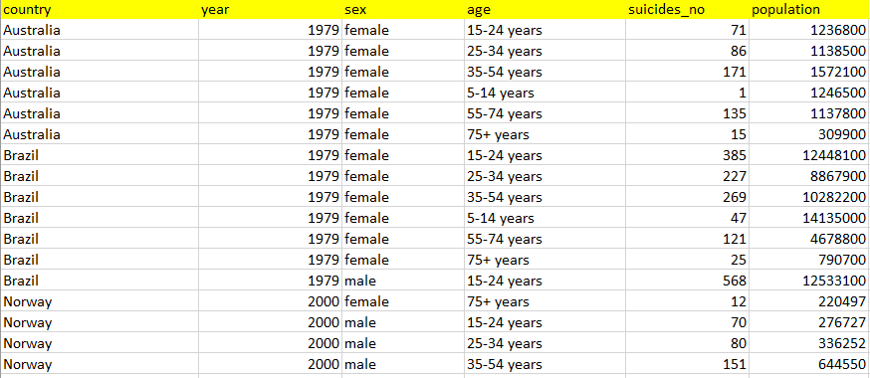
Dataset
2013 | Canada | USA
Population | 35 Million | 315 Million
No. of suicides | 4054 | 41143
Suicide rate per 100k | 11.58 | 13.06
Source: World Health Organization (WHO)

Slide 3
Inspiration and Idea
Worldwide close to 800,000 people die due to suicide every year. which is one person every 40 seconds.
More people die from suicide than other common death causes like drug use, poison, terrorism, natural disasters.
We think suicide is a condition that can be prevented by taking the necessary actions.
National Suicide Prevention Lifeline is a body that works towards the goal of reducing suicides.
It is essential to know the specific people, their geographic location, Age group, gender that are at high risk of suicide.
Once we have this data, it will be easy for the National Suicide Prevention community to help such people.
This is our sincere effort to put down our work in data visualization, contribute to our community, and address a social issue.

Slide 4
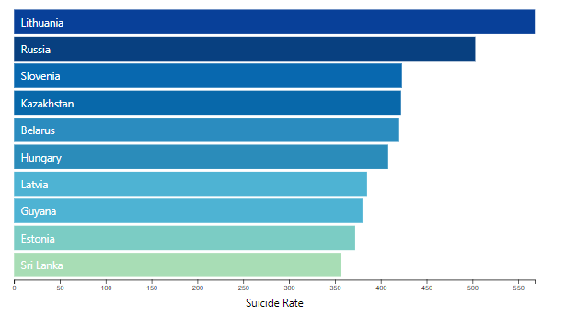
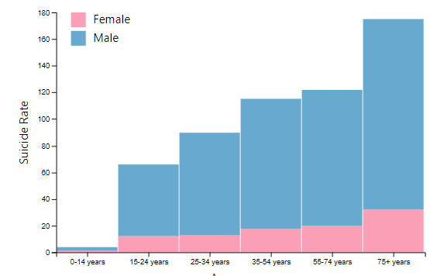
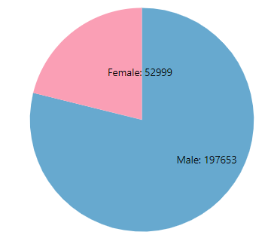
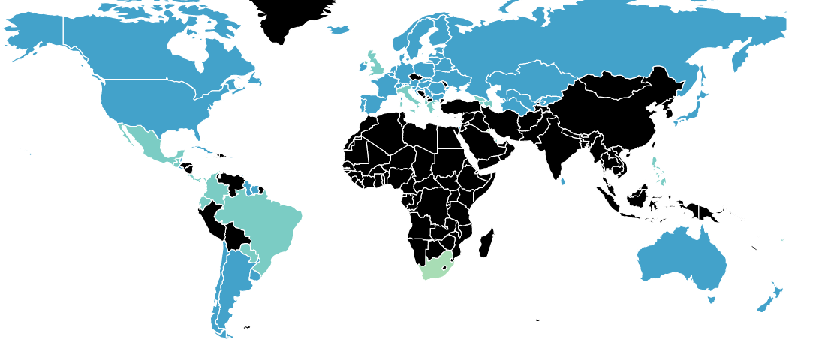
Website
http://mohammedbharmal.github.io/suicide_rate_worldwide

Slide 5

Website Demo

