Slide 1
Introduction
Agriculture plays a crucial role in sustaining human life by providing food, fiber, and other essential resources. However, agricultural productivity is constantly threatened by various pests that can cause significant crop damage and economic losses. Detecting and managing these pests is essential for ensuring crop health, maximizing yields, and maintaining food security.
The primary objective of this presentation is to showcase the potential of machine learning in aiding pest detection in agriculture. By leveraging the Agricultural Pest Image Dataset and advanced machine learning techniques, we aim to demonstrate how artificial intelligence can assist farmers and agricultural practitioners in identifying and mitigating pest infestations more efficiently.

Slide 2
Dataset Overview
Dataset Description:
The Agricultural Pest Image Dataset is a collection of images of 12 different types of agricultural pests, namely Ants, Bees, Beetles, Caterpillars, Earthworms, Earwigs, Grasshoppers, Moths, Slugs, Snails, Wasps, and Weevils. The images were obtained from Flickr using the API and were resized to have a maximum width or height of 300px.
There are 5494 images in the dataset.
This project aims to develop and evaluate machine learning models for agricultural pest classification using the Agricultural Pest Image Dataset.

Slide 3
Project WORKFLOW
Data Preprocessing:
Resize: Ensuring uniform image dimensions for consistency and computational efficiency.
Center Crop: Removing unnecessary borders or background noise to focus on the central region of interest.
Normalize: Standardizing pixel values to a consistent range for improved model convergence.
Model selection: Here we are using Simple CNN, DesNet 121, ResNet 50, and MobileNetV2.
Model evaluation: Evaluate the performance of the model with respect to measures like Confusion Matrix, F1 score, Accuracy, Precision, and Recall.
Prediction: To valiate the model on the test dataset and discuss the model's capacity to generalize on untested data and report the final metrics.

Slide 4
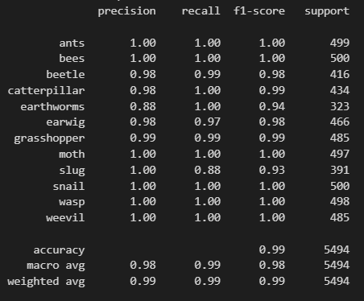
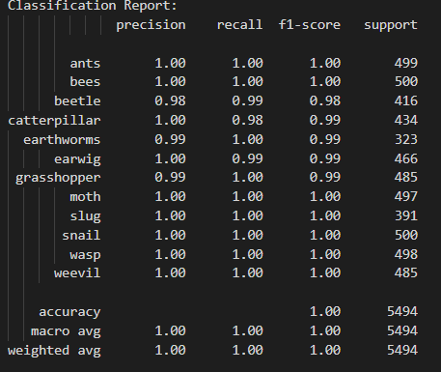
REnet 50
Denet121
Architecture:
Loads a Pretrained ResNet-50 model and retrieves the number of input features for its fully connected layer.
The model's architecture consists of multiple fully connected layers with ReLU activation and dropout.
It trains the model for 50 epochs, and the number of layers (20 layers) are notable.
Classification Report:
Architecture:
Loads a pretrained DenseNet121 model and modifies its classifier to match the number of classes in the dataset.
Number of epochs = 20, Loss = CrossEntropyLoss.
Within each epoch, it iterates over training data, performs forward and backward passes, updates model parameters, and computes training loss and accuracy.
Classification Report:

Slide 5
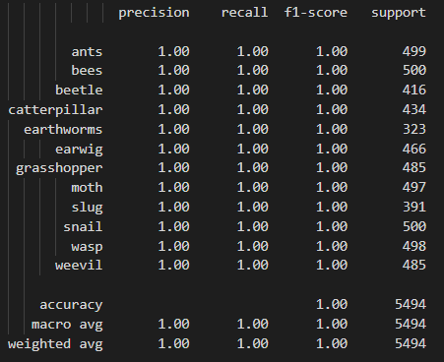
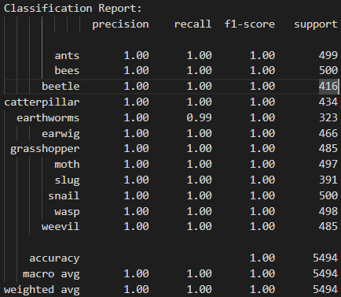
Simple cnn
MobileNet-v2
Architecture:
It consists of three convolutional layers with ReLU activation followed by max-pooling layers and two fully connected layers.
Number of epochs = 20, Loss = CrossEntropyLoss.
Exponential learning rate scheduler is defined with a decay factor (gamma) of 0.9.
Classification Report:
Architecture:
Loads a pretrained MobileNetV2 model and modifies its classifier to match the number of classes in the dataset.
Number of epochs = 10, Loss = CrossEntropyLoss.
Adam optimizer is used to optimize the model parameters with a learning rate of 1e-4.
Classification Report:

Slide 6
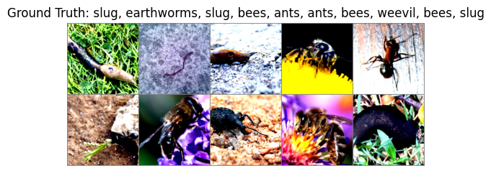
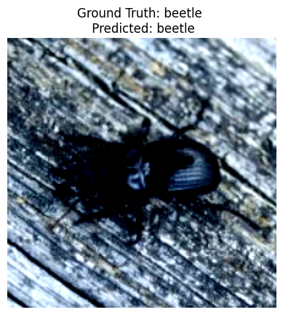
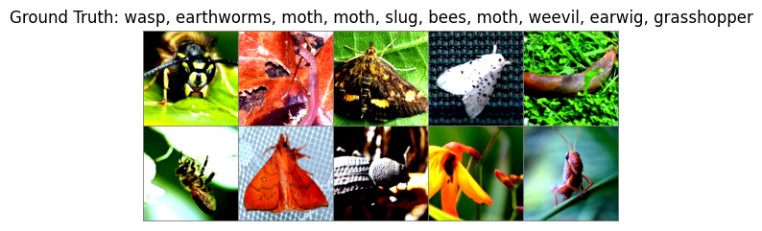
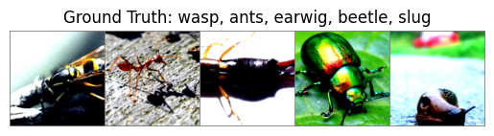
Prediction
DesNet121
ResNet50
MobileNet V2
Simple CNN

Slide 7
Conclusion
In conclusion, the classification reports demonstrate the performance of four different models trained on the agricultural pests dataset. Overall, all models achieve outstanding results with an accuracy of 1.00, indicating perfect classification across all classes. This suggests that each model effectively learns the distinguishing features of the agricultural pests, resulting in precise identification and classification. Therefore, based on these classification reports, we can conclude that all models exhibit excellent performance in accurately classifying agricultural pests, making them suitable for practical deployment in pest detection systems.

Slide 8
Real Time Appication
Early Detection: Enables swift identification of pest infestations, allowing farmers to take immediate action to prevent crop damage.
Precision Agriculture: Facilitates targeted pest management strategies, reducing costs and minimizing environmental impact by applying treatments only where necessary.
Automated Monitoring: Integration into automated systems provides continuous crop health monitoring, offering instant feedback to farmers.
IoT and AI Integration: Combining real-time detection with IoT and AI technologies enhances scalability and effectiveness in pest management.
Yield and Quality Enhancement: Ultimately leads to improved crop yield and quality by mitigating pest damage and optimizing production processes.

Slide 9
Thank you!

