Slide 1
SPARK SQL

Slide 2
Spark SQL is a module in Apache Spark designed for structured data processing. It provides a programming interface for data manipulation using SQL queries, DataFrame APIs, and integrates seamlessly with Spark's distributed processing capabilities.
Spark SQL unifies relational processing with Spark's functional programming API, offering users a flexible and powerful way to analyze structured and semi-structured data.

Slide 3
Some key features and concepts related to Spark SQL:
1) DataFrame: Spark SQL introduces the DataFrame abstraction, which is a distributed collection of data organized into named columns. DataFrames can be created from various sources such as structured data files (e.g., Parquet, Avro, ORC), Hive tables, external databases, or existing RDDs (Resilient Distributed Datasets).
2) SQL Queries: Spark SQL allows you to execute SQL queries on your DataFrame data. You can register a DataFrame as a temporary SQL table or view and then query it using standard SQL syntax.

Slide 4
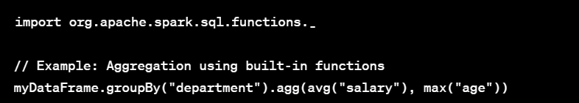
3) Hive Integration: Spark SQL provides seamless integration with Apache Hive, allowing you to query Hive tables and use Hive's rich ecosystem of UDFs (User-Defined Functions).
4) Built-in Functions: Spark SQL includes a variety of built-in functions for common data manipulation tasks, similar to traditional SQL databases.

Slide 5
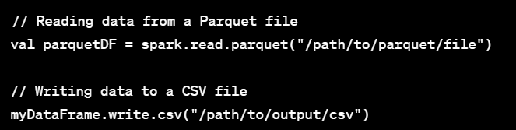
5) Data Sources and Formats: Spark SQL supports various data sources and file formats for reading and writing data. Some of the supported formats include Parquet, Avro, JSON, CSV, and more.
6) Catalyst Optimizer: Spark SQL uses the Catalyst optimizer to optimize and execute query plans. This helps in improving the performance of queries by optimizing the physical execution plan.

Slide 6
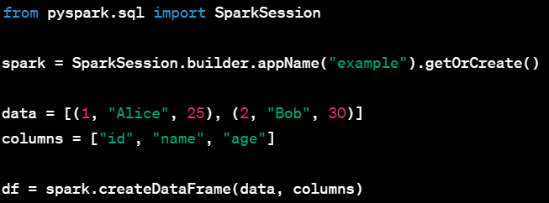
Basic commands
1) Creating a dataframe:
In PySpark, we use the createDataFrame method to create a DataFrame from an existing Python list of tuples, specifying column names.

Slide 7


Basic commands
2) Viewing DataFrame Schema:
The printSchema method is used to display the schema of the DataFrame, which includes the data types and nullable information for each column.
3) Displaying DataFrame Contents:
The show method is used to display the contents of the DataFrame in a tabular format. By default, it shows the first 20 rows.

Slide 8


Basic commands
4) Registering DataFrame as a Temporary Table:
The createOrReplaceTempView method registers the DataFrame as a temporary table with the specified name, allowing SQL queries on it.
5) Running SQL Queries:
The spark.sql method is used to execute SQL queries on registered tables/views. In this example, it selects all columns from the registered table "myTable" where the age is greater than 25.

Slide 9
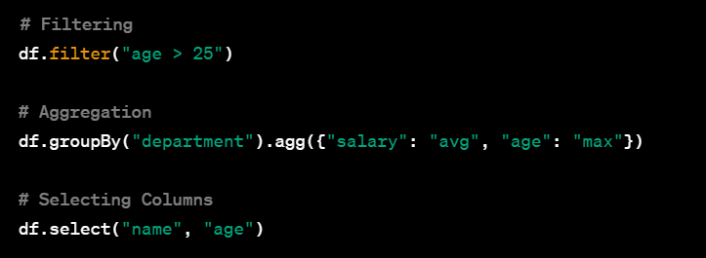
Basic commands
6) Basic DataFrame Operations:
These are basic DataFrame operations. Filtering is performed using the filter method, aggregation using the groupBy and agg methods, and column selection using the select method.

Slide 10
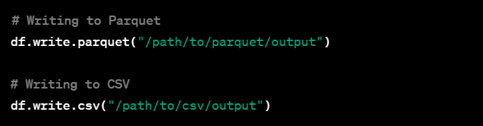
Basic commands
7) Writing Data to a Data Sink:
The write method is used to persist the DataFrame to an external storage system. In these examples, we write the DataFrame to Parquet and CSV formats.

Slide 11


Basic commands
8) Caching DataFrame:
The cache method is used to persist the DataFrame in memory for faster access. It is beneficial when you plan to reuse the DataFrame multiple times.
9) Removing DataFrame from Cache:
The unpersist method is used to remove the DataFrame from the cache, freeing up the memory it occupied.

Slide 12

Basic commands
10) Query Execution :
The explain method is used to display the physical plan and optimization steps undertaken by Spark for executing the given query.

Slide 13
Case Study 1
Doing analysis of data of customers who have ordered food.
The table is having
Order id
Food type
Month ordred (months jan, feb, march and april have been taken)
Customer name
Rating given by them out of 5

Slide 14
SerialNumber,FoodItemOrdered,Month,CustomerName,Rating
1,Indian,January,Ram,4
2,American,January,John,3
3,Chinese,February,Seth,5
4,Italian,February,Shyam,2
5,Mexican,February,Micheal,4
6,Indian,March,Tom,5
7,American,March,Robert,3
8,Chinese,March,Dwayne,2
9,Italian,April,Raj,4
10,Mexican,January,Chris,1
11,Indian,January,Ram,5
12,American,February,John,3
13,Chinese,February,Seth,4
14,Italian,February,Shyam,2
15,Mexican,March,Micheal,5
16,Indian,March,Tom,4
17,American,March,Robert,3
18,Chinese,January,Dwayne,1
19,Italian,April,Raj,4
20,Mexican,April,Chris,2
21,Indian,April,Ram,3
22,American,January,John,4
23,Chinese,February,Seth,5
24,Italian,February,Shyam,1
25,Mexican,February,Micheal,3
26,Indian,March,Tom,2
27,American,March,Robert,4
28,Chinese,March,Dwayne,5
29,Italian,April,Raj,3
30,Mexican,April,Chris,4
31,Indian,April,Ram,5
32,American,January,John,2
33,Chinese,February,Seth,4
34,Italian,February,Shyam,3
35,Mexican,February,Micheal,1
36,Indian,March,Tom,4
37,American,March,Robert,5
38,Chinese,March,Dwayne,2
39,Italian,April,Raj,3
40,Mexican,April,Chris,4
41,Indian,April,Ram,5
42,American,January,John,2
43,Chinese,February,Seth,4
44,Italian,February,Shyam,3
45,Mexican,February,Micheal,1
46,Indian,March,Tom,4
47,American,March,Robert,5
48,Chinese,March,Dwayne,2
49,Italian,April,Raj,3
50,Mexican,April,Chris,4
51,Indian,April,Ram,5
52,American,January,John,2
53,Chinese,February,Seth,4
54,Italian,February,Shyam,3
55,Mexican,February,Micheal,1
56,Indian,March,Tom,4
57,American,March,Robert,5
58,Chinese,March,Dwayne,2
59,Italian,April,Raj,3
60,Mexican,April,Chris,4
61,Indian,April,Ram,5
62,American,January,John,2
63,Chinese,February,Seth,4
64,Italian,February,Shyam,3
65,Mexican,February,Micheal,1
66,Indian,March,Tom,4
67,American,March,Robert,5
68,Chinese,March,Dwayne,2
69,Italian,April,Raj,3
70,Mexican,April,Chris,4
71,Indian,April,Ram,5
72,American,January,John,2
73,Chinese,February,Seth,4
74,Italian,February,Shyam,3
75,Mexican,February,Micheal,1
76,Indian,March,Tom,4
77,American,March,Robert,5
78,Chinese,March,Dwayne,2
79,Italian,April,Raj,3
80,Mexican,April,Chris,4
81,Indian,April,Ram,5
82,American,January,John,2
83,Chinese,February,Seth,4
84,Italian,February,Shyam,3
85,Mexican,February,Micheal,1
86,Indian,March,Tom,4
87,American,March,Robert,5
88,Chinese,March,Dwayne,2
89,Italian,April,Raj,3
90,Mexican,April,Chris,4
91,Indian,April,Ram,5
92,American,January,John,2
93,Chinese,February,Seth,4
94,Italian,February,Shyam,3
95,Mexican,February,Micheal,1
96,Indian,March,Tom,4
97,American,March,Robert,5
98,Chinese,March,Dwayne,2
99,Italian,April,Raj,3
100,Mexican,April,Chris,4
101,Indian,April,Ram,5
102,American,January,John,2
103,Chinese,February,Seth,4
104,Italian,February,Shyam,3
105,Mexican,February,Micheal,1
106,Indian,March,Tom,4
107,American,March,Robert,5
108,Chinese,March,Dwayne,2
109,Italian,April,Raj,3
110,Mexican,April,Chris,4
111,Indian,April,Ram,5
112,American,January,John,2
113,Chinese,February,Seth,4
114,Italian,February,Shyam,3
115,Mexican,February,Micheal,1
116,Indian,March,Tom,4
117,American,March,Robert,5
118,Chinese,March,Dwayne,2
119,Italian,April,Raj,3
120,Mexican,April,Chris,4
121,Indian,April,Ram,5
122,American,January,John,2
123,Chinese,February,Seth,4
124,Italian,February,Shyam,3
125,Mexican,February,Micheal,1
126,Indian,March,Tom,4
127,American,March,Robert,5
128,Chinese,March,Dwayne,2
129,Italian,April,Raj,3
130,Mexican,April,Chris,4
131,Indian,April,Ram,5
132,American,January,John,2
133,Chinese,February,Seth,4
134,Italian,February,Shyam,3
135,Mexican,February,Micheal,1
136,Indian,March,Tom,4
137,American,March,Robert,5
138,Chinese,March,Dwayne,2
139,Italian,April,Raj,3
140,Mexican,April,Chris,

Slide 15
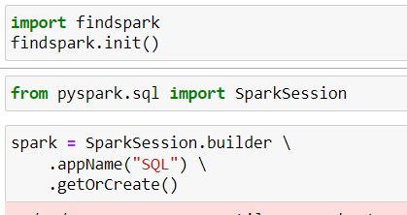

Creating a table locally

Slide 16
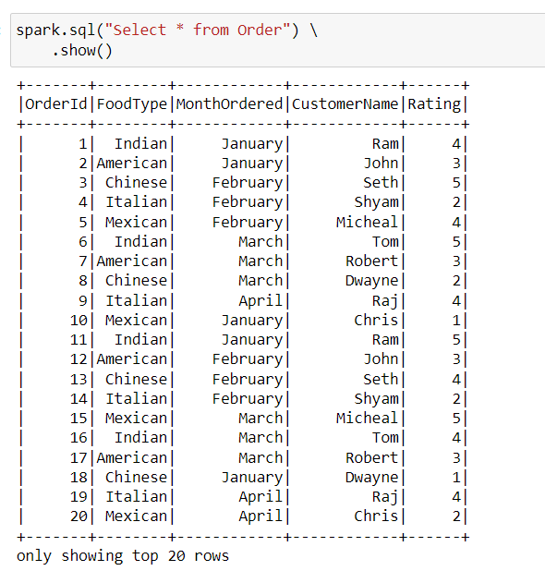
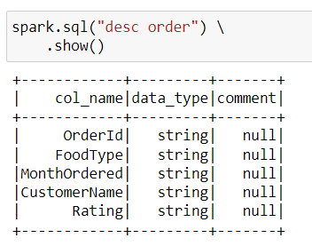
Description and select *

Slide 17
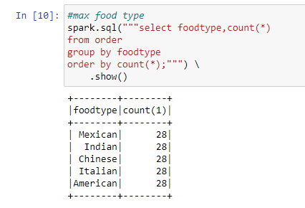
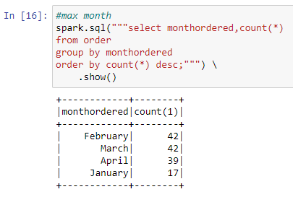
Count of orders wrt
Food type
Month ordered

Slide 18
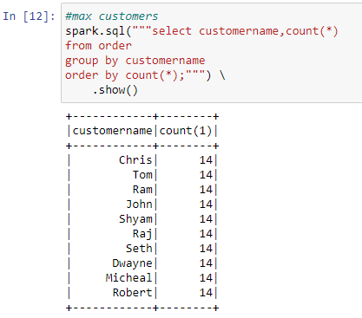
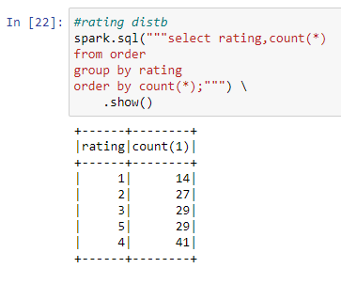
Count of orders wrt
Customer name
rating

Slide 19
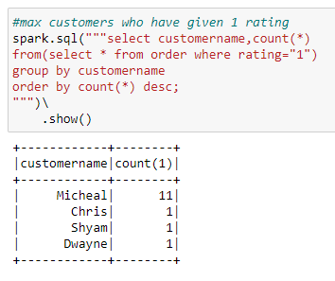
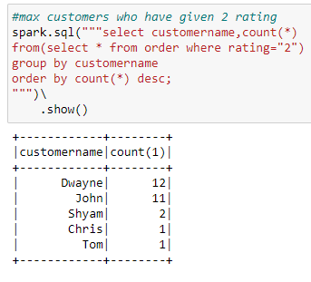
Customers giving a rating of
1
2

Slide 20
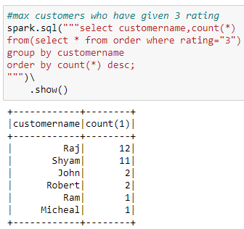
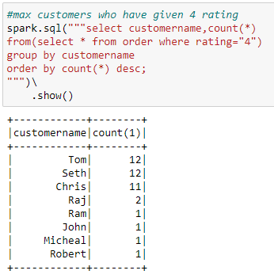
Customers giving a rating of
3
4

Slide 21
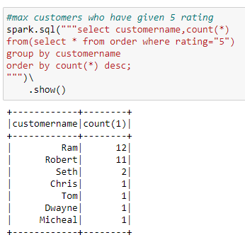
Customers giving a rating of
5

Slide 22
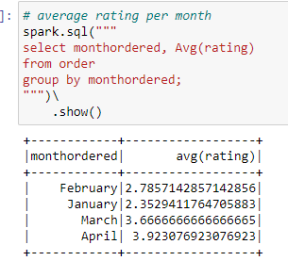
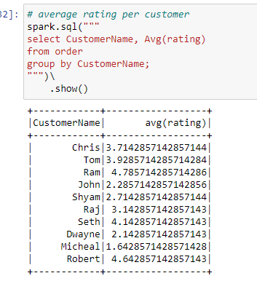
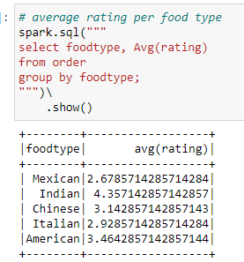
Average rating given wrt
Month ordered
Food type
customer

Slide 23
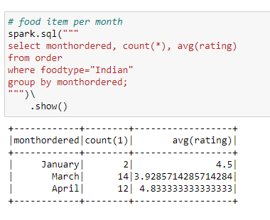
Orders by indian food type
Count of orders given per month and their rating month wise.

Slide 24
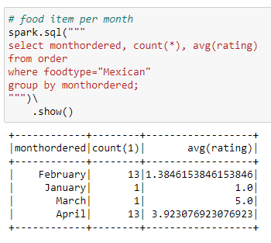
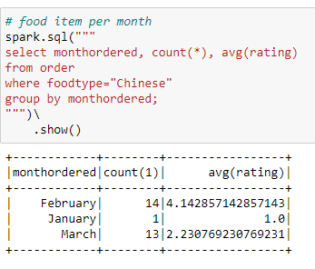
Orders by mexican and chinese food type
Count of orders given per month and their rating month wise.

Slide 25
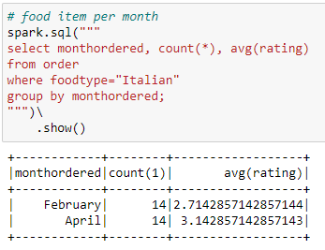
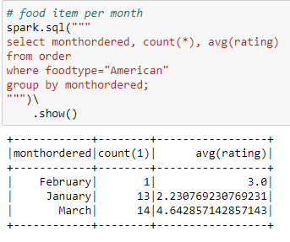
Orders by italian and american food type
Count of orders given per month and their rating month wise.

Slide 26
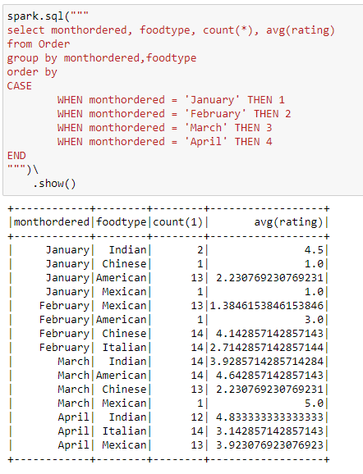
month wise orders and their count and average rating

Slide 27
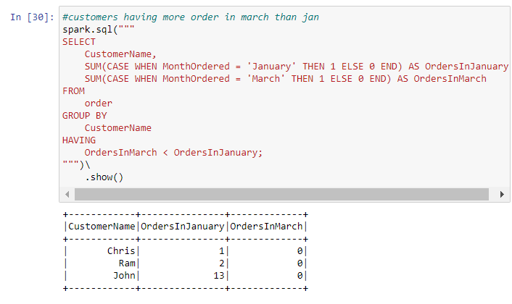
Customers who have given more orders in jan than march
Meaning their have been a reduction in orders by that customer

Slide 28
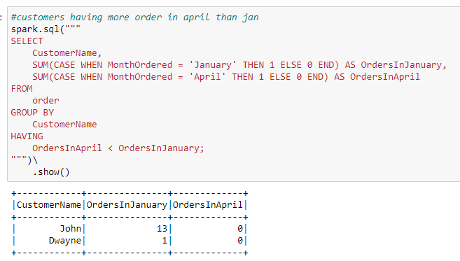
Customers who have given more orders in jan than april
Meaning their have been a reduction in orders by that customer

Slide 29
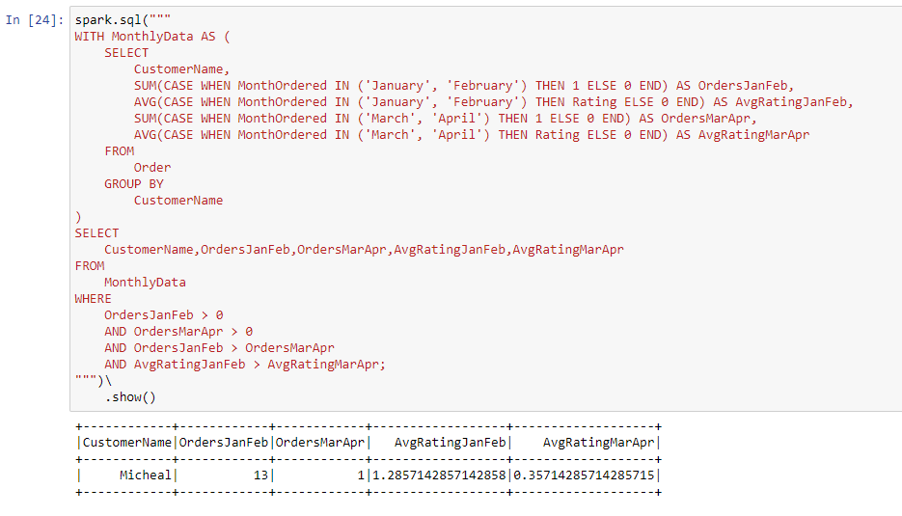
We can also find the customer who can stop using this business
I tried to find these customers by finding who have ordered less in 2nd half as compared to 1st half and whose average rating has decreased from 1st half to 2nd half
Here 1st half is taken as January and February and 2nd half is taken as March and April.

Slide 30
Case Study 2
Doing analysis of data of Books in a Book Store.
Columns in the table are :
Id
Title
Author
Genre
Price

Slide 31
id,title,author,genre,price
1,The Great Gatsby,F. Scott Fitzgerald,Fiction,10.99
2,To Kill a Mockingbird,Harper Lee,Fiction,12.99
3,1984,George Orwell,Science Fiction,15.99
4,The Catcher in the Rye,J.D. Salinger,Fiction,11.99
5,The Hobbit,J.R.R. Tolkien,Fantasy,18.99
6,The Da Vinci Code,Dan Brown,Mystery,14.99
7,Harry Potter and the Sorcerer's Stone,J.K. Rowling,Fantasy,20.99
8,The Hunger Games,Suzanne Collins,Science Fiction,16.99
9,The Lord of the Rings,J.R.R. Tolkien,Fantasy,25.99
10,The Shining,Stephen King,Horror,13.99
11,Brave New World,Aldous Huxley,Science Fiction,14.49
12,The Alchemist,Paulo Coelho,Fiction,12.50
13,One Hundred Years of Solitude,Gabriel Garcia Marquez,Magic Realism,14.99
14,The Hitchhiker's Guide to the Galaxy,Douglas Adams,Science Fiction,11.00
15,Pride and Prejudice,Jane Austen,Romance,9.99
16,The Road,Cormac McCarthy,Dystopian Fiction,13.49
17,The Martian,Andy Weir,Science Fiction,16.50
18,The Girl on the Train,Paula Hawkins,Thriller,15.00
19,A Song of Ice and Fire: A Game of Thrones,George R.R. Martin,Fantasy,22.99
20,The Silent Patient,Alex Michaelides,Thriller,17.50
21,The Old Man and the Sea,Ernest Hemingway,Adventure,11.99
22,The Picture of Dorian Gray,Oscar Wilde,Classics,12.99
23,The Kite Runner,Khaled Hosseini,Fiction,14.75
24,The Road Less Traveled,M. Scott Peck,Self-Help,10.50
25,The Secret Garden,Frances Hodgson Burnett,Children's Literature,8.99
26,The Color Purple,Alice Walker,Fiction,13.25
27,Sapiens: A Brief History of Humankind,Yuval Noah Harari,History,19.99
28,The Brothers Karamazov,Fyodor Dostoevsky,Classics,15.99
29,The Wind in the Willows,Kenneth Grahame,Children's Literature,9.50
30,The Great Expectations,Charles Dickens,Classics,12.25

Slide 32
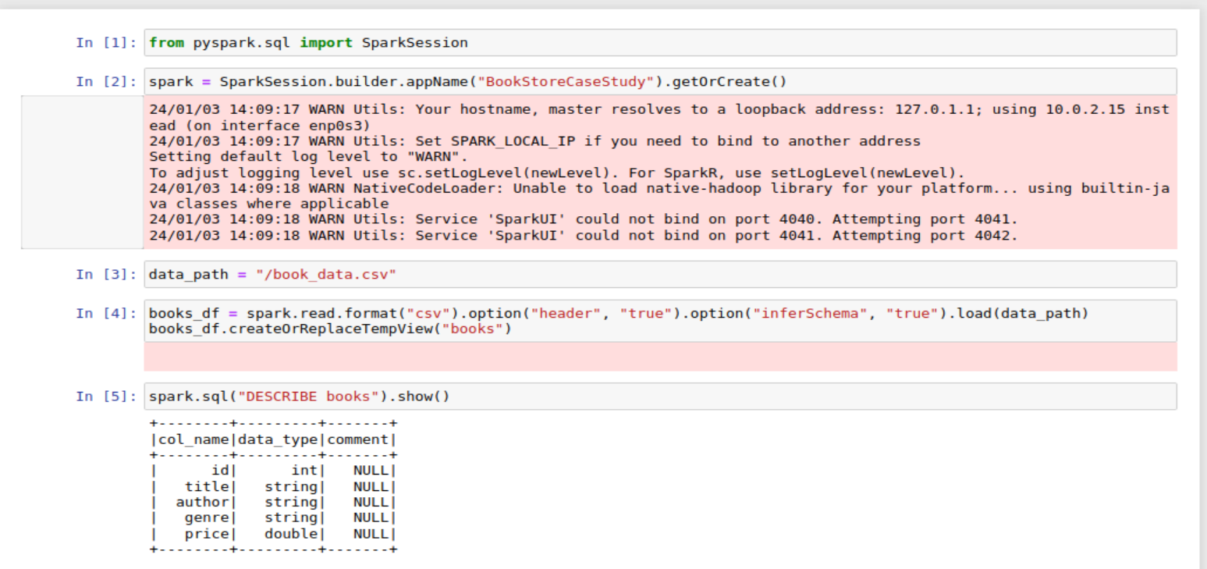
Creating a spark session and importing the csv file.
Reading the csv file and creating a temporary view.

Slide 33
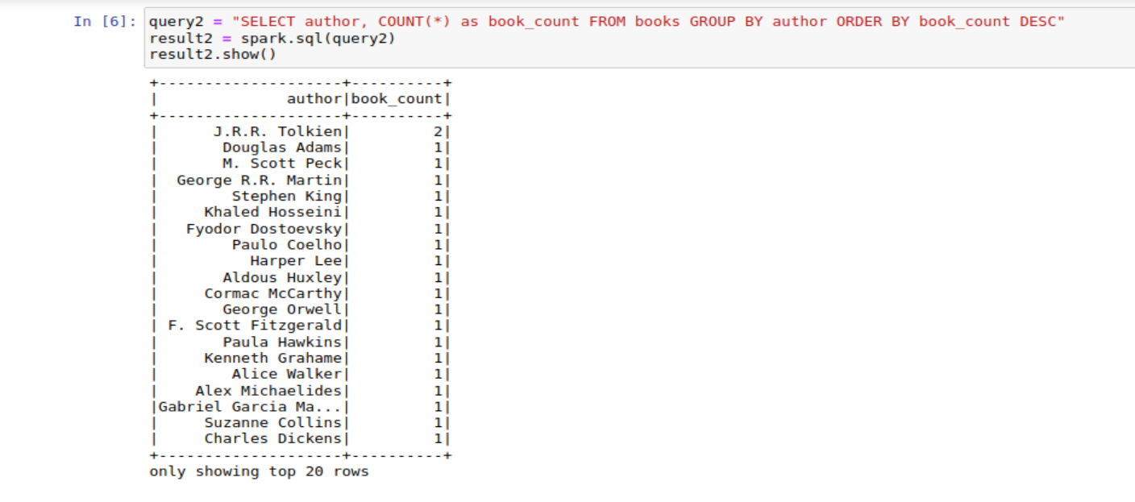
Printing the list of unique authors and the number of books per author.

Slide 34
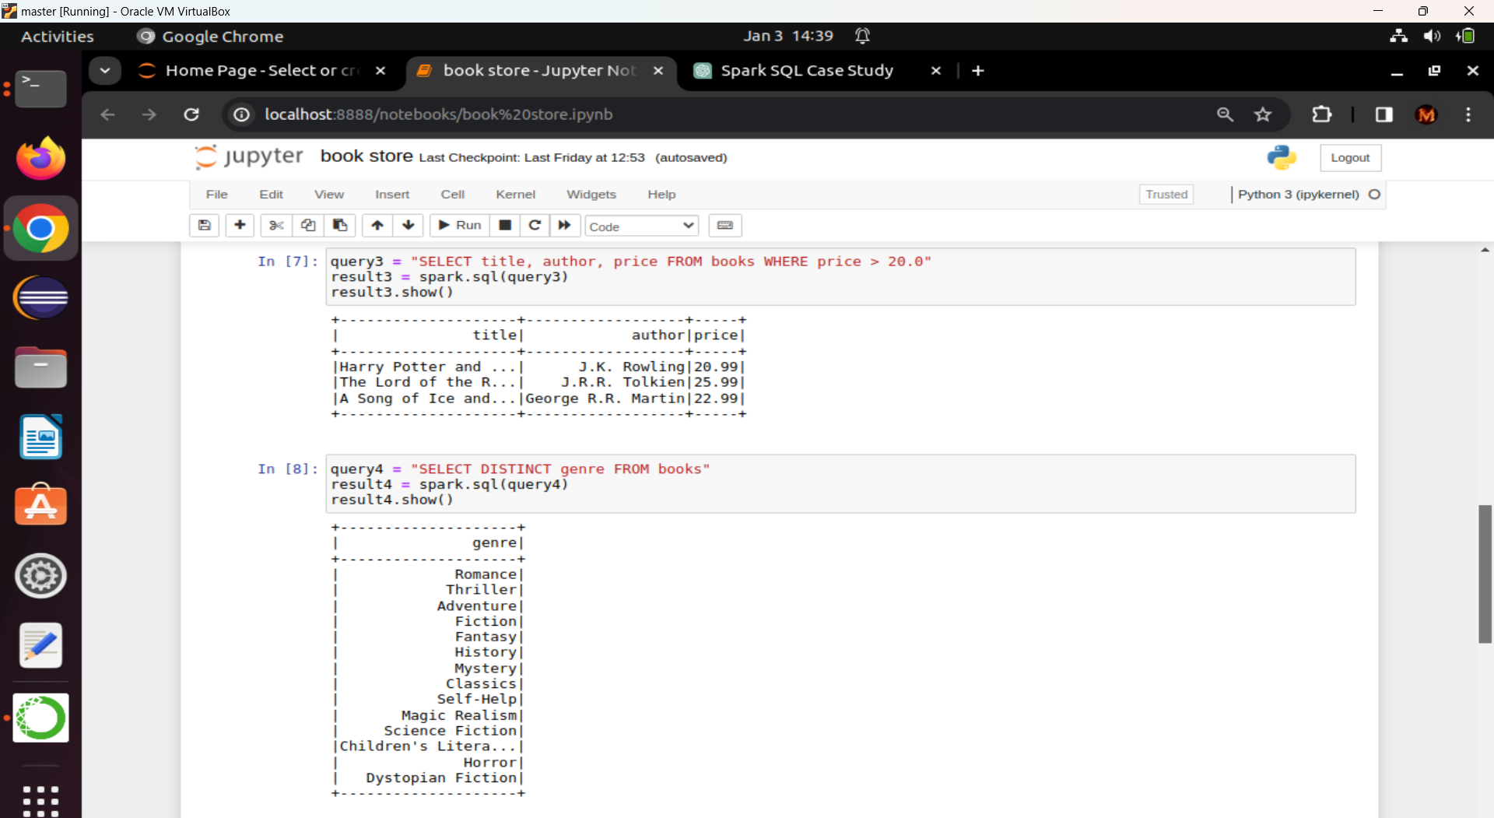
Filtering the table based on price.
Printing all unique genres in the table.

Slide 35
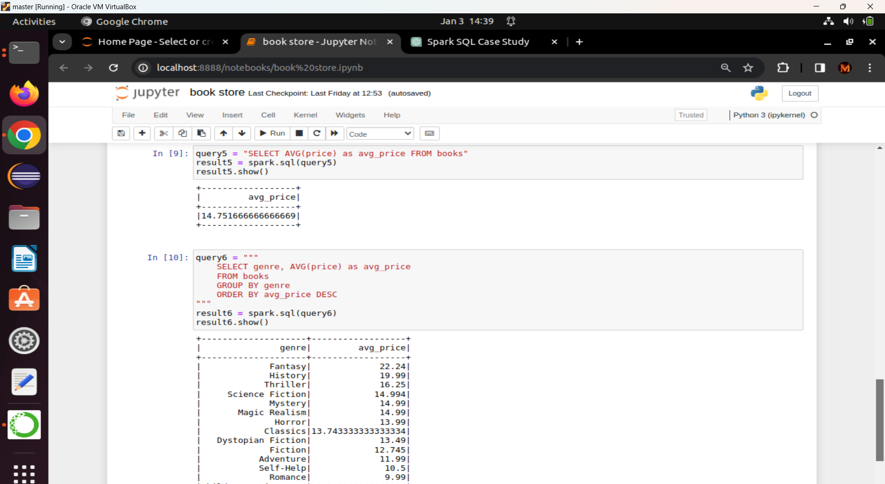
Finding the average price of all the books.
Finding the average price of books based on genre.

Slide 36
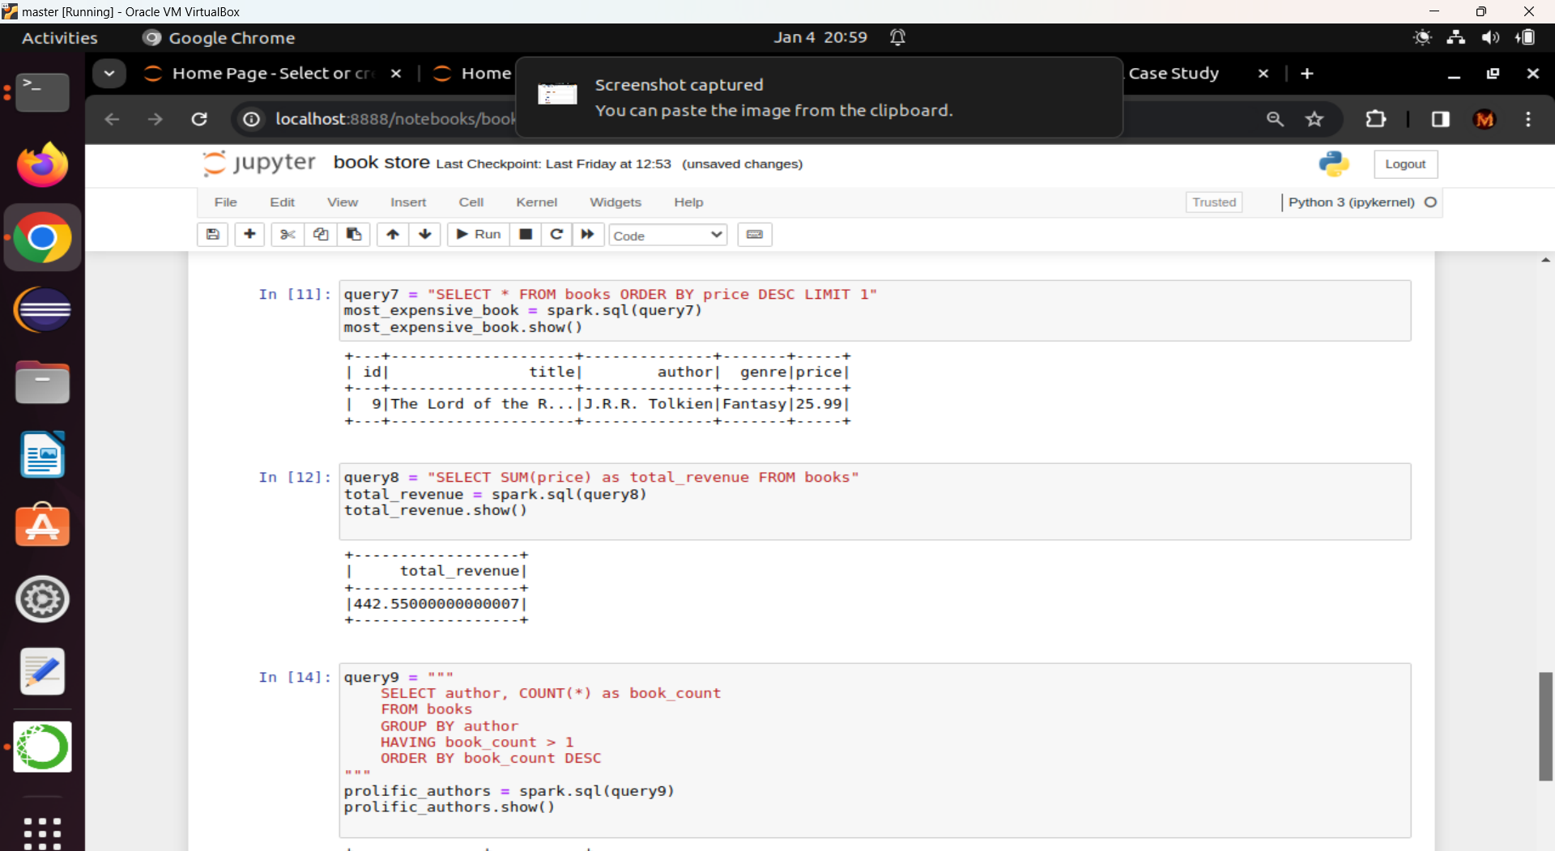
Find the most expensive book.
Calculate total revenue from book sales.

Slide 37
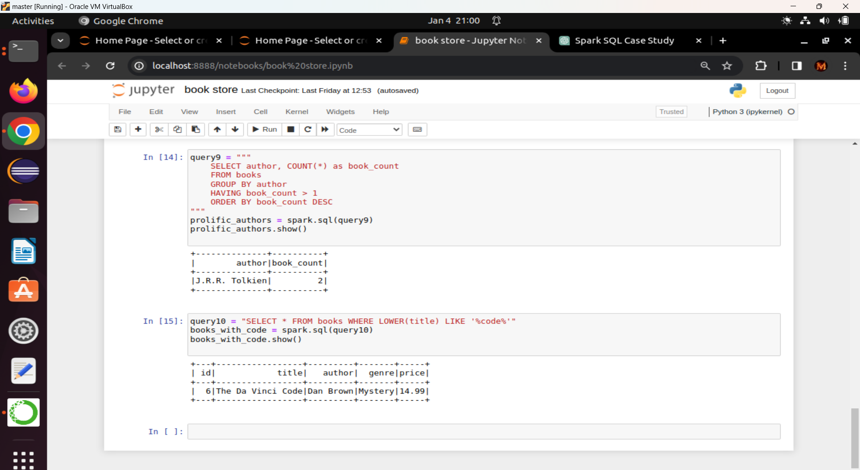
List authors with more than one books.
Find books with titles containing the word code.

