Slide 1
Assignment 1 - INTRODUCTION
Problem Statement: The assignment has 2 parts
Regression Regularization and Cross Validation
Linear Regression along with its versions, and Logistic Regression(Classification)
The experiment includes evaluating multiple regularization strengths and interpreting their effect on:
Training and testing loss
L2 norm of model weights
Overall accuracy and generalization
By:
Roll number: 160123737195
Class: IT3 5th Semester
Name: Mohammed Faizan Ul Islam

Slide 2
Datasets and Models used
Part | Dataset | Regression / Model Type | Target Variable
Part A | Heart Disease Dataset | Classification (Logistic Regression or similar) | Whether the patient has heart disease or not
Part B | Insurance Dataset | Simple, Multiple, and Polynomial Regression | Charges incurred to the company
Part B | Wisconsin Breast Cancer Diagnostic Dataset | Logistic Regression | Whether the patient has cancer or not
Model / Technique | Type | Goal
Logistic Regression with Regularization | Linear Model (L2 penalty) | Reduces overfitting while keeping linear separation
Linear Regression | Linear Model | Models linear relationship between features and target
Polynomial Feature Transformation | Feature Engineering | Creates higher-degree features to capture nonlinear patterns
StandardScaler | Data Normalization | Standardizes features for better model performance

Slide 3
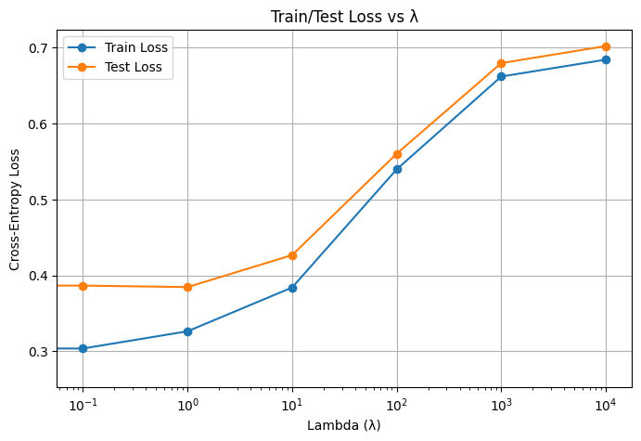
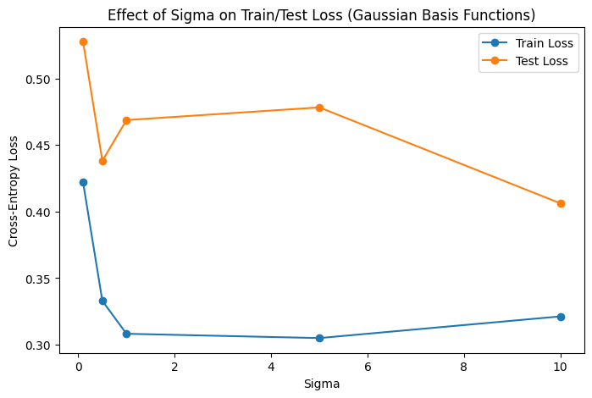
Observations
Train and Test loss increases with increase in lambda
Weight Norm reduces with increase in lambda
Effect of Sigma Gaussian Basis: Train – Test loss decreases sharpy initially and then doesn’t change a lot later
Using Gaussian Basis reduces the gap between train and test loss

Slide 4
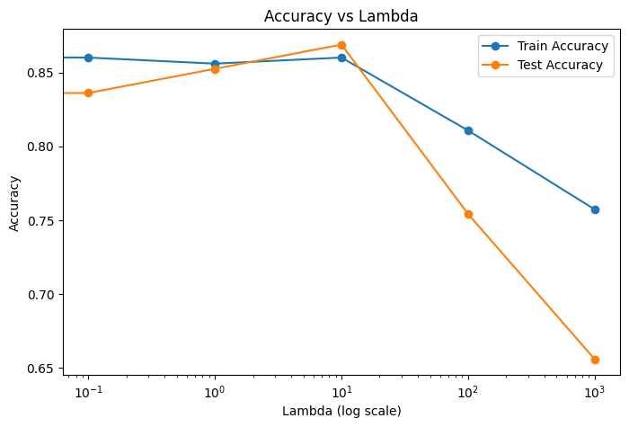
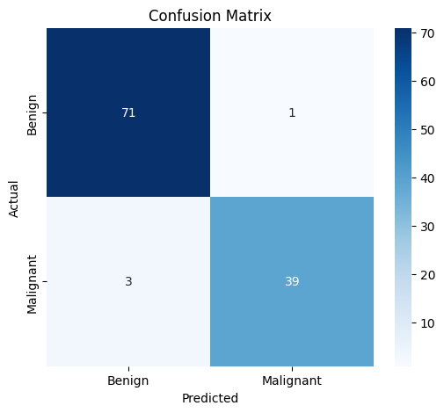
Results
Best Lambda value: 10
Logistic Regression Confusion Matrix
Simple Linear Regression Evaluation:
MSE : 135983957.4805469 MAE : 9173.258196746589 RMSE: 11661.21595205864
Multiple Linear Regression Results
MSE: 33979257.05080821 RMSE: 5829.17293025419 MAE: 4213.484797807137
Polynomial Regression Evaluation
MSE: 152452515.64886093 RMSE: 12347.166300364668 MAE: 9863.434994766281

Slide 5
Conclusion
Regularization prevents overfitting by adding a penalty for model complexity it helps avoid extremes
very small λ overfits; very large λ underfits. A middle λ worked best.
Weights get smaller as λ grows.
Gaussian basis functions transform features to capture non-linear relationships.
The width (σ) controls the trade-off between bias and variance.
Regularization is used to prevent overfitting when many basis functions are combined.

Slide 6
Assignment 2 - Introduction
Paper Referred: Improving classification algorithm on education dataset using hyperparameter tuning
The objective of this assignment was to analyse and enhance supervised classification models for predicting student placement outcomes.
The paper compared several algorithms (LDA, SVM, KNN, Decision Tree, Random Forest, etc.) and found that a tuned Linear Discriminant Analysis (LDA) model achieved the best accuracy on the Factors Affecting Campus Placement dataset.
Research Gap: Only LDA was tuned, while other algorithms like Random Forest, Decision Tree, and SVM were not optimized or compared under the same tuning conditions.

Slide 7
Dataset and Model Used
Attribute | Description
Dataset Name | Factors Affecting Campus Placement (Kaggle)
Task | Binary Classification – Predict whether a student will be placed
Samples | ~215 records
Features | Categorical + Numeric (academic scores, degree type, specialization, etc.)
Target Variable | status → Placed (1) / Not Placed (0)
Model | Type | Goal
Logistic Regression | Linear Model | Provides baseline for linear separation
SVM | Kernel Model | Captures nonlinear boundaries
KNN | Instance-Based | Relies on distance metrics
Decision Tree | Tree | Simple nonlinear split model
Random Forest | Ensemble (Bagging) | Reduces variance
Gradient Boosting | Ensemble (Boosting) | Reduces bias
LDA | Linear Discriminant | Dimension reduction & classification

Slide 8
Observations
Baseline Performance Summary
Best parameter values found after hyperparameter tuning
Model | Accuracy | F1-Score | ROC-AUC
Logistic Regression | 0.837209 | 0.877193 | 0.930769
SVM | 0.883721 | 0.915254 | 0.905128
KNN | 0.790698 | 0.857143 | 0.808974
Decision Tree | 0.744186 | 0.830769 | 0.642308
Random Forest | 0.837209 | 0.888889 | 0.912821
Gradient Boosting | 0.813953 | 0.870968 | 0.920513
LDA | 0.860465 | 0.896552 | 0.923077
Model | Best Values Found
Decision Tree | 'max_depth': 4, 'min_samples_leaf': 4, 'min_samples_split': 10
Random Forest | 'max_depth': None, 'max_features': 'sqrt', 'min_samples_split': 2, 'n_estimators': 50
Gradient Boosting | 'learning_rate': 0.05, 'max_depth': 5, 'n_estimators': 100, 'subsample': 0.8}
SVM | 'C': 0.1, 'gamma': 'scale', 'kernel': 'linear'
LDA | 'shrinkage': 'auto', 'solver': 'lsqr'
SVM achieved the highest baseline accuracy, followed closely by LDA.

Slide 9
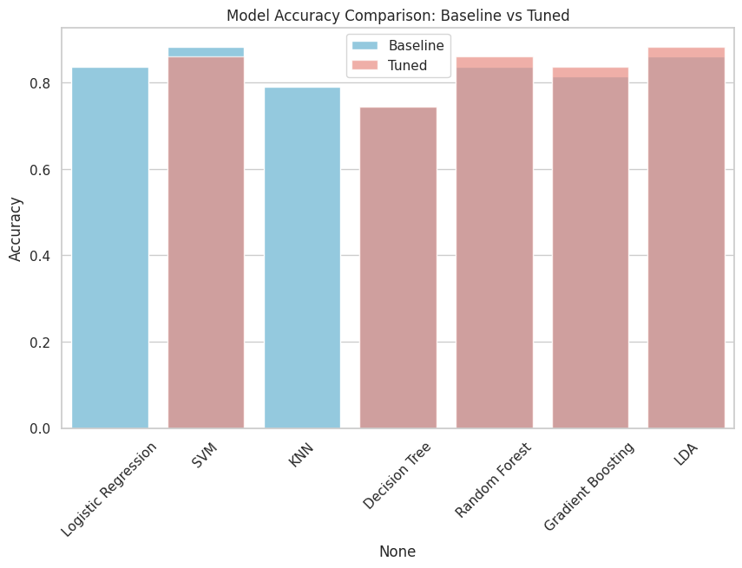
Results
Results after hyperparameter tuning of models
Model | Accuracy | F1-Score | ROC-AUC
LDA | 0.883721 | 0.915254 | 0.946154
SVM | 0.860465 | 0.896552 | 0.938462
Random Forest | 0.860465 | 0.903226 | 0.929487
Gradient Boosting | 0.837209 | 0.888889 | 0.882051
Decision Tree | 0.744186 | 0.830769 | 0.666667
The tuned LDA model achieved the best overall performance with an accuracy of 0.88 and ROC-AUC of 0.95, indicating excellent class separation and balanced predictions.

Slide 10
Conclusion
Key Takeaways
Hyperparameter tuning improved the performance of all classifiers for predicting student placements.
The tuned Linear Discriminant Analysis (LDA) model performed the best, showing its suitability for this dataset.
Metrics like ROC-AUC and confusion matrices showed better class separation and fewer errors after tuning.
Research Gap Filled This work extends the referenced paper by:
Implementing systematic hyperparameter tuning across multiple models, and
Quantitatively demonstrating performance improvements due to optimization.

