Slide 1


BORN FRAGRANCE / ARCHITECTURE + INTERIOR DESIGN
Retail interior / coordinated design
Design intent, measured geometry and assembly strategies
PROJECT
2400 × 3106 internal
2600 ceiling
Black steel / plaster / stone-look floor
ISSUE PURPOSE
Client review and consultant coordination. Detailed strategies are preliminary pending the stated confirmations.
DRAWING PRIORITY
Geometry follows approved Rev A. Render conveys material and lighting character only.
READING SEQUENCE
Layout → elevations → materials → assembly details → coordination decisions.
REFERENCE RENDER · NOT TO SCALE · styling props excluded from technical scope
FOR COORDINATION · SITE ITEMS OPEN · REV B
06 OCT 2026 / SOURCE REV A
NTS @ A3 · DIMENSIONS mm
SPEC SNAPSHOT eeccbde1cd
AP-01

Slide 2
BORN FRAGRANCE / ARCHITECTURE + INTERIOR DESIGN
Overall plan / setting-out
Setting-out / coordinated interfaces · 1:20 · finish-face dimensions; site verification pending
SET-OUT DATUMS
01 / FRAME + SETTING-OUT
A 0 / 0
B 2400 / 0
C 2400 / 3106
D 0 / 3106
250
1900
250
250 deep side units. Four 664 modules from y=450 to 3106. 25 main uprights shown; shelf/support lines distinguished.
D
C
N ↓ STOREFRONT
ASSUMED #23
664
700
02 / COUNTER + REAR
1000 × 450 counter; x=700–1700, y=1706–2156. 700 to rear-unit face. Side routes remain 450 / 450.
01
664
02
3106
450
450
03 / GLAZED ENTRANCE
664
#16
450 side routes
Access / escape unresolved
488 fixed pane + 1000 pivot leaf + three 4 gaps = 1500. Pivot 100 from right edge; inward sweep shown.
664
Wall bands graphic only
Thickness TBC #26
Envelope TBC #4
04 / COORDINATION STATUS
LOD 350 development target: interfaces shown, not certified complete. Anchors, hardware, substrate and access remain TBC #16/#26.
450
03
A
B
450
1500
450
2400
0 1000 mm | 1:20
FOR COORDINATION · SITE ITEMS OPEN · REV C
06 OCT 2026 / SOURCE REV A
06 OCT 2026 / SOURCE REV A
1:20 @ A3 · DIMENSIONS mm
SPEC SNAPSHOT eeccbde1cd
AP-03

Slide 3
BORN FRAGRANCE / ARCHITECTURE + INTERIOR DESIGN
Floor finish / module setting-out
AP-04 · porcelain extent includes floor beneath units
M04 / PORCELAIN
1194
1200 × 600 rectified stone-look porcelain. Option A: long side across shop. Joint = 2; perimeter = 5.
WIDTH CHAIN
5 + 1194 + 2 + 1194 + 5 = 2400
DEPTH CHAIN
3106
5 + 343 + (4 × 600) + (5 × 2) + 343 + 5 = 3106
#4 / #26
Survey before tile ordering.
Cuts exclude fabrication tolerances.
FLOOR BUILD-UP
Tile, adhesive and substrate thicknesses TBC #26. Flush threshold detail on AP-17; no step introduced.
343
2400
0 2000 mm | 1:20
FOR COORDINATION · SITE ITEMS OPEN · REV B
06 OCT 2026 / SOURCE REV A
1:20 @ A3 · DIMENSIONS mm
SPEC SNAPSHOT eeccbde1cd
AP-04

Slide 4
BORN FRAGRANCE / ARCHITECTURE + INTERIOR DESIGN
Ceiling / lighting coordination
AP-05 · lighting positions follow confirmed Rev A
L01 / TRACKS
Two black tracks: x=650 / 1750, y=450–2656. Four adjustable cylindrical spots per track. All lighting 3000 K.
L02 / DOWNLIGHTS
Three fittings at x=700 / 1200 / 1700; y=225. Spacing retained from approved design.
L03 / SHELF + PLINTH
3106
2206
Concealed under-shelf LEDs; toe-kick LEDs 2 × 2656. Access and wiring strategy AP-14.
CEILING / MEP
Smooth gypsum, warm off-white. Ceiling support, fire/MEP devices and driver ventilation require consultant coordination #16.
2400
0 2000 mm | 1:20
FOR COORDINATION · SITE ITEMS OPEN · REV B
06 OCT 2026 / SOURCE REV A
1:20 @ A3 · DIMENSIONS mm
SPEC SNAPSHOT eeccbde1cd
AP-05

Slide 5
BORN FRAGRANCE / ARCHITECTURE + INTERIOR DESIGN
Storefront / external elevation
AP-06 · glazed entrance and halo-lit fascia
FRONTAGE
450 + 1500 + 450 = 2400. The 450 × 450 display columns face the street; shelf depth remains 250.
600
G01 / GLAZING
Door 1000 × 2580 × 12 toughened glass. Fixed pane 488 W. Three nominal 4 gaps: 488 + 1000 + 12 = 1500.
3200
SIGN BAND
600 high above 2600 ceiling datum; total storefront height 3200. Exterior logo 1000 W, uniformly scaled.
2580
12 mm GLASS
#16 — top/bottom clearance
10 + 2580 + 10 = 2600
PROPOSED split; glazier to confirm
DETAIL REFERENCES
Head AP-15
Jamb / pivot AP-16
Flush threshold AP-17
Sign backing AP-18
2400
0 2000 mm | 1:20
FOR COORDINATION · SITE ITEMS OPEN · REV B
06 OCT 2026 / SOURCE REV A
1:20 @ A3 · DIMENSIONS mm
SPEC SNAPSHOT eeccbde1cd
AP-06

Slide 6
BORN FRAGRANCE / ARCHITECTURE + INTERIOR DESIGN
Rear focal wall / internal elevation
AP-07 · wall-mounted non-illuminated brand mark
REAR MODULES
250 side + 500 display + 900 logo zone + 500 display + 250 side = 2400. Rear display depth 250.
BRAND
600 W logo at centre z=1900. Native asset ratio retained; approximately 271.8 H. No illumination or rear mesh.
2600
DISPLAY LEVELS
600 / 1000 / 1400 / 1800 / 2200 AFFL. Frame 2600; top mesh is confined to side units.
900
ASSEMBLY
Removable central back panel and wall fixing strategy AP-19. Rear shelf LEDs return into accessible service routes.
2400
0 2000 mm | 1:20
FOR COORDINATION · SITE ITEMS OPEN · REV B
06 OCT 2026 / SOURCE REV A
1:20 @ A3 · DIMENSIONS mm
SPEC SNAPSHOT eeccbde1cd
AP-07

Slide 7
BORN FRAGRANCE / ARCHITECTURE + INTERIOR DESIGN
Left display / internal elevation
Developed display elevation · interfaces + material codes · bottles indicative only
M01 / BLACK STEEL M02 / NEUTRAL PPC M05 / MESH L03 / 3000 K LED
01 / STEEL FRAME
25 × 25 × 1.6 main SHS; 20 × 20 × 1.6 secondary supports. 664 module is not a fabrication cut size.
03
400
02 / SHELF + LIGHT
400
3 mm tray / 25 downstand / 250 depth. Concealed 3000 K LED behind front edge; see section inset.
400
02
2600
03 / BASE + MESH
400
600 base includes 100 recessed plinth. 1.5 PPC doors. Mesh at 2200–2600; approximate 20 × 40 diamonds.
250
400
SHELF SECTION 1:5
500
01
04 / INDICATIVE CONTENT
100
Sparse fragrance bottles added at owner request for visual scale only. Excluded from dimensions and schedules. Fixings and cable routing #16 remain open.
664
664
664
664
3106
INDICATIVE BOTTLES · NOT A STOCK / CAPACITY SCHEDULE
0 1000 mm | 1:20
FOR COORDINATION · SITE ITEMS OPEN · REV C
06 OCT 2026 / SOURCE REV A
06 OCT 2026 / SOURCE REV A
1:20 @ A3 · DIMENSIONS mm
SPEC SNAPSHOT eeccbde1cd
AP-08

Slide 8
BORN FRAGRANCE / ARCHITECTURE + INTERIOR DESIGN
Right display / internal elevation
Developed display elevation · interfaces + material codes · bottles indicative only
M01 / BLACK STEEL M02 / NEUTRAL PPC M05 / MESH L03 / 3000 K LED
01 / STEEL FRAME
25 × 25 × 1.6 main SHS; 20 × 20 × 1.6 secondary supports. 664 module is not a fabrication cut size.
03
400
02 / SHELF + LIGHT
400
3 mm tray / 25 downstand / 250 depth. Concealed 3000 K LED behind front edge; see section inset.
400
02
2600
03 / BASE + MESH
400
600 base includes 100 recessed plinth. 1.5 PPC doors. Mesh at 2200–2600; approximate 20 × 40 diamonds.
250
400
SHELF SECTION 1:5
500
01
04 / INDICATIVE CONTENT
100
Sparse fragrance bottles added at owner request for visual scale only. Excluded from dimensions and schedules. Fixings and cable routing #16 remain open.
664
664
664
664
3106
INDICATIVE BOTTLES · NOT A STOCK / CAPACITY SCHEDULE
0 1000 mm | 1:20
FOR COORDINATION · SITE ITEMS OPEN · REV C
06 OCT 2026 / SOURCE REV A
06 OCT 2026 / SOURCE REV A
1:20 @ A3 · DIMENSIONS mm
SPEC SNAPSHOT eeccbde1cd
AP-09

Slide 9
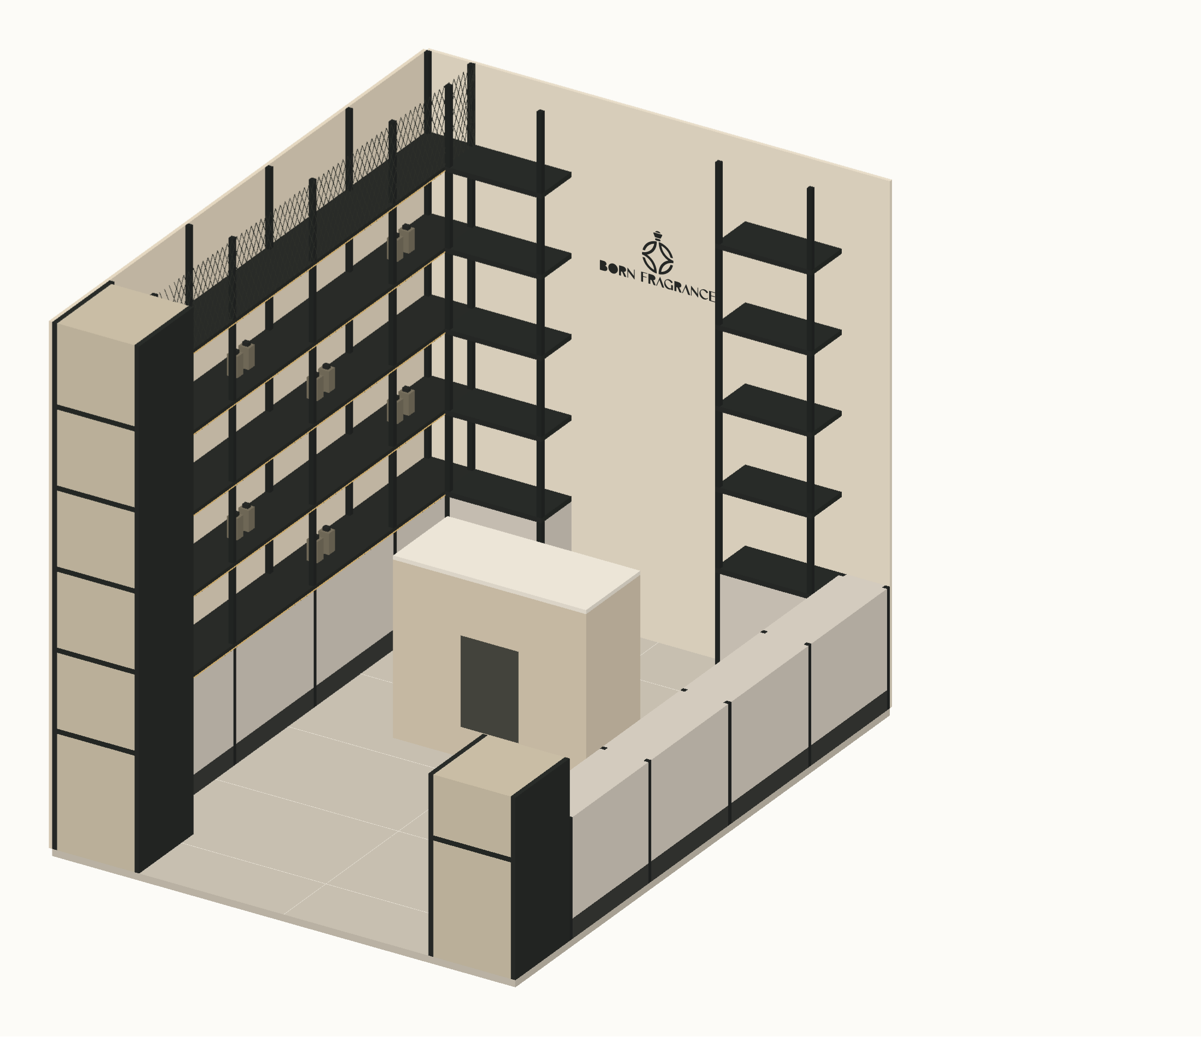
BORN FRAGRANCE / ARCHITECTURE + INTERIOR DESIGN
Spatial assembly / cutaway axonometric
Shaded cutaway / approved geometry + render material language · near wall and ceiling removed
01 / SPATIAL CHARACTER
Warm plaster, black frames, mesh, neutral cabinetry and warm shelf lighting follow the reference render.
02 / GEOMETRIC BASIS
2400 × 3106 × 2600 envelope. Four 664 modules; centred 1000 × 450 counter; 500 / 900 / 500 rear zones.
03 / CUTAWAY
Near-side upper units and ceiling removed to expose the room. Their full extent remains on the plans and elevations.
04 / ACCURACY LIMIT
Visual fidelity target, not a measurable 80% certification. Approved dimensions override the render. Bottles are indicative; hardware and fixings remain TBC.
CUTAWAY AXONOMETRIC · NTS · ceiling and near-side upper joinery omitted
FOR COORDINATION · SITE ITEMS OPEN · REV C
06 OCT 2026 / SOURCE REV A
06 OCT 2026 / SOURCE REV A
NTS @ A3 · DIMENSIONS mm
SPEC SNAPSHOT eeccbde1cd
AP-10

Slide 10
BORN FRAGRANCE / ARCHITECTURE + INTERIOR DESIGN
Material palette / visible finishes
AP-11 · sample-led specification; colours are indicative
M01 / BLACK STEEL
M02 / CABINET STEEL
M03 / PLASTER
25 × 25 × 1.6 main SHS
20 × 20 × 1.6 secondary SHS
Matte black powder coat
1.5 mm PPC doors
Light-neutral finish
Flush, handleless
Raw light textured plaster
Approve physical sample
Substrate / buildup #26
M04 / PORCELAIN
G01 / CLEAR GLASS
M05 / EXPANDED MESH
1200 × 600 rectified
2 grout / 5 perimeter joint
Stone-look, sample approval
12 mm toughened door
Hardware / gaps #16
Fixed pane specification TBC
Approx. 20 × 40 diamond
Black finish / framed edges
Gauge and fixing #16
FOR COORDINATION · SITE ITEMS OPEN · REV B
06 OCT 2026 / SOURCE REV A
NTS @ A3 · DIMENSIONS mm
SPEC SNAPSHOT eeccbde1cd
AP-11

